Slide 1

The Childcare Cost Crisis: Understanding Affordability and Policy Solutions
Karthika Vellingiri

Slide 2

Introduction
Childcare expenses continue to rise nationwide, often outpacing household income growth.
The burden falls most heavily on low- and middle-income families, limiting access to affordable, quality care.
Affordability is shaped by both income levels and where families live.
This analysis explores childcare costs, income burdens, and regional disparities, offering insights to guide policymakers, advocates, and communities toward effective solutions.
Notes:
Childcare costs are rising across the country, often faster than household incomes.
This puts the greatest strain on low- and middle-income families, limiting their access to quality care.
Affordability also varies widely depending on where families live.
Our analysis examines cost trends, income burdens, and regional differences to help guide effective policy and community solutions

Slide 3
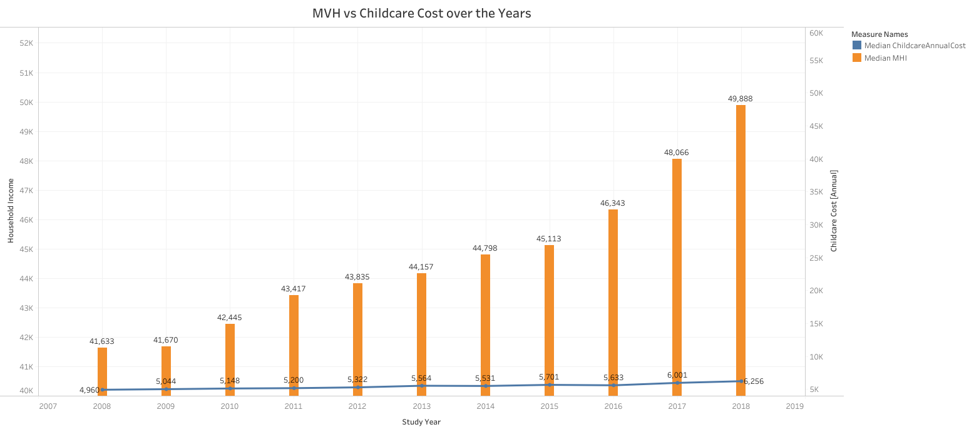
Median Household Income vs Childcare Cost Over Time
Median household income increased by about 21% (from $41K to $49.8K)
Childcare costs increased by nearly 26% (from $4.9K to $6.2K)
Childcare cost growth outpaces income growth by roughly 5 percentage points
Indicates rising financial pressure on families over time
Notes:
This chart compares median household income (MHI) and median annual childcare costs from 2008 to 2018.
Over this decade, MHI grew from around $41,633 to nearly $49,888, showing a steady rise.
However, childcare costs also increased consistently, from $4,960 in 2008 to $6,256 in 2018.
While incomes rose by about 20%, childcare costs rose by more than 26%, indicating that childcare expenses are growing faster than household earnings.
This trend suggests an increasing strain on family budgets, even as overall incomes improve.

Slide 4
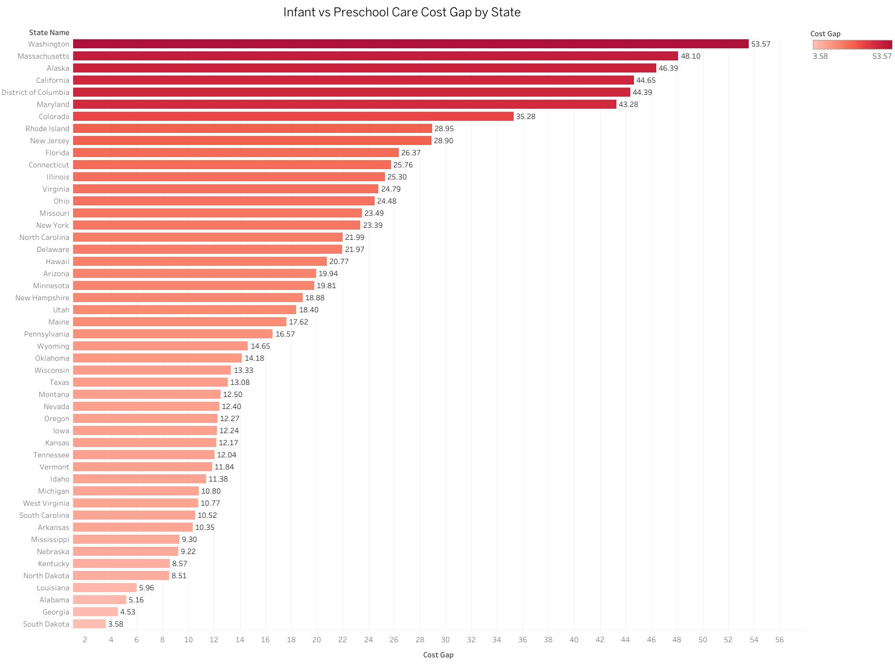
Infant vs Preschool Care Cost Gap by State
Infant vs preschool care cost gap: $3.58 to $53.57/week
Infant care generally more expensive
Large variation across states
Critical affordability issue for infant care
Notes:
Significant cost gap exists between infant and preschool care across states.
Difference ranges from as low as $3.58 to as high as $53.57 per week.
Many states show much higher costs for infant care compared to preschool.
Highlights the urgent need to address affordability for infant care.
Understanding this gap helps prioritize funding and policy interventions.

Slide 5
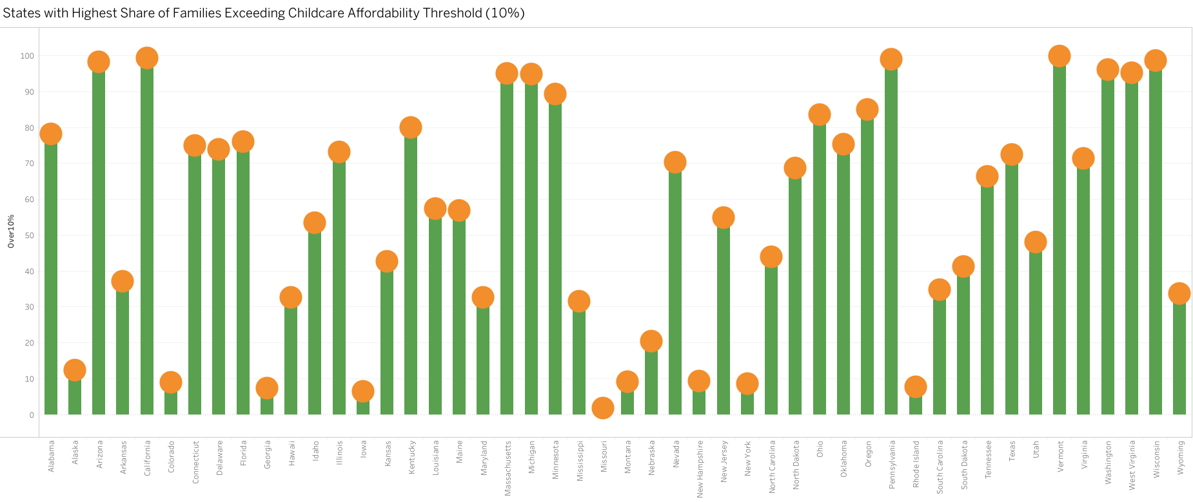
Families Exceeding Childcare Affordability Threshold (10%)
70%+ families exceed 10% childcare cost in many states.
Highest: TX 99.86%, CT 99.31%, AZ 98.17%, PA 98.89%, WY 98.64%.
Lowest: MO 1.66%, IL 6.37%, CA 8.83%, NY 8.55%.
Gap: ~98 percentage points between highest & lowest.
Affordability issues are widespread but uneven across states.
Notes:
Texas (99.86%), Connecticut (99.31%), Arizona (98.17%), Pennsylvania (98.89%), Wyoming (98.64%), and Washington (96.13%) show the highest burdens.
Majority of states exceed 70% of families over the affordability threshold.
We also see Alaska (12.38%), California (8.83%), Missouri (1.66%), and Illinois (6.37%) having significantly lower shares.
This indicates there is large disparities between highest and lowest states (range: ~1.66% to ~99.86%).
Many high-percentage states cluster in the Northeast, South, and West.
This Indicates significant national challenge; affordability issues prevalent but vary sharply by state.

Slide 6
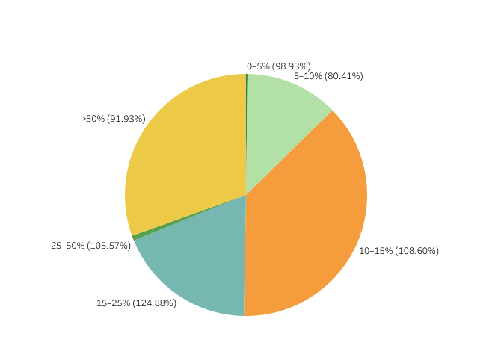
Distribution of Families by Childcare Cost-to-Income Ratio
Largest share of families spend 15–25% of income on childcare (124.88%).
10–15% range is also significant (108.60%).
25–50%: 105.57%, showing a sizable high-cost burden group.
>50%: 91.93%, indicating extreme affordability issues for many families.
Lowest share: 0–5% (98.93%) and 5–10% (80.41%), showing few families experience minimal cost burden.
Notes:
This pie chart illustrates the distribution of families based on their childcare cost-to-income ratio.
The largest segment falls within the 15–25% range, indicating that many families dedicate a substantial portion of their income to childcare.
The 10–15% and 25–50% categories also represent significant shares, suggesting that childcare costs frequently exceed the commonly accepted affordability threshold of 10%.
Notably, over 90% of families in the >50% category face extremely high cost burdens, where childcare consumes more than half of household income.
Conversely, relatively few families fall into the 0–5% or 5–10% ranges, indicating that only a small minority experiences minimal childcare expenses relative to income.

Slide 7
Policy Recommendations
Expand Child Tax Credit: Increase federal tax credits to offset childcare expenses, particularly for families earning under $100,000 annually.
Subsidize Provider Infrastructure: Invest in childcare facility construction and workforce development to increase supply and reduce costs.
Employer Incentives: Create tax breaks for companies offering childcare benefits or on-site facilities to their employees.

Slide 8
Implications
Economic Impact:
High childcare costs reduce workforce participation, particularly among women, limiting economic growth and household income potential.
01
Social Equity:
Childcare accessibility creates generational wealth gaps, as families with resources can invest in quality care while others face limited options.
02
Policy Urgency:
Without intervention, childcare costs will continue outpacing wage growth, requiring comprehensive federal and state-level solutions.
03

Slide 9
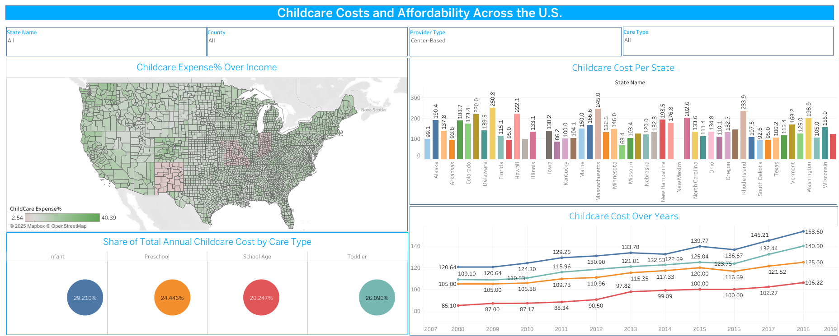
Tableau Dashboard

Slide 10
Thank You!!!

