Slide 1
Greenhouse Gas Emissions in Washington A Visual Exploration for a Greener Future
Presented by Karthika Selvaraj, Aishwarya Saibewar, and David Abney

Slide 2
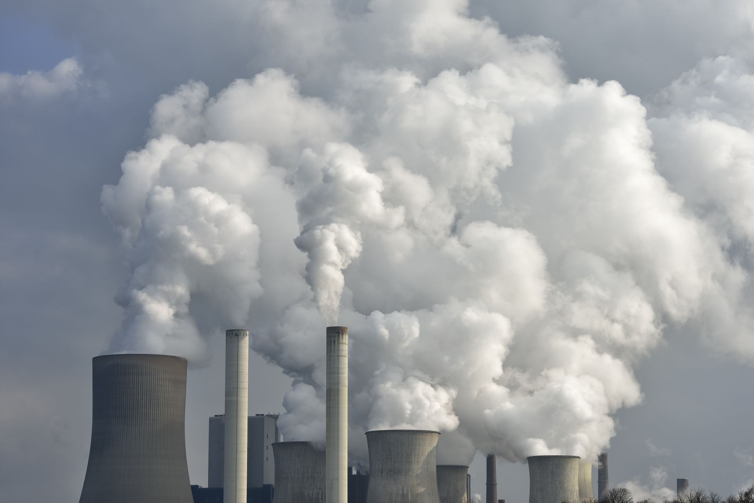
Goals
GHG Emissions
Main contributors
Emission trends
Regional impact
Renewable Energy
Energy Generation across US
Energy Consumption trends in WA
Power Plant
Fuel types with the highest power production
Potential Impacts

Slide 3
Data Inventory
Greenhouse gas Emission
Washington State Department of Ecology
US Energy Information Administration
National Weather Service
Renewable and Power Plant
Rainfall

Slide 4
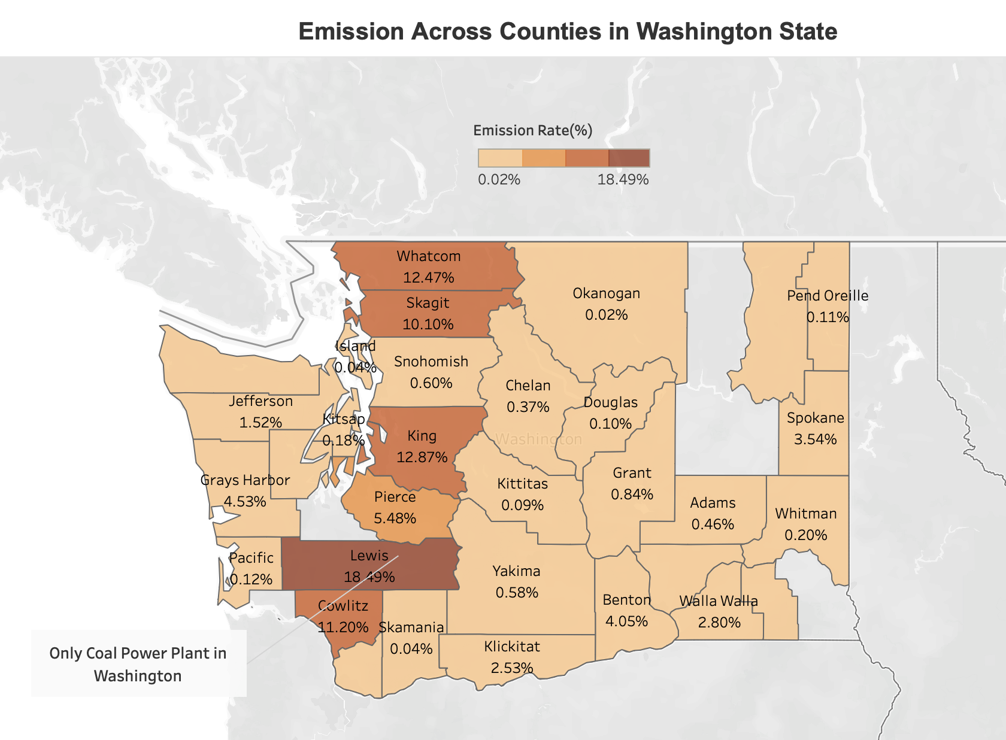
Regional Impact

Slide 5
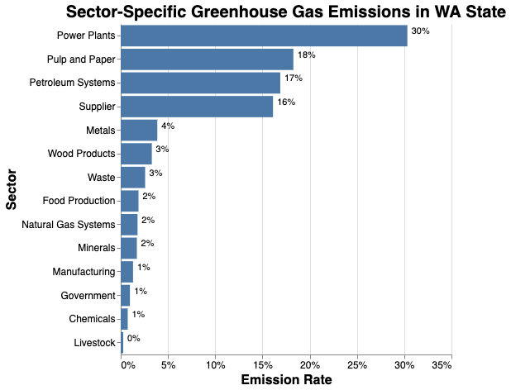
Sector wise Emissions in WA

Slide 6
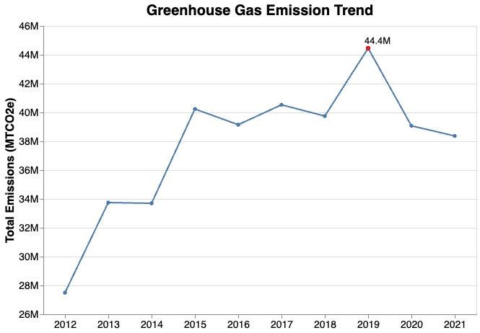
Washington Emission Trend

Slide 7
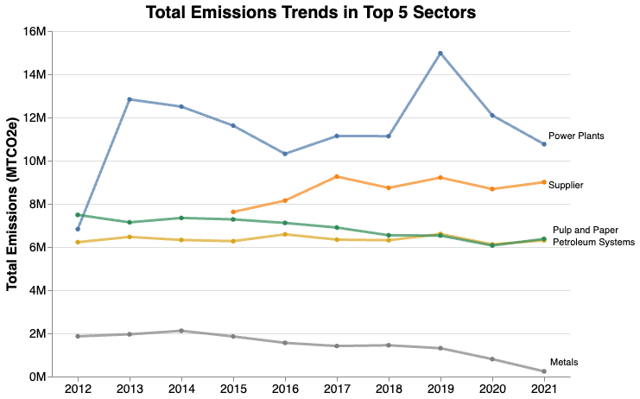
Total Emission in Different Sectors

Slide 8
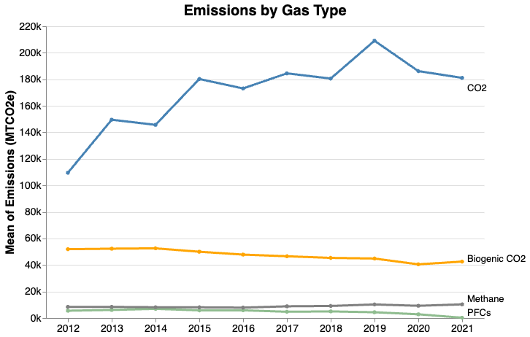
GHG Emissions by Gas

Slide 9
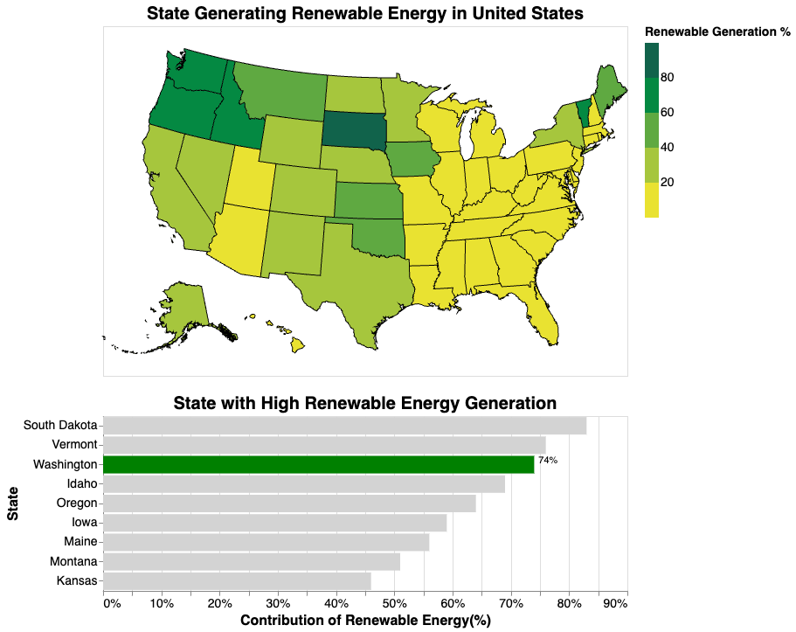
US Renewable Energy Distribution

Slide 10
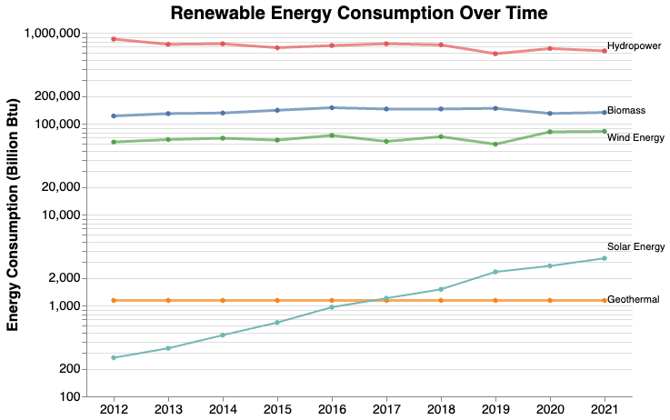
Renewable Energy Consumption

Slide 11
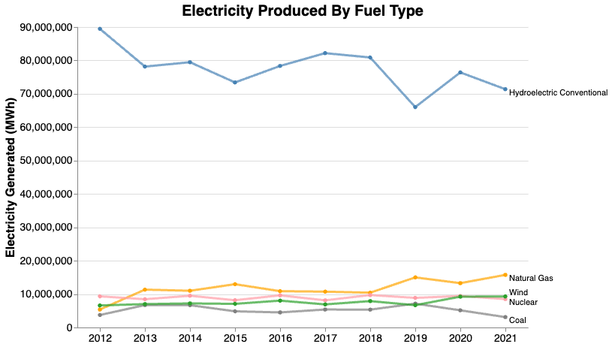
Power Plant Production

Slide 12
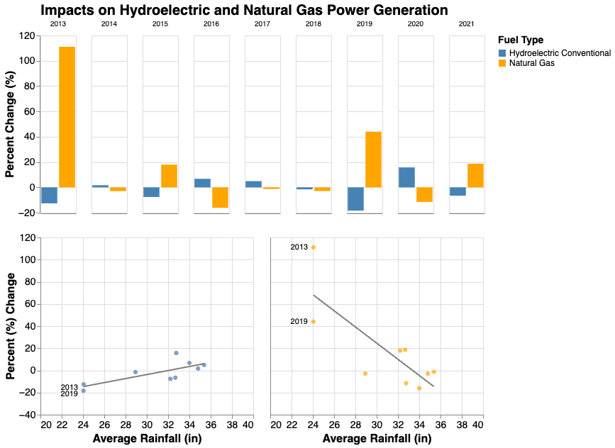
Utilization of Hydroelectric and Natural Gas

Slide 13
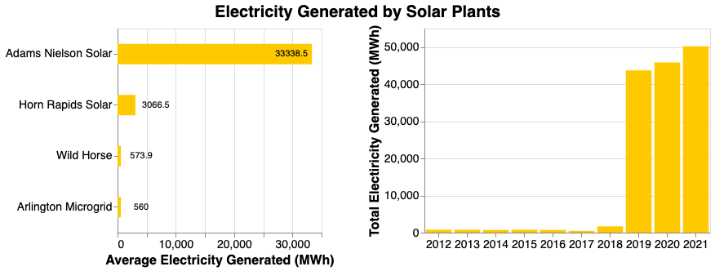
Solar Production

Slide 14
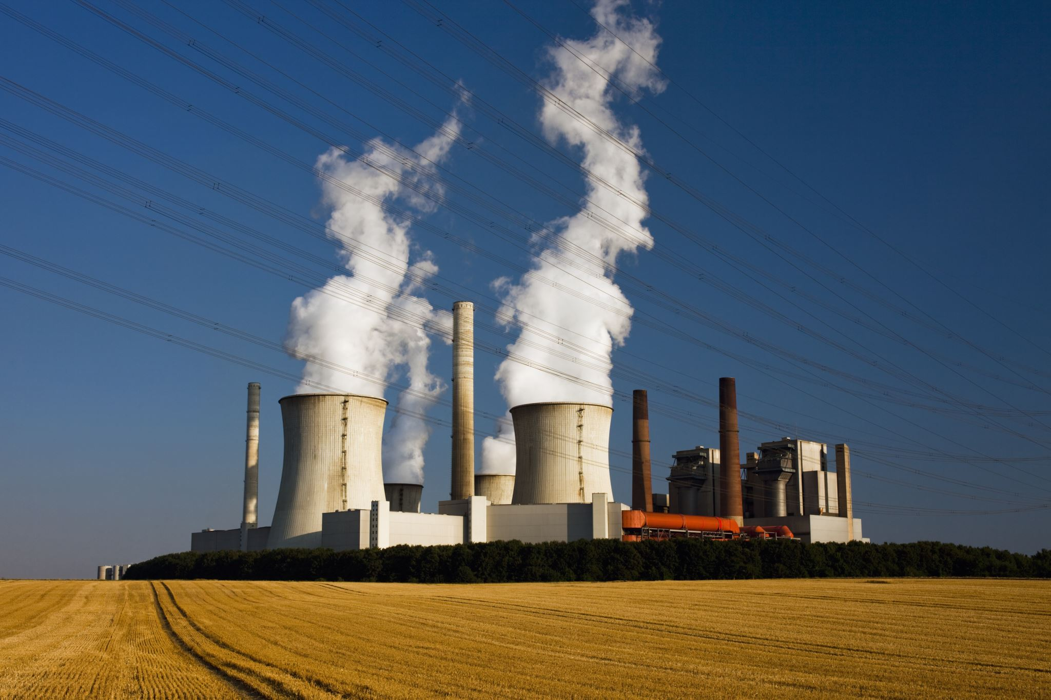
Conclusion
Power Plants are the main contributors
Co2 Emissions are higher
Washington Ranks 3rd in renewable energy
Hydroelectric generation is impacted by Rainfall
Solar Energy generation has drastically increased

Slide 15
Thank you !

Slide 16
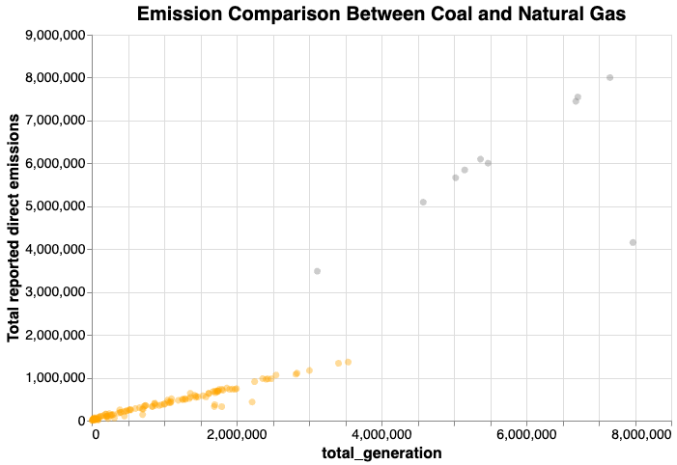
Additional Slides

Slide 17
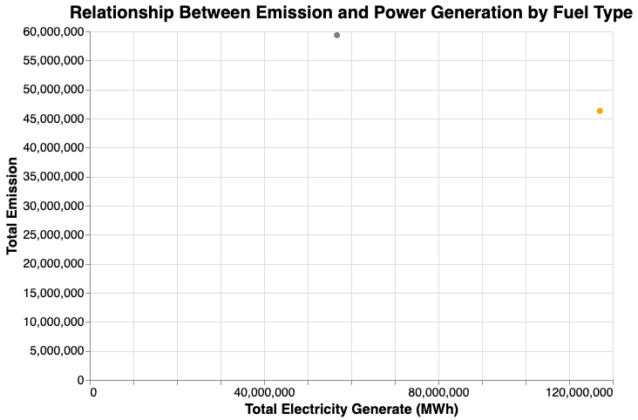
Additional Slides

Slide 18
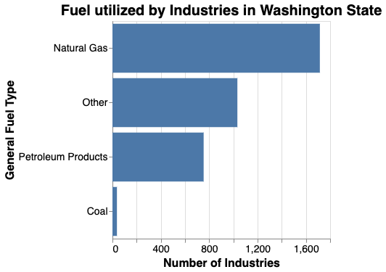
Additional Slides

