Slide 1
CUSTOMER CHURN ANALYSIS
Subscription Churn: Drivers, Risk, and a Retention Dashboard
Excel • SQL • Python • Power BI

Slide 2
PROJECT OVERVIEW
Why customers churn, and who's next
A subscription business wanted to understand churn drivers and identify at-risk segments. This project analyzes 1,500 customers across plan, contract, tenure, usage, and complaint history — then builds a model to flag which active customers are most likely to leave next.
1,500
Customers analyzed
18.9%
Excel: Clean & formula-driven analysis
Overall churn rate
SQL: Schema, cleaning view, 13 queries
Python: Visualizations + churn prediction model
17
Power BI: 3-page interactive dashboard
Data fields per customer

Slide 3
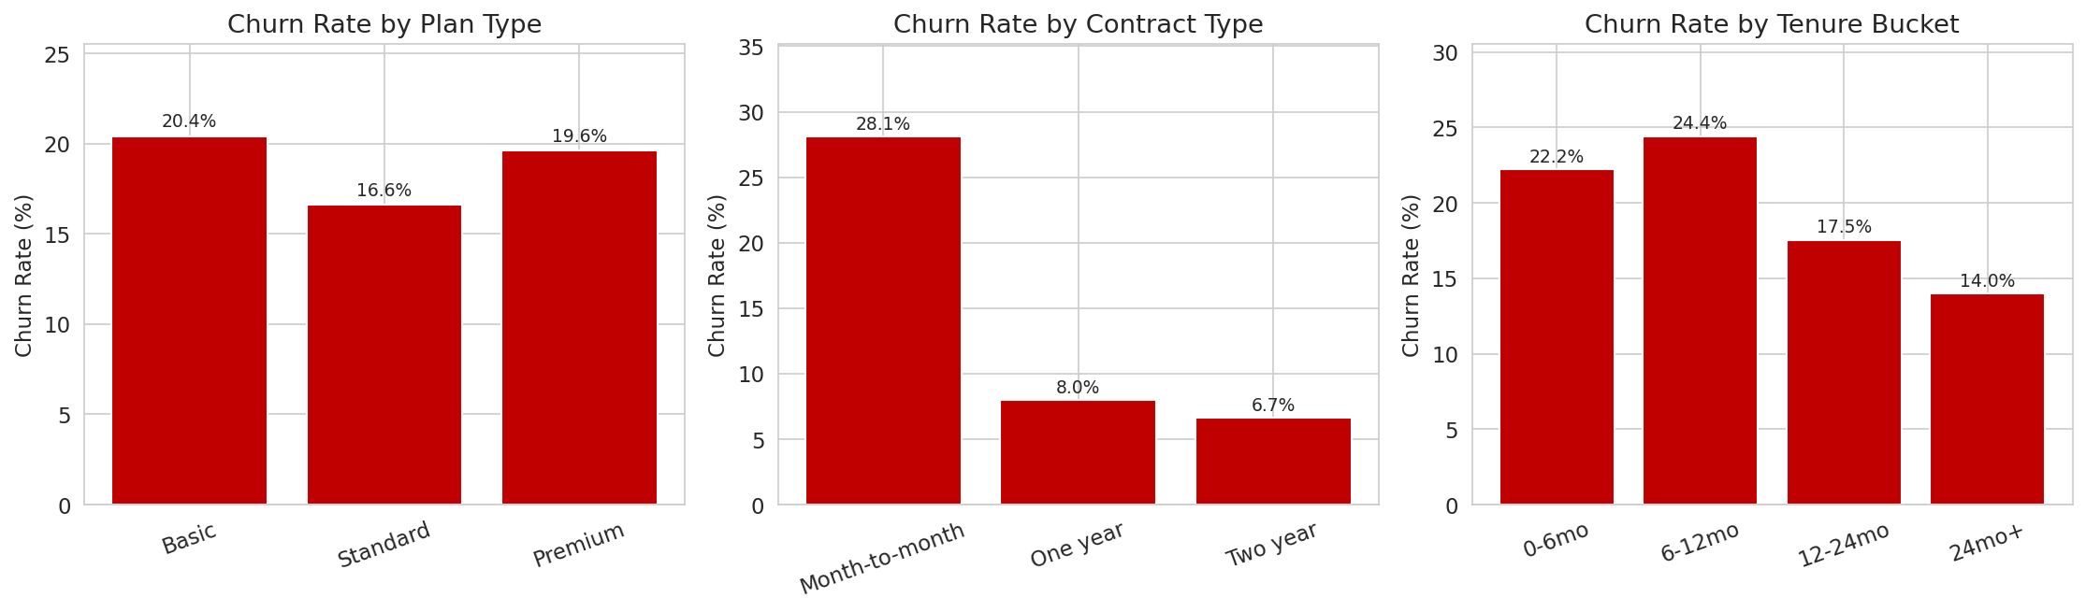
KEY FINDINGS
Contract type is the #1 churn driver
Month-to-month customers churn at 28.1% — over 4× the rate of Two-year contracts (6.7%). Churn also peaks in the first 12 months of tenure, then steadily declines.

Slide 4
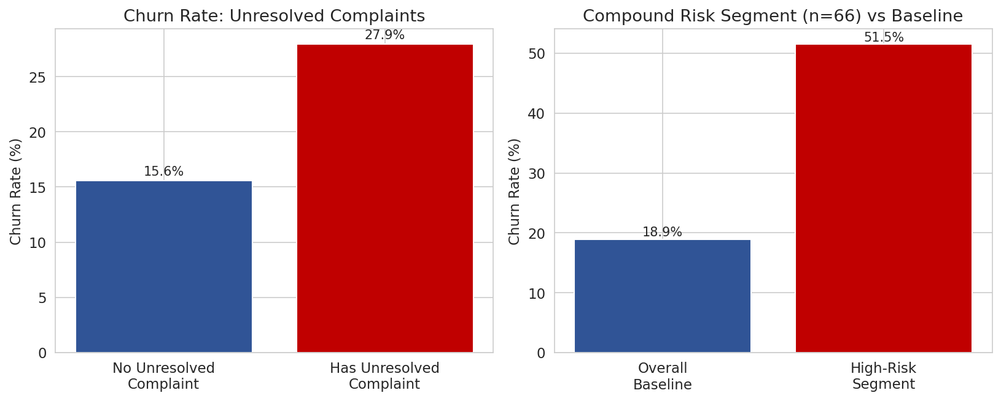
REVENUE & RISK FACTORS
What else separates churned customers
15.1%
of total revenue came from churned customers ($91.1k of $602k)
27.9%
churn rate when a complaint is unresolved — nearly 2× the 15.6% baseline
51.5%
churn rate for the compound risk segment: month-to-month + low usage + unresolved complaint (n=66)

Slide 5
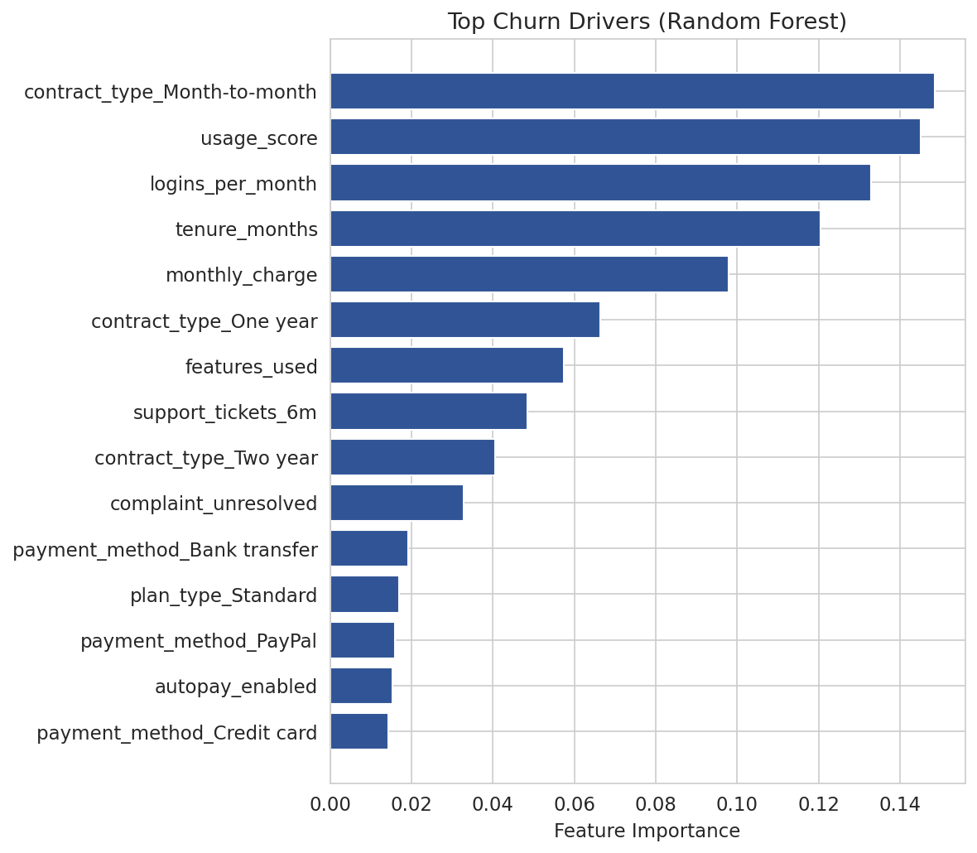
PREDICTIVE MODEL
Python confirms the same drivers, independently
0.80
Logistic Regression AUC (best performer)
0.76
Random Forest AUC
Both models were trained on 75% of customers and tested on the remaining 25% they'd never seen. The model independently ranked contract type, usage score, and login frequency as the top churn drivers — the same answer found by hand in Excel and SQL.

Slide 6
RECOMMENDATIONS
Where to act first
1
Prioritize contract conversion
Moving month-to-month customers to annual plans is the single highest-leverage lever (28.1% vs 6.7% churn).
2
Focus retention on year one
Churn peaks in months 0–12 — front-load onboarding and engagement efforts into a customer's first year.
3
Resolve complaints fast
An unresolved complaint nearly doubles churn risk — speed of resolution matters, not just responsiveness.
4
Target the compound-risk segment
66 customers are month-to-month, low-usage, AND have an unresolved complaint — 51.5% churn rate, top priority for outreach.

Slide 7
Deliverables
Excel
SQL
Formula-driven workbook: cleaned data, live summary metrics, and an auto-ranking at-risk customer list
Schema, a cleaning view, and 13 validated queries covering every finding in this deck
Python
Power BI
8 visualizations, a trained churn-prediction model, and a model-scored at-risk list for all 1,216 active customers
3-page interactive dashboard: Churn Trends, Cohort Analysis, and At-Risk Customers

