Slide 1

Veeam Software _ Technical Task
Submitted By,
Karthika Thottingal
+4915510046899
thottingalkarthika@gmail.com

Slide 2
Task : 1
1. Sasha is looking at Olga, and Olga’s looking at Andrew. Sasha has children, and Andrew does not. Is a person who has children looking at a person who does not have children? The answer options are "Yes", "No", "Cannot be determined". Explain your reasoning.
Sasha
Child
Olga
??
Andrew
To Prove: Is a person who has children looking at a person who does not have children → Hypothesis 1
Case ‘A’: The probability that Olga has children: ½
Case ‘B’: The probability that Olga don’t have children: ½
Consider Case ’A’ is ‘True’ i.e., Olga has children. Then,
Sasha is looking at Olga => Person who has children is looking for person who has children.
Olga’s looking at Andrew => Person who has children is looking for who has no children.
Case ‘A’ is not able to prove Hypothesis 1
Consider Case ‘B’ is ‘True’ i.e., Olga don’t have children.
Sasha is looking at Olga => Person who has children is looking for person who has no children.
Olga’s looking at Andrew => Person who has no children is looking for who has no children.
Case ‘B’ is not able to prove Hypothesis 1.
Hence the hypothesis is false.
Is a person who has children looking at a person who does not have children → No

Slide 3
Task : 2
2) Assume that the company you work for is planning to start building houses in Antarctica in the next ten years. Your role is Technical Project Manager. A seminar will soon be organized with experts on issues related to this task. What would you like to clarify with them to start working on the project? Prepare a list of specific questions, answers to which you will need to start designing the houses and the required infrastructure.
Seminar Topic: Technical discussion on building houses in Antarctica in a span of 10 years
Agenda: Clarification on below queries
Building Material to use
Raw materials used for building house
Raw materials availability
Raw materials ability to withstand extreme climatic conditions
Raw materials financial feasibility
Customer’s satisfaction towards the material
Building Design – utilizing the benefits of climate in its maximum to get the aesthetic appeal, acceptance by customer, matching customer habits(In India they have wet bathroom, but in UK they have dry bathroom)
Building Plumping – Availability of water, maintaining temperature of water
Building Drainage – Ways to recycle water, maintain temperature of water so that there is no blockage
Building Power – Main source of power, power for heating building, Secondary source of power in case of any emergency
Temperature and humidity control – Ways to control temperature and humidity inside the building
Legal and environmental impact of building – To clear all the legal issues, get environmental clearance for the building
Waste disposal- Ways for disposal of solid waste
Transportation challenges – Transportation of labours, raw materials and daily necessities of building including heating raw materials of building
Challenges due to global warming – 3°C/year increase is estimated, building should be able to cope up with change in temperature for 30/40 years(depth of piling done depends on the amount melting snow)
Disaster Mitigation plan – In case of any disaster, emergency route for escape, ways to let the rescue team know about it
Contingency plan in case of medical emergency – Ways to get help from medical team, fire and safety department

Slide 4
Task : 3
3) Estimate the number of mechanical weighing scales in operation in the Czech Republic. Nobody knows the exact number but try to estimate it as closely as possible. Explain your reasoning.
Czech Republic population = 10,827,529 people. ( In 2023)
As per annual international trade statistics of the country ( In 2019) 221,913 machines were exported. This include export of Weighing machines; weights of all kinds, parts of weighing machinery. It amounted in the range of 30,061,400 – 29,237,168 USD. Thus we are considering average export value in this range → 29,649,284 USD
=> 29,649,284/221,913 gives cost of 1 machine i.e., 1 machine cost 133.7 USD ( approximate value)
In 2023, export value in USD is 31,255,658 and import value in USD is 27,700,834. Hence total turnover value is -3,554,824 USD. => 3,554,824/133.7 => 26,588 machines where exported. (Taking 1 machine cost value from 2019) .Considering this category include all kind of weighting machines, we take only 27% as mechanical weighting scale => 26,588* 27% = 7178.8 or 7179 machines are exported in 2023. → (A)
Mechanical Weighting scales are used :
565 secondary vocational schools * 3 = 1695 machines
26 Universities *5 = 130 machines
331 Laboratories ( 169 medical) = 993 machines
6 Weighting of situ* 4 = 24 machines
Total number of machines used = 2842 machines → (B)
Out of total population, 60% are overweight (20 – 25% of adults are obese) = 10,827,529 * 60% => 6,496,517.4 people
Out of total population, 3.7 % are unemployed and 63 % are getting bare minimum wage , so there is no change for them to buy a weighting machine. Thus the % of population buying a mechanical weight is 33.3% = 6,496,517.4*33.3% = 2,163,340.29 people
Out of this, consider only 45% will be using mechanical weight = 2,163,340.29*45% = 973,503.13 people
Ot of total population, each household have 2.3 per home. We are assuming about 20% obese people are from one household. Thus, reducing this amount gives =973,503.13*80% = 778,802.50 people
This implies total Mechanical machines in households amount to 778,803 machines →(C)
Total number of machines in Czech Republic = (B) + (C) – (A) = 2842 +778803 -7179 = 774,466 Mechanical Weighting Machines

Slide 5
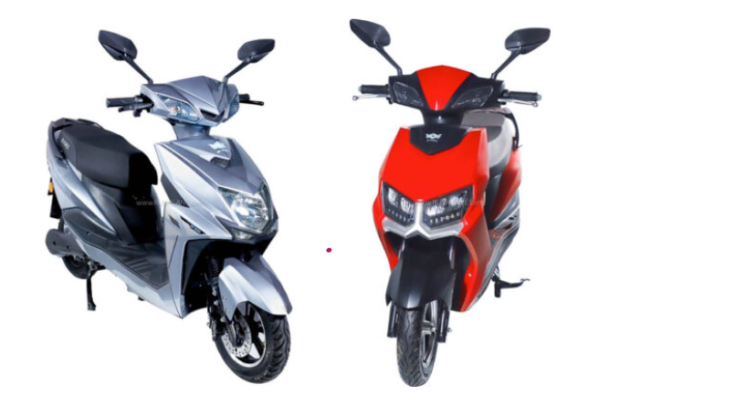
Task : 4
Assume that the company you work for is making electric scooters. You are assigned to work on the safety of this future product. What safety tests will you perform?
Battery:
Too easy to catch fire – Load test need to be done to identify circumstances in which a battery catch fire
Poor Battery Management system can also cause break out of fire or smoke – Circuit testing need to be done and if any source of unwanted heat is there, it need to be removed
Easily drain – Easy drainage of battery may also cause breakout – Stress test, Performance test need to be done to analyse the sustainability of battery and identify how easily it drain
Functional Safety
Sudden Acceleration can cause a jump when we start an electric scooter – Trained user, mechanical accuracy need to be verified
Software Testing – Functional Testing , Performance Testing, Load Testing, Stress Testing
Mechanical check points including screws fitting in place, bolts are tight , lights are working etc
Extra electric circuits check – User may have added some custom electric circuits for light, sound etc. Those circuits may also cause overheating and fire outbreak. Circuit testing, certified wire need to be used , ISO standards need to be followed
Monkey Testing – Using the machine in unexpected way and checking if there is any life threating alarm from the machine. This include charging the battery for an extended duration , Travelling with more people than permitted etc
Protection from external particles
Possibility of exposure to water , rain , mud, oil, snow should not impact the functionality and performance of the scooter. Testing in adverse circumstance need to be done.
Tires
Cross checking the alignment and air pressure are correct. Wheel change depending on climate if needed can also be done

