Slide 1
Entity relationship diagram for Flight reservation

Slide 2
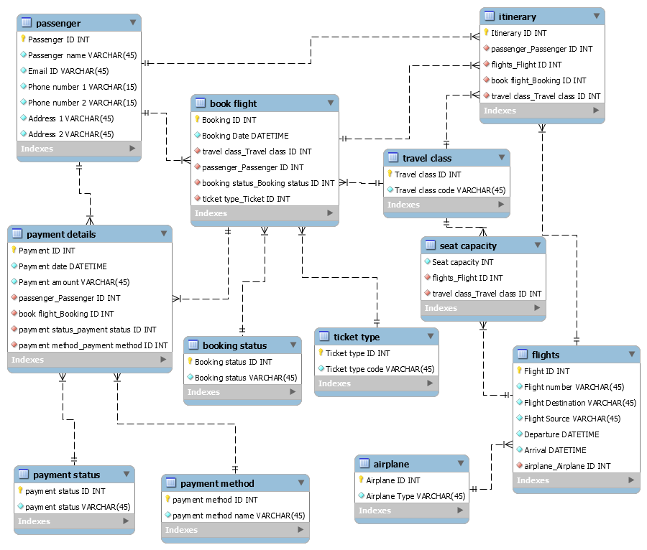

Slide 3
Passenger table
CREATE TABLE Passenger(
Passenger ID INT NOTNULL
Passenger Name VARCHAR(45) NOT NULL
Email ID VARCHAR(45) NOT NULL
Phone number 1 VARCHAR(15) NOT NULL
Phone number 2 VARCHAR(15) NOT NULL
Address1 VARCHAR(45) NOT NULL
Address2 VARCHAR(45) NOT NULL);
Functional dependencies
Passenger ID, Passenger name, Email ID, Phone number 1, Phone number 2, Address 1, Address 2
Sample data
Passenger ID | Passenger name | Email ID | Phone number 1 | Phone number 2 | Address 1 | Address 2
1 | A | aa@gmail.com | 9876543210 | 9080765432 | 4th avenue, Bangalore | 4th avenue, Bangalore
2 | B | bb@gmail.com | 9865324819 | 9708605402 | 134, Akila spring, hosur | 33, kumaran street, erode
3 | C | cc@gmail.com | 9753186420 | 9453123367 | 23, M nagar, chennai west | 42, kk nagar, vilupuram

Slide 4
Travel Class
CREATE TABLE Travel Class(
Travel Class ID INT NOTNULL
Travel class code VARCHAR(45) NOT NULL
);
Functional dependencies
Travel Class ID, Travel class code
Sample data
Travel Class ID | Travel class code
1 | First class
2 | Premium Economy
3 | Economy
4 | Business class

Slide 5
Flights Table
CREATE TABLE Flights(
Flight ID INT NOTNULL
Flight number INT NOT NULL
Flight Source VARCHAR(45) NOT NULL
Flight destination VARCHAR(45) NOT NULL
Departure DATETIME NOT NULL
Arrival DATETIME NOT NULL
Airplane ID INT NOT NULL Foreign key);
Functional dependencies
Flight ID, Airplane ID, Flight number, Flight Source, Flight destination, Departure, Arrival.
Sample data
Airplane ID | Flight ID | Flight number | Flight Source | Flight destination | Departure | Arrival
A301 | 001 | 41 | Bangalore | Chennai | 1/12/2020 12.50 | 1/12/2020 17.30
A302 | 002 | 42 | Mumbai | Bangalore | 2/12/2020 1.30 | 2/12/2020 8.00
A303 | 003 | 43 | Delhi | Mumbai | 3/12/2020 5.00 | 3/12/2020 10.30
A304 | 004 | 44 | Chennai | Pune | 4/12/2020 11.30 | 4/12/2020 19.20

Slide 6
Airplane Table
CREATE TABLE Airplane(
Airplane ID INT NOTNULL
Airplane type VARCHAR(45) NOT NULL
);
Functional Dependencies
Airplane ID, Airplane type
Sample data
Airplane ID | Airplane Type
A301 | 767-300ER
A302 | A330
A303 | CRJ700
A304 | ERJ145

Slide 7
Seat capacity table
CREATE TABLE Seat capacity(
Seat capacity VARCHAR(45) NOT NULL
Travel class ID INT NOT NULL FOREIGN KEY
Flight ID INT NOT NULL FOREIGN KEY
);
Functional Dependencies
Flight ID, Travel class ID, Seat capacity
Sample data
Flight ID | Travel class ID | Seat capacity
001 | 1 | 33
002 | 2 | 12
003 | 3 | 20
004 | 4 | 9

Slide 8
Book Flight table
CREATE TABLE Book Flight(
Flight ID INT NOTNULL FOREIGN KEY
Booking ID INT NOT NULL
Booking Date DATETIME NOT NULL
Passenger ID INT NOT NULL FOREIGN KEY
Ticket ID INT NOT NULL FOREIGN KEY
Booking status ID INT NOT NULL FOREIGN KEY
Travel class ID INT NOT NULL FOREIGN KEY);
Functional dependencies
Flight ID, Booking ID, Booking Date, Passenger ID, Ticket ID, Booking status ID, Travel class ID.
Sample data
Flight ID | Booking ID | Booking Date | Passenger ID | Ticket ID | Booking status ID | Travel class ID
001 | 41 | 20/11/2020 | 1 | 1 | 1 | 1
002 | 42 | 21/11/2020 | 2 | 1 | 2 | 3
003 | 43 | 23/11/2020 | 3 | 2 | 3 | 4

Slide 9
Ticket type
CREATE TABLE Airplane(
Ticket type ID INT NOTNULL
Ticket type code VARCHAR(45) NOT NULL
);
Functional Dependencies
Ticket type ID, Ticket type code
Sample data
Ticket type ID | Ticket type code
1 | One way trip
2 | Multi city trip
3 | Round trip

Slide 10
Booking Status table
CREATE TABLE Booking status(
Booking status ID INT NOTNULL
Booking status VARCHAR(45) NOT NULL
);
Functional Dependencies
Booking status ID, Booking status
Sample data
Booking status ID | Booking status
1 | Booked
2 | Waiting list
3 | Cancelled

Slide 11
Payment Details Table
CREATE TABLE Payment Details(
Payment ID INT NOTNULL
Booking ID INT NOT NULL FOREIGN KEY
Payment Date DATETIME NOT NULL
Payment Amount VARCHAR(45) NOT NULL
Payment Method ID INT NOT NULL FOREIGN KEY
Payment Status ID INT NOT NULL FOREIGN KEY
Passenger ID INT NOT NULL FOREIGN KEY
);
Functional dependencies
Payment ID, Booking ID, Payment Date, Payment Amount, Payment Method ID, Payment status ID, Passenger ID.
Sample data
Payment ID | Booking ID | Payment Date | Payment Amount | Payment Method ID | Payment Status ID | Passenger ID
1001 | 41 | 21/11/2020 | 12000 | 1 | 1 | 1
1002 | 42 | 23/11/2020 | 20000 | 3 | 2 | 2

Slide 12
Payment Status Table
CREATE TABLE Payment Status(
Payment Status ID INT NOTNULL
Payment Status VARCHAR(45) NOT NULL
);
Functional Dependencies
Payment Status ID, Payment Status
Sample data
Payment Status ID | Payment Status
1 | Pending
2 | Completed

Slide 13
Payment Method
CREATE TABLE Payment method(
Payment method ID INT NOTNULL
Payment method VARCHAR(45) NOT NULL
);
Functional Dependencies
Payment method ID, Payment method
Sample data
Payment method ID | Payment method
1 | Credit card
2 | Wallet
3 | Debit card
4 | Net banking
5 | UPI

Slide 14
Itinerary Table
CREATE TABLE Itinerary (
Itinerary ID INT NOTNULL
Passenger ID INT NOT NULL FOREIGN KEY
Travel class ID INT NOT NULL FOREIGN KEY
Flight ID INT NOT NULL FOREIGN KEY
Booking ID INT NOT NULL FOREIGN KEY);
Functional dependencies
Itinerary ID, Passenger ID, Travel class ID, Flight ID, Booking ID
Sample data
Itinerary ID | Passenger ID | Travel class ID | Flight ID | Booking ID
1 | 2 | 1 | 001 | 41
2 | 3 | 2 | 002 | 42
3 | 5 | 4 | 002 | 42

