Slide 1
Entity Relationship Diagram

Slide 2
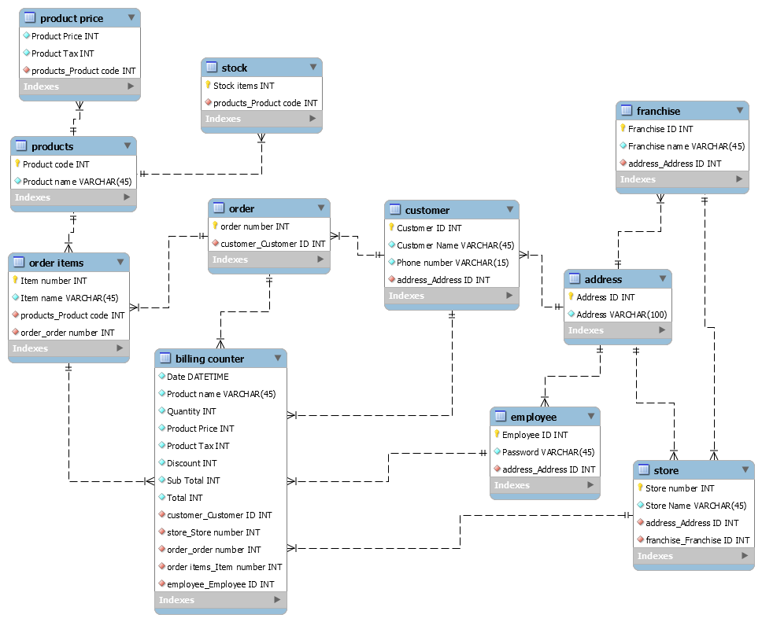

Slide 3
Product
Products will be maintained by Shop data maintainer , has the Product code and Product name.
CREATE TABLE products(
Product code INT NOT NULL
Product name VARCHAR(45) NOT NULL);
Functional dependencies
Product code, Product name
Sample data
Product code | Product name
001 | Banana fruit
002 | Hide and seek biscuit
003 | Dove shampoo
004 | Pears soap
005 | Moong dal
006 | Gold winner oil
007 | Tomato vegetable

Slide 4
Product price
CREATE TABLE Product Price(
Product Price INT NOT NULL
Product Tax INT NOT NULL
Product code INT NOT NULL Foreign key
);
Functional dependencies
Product code, Product price, Product tax
Sample data
Product code | Product price | Product Tax
001 | 10 | 0%
002 | 25 | 2%
003 | 45 | 4%
004 | 40 | 0%

Slide 5
Stock
Shop data maintainer maintains the Product’s code and amount of stock available.
CREATE TABLE stock(
Stock items INT NOT NULL
Product code INT NOT NULL Foreign key);
Functional dependencies
Product code, Stock items, Quantity
Sample data
Product code | Stock items
001 | 200
002 | 10
003 | 60
004 | 45
005 | 125
006 | 18
007 | 29

Slide 6
Address
CREATE TABLE Address(
Address ID INT NOT NULL
Address VARCHAR(100) NOT NULL
);
Functional dependencies
Address ID, Address
Sample data
Address ID | Address
51 | 3rd street, M nagar, Hosur
52 | 157, Akila springs, bangalore
53 | 4th avenue, Mid street, Erode

Slide 7
Customer
Customer will have an Unique Customer ID for ordering the products.
CREATE TABLE customer(
Customer ID INT NOT NULL
Customer name VARCHAR(45) NOT NULL
Phone number VARCHAR(15) NOT NULL
Address ID INT NOT NULL Foreign key);
Functional dependencies
Customer id, Customer name, Phone number, Address ID
Sample data
Customer ID | Customer name | Phone number | Address ID
1 | Karthikaa M | 9876543210 | 50
2 | Janani M | 9753124680 | 51
3 | Charu B | 9638527410 | 52
4 | Jeni P | 9518473620 | 53
5 | Karthikaa S | 9182736450 | 54
6 | Janani T | 9812763450 | 55
7 | Kayal V | 9345688218 | 56

Slide 8
Employee
CREATE TABLE Employee(
Employee ID INT NOT NULL
Password VARCHAR(45) NOT NULL
Address ID INT NOT NULL Foreign key
);
Functional dependencies
Employee ID, Password, Address ID.
Sample data
Employee ID | Password | Address ID
01 | ADMIN | 55
02 | ADMIN1 | 56
03 | ADMIN2 | 57
04 | ADMIN3 | 58

Slide 9
Order
Customer orders the product from shop, where order has Order code for every order the customer make.
CREATE TABLE order(
Order number INT NOT NULL
Customer ID INT NOT NULL Foreign key);
Functional dependencies
Order code, Customer ID, Product code
Sample data
Order number | Customer ID
1 | 2
2 | 12
3 | 23
4 | 13
5 | 90
6 | 60

Slide 10
Order items
CREATE TABLE order items(
Item number INT NOT NULL
Item name VARCHAR(45) NOT NULL
Product code INT NOT NULL Foreign key
Order number INT NOT NULL Foreign key);
Functional dependencies
Item number, Item name, Product code, Order number
Sample data
Item number | Item name | Product code | Order number
1 | AA | 001 | 1
2 | BB | 002 | 2
3 | CC | 003 | 3
4 | DD | 004 | 4
5 | EE | 005 | 5

Slide 11
Store
CREATE TABLE store(
Store number INT NOT NULL
Store name VARCHAR(45) NOT NULL
Address ID INT NOT NULL Foreign key
Franchise ID INT NOT NULL Foreign key
);
Functional dependencies
Store number, Store name, Address ID, Franchise ID
Sample data
Store number | Store name | Address ID | Franchise ID
20 | Big bazaar | 60 | 100
21 | Big bazaar | 61 | 101
22 | Big bazaar | 62 | 102
23 | Big bazaar | 63 | 103
24 | Big bazaar | 64 | 104
25 | Big bazaar | 65 | 105

Slide 12
Franchise
CREATE TABLE Franchise(
Franchise ID INT NOT NULL
Franchise name VARCHAR(45) NOT NULL
Address ID INT NOT NULL Foreign key
);
Functional dependencies
Franchise ID, Franchise name, Address ID
Sample data
Franchise ID | Franchise name | Address ID
101 | Big bazaar | 60
102 | Big bazaar | 61
103 | Big bazaar | 62
104 | Big bazaar | 63
105 | Big bazaar | 64
106 | Big bazaar | 65
107 | Big bazaar | 66

Slide 13
Billing counter
CREATE TABLE Billing counter(
Order number INT NOT NULL Foreign key
Item number INT NOT NULL Foreign key
Customer ID INT NOT NULL Foreign key
Employee ID INT NOT NULL Foreign key
Store number INT NOT NULL Foreign key
Date DATETIME NOT NULL
Product name VARCHAR(45) NOT NULL
Quantity VARCHAR(20) NOT NULL
Product price INT NOT NULL
Product Tax INT NOT NULL
Discount INT NOT NULL
Sub total INT NOT NULL
Total INT NOT NULL
);

Slide 14
Billing counter
Functional dependencies
Order number, Ordered Product code, Customer ID, Employee ID, Date, Product name, Quantity, Product price, Product tax, Discount, Subtotal, Total.
Sample data
Store Number | Order no | Item number | Cust ID | Emp ID | Date | Prod name | Quantity | Prod price | Prod tax | Discount | Sub Total | Total
21 | 1 | 1 | 2 | 3 | 24/11 | Banana | 12 | 10 | 0% | 0 | 120 | 396
 |  | 2 |  |  |  | Hide & Seek | 2 | 25 | 2% | 0 | 54
 |  | 4 |  |  |  | Pears | 4 | 45 | 4% | 0 | 182
 |  | 7 |  |  |  | Tomato | 1kg | 40 | 0% | 0 | 40

