Slide 1
Visualizing Global EV Growth and Market Dynamics
Team members: Karthika Ganjilenka, Devendhar Sangraj
Information Visualization
Prof. Haoyu Li

Slide 2

Dataset Description
Dataset: IEA Global EV Data 2010–2023 (Kaggle)
Attributes:
year, region, category, parameter (e.g. EV sales, stock, oil displacement), value, powertrain, mode, unit
Data Cleaning:
Removed missing/empty values
Filtered only useful parameters
Ensured numerical consistency
Public Source: Kaggle IEA EV data (linked)

Slide 3
What We Set Out to Do:
Understand and visualize global EV adoption trends from 2010–2023.
Explore regional differences, powertrain types, and environmental impact.
Why It Matters:
EVs are key to reducing global oil dependency and emissions.
Insights help policymakers, researchers, and consumers.
Our Key Questions/Tasks:
How have global EV sales evolved over time?
How does EV adoption vary across countries/regions?
What’s the relationship between EV growth and oil displacement?
Which regions dominate in BEV vs. PHEV?
Where is EV penetration highest?
Which Powertrain Types Dominate the EV Landscape Globally?
Task Definition & Motivation

Slide 4
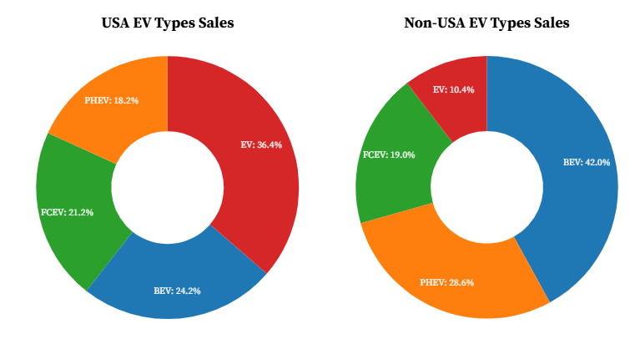
How Do EV Powertrain Types Differ Between USA and the Rest of the World?

Slide 5
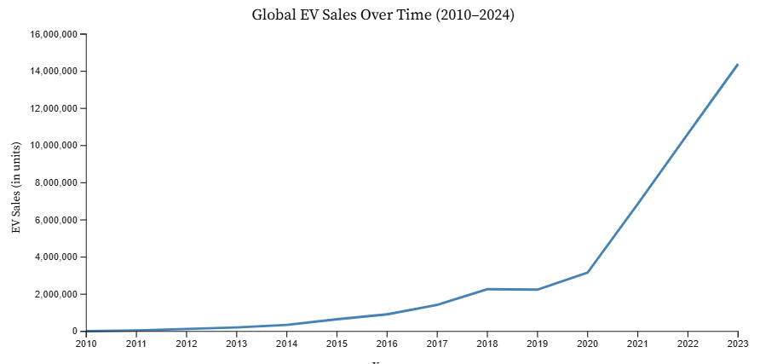
How Has Global EV Adoption Grown Over Time?

Slide 6
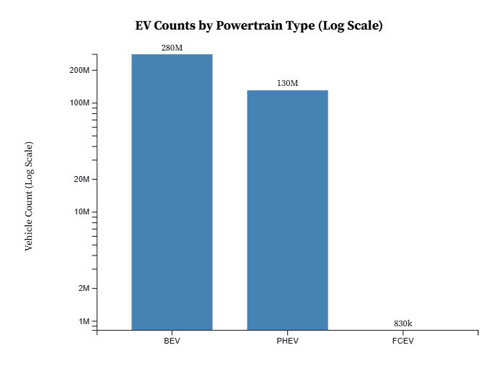
Which Powertrain Types Dominate the EV Landscape Globally?

Slide 7
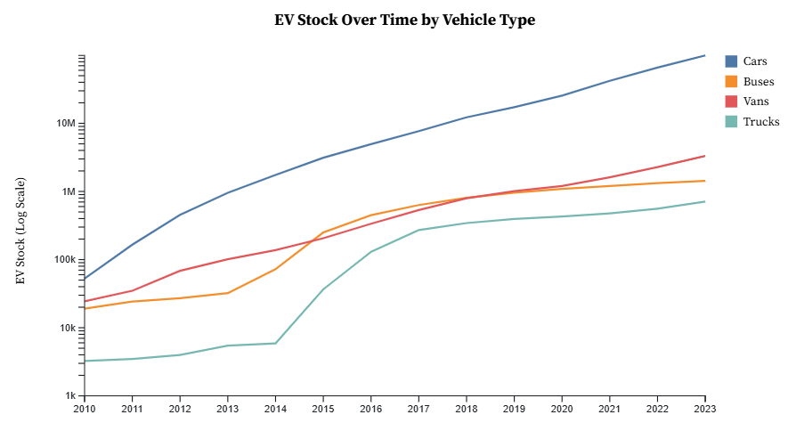
Which EV Vehicle Types Are Growing the Fastest Over Time?

Slide 8
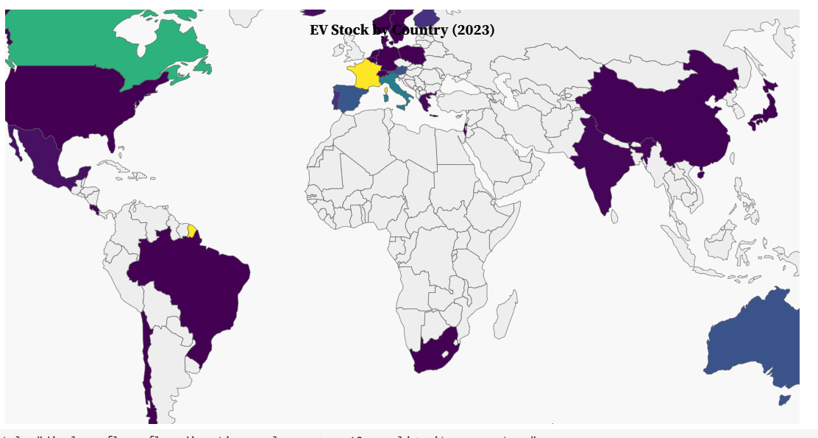
Where Is EV Adoption Highest Around the World?

Slide 9
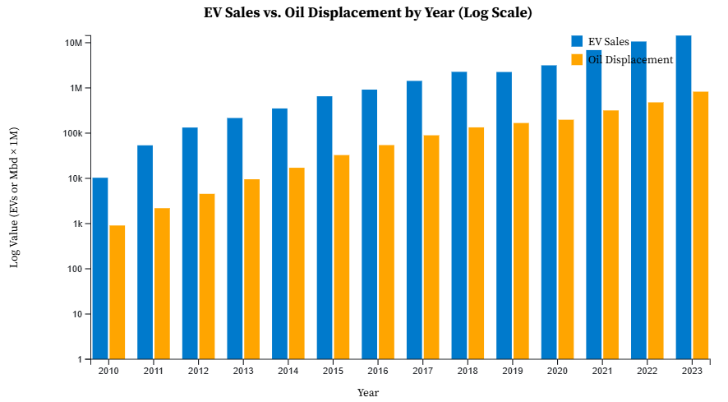
Is EV Adoption Effectively Reducing Oil Dependence?

Slide 10

Conclusion
Global EV adoption is rising exponentially
France = major EV hubs in 2023
BEVs now outperform PHEVs
EVs contribute significantly to oil savings
EV drives into technological growth, regional adoption, and the global shift toward cleaner transportation

Slide 11


Roles & Tools
Karthika – Line, Multiline-chart, Grouped Bar
Devendhar – Donut chart, Map, Bar
Tools Used:
D3.js (visualization)
Observable
Python for preprocessing

Slide 12
Thank you!
Any Questions?

