Slide 1
What is Business Intelligence
Basic Definition :Information that people use to support their decision making efforts. Data Mining and Data Analytics/predictive Analytics falls within this field.
Notes:
Business intelligence (BI) is a technology-driven process for analyzing data and delivering actionable information that helps executives, managers and workers make informed business decisions. Basic Definition :Information that people use to support their decision making efforts. Data Mining and Data Analytics/predictive Analytics falls within this field.
Literally, business intelligence means being more intelligent about your business. And your approach to BI is defined by the tools you use. Examples of BI tools include data warehouses, dashboards, reports, data discovery tools, and cloud data services.

Slide 2
What is Data Mining
Data Mining (The analysis step of Knowledge Discovery in Databases” Process or KDD), an interdisciplinary subfield of computer Science, is the computational process of discovering patterns in large data sets involving methods at the intersection of artificial intelligence, machine learning, statistics, and database management systems.
Notes:
Data a collection iof facts usually obtained as the result of experiences, observations or experiments
Data may consist of number of words and images
Data: Lowest level of abstraction (from which information and knowledge are derived)
Data Mining (The analysis step of Knowledge Discovery in Databases” Process or KDD), an interdisciplinary subfield of computer Science, is the computational process of discovering patterns in large data sets involving methods at the intersection of artificial intelligence, machine learning, statistics, and database management systems.
These are in addition to the primary DM tasks (prediction, association, clustering)
- Time-series forecasting
- Part of sequence or link analysis - Visualization
- Another data mining task
Types of DM
- Hypothesis-driven data mining
- Discovery-driven data mining

Slide 3
Data Analytics/Predictive Analytics
Data analytics (DA) is the science of examining raw data with the purpose of drawing conclusions about that information. Data analytics is used in many industries to allow companies and organization to make better business decisions and in the sciences to verify or disprove existing models or theories
Notes:
Applications:
Customer Relationship Manage ment
- maximize return or marketing campaigns
- Improve customer retentions (churn analysis)
- Maximize customer value (cross-up-selling)
- Identify and treat most valuable customers
Data analytics (DA) is the science of examining raw data with the purpose of drawing conclusions about that information. Data analytics is used in many industries to allow companies and organization to make better business decisions and in the sciences to verify or disprove existing models or theories

Slide 4
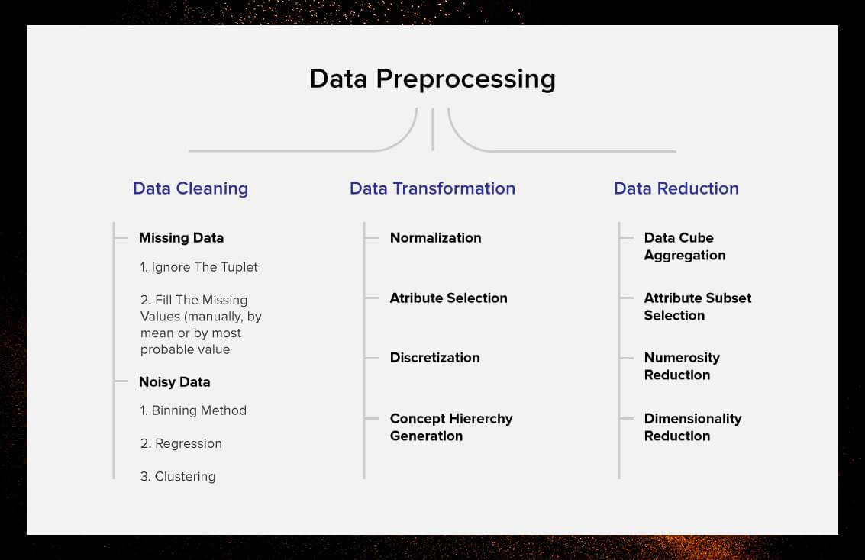
Data Processing
Data analytics is distinguished from Data mining by the scope, purpose and focus of the analysis. Data miners sort through huge data sets using sophisticated software to identify undiscovered patterns and establish hidden relationships. Data analytics focuses on inference, the process of deriving a conclusion based solely on what is already known by the researcher.
Notes:
Data processing, manipulation of data by a computer. It includes the conversion of raw data to machine-readable form, flow of data through the CPU and memory to output devices, and formatting or transformation of output. Any use of computers to perform defined operations on data can be included under data processing.
Data analytics is distinguished from Data mining by the scope, purpose and focus of the analysis. Data miners sort through huge data sets using sophisticated software to identify undiscovered patterns and establish hidden relationships. Data analytics focuses on inference, the process of deriving a conclusion based solely on what is already known by the researcher.

Slide 5
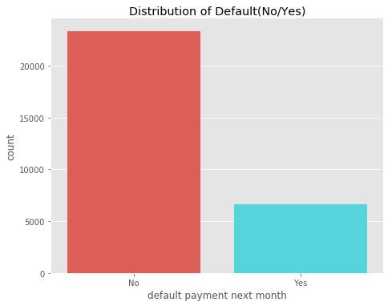
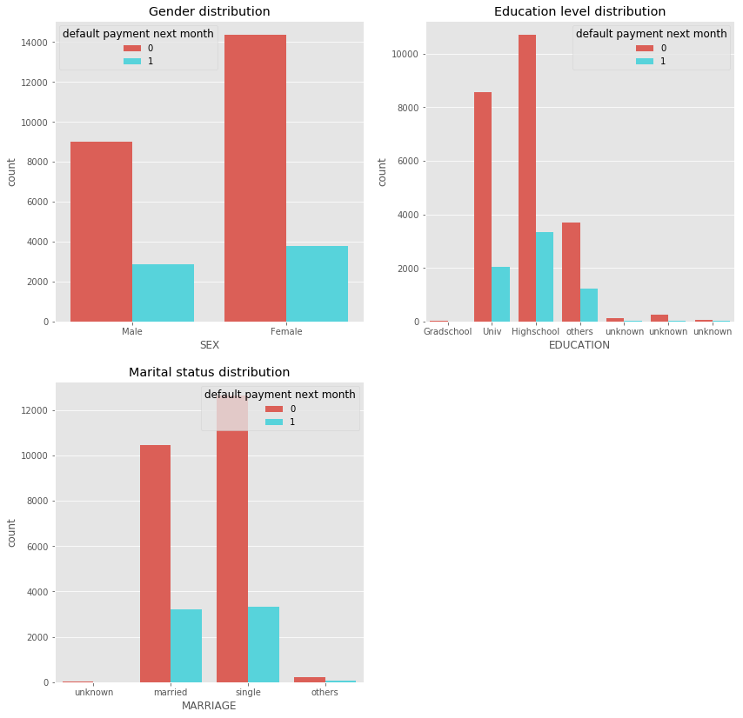
Data Visualization
Notes:
The above calculation tells us that out of the 30,000 clients, 78% have not defaulted, where as 22% did as illustrated in the countplot(). The dataset can't be called as 'skewed' as this proprtion is observed in most practical scenarios.
From SEX variable, approx. 1/3 rd of males defaulted and the same ratio is observed for females too. In EDUCATION variable, the relevant hits are for the university and high School classes, with almost similar ratio of defaults. The MARRIAGE variable gives out similar proportions for married and single classes. This implies that these variables may not function as good predictors for the classification problem, as the amount of variablility in data is limited.

Slide 6
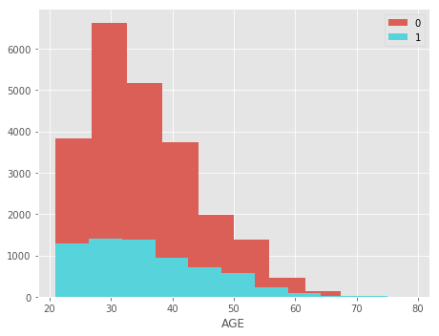
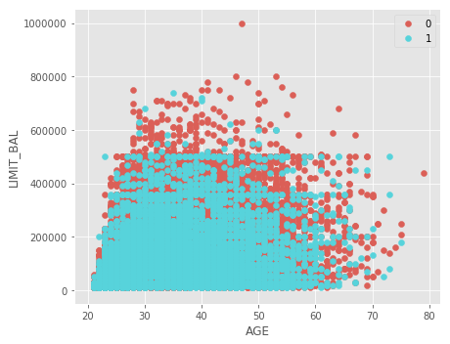
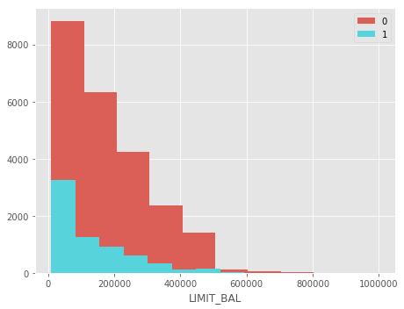
Notes:
The above implies that the amount of balance limit setting is decided by the bank based on AGE

Slide 7
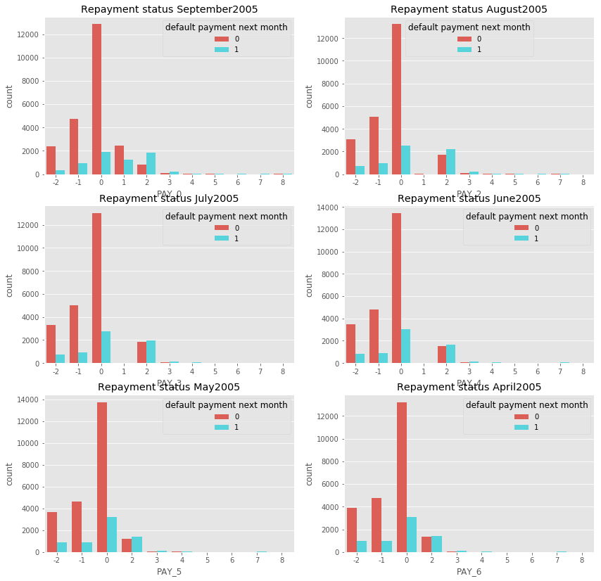
Notes:
From above, observed that the majority of clients have revolving credits that does not have a fixed number of payments (belong to class 0) and they do have the least proprtion of defaults. A closer look at the above histograms reveal that those who have payment delay for two months (class 2) have a higher ratio of defaults, as a payment delay may be a good indicator of default too.

Slide 8
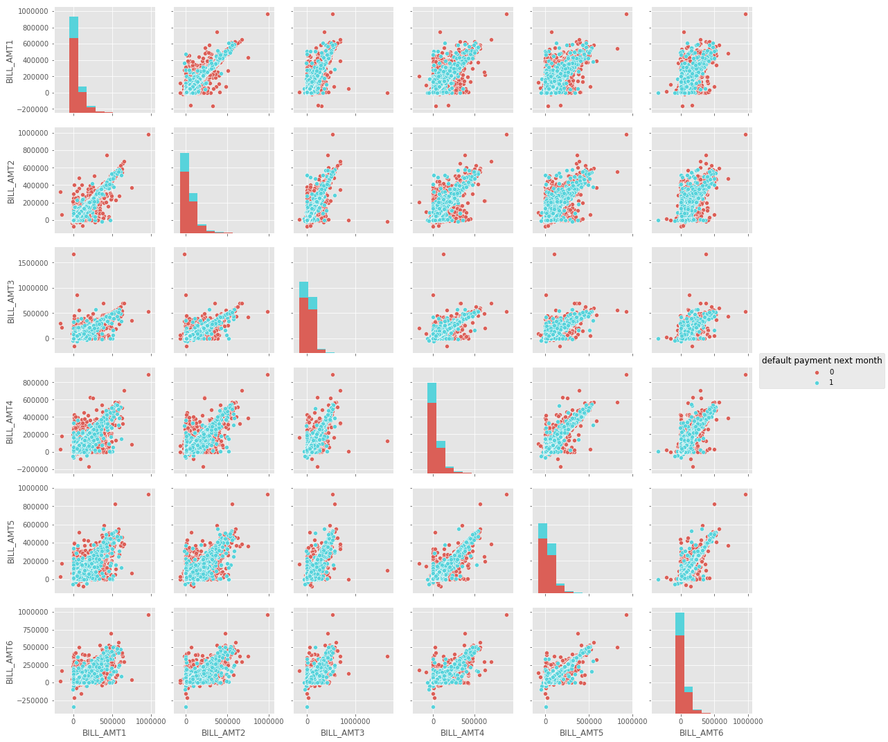
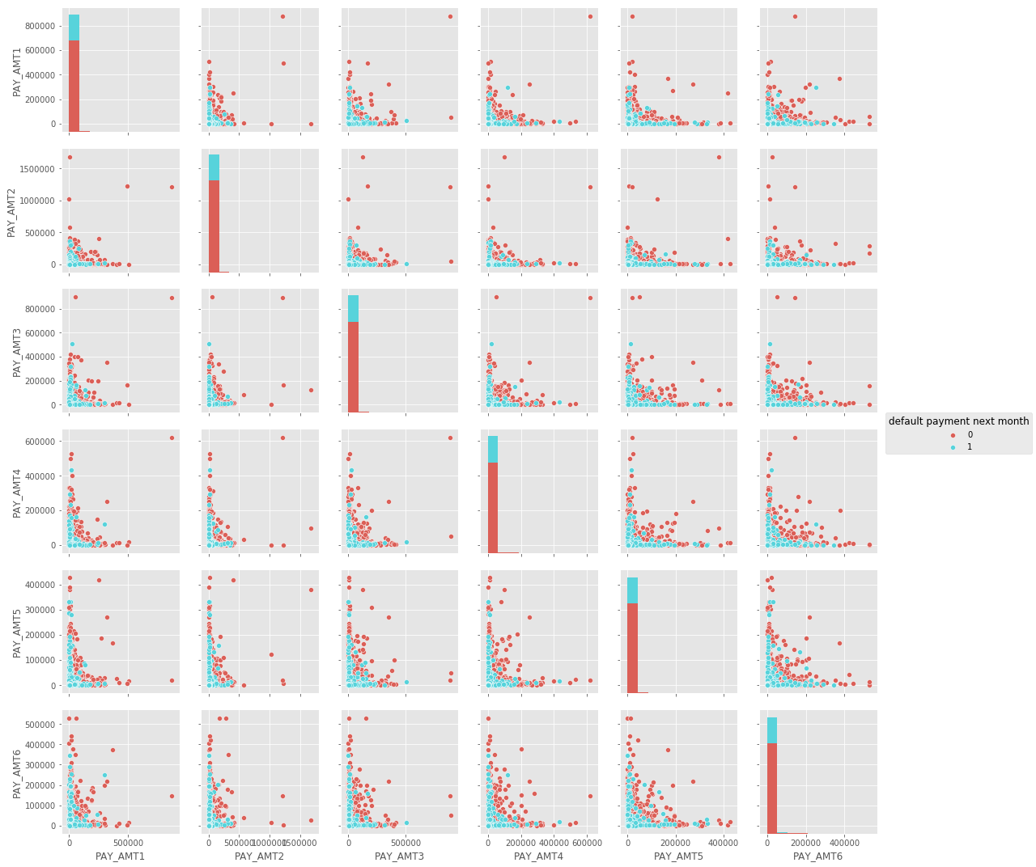
Notes:
From above the variables BILL_AMT2 ,BILL_AMT3,BILL_AMT5 have similar distributions where as BILL_AMT1 and BILL_AMT6 are similar. Also they are highly positively correlated as is quite intutive.
The above variables seem to be negatively correlated and with slighlty nonlinear variations. Intuitively, Amount of previous payment can affect the defaults.

Slide 9
Emerging Technology
Data mining is one of the “10 emerging technologies that will change the world” listed by the MIT Technology Review (Larose).
There is no doubt why many firms embrace data mining in their operations. An article in Information System Management points out that “data mining has become a widely accepted process for organizations to enhance their organizational performance and gain a competitive advantage”

Slide 10
Data Mining Applications
In direct marketing a company saves much time by marketing to prospects that would have the highest reply rate. Instead of random selection on which customers to pick for their surveys, a company could use direct marketing from data mining to find the “correct” customers to ask.
Notes:
In direct marketing a company saves much time by marketing to prospects that would have the highest reply rate. Instead of random selection on which customers to pick for their surveys, a company could use direct marketing from data mining to find the “correct” customers to ask. More intense competition at the global scale recognition of the value in data sources, availability of quality data on customers, vendors, transactions, wen, etc.

