Slide 1

Correlation in the Movie Industry
By Francois Bailly and Walker Kirk
By Francois Bailly and Walker Kirk

Slide 2
Problem description and the current state of the domain: Define the business problem(s) you want to investigate using the dataset. Also, briefly describe existing work or what others have done in this domain.
With thousands of movies coming out every year, it is becoming increasingly difficult for producers, writers, and directors to make educated decisions when it comes to the types of movies they need to work on, or for actors to decide whether to participate in a movie.
No.1: Can users be categorized based on their ratings?
No.2: Are tags a better predictor of movie ratings than the movie genre?
No.3: Can we predict the rating of a future movie using certain attributes and the number of voting?
Notes:
We build a deep learning model using Entity Embeddings for Categorical Variables,, that achieves an **RMSE of 0.81**, on par with state of the art models.
The neural network is implement in Keras with TensorFlow backend. The code is in the "movienet.py" file, and the training is in the training notebook.

Slide 3
Dataset description: origin, data points, variables: Your data set should contain minimally 5,000 data points after preprocessing. Describe its origin, the number of variables (at least 5), names or description of variables, and descriptive statistics for your data (e.g., mean, standard deviation, min, max, etc.)
The data being used is from MovieLens, which is available from the MovieLens.org website (https://grouplens.org/datasets/movielens/). The version of the dataset that we selected is the smallest one, which contains 100,000 ratings and 3,600 tag applications applied to 9,000 movies by 600 users. The entire MovieLens dataset consists of 4 relational files. Each subset is contained in a comma-separated text file (csv). 3 subsets are selected for this study: movies, ratings, and tags.
MovieLens is run by GroupLens, a research lab at the University of Minnesota.

Slide 4
Data preprocessing
Data preprocessing activities and results: Describe your data preprocessing activities. Describe the data transformations made, the rationale behind them, and the results with descriptive statistics. You need to show descriptive data that shows WHY you will preprocess your data as claimed. Then briefly describe the transformations you made, their rationale, and the transformation results with descriptive statistics.
We all produce a lot of data. All the time.
We need to treat all that data in order to make it useful and extract high-quality information from the text, that can be used for predictions and natural language processing.
The main objective here is to give a short information about some tools that data scientist have been using to data mining.
It's important to always focus on the business and see what are the tools that most fit with it.
The techniques that we are going to use are:
1-Case alignment
2-Tokenization
3-Stopwords removal
4-Stemming
5-Lemmatization
Notes:
Data pre-processing involves transforming raw data to well-formed data sets so that data mining analytics can be applied. Raw data is often incomplete and has inconsistent formatting. The adequacy or inadequacy of data preparation has a direct correlation with the success of any project that involve data analytics.
Pre-processing involves both data validation and data imputation. The goal of data validation is to assess whether the data in question is both complete and accurate. The goal of data imputation is to correct errors and input missing values -- either manually or automatically through business process automation (BPA) programming. Data pre-processing is used in both database-driven and rules-based applications. In machine learning (ML) processes, data pre-processing is critical for ensuring large datasets are formatted in such a way that the data they contain can be interpreted and parsed by learning algorithms.

Slide 5
Algorithms used and rationale: Describe your data mining approach. Which algorithms did you use, which variables, and why? Show details of the algorithm, such as the parameters used and the model illustrations (equations or plots). OR Intended algorithms to be used and rationale: Describe your data mining approach. Which algorithms do you plan to use, with which variables, and why? (The algorithms can be improved in the final report.
For this project, we chose to use two predictive methods; Naïve Bayes, and Support Vector Machine. Naïve Bayes is particularly well suited for this case study, as it performs well in cases of categorical inputs, and is widely used for predictions and forecasting. Support Vector Machine on the other hand, is useful for classification, regression, and outlier detection. This will be useful for us to answer whether users can be categorized based on their ratings.
In addition, we will also use cluster analysis as a descriptive method, so that we can group similar users together. In our case, the dependent variable will be rating, as this is the variable that we are trying to predict. Tag and genre will be the independent variables that help us to predict rating.
Notes:
“Support Vector Machine” (SVM) is a supervised machine learning algorithm that can be used for both classification or regression challenges. However, it is mostly used in classification problems. In the SVM algorithm, we plot each data item as a point in n-dimensional space (where n is a number of features you have) with the value of each feature being the value of a particular coordinate

Slide 6
Reading the dataset
Preliminary analysis and results: Show the details of your preliminary analysis and the results. The analysis is based on a smaller dataset or a subset of variables, or both. The goal is to show that your project has a good chance of being successful.
Keras Model
The model works as follows:
Embedds the user and movie id.
Concanate the user embedding, movie embedding and the weighted rating into one vector.
Passes to linear layers with dropout.
The architecture takes as parameters the embedding size, the size of hidden layers, and the dropout probability associate to them.
Notes:
Keras is an API designed for human beings, not machines. Keras follows best practices for reducing cognitive load: it offers consistent & simple APIs, it minimizes the number of user actions required for common use cases, and it provides clear & actionable error messages. It also has extensive documentation and developer guides.

Slide 7

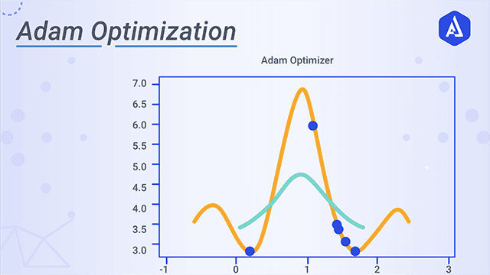
Adam optimizer
Adaptive Moment Estimation is an algorithm for optimization technique for gradient descent. The method is really efficient when working with large problem involving a lot of data or parameters. It requires less memory and is efficient.
Adam is the best among the adaptive optimizers in most of the cases. Good with sparse data: the adaptive learning rate is perfect for this type of datasets.
Notes:
Gradient descent is one of the most popular algorithms to perform optimization and by far the most common way to optimize neural networks. At the same time, every state-of-the-art Deep Learning library contains implementations of various algorithms to optimize gradient descent (e.g. lasagne's, caffe's, and keras' documentation). These algorithms, however, are often used as black-box optimizers, as practical explanations of their strengths and weaknesses are hard to come by.
Adaptive Moment Estimation (Adam) is another method that computes adaptive learning rates for each parameter. In addition to storing an exponentially decaying average of past squared gradients like Adadelta and RMSprop, Adam also keeps an exponentially decaying average of past gradient, similar to momentum. Whereas momentum can be seen as a ball running down a slope, Adam behaves like a heavy ball with friction, which thus prefers flat minima in the error surface. We compute the decaying averages of past and past squared gradients

Slide 8
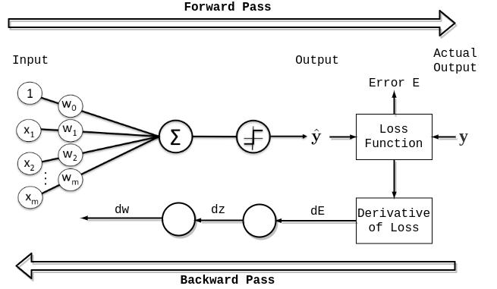
Epochs
In terms of artificial neural networks, an epoch refers to one cycle through the full training dataset. Usually, training a neural network takes more than a few epochs. Iterations is the number of batches or steps through partitioned packets of the training data, needed to complete one epoch.
An epoch means training the neural network with all the training data for one cycle. In an epoch, we use all of the data exactly once. A forward pass and a backward pass together are counted as one pas
Notes:
An epoch is a term used in machine learning and indicates the number of passes of the entire training dataset the machine learning algorithm has completed. Datasets are usually grouped into batches (especially when the amount of data is very large). Some people use the term iteration loosely and refer to putting one batch through the model as an iteration.
If the batch size is the whole training dataset then the number of epochs is the number of iterations. For practical reasons, this is usually not the case. Many models are created with more than one epoch.

Slide 9
Step wise implementation
Importing all necessary libraries for training the model
Loading the dataset, and reading the dataset
Displaying the data
Feature Engineering – The datasets are clean, by only creating dictionaries to convert ids and indexes.
Creating dictionaries to convert userId and movieId into index and vice versa.
Saving the data as pickle file
Loading keras model (as mentioned in the 6th slide)
Splitting up the data as training set and validation set. (Split can be according to user’s wish
Based on the length of the dataset parameters will set automatically
Dropping out units (i.e. neurons) during the training phase of certain set of neurons which is chosen at random.
Setting up epochs and Batch size.
Testing the trained model
Saving the model.
(Note: It's important that every movie are in the training set to have trained embedding of each of them.)

Slide 10
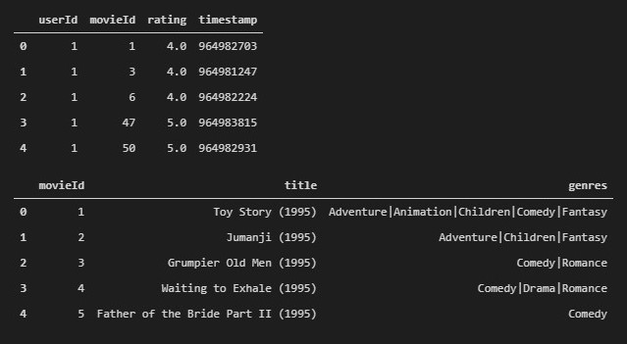
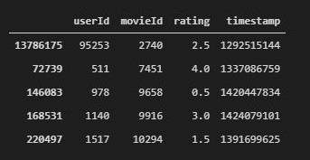
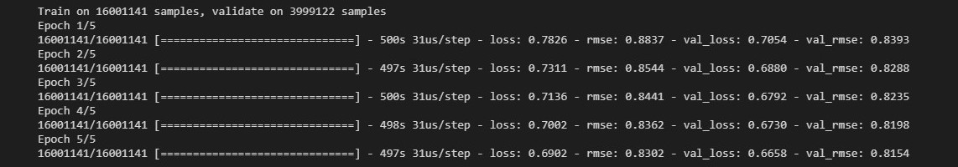
Training the model with the dataset

Slide 11
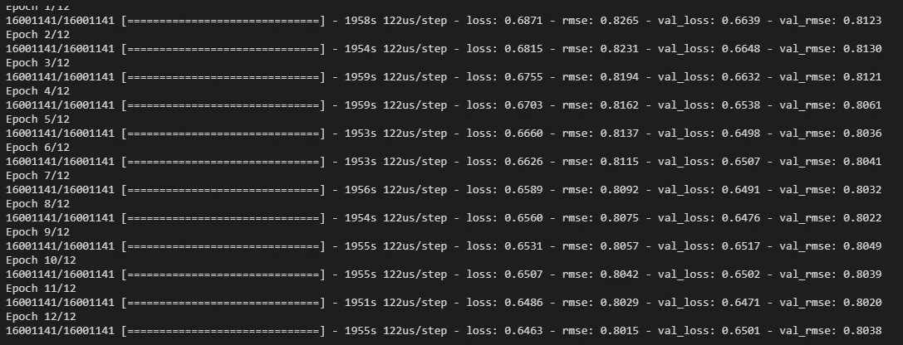
Training the model with the dataset

Slide 12
output
The current state of the art models uses either matrix factorization with RMSE of 0.80 or autoencoders with RMSE of 0.81.
Our model has a RMSE of ~0.80, on par with state of the art models. The approach of entity embeddings is simple but efficient.

