Slide 1


AI BASED DIABETES PREDICTION SYSTEM
PROBLEM DEFINITION AND DESIGN THINKING

Slide 2
Introduction
The Exploring innovative techniques in AI-based diabetes prediction systems, including ensemble methods and deep learning architectures, is a promising approach to improve accuracy and robustness. Here’s why these techniques are valuable:

Slide 3

DEEP LEARNING ARCHITECTURE
Deep learning models, such as neural networks, offer the ability to capture complex patterns in data, making them suitable for healthcare applications like diabetes prediction. Architectures like convolutional neural networks (CNNs) for image data or recurrent neural networks (RNNs) for time-series data can be adapted to improve predictive accuracy

Slide 4

Technologies and tools
.Naive bayes
.probabilistic neural network
.Support vector machine
.Artificial neural network

Slide 5

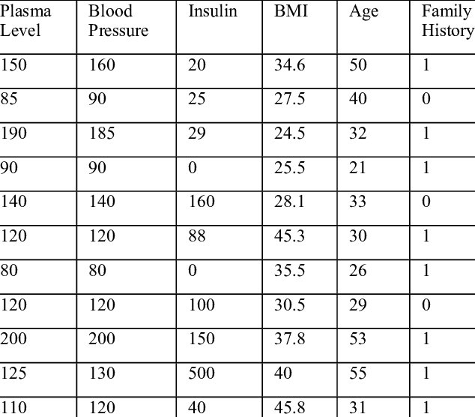
Data collection and processing:

Slide 6

Modal development
# Import the necessary libraries
from sklearn.model_selection import train_test_split
from sklearn.naive_bayes import MultinomialNB
from sklearn.feature_extraction.text import CountVectorizer
from sklearn.metrics import accuracy_score, classification_report
# Sample data
data = [
("I love this movie", "positive"),
("This is a great product", "positive"),
("I hate this movie", "negative"),
("This product is terrible", "negative"),
("I'm not sure about this", "neutral"),
]
# Separate data into features (X) and labels (y)
X = [item[0] for item in data]
y = [item[1] for item in data]
# Split data into a training and testing set
X_train, X_test, y_train, y_test = train_test_split(X, y, test_size=0.2, random_state=42)
# Convert text data into a numerical format using CountVectorizer
vectorizer = CountVectorizer()
X_train = vectorizer.fit_transform(X_train)
X_test = vectorizer.transform(X_test)
# Train a Naive Bayes classifier (MultinomialNB)
naive_bayes = MultinomialNB()
naive_bayes.fit(X_train, y_train)
# Make predictions on the test data
y_pred = naive_bayes.predict(X_test)
# Evaluate the model's performance
accuracy = accuracy_score(y_test, y_pred)
report = classification_report(y_test, y_pred)
print(f"Accuracy: {accuracy}")
print("Classification Report:\n", report)

Slide 7

Naive Bayes is a simple and effective machine learning algorithm used for classification and probabilistic tasks. It is based on Bayes' theorem, which is a fundamental probability theory. The "naive" part of Naive Bayes comes from the assumption that features are conditionally independent, given the class label. In other words, it assumes that the presence or absence of one feature is unrelated to the presence or absence of any other feature

Slide 8
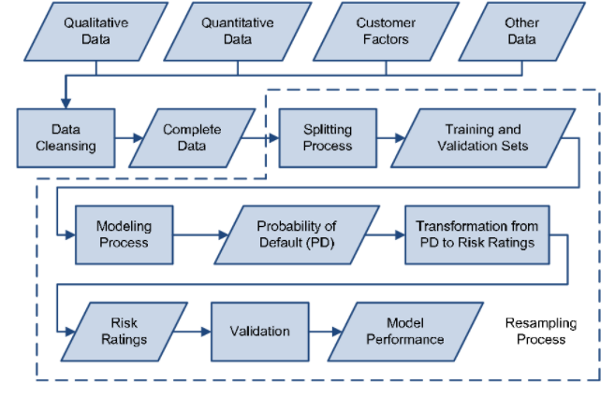
User interface

Slide 9


