Slide 1
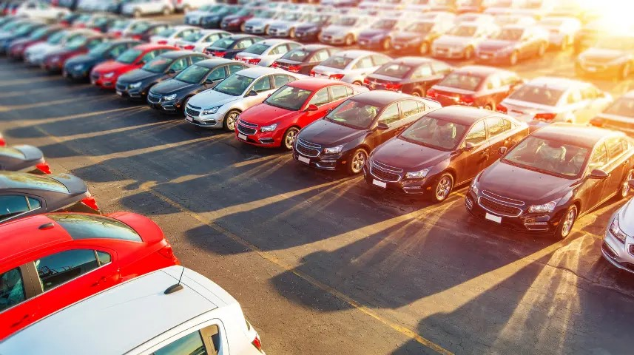
PARKINGLOT TICKET GENERATOR
“SIMPLE PARKING MADE
EASY”
PRESENTED BY
BHARATHI P
KEERTHIGA N
KARTHIKA R

Slide 2
INTRODUCTION :
The Parking Lot Ticket Generator is a Java-based console application that
streamlines vehicle entry and exit management in parking facilities. It
automatically generates unique ticket IDs, records entry and exit times, and
calculates parking fees based on the duration of stay. Utilizing object-oriented
programming principles, LocalDateTime for time handling, for
ticket management, the system ensures efficient and accurate operation. The
application is modular, featuring separate classes for ticket creation, fee
calculation, and user interaction. It is easily extendable, with future
enhancements possible through GUI implementation, file storage, slot tracking,
or database integration, making it scalable for larger applications

Slide 3
PROBLEM STATEMENT :
Managing vehicle entries and exits in parking lots can be inefficient and prone to human
error when done manually. Many parking facilities lack a streamlined system for issuing
entry tickets, tracking parked vehicles, and calculating parking duration or fees. This
results in time delays, mismanagement of space, and revenue loss due to inaccurate
billing.
The goal of this project is to design and implement a Parking Lot Ticket Generator system
that automatically creates and manages parking tickets upon vehicle entry. The system
will generate a unique ticket ID, record the entry time, vehicle details, and assigned
parking spot, and optionally calculate fees based on the parking duration. This solution
aims to improve operational efficiency, reduce manual errors, and provide a foundation
for future integration with digital payment systems or automated barriers.

Slide 4
OBJECTIVES :
Automate Ticket Generation Develop a system that automatically generates parking tickets with unique IDs upon vehicle entry.
Record Essential Vehicle Information Capture and store key details such as vehicle number, entry time, and assigned parking spot.
Ensure Ticket Uniqueness and Accuracy Use reliable methods (e.g., UUIDs and timestamps) to prevent duplicate or inaccurate ticket data.
Improve Operational Efficiency Reduce manual work and human error involved in issuing and tracking parking tickets.
Support Future Enhancements Design the system to allow easy integration with features like fee calculation, digital payments, or exit time tracking.

Slide 5
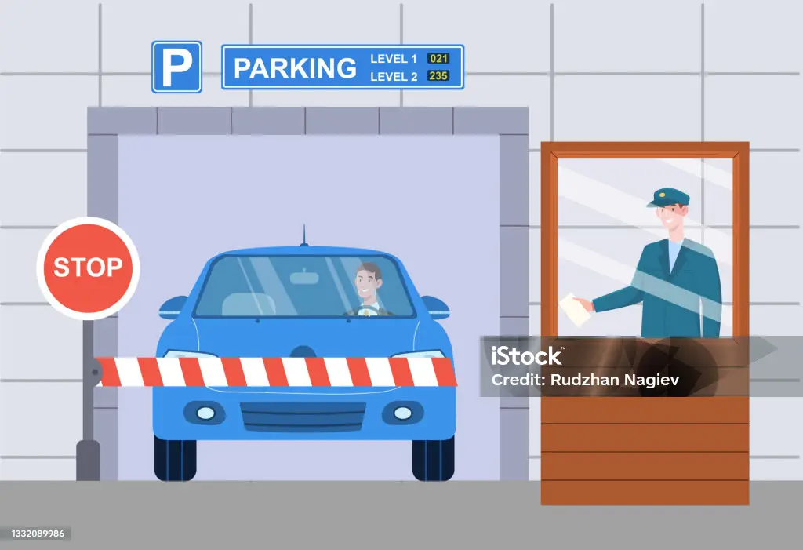
TECHNOLOGIES USED :
PROGRAMMING LANGUAGE : JAVA
DATABASE : MySQL DATABASE
CONNECTIVITY : JDBC ( Java Database Connectivity)
DEVELOPMENT ENVIRONMENT : ECLIPSE IDE.
JAVA CONCEPTS : OOP CONCEPTS,EXCEPTION HANDLING,FILE HANDLING.

Slide 6
ADVANTAGES :
Reduces Human Error : Automating ticket generation ensures accurate entry records and eliminates mistakes from manual data entry.
Saves Time : Speeds up the check-in process for vehicles, improving overall efficiency in parking lot operations.
Improves Data Management : Stores vehicle and entry data in a structured format, making it easier to track and analyze parking usage.
Enhances Security : With proper tracking of vehicles and time stamps, the system helps prevent unauthorized access or misuse of parking spaces.
Supports Scalability : Can be extended in the future with features like exit tracking, fee calculation, digital payments, or barrier integration.

Slide 7
FUTURE ENHANCEMENT :
Although the current version of the Parking Lot Ticket Generator focuses on generating basic parking tickets with essential information such as vehicle number, entry time, and assigned parking spot, there are several potential enhancements that can significantly improve the system’s functionality and efficiency. One major enhancement is the implementation of exit time tracking and an automated billing system, where the system can record the exact time a vehicle exits and calculate parking charges based on the total duration. Integration of QR codes or barcodes on tickets will allow for faster and more secure verification at entry and exit points using scanners. Another powerful feature would be the inclusion of digital payment options, enabling users to pay through mobile wallets, UPI, credit/debit cards, or online banking, thus promoting a cashless and convenient experience. The system can also be upgraded to include License Plate Recognition (LPR) using cameras and image processing, which would automate vehicle identification and further minimize manual input. To improve user experience, a mobile application or web portal could be developed, allowing users to check parking availability in real-time, book slots in advance, or retrieve digital copies of their parking tickets

Slide 8

IMPLEMENTATION STEPS:
Start the System
Detect Vehicle Arrival
Collect Vehicle Information
Generate Parking Ticket
Assign Parking Spot
Print and Issue Ticket
Allow Vehicle to Enter
Wait for Vehicle Exit
Calculate Parking Fee
Process payment
Open Exit Gate
End

Slide 9
CONCLUSION :
The Parking Lot Ticket Generator project successfully demonstrates how
automation can streamline and improve the efficiency of vehicle entry
management in parking facilities. By generating unique tickets that
capture essential information such as license plate number, entry time,
and parking spot, the system reduces manual work, minimizes human
error, and enhances overall organization. This project lays the
foundation for more advanced parking management systems by
showcasing a basic yet functional model. With future enhancements
like exit time tracking, fee calculation, digital payments, and real-time
slot monitoring, the system has strong potential to evolve into a
comprehensive, smart parking solution. Overall, this project highlights
the importance of automation in everyday operations and serves as a
practical example of how simple technologies can lead to significant
improvements in service delivery and user convenience.

Slide 10
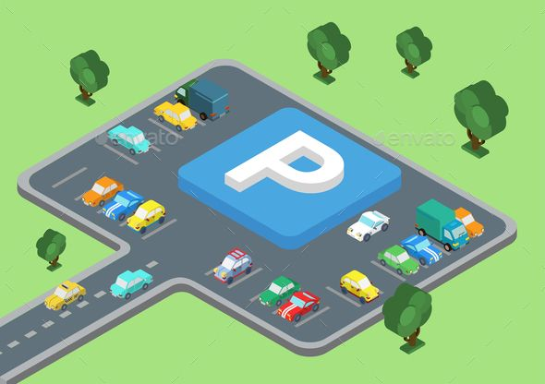
"Park Smart! Pay Fast!!
Go Easy!!!“
THANK YOU!!!

