Slide 1



Business Insights 360
View in Power BI
Last data refresh:
4/24/2024 1:03:34 AM UTC
Downloaded at:
4/24/2024 1:25:56 AM UTC

Slide 2
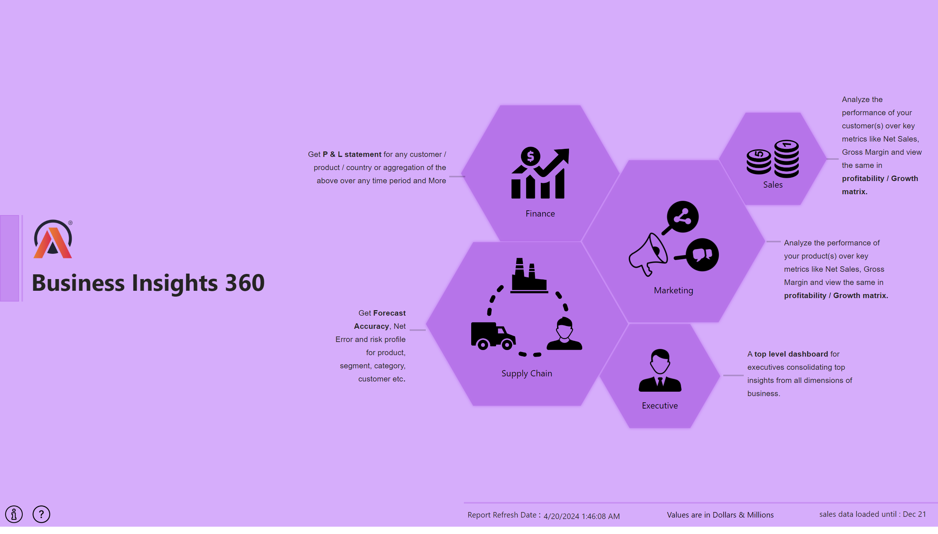
Home
Notes:
image
No alt text provided
textbox
No alt text provided
textbox
No alt text provided
textbox
No alt text provided
textbox
No alt text provided
textbox
No alt text provided
textbox
No alt text provided
shape
No alt text provided
card
No alt text provided
textbox
No alt text provided
card
No alt text provided
textbox
No alt text provided
shape
No alt text provided
shape
No alt text provided
shape
No alt text provided
shape
No alt text provided
shape
No alt text provided
image
No alt text provided
image
No alt text provided
image
No alt text provided
image
No alt text provided
shape
No alt text provided
shape
No alt text provided
shape
No alt text provided
shape
No alt text provided
shape
No alt text provided
shape
No alt text provided
image
No alt text provided
image
No alt text provided
image
No alt text provided
shape
No alt text provided

Slide 3
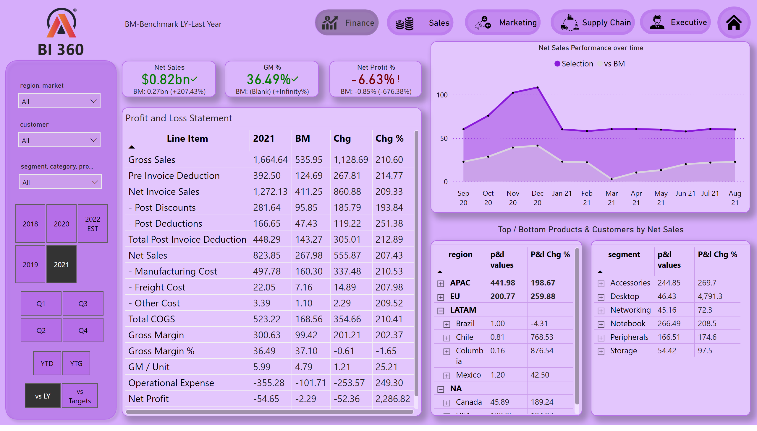
Finance View
Notes:
Profit and Loss Statement
No alt text provided
Net Sales Performance over time
No alt text provided
pivotTable
No alt text provided
pivotTable
No alt text provided
card
No alt text provided
Net Sales
No alt text provided
GM %
No alt text provided
Net Profit %
No alt text provided
image
No alt text provided
card
No alt text provided
shape
No alt text provided
slicer
No alt text provided
slicer
No alt text provided
slicer
No alt text provided
slicer
No alt text provided
slicer
No alt text provided
slicer
No alt text provided
shape
No alt text provided
shape
No alt text provided
shape
No alt text provided
shape
No alt text provided
shape
No alt text provided
shape
No alt text provided
image
No alt text provided
image
No alt text provided
image
No alt text provided
image
No alt text provided
image
No alt text provided
image
No alt text provided
slicer
No alt text provided
shape
No alt text provided
textbox
No alt text provided
textbox
No alt text provided

Slide 4
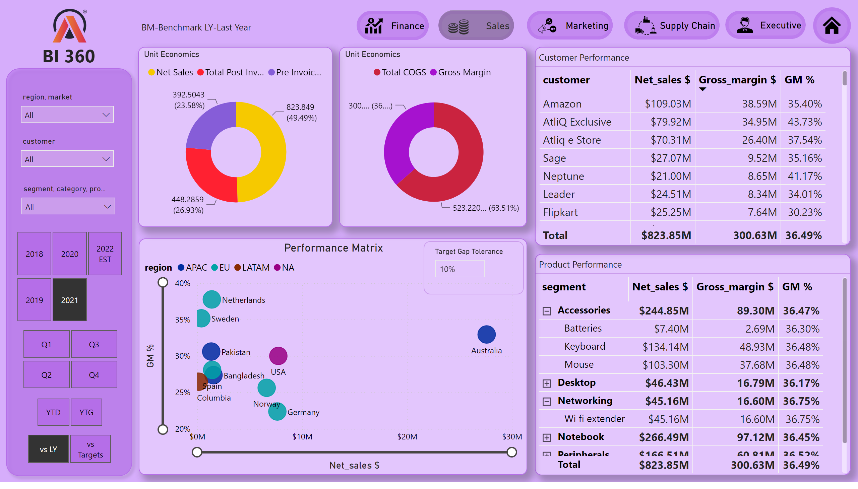
Sales View
Notes:
image
No alt text provided
shape
No alt text provided
slicer
No alt text provided
slicer
No alt text provided
slicer
No alt text provided
slicer
No alt text provided
slicer
No alt text provided
slicer
No alt text provided
shape
No alt text provided
shape
No alt text provided
shape
No alt text provided
shape
No alt text provided
shape
No alt text provided
shape
No alt text provided
image
No alt text provided
image
No alt text provided
image
No alt text provided
image
No alt text provided
image
No alt text provided
image
No alt text provided
slicer
No alt text provided
shape
No alt text provided
textbox
No alt text provided
textbox
No alt text provided
Customer Performance
No alt text provided
Product Performance
No alt text provided
Performance Matrix
No alt text provided
Unit Economics
No alt text provided
Unit Economics
No alt text provided
slicer
No alt text provided

Slide 5
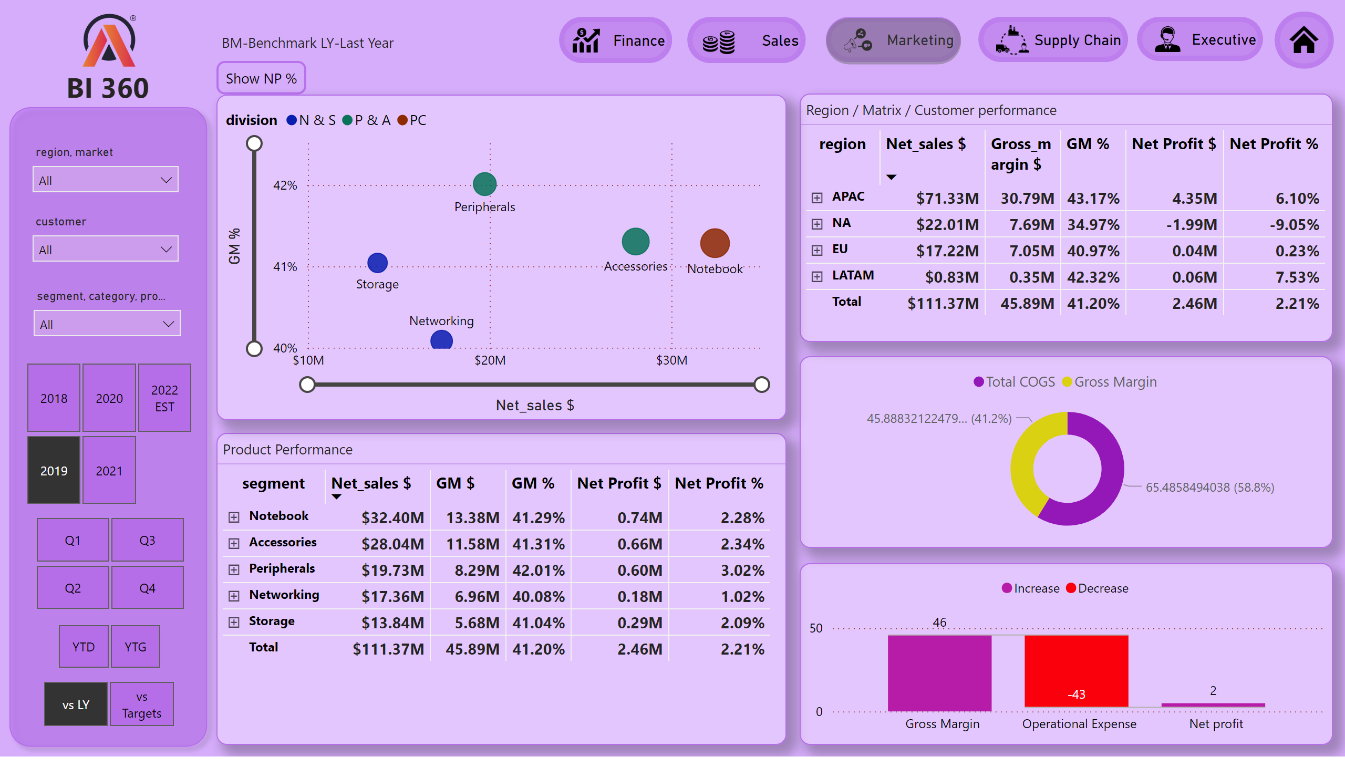
Marketing View
Notes:
image
No alt text provided
shape
No alt text provided
slicer
No alt text provided
slicer
No alt text provided
slicer
No alt text provided
slicer
No alt text provided
slicer
No alt text provided
slicer
No alt text provided
shape
No alt text provided
shape
No alt text provided
shape
No alt text provided
shape
No alt text provided
shape
No alt text provided
shape
No alt text provided
image
No alt text provided
image
No alt text provided
image
No alt text provided
image
No alt text provided
image
No alt text provided
image
No alt text provided
slicer
No alt text provided
shape
No alt text provided
textbox
No alt text provided
textbox
No alt text provided
Product Performance
No alt text provided
Region / Matrix / Customer performance
No alt text provided
actionButton
No alt text provided
scatterChart
No alt text provided
NP % BUTTON
No alt text provided
GM% VISUAL
No alt text provided
donutChart
No alt text provided
waterfallChart
No alt text provided

Slide 6
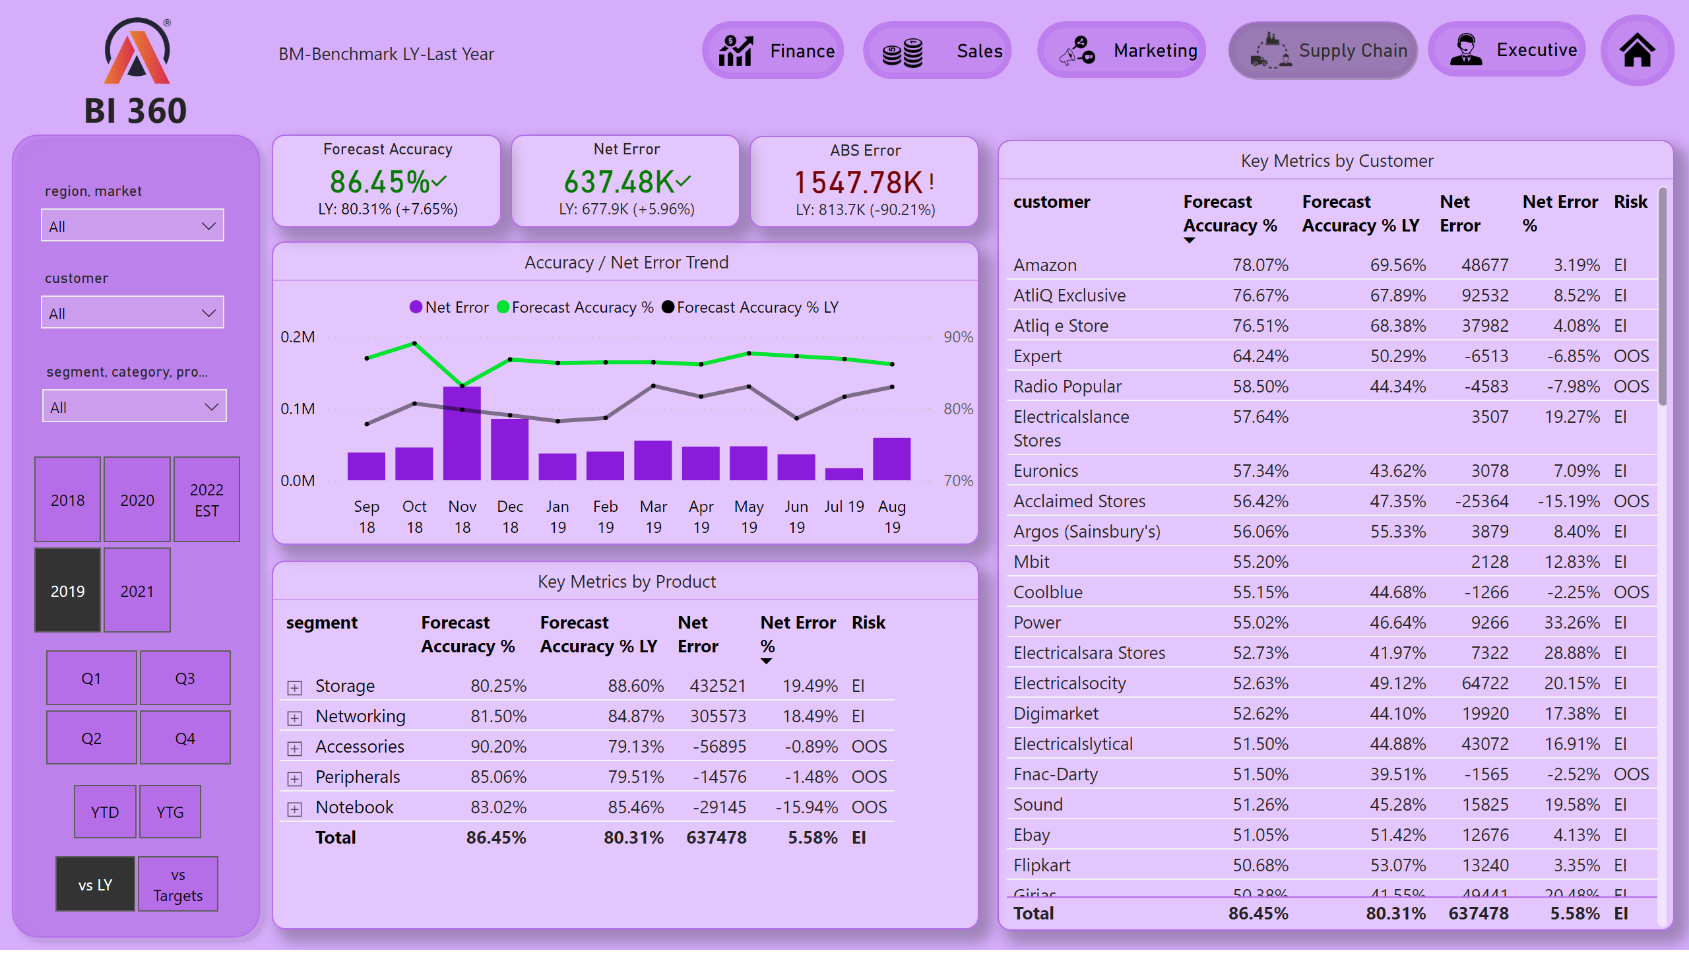
Supply Chain View
Notes:
image
No alt text provided
card
No alt text provided
shape
No alt text provided
slicer
No alt text provided
slicer
No alt text provided
slicer
No alt text provided
slicer
No alt text provided
slicer
No alt text provided
slicer
No alt text provided
shape
No alt text provided
shape
No alt text provided
shape
No alt text provided
shape
No alt text provided
shape
No alt text provided
shape
No alt text provided
image
No alt text provided
image
No alt text provided
image
No alt text provided
image
No alt text provided
image
No alt text provided
image
No alt text provided
slicer
No alt text provided
shape
No alt text provided
textbox
No alt text provided
textbox
No alt text provided
Forecast Accuracy
No alt text provided
Net Error
No alt text provided
ABS Error
No alt text provided
Key Metrics by Customer
No alt text provided
Key Metrics by Product
No alt text provided
Accuracy / Net Error Trend
No alt text provided

Slide 7
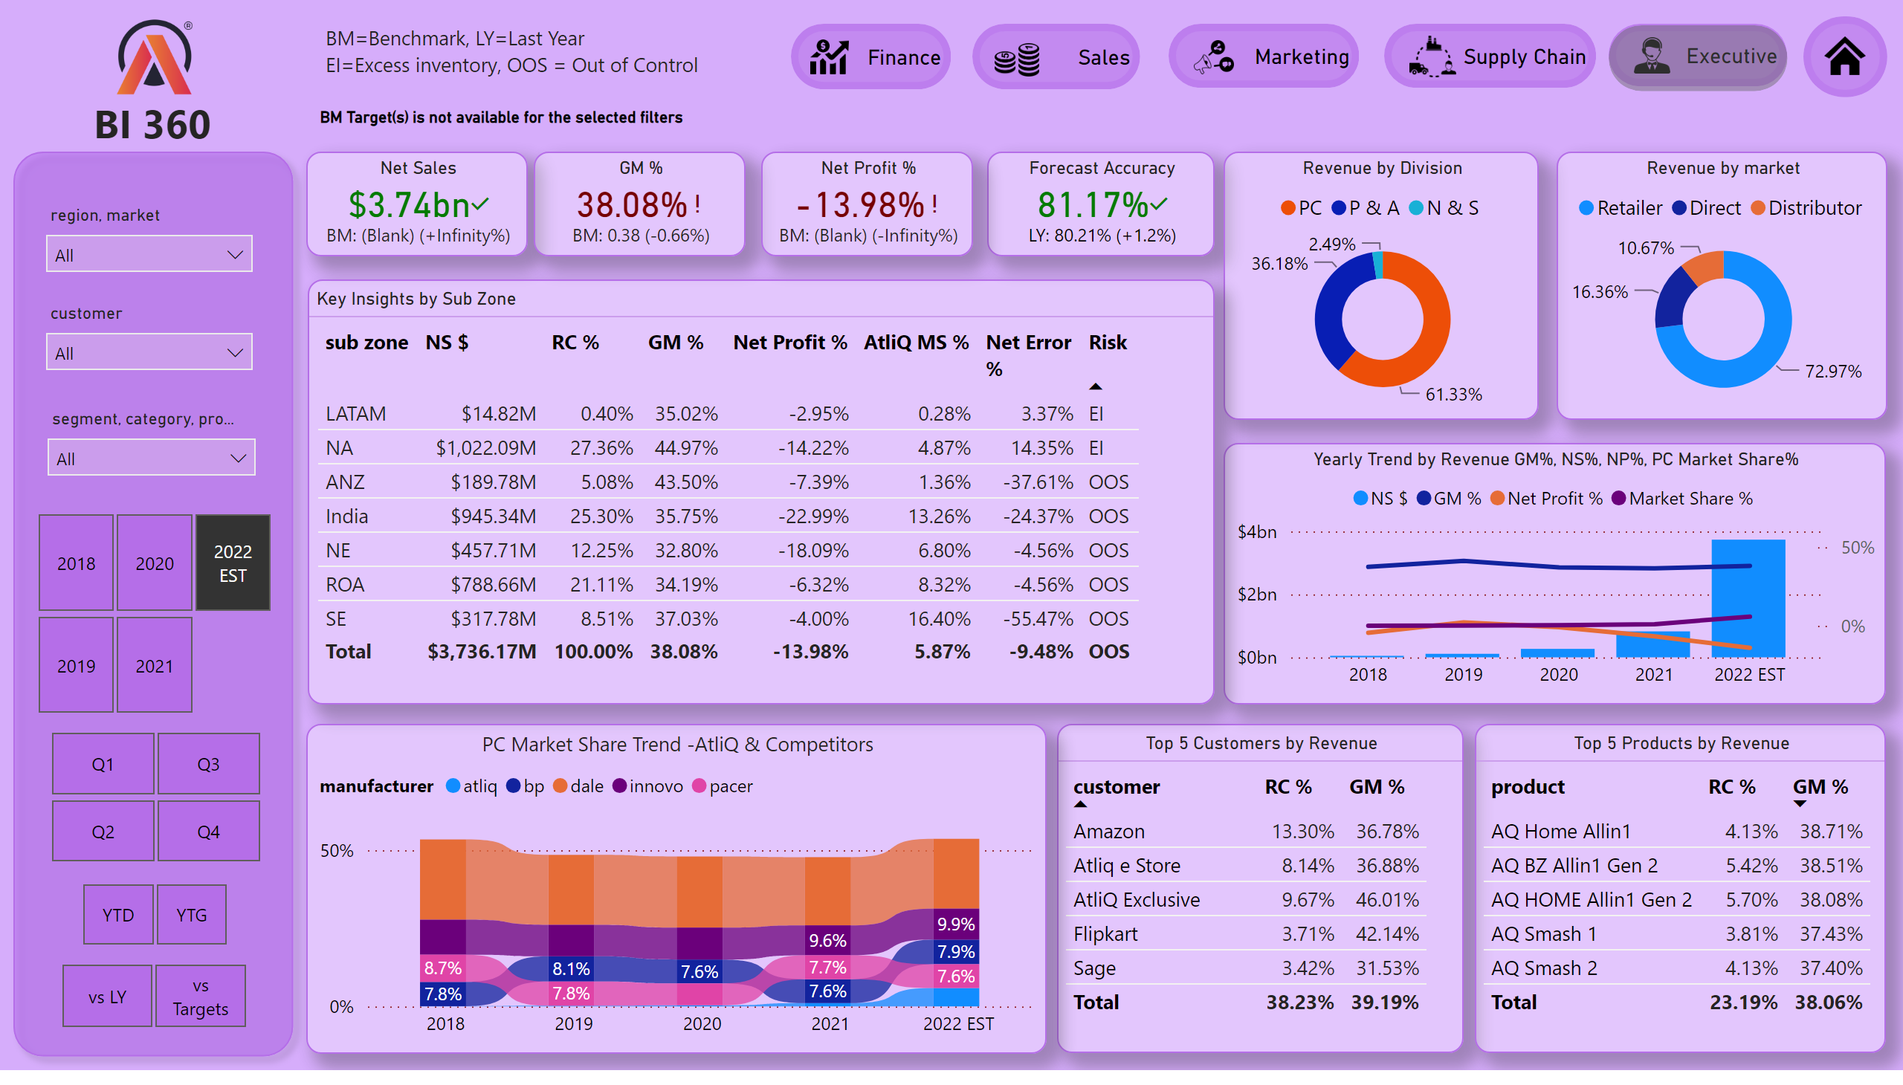
Executive View
Notes:
image
No alt text provided
card
No alt text provided
shape
No alt text provided
slicer
No alt text provided
slicer
No alt text provided
slicer
No alt text provided
slicer
No alt text provided
slicer
No alt text provided
slicer
No alt text provided
shape
No alt text provided
shape
No alt text provided
shape
No alt text provided
shape
No alt text provided
shape
No alt text provided
shape
No alt text provided
image
No alt text provided
image
No alt text provided
image
No alt text provided
image
No alt text provided
image
No alt text provided
image
No alt text provided
slicer
No alt text provided
shape
No alt text provided
textbox
No alt text provided
textbox
No alt text provided
Forecast Accuracy
No alt text provided
Net Sales
No alt text provided
GM %
No alt text provided
Net Profit %
No alt text provided
Yearly Trend by Revenue GM%, NS%, NP%, PC Market Share%
No alt text provided
Revenue by Division
No alt text provided
Revenue by market
No alt text provided
Key Insights by Sub Zone
No alt text provided
Top 5 Customers by Revenue
No alt text provided
Top 5 Products by Revenue
No alt text provided
PC Market Share Trend -AtliQ & Competitors
No alt text provided

Slide 8
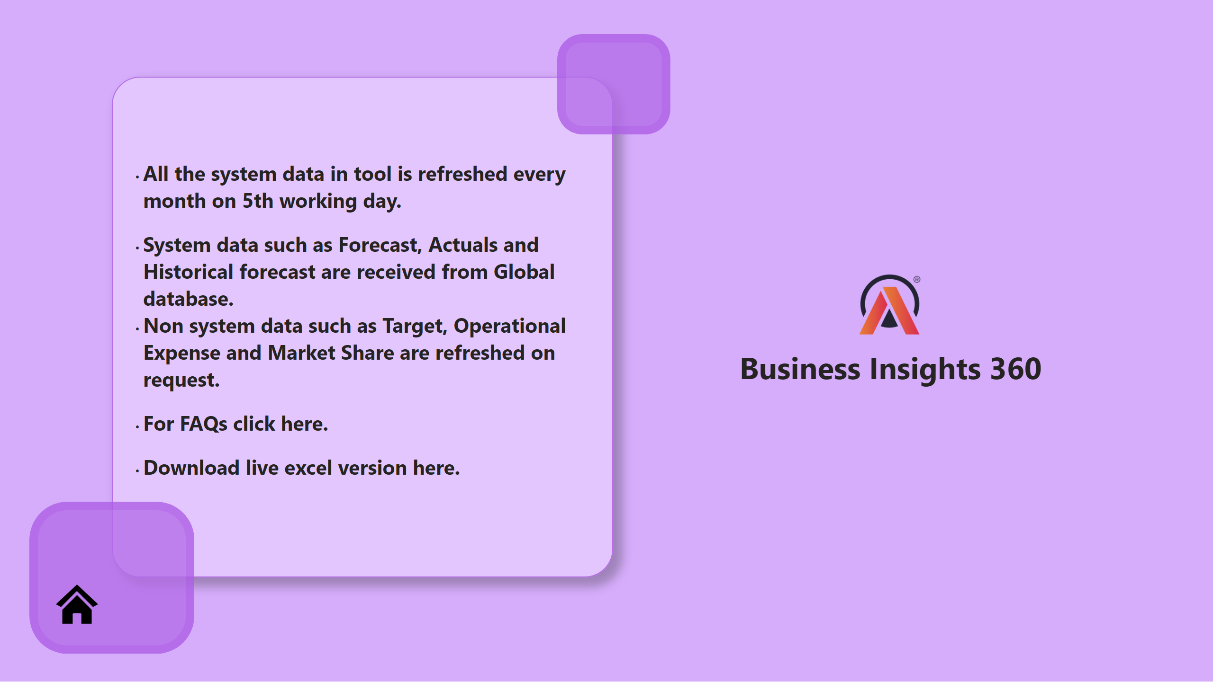
Info
Notes:
image
No alt text provided
textbox
No alt text provided
textbox
No alt text provided
shape
No alt text provided
shape
No alt text provided
image
No alt text provided

Slide 9
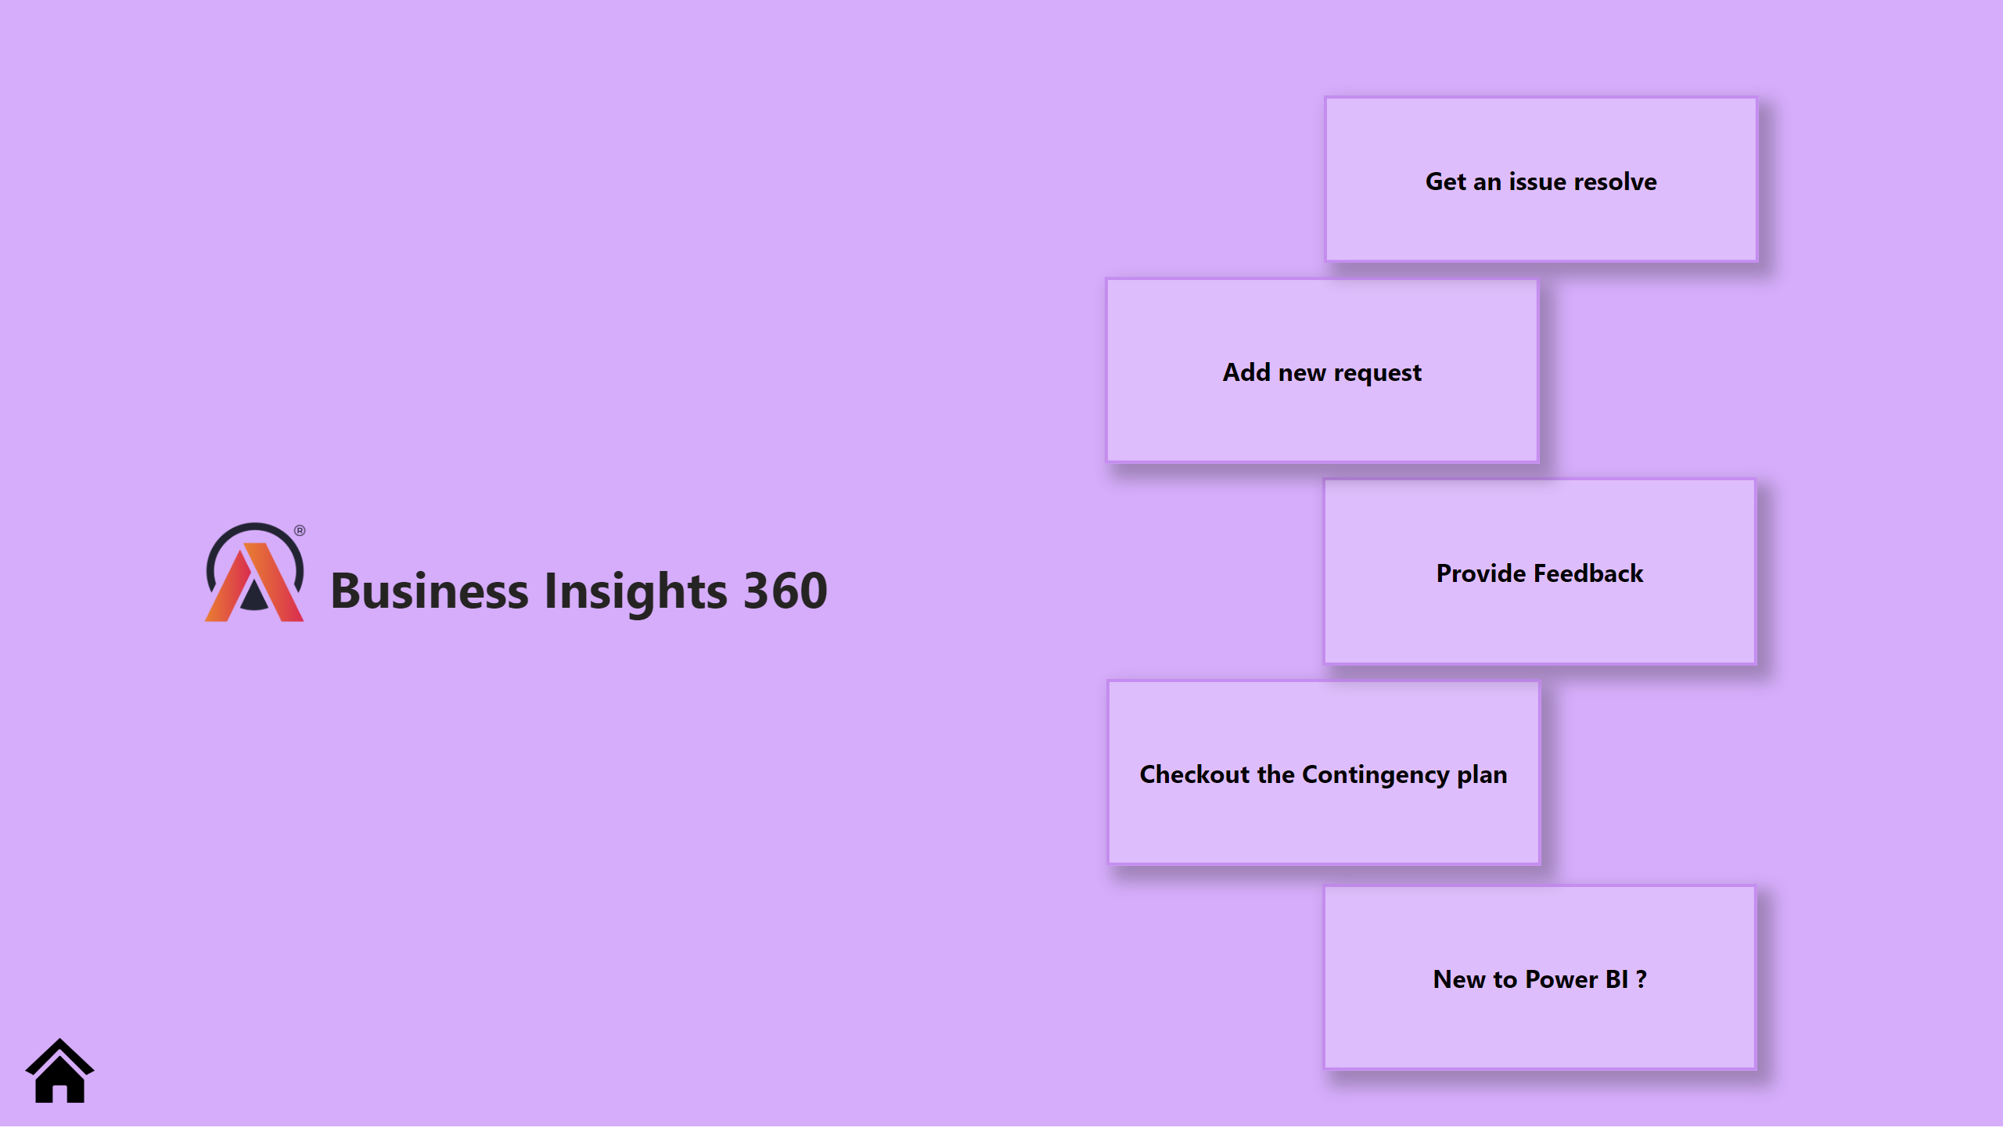
Support
Notes:
image
No alt text provided
textbox
No alt text provided
shape
No alt text provided
shape
No alt text provided
shape
No alt text provided
shape
No alt text provided
shape
No alt text provided
image
No alt text provided

