Slide 1
COURSE OBJECTIVES OF BM&FA
1. To Include the students regarding the adoption and implementation of management principles.
2. To create a focus on the functional organizational structure and its coordination in organization.
3. To make the students understand the concepts of economics and managerial economics.
4. To develop the skills, abilities and competencies regarding cost reduction in various producing conditions.
5. To nurture the students about the financial world of investment decisions.

Slide 2
Definitions:-
“Management is the art of getting things done through and with people in formally organized groups” - Harold Knootz
“To manage is to forecast and plan, to organize, to command, to coordinate and control” - Henry Fayol Characteristics/Salient Features (Nature of Management)
Management is a social process- Management takes place through people. It is the human element which gives management its special character.
Management also denotes a body of people involved in decision making.
Management is action-based.
Management aims at coordination of activities
Management is innovative.
Management aims at achieving predetermined objectives.
Management is inter-disciplinary.
Manager has four types of resources the four M’s : men, money material and machines

Slide 3
THE SCOPE OF MANAGENT:
Financial Management. Financial management is a top priority for companies as the effective and proper managing of finances enables them to stay in business and remain competitive.
Marketing Management: Here different marketing activities undertaken in company’s marketing department.
Personnel Management: It involves managing employees / staff in an organinsation.
Production Management: Handling the entire production process.
Office Management: It involves planning, coordinating, controlling of different activities in an office environment.

Slide 4
Significance/Importance of Management
It facilitates the achievement of goals through limited resources:
Optimum Utilisation of resources: Management facilitates optimum utilisation of available human and physical resources, which leads to progress and prosperity of a business enterprise.
It focus on group efforts:
Ensures effective use of managers: Management ensures effective use of managers so that the benefits of their experience, skills and maturity are available to the enterprise.
It Ensures smooth functioning in case of difficulties: Management ensures smooth, orderly and continues functioning of an enterprise in trouble. It also raises the efficiency, productivity and profitability of an enterprise.

Slide 5
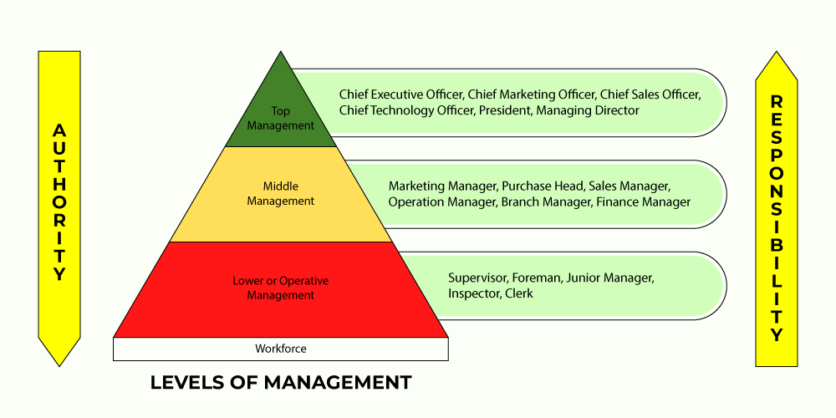

Slide 6
FUNCTIONS OF MANAGEMENT:
Planning
Organizing: Organizing means arranging ways and means for the execution of a business plan.
Staffing
Directing (Leading):Directing as a managerial function, deals with guiding and instructing people to do the work in the right manner. (a) Leading (b) Motivating © Commutating
Coordinating
Reporting
Budgeting
Controlling: Controlling is an important function of management. It is necessary in the case of individuals and departments so as to avoid wrong actions and activities.

Slide 7
SCIENTIFIC MANAGEMENT
Frederick W. Taylor (1856-1915), developer of scientific management. Scientific management (also called Taylorism or the Taylor system) is a theory of management that analyzes and synthesizes workflows, with the objective of improving labour productivity.
Taylor believed that decisions based upon tradition and rules of thumb should be replaced by precise procedures developed after careful study of an individual at work.
PRINCIPLES OF SCIENTIFIC MANAGEMENT
Replacing rule of thumb with science: Development of Science for each part of men's job (replacement of rule of thumb) This principle suggests that work assigned to any employee should be observed, analyzed with respect to each and every element and part and time involved in it.
Harmony in group action: Harmony means that a group should work as a unit and contribute to the maximum.
Co-operation
Maximum output
Development of workers

Slide 8
General approach
Shift in decision making from employees to managers
Develop a standard method for performing each job
Select workers with appropriate abilities for each job
Train workers in the standard method previously developed
Support workers by planning their work and eliminating interruptions
Provide wage incentives to workers for increased output.
CONTRIBUTIONS OF SCIENTIFIC MANAGEMENT:
Scientific approach to business management and process improvement
Importance of compensation for performance
Began the careful study of tasks and jobs.
Importance of selection criteria by management

Slide 9
Features of Scientific Management
Scientific task setting: F. W. Taylor suggested the introduction of standard task which every worker is expected to complete within one day (working hours) the task is to be calculated through careful scientific investigation. For this, work study (i.e. method study and work measurement study) is essential.
Planning the task: For performing the task by every worker, Taylor suggested the need of planning the production activity accurately.
Scientific selection and training of workers: Taylor suggested the need of scientific selection of workers for the plant/production activities.
Standardization: Taylor suggested the importance of standardization of tools and equipment, materials, conditions of work and speed of machines.
Specialization: Taylor suggested specialization in the administrative and organizational setup of the plant He suggested functional foremanship.

Slide 10
The fourteen principles of management created by Henri Fayol are explained below.
1. Division of Work-
2. Authority and Responsibility-
3. Discipline-
4. Unity of Command-
5. Unity of Direction-
6. Subordination of Individual Interest to organizational interest
7. Remuneration-
8. Centralization-
9. Scalar Chain-
10. Order-
11. Equity-
12.Stability of tenure
13. Initiative-
14. Esprit de Corps-

Slide 11
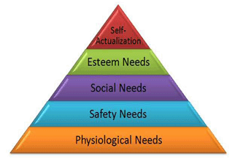
Human Relations Period (or) Motivational Theory:
Abraham Maslow’s “Need Hierarchy Theory”:
Abraham Maslow is well renowned for proposing the Hierarchy of Needs Theory in 1943. This theory is a classical depiction of human motivation. This theory is based on the assumption that there is a hierarchy of five needs within each individual.

Slide 12
Physiological needs- These are the basic needs of air, water, food, clothing and shelter.
Safety needs- For instance- Job security, financial security, protection from animals, family security, health security, etc.
Social needs- It include love, affection, care, belongingness, and friendship.
Esteem needs- self- respect, confidence, competence, achievement and freedom and external recognition, power, status.
Self-actualization need- It explains what you potential to become. It includes the need for growth and self-contentment. It also includes desire for gaining more knowledge, social- service, creativity and being aesthetic.

Slide 13
“Theory X and Theory Y” of Douglas McGregor: In 1960, Douglas McGregor formulated Theory X and Theory Y suggesting two aspects of human behaviour at work. one of which is negative, called as Theory X and the other is positive, so called as Theory Y. According to McGregor, the perception of managers on the nature of individuals is based on various assumptions.
Assumptions of Theory X
Employees are inherently lazy.
They require constant guidance and support
Some time they require even coercion and control.
Given opportunity, they would like to avoid responsibility.
They do not show up any ambition but always seek security.
Assumptions of Theory Y
Some employees consider work as natural as play or rest.
These employees are capable of directing and controlling performance on the own.
Higher rewards make these employees more committed to organization.
Give an opportunity, they not only accept responsibility but also look for opportunities to outperform others.
Most of them are highly imaginative, creative, and display ingenuity in handling organizational issues.

Slide 14
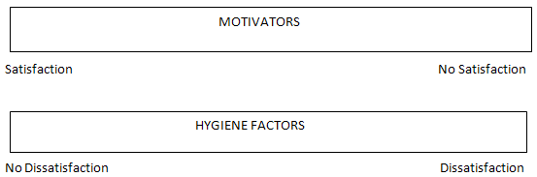
Herzberg’s Two-Factor Theory of Motivation In 1959, Frederick Herzberg, a behavioural scientist proposed a two-factor theory or the motivator-hygiene theory. According to Herzberg, there are some job factors that result in satisfaction while there are other job factors that prevent dissatisfaction.
Hygiene factors- Hygiene factors are those job factors which are essential for existence of motivation at workplace.
Pay - It must be equal and competitive to those in the same industry in the same domain.
Company Policies and administrative policies - They should be fair and clear. It should include flexible working hours, dress code, breaks, vacation, etc.
Fringe benefits - The employees should be offered health care plans (mediclaim), benefits for the family members,
Physical Working conditions - The working conditions should be safe, clean and hygienic.
Status - The employees’ status within the organization should be familiar and retained.
Interpersonal relations - The relationship of the employees with his peers, superiors and subordinates.
Job Security - The organization must provide job security to the employees.

Slide 15
Motivational factors- According to Herzberg, the hygiene factors cannot be regarded as motivators. The motivational factors yield positive satisfaction.
Recognition -
Sense of achievement - The employees must have a sense of achievement. This depends on the job. There must be a fruit of some sort in the job.
Growth and promotional opportunities –
Responsibility - The employees must hold themselves responsible for the work. The managers should give them ownership of the work. They should minimize control but retain accountability.

Slide 16
Hawthorne Experiments:
Mayo is best known for his work on the project commonly referred to as the Hawthorne Studies. They were conducted in the Hawthorne plant of Western Electric Company in the USA between 1927 and 1932. Mayo has drawn various conclusions from these studies.
Some of the major findings of Hawthorne Studies we as noted below:
Individual workers must be seen as members of a group.
The sense of belongings and effective management were the two secrets unfolded by the Hawthrone experiments.
Need for status and belongingness to a group were viewed as more important the monetary incentives or good physical working conditions.
To seek workers cooperation’s the management should be aware of their social needs and cater to them.

Slide 17
Leadership Styles:
Autocratic Leadership
Democratic Leadership
Laissez-Faire Leadership
Theories of Leadership:
The great man theory
Trait theory
The behavioral theory
The transactional theory or management theory
The transformational theory or relationship theory
The situational theory

