Slide 1

CMR COLLEGE OF ENGINEERING & TECHNOLOGY
Kandlakoya, Medchal, Hyderabad - 501401
Department of Computer Science and Engineering
Resume Analysis and skills advisor
Batch No.: 53
Name of the student:
K.Shaarvanie (20H51A0597)
A.Navya (20H51A05G3)
Ch.Karthik (20H51A05N3)
Under esteemed guidance of
Guide Name
Ms.P.Sravanthi (Assistant Professor)
Batch: 2020-2024 Major Project Phase 1

Slide 2
Outline
Abstract
Introduction
Literature survey
Existing system
- Problems in existing system
Research Objective of Presentation
Problem Definition
Research work
- Proposed system architecture
- Methods
- Comparison of Proposed system with an existing system
Performance Measure
Results
Conclusion
Future Work
References
Notes:
2

Slide 3
Abstract
Notes:
3

Slide 4
ABSTRACT
Recruiting candidates to fit a particular job profile is a task crucial to most of the companies. Due to increasing growth in online recruitment, traditional hiring methods are becoming inefficient. The conventional techniques usually include a labor-intensive process of manually searching through the applied candidates, reviewing their resumes, and then producing a shortlist of suitable candidates to be interviewed. In this era of technology, job searching has become smarter and more accessible at the same time. The companies receive enormous numbers of resumes/CVs, which are not always structured. There have been lots of work done for the job searching process. Whereas, the process of selecting a candidate based on their resume has not been entirely automated. This research proposes a model of extracting valuable information from the resume and ranking it according to the preference and requirement of the company. To achieve the desired goal, the entire process has been divided into three segments. The first segment consists of converting the unstructured resumes in structured data using NLP, and the second segment consists of the extraction phase, where the relevant information is extracted from the resume and giving them an identifier value. Finally, based on the values assigned, the resumes are ranked accordingly in the final segment.

Slide 5
Introduction
Notes:
5

Slide 6
Introduction
For each recruitment, companies take out online ads, referrals and go through them manually.Companies often submit thousands of resumes for every posting.
When companies collect resumes through online advertisements, they categorize those resumes according to their requirements.After collecting resumes, companies close advertisements and online applying portals.Then they send the collected resumes to the Hiring Teams.
It becomes very difficult for the hiring teams to read the resume and select the resume according to the requirement, there is no problem if there are one or two resumes but it is very difficult to go through 1000’s resumes and select the best one.
Notes:
6

Slide 7
Literature Review
Notes:
7

Slide 8
Comparison table for the existing system
S.No | Authors and Journal Name& Year of publication | Problem Statement | Name of the Proposed solution/Method | Solution | Remarks
1 | M.F. Mridha, Rabeya Basri, Muhammad Mostafa Monowar (ICSCT), 2021 | Using CNN Algorithm For resume Screening. | A Machine Learning Approach for Screening Individual’s Job Profile Using Convolutional Neural Network | Convolution Neural Network (CNN) based approach applied to screen candidate job profiles | It will be only useful if resume given is in image format and only helpful in understanding the format of resume.
2 | Tumula Mani Harsha, Gangaraju Sai Moukthika | Using nlp algorithm for resume filtration. | Automated Resume Screener using Natural Language Processing(NLP) | It involves using algorithms to quickly filter and prioritize. | It will not suggest the skills required for job profile.
3 | M. Alamelu, D. Sathish Kumar, R. Sanjana, J. Subha Sree | The objective of this project is to create a robust and efficient system for resume validation and filtration using Natural Language Processing (NLP) techniques. | Resume Validation and Filtration using Natural Language Processing”, | It verifies the authenticity of resumes, extracts relevant information, and filters them based on predefined criteria, optimizing the recruitment process. | It will only validate the resumes.

Slide 9
Problems in the Existing System
The existing system is a traditional Machine Learning based system. It gives lower rates of accuracy. It has lower efficiency. It gives lower inaccurate results. This system may lead to loss of human potential. The methods used are NER (Named Entity Recognition), section based segmentation.
Existing working methods are time consuming and may review the same resume multiple times if not recognized. The amount of manual work involved in recruiting processes has been reduced, and the initial screening of candidates has been completed. By removing the redundant candidates, you can keep only the ones who are relevant.

Slide 10
Research Objective
Notes:
10

Slide 11
Research objective
The major objective of our system is to take the current resume ranking system to other level and makes it more flexible for both the entity.
1) Candidates, who has been hired.
2) Client company, who is hiring the candidates.
And also suggest the missing skills required for the role of the company

Slide 12
Problem Definition
Notes:
12

Slide 13
Problem Definition
In this project ,we are using Natural processing domain and Knn Algorithm for Analysing the resume as well as to suggest skills existing in the resume automatically.
A company will get 1000’s of resume everyday. Our system will analyse those resumes in fraction of seconds.
If the resumes not have the skills for required for the company .It will suggest the skills and given resumes with score and missing skills is filled in excel sheet.

Slide 14
Research Work
Notes:
14

Slide 15
Proposed system
In this project using NLP and KNN algorithm we are parsing resume to extract details like skills, qualification and personal details and this extraction is very helpful for companies where they are not supposed to manually scan each and every resume. Once resume uploaded then based on required skills and applicant skills score will be calculated and if score is high then company will shortlist those applicant and call for interviews .Applicant will get skills suggestion based on job description.

Slide 16
System architecture
Notes:
16

Slide 17

Upload resume
Text extraction
Using the NLP and KNN
Training the model using labeled dataset
Vectorizing the data
Preprocessing the data
Extracting keywords
Identify missing keywords in resume and JD
output
the scores are uploaded resume e updated in excel sheet
Score of resume and missing skills to user
Candidate 1
Candidate 2
Candidate n

Slide 18
System flowchart
Notes:
18

Slide 19
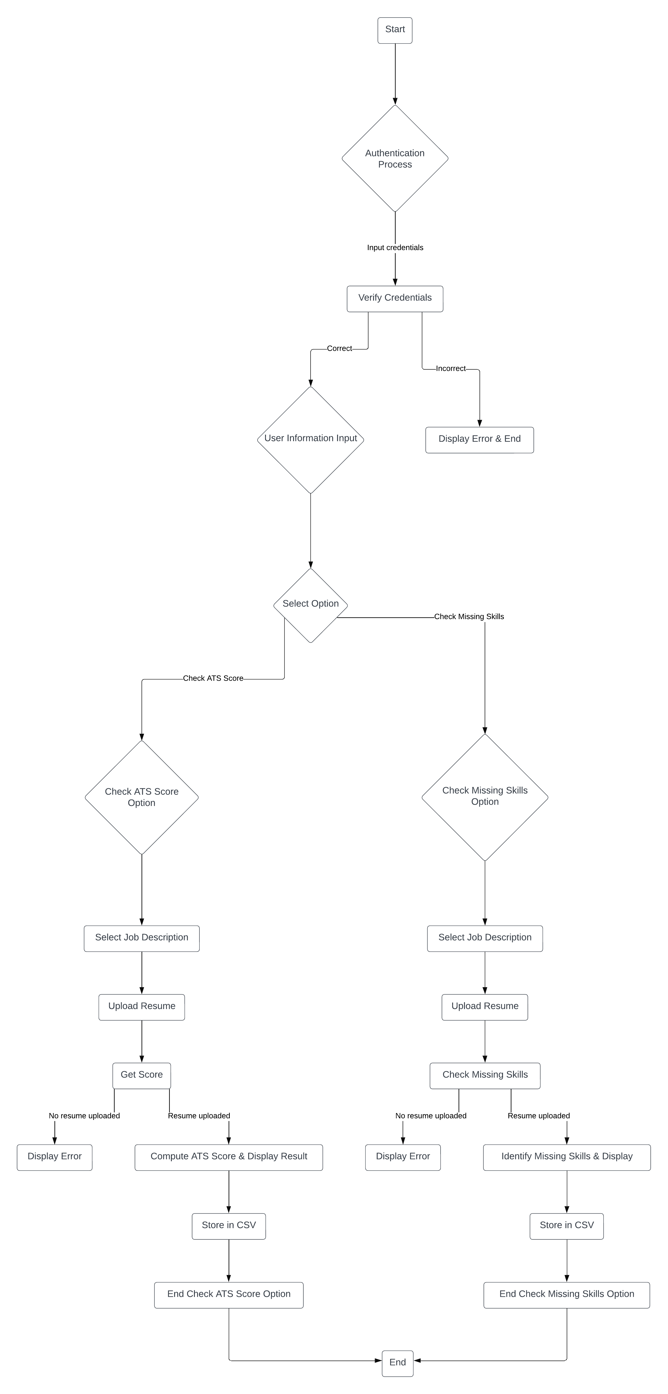

Slide 20
Methods
Data Preprocessing:-
*Input*: User uploads a resume (in PDF format) and selects a job description.
*Process*:
1. Extract text from the uploaded resume using the pdf_to_text function.
2. Preprocess the text data from both the resume and the job description (e.g., tokenization, lowercasing, removing stop words, stemming/lemmatization).
3. Vectorize the text data using techniques like TF-IDF (Term Frequency-Inverse Document Frequency) to represent the documents numerically.
2. Training KNN Model:-
*Input*: Vectorized resume data, vectorized job description data.
*Process*:
Train a KNN model on a dataset containing vectorized resume data and corresponding labels (e.g., job titles or categories).
2. Use a labeled dataset where each resume is labeled with the job title/category it belongs to.
3.Using NLP: Giving a prompt to system for calculation of score by relevant skills compared to given resume skills by identifying keywords.

Slide 21
3. Matching Keywords:-
*Input*: Vectorized resume data, vectorized job description data.
*Process*:
1. For each resume, use the trained KNN model to find the k nearest neighbors (resumes) based on cosine similarity or other distance metrics.
2. Extract keywords from the k nearest neighbors' job descriptions.
3. Compare the extracted keywords with the keywords in the selected job description.
4. Identify missing keywords by finding the keywords present in the selected job description but not in the extracted keywords from the nearest neighbors.
4. Output:-
*Output*: Display the missing keywords and score to the user.

Slide 22
Comparison of Proposed system with an existing system
Our system suggests the missing skills relevant of the given job.
It better than the traditional methods.
The user can predict the chances of getting shortlisted.

Slide 23
Performance measure
Notes:
23

Slide 24
Performance measure
As we know Indian I.T sector is second largest candidate recruiting sector of our country. It contribute about 7.5% to our Gross Domestic Product(G.D.P) Our Proposed system is initially concerned with the I.T sector of our country. It is mainly going to deal the Indian I.T industry .
it can be extended to various other commercial sector where, intake and elimination are in bulk like for Govermental Jobs.

Slide 25
Results
Notes:
25

Slide 26
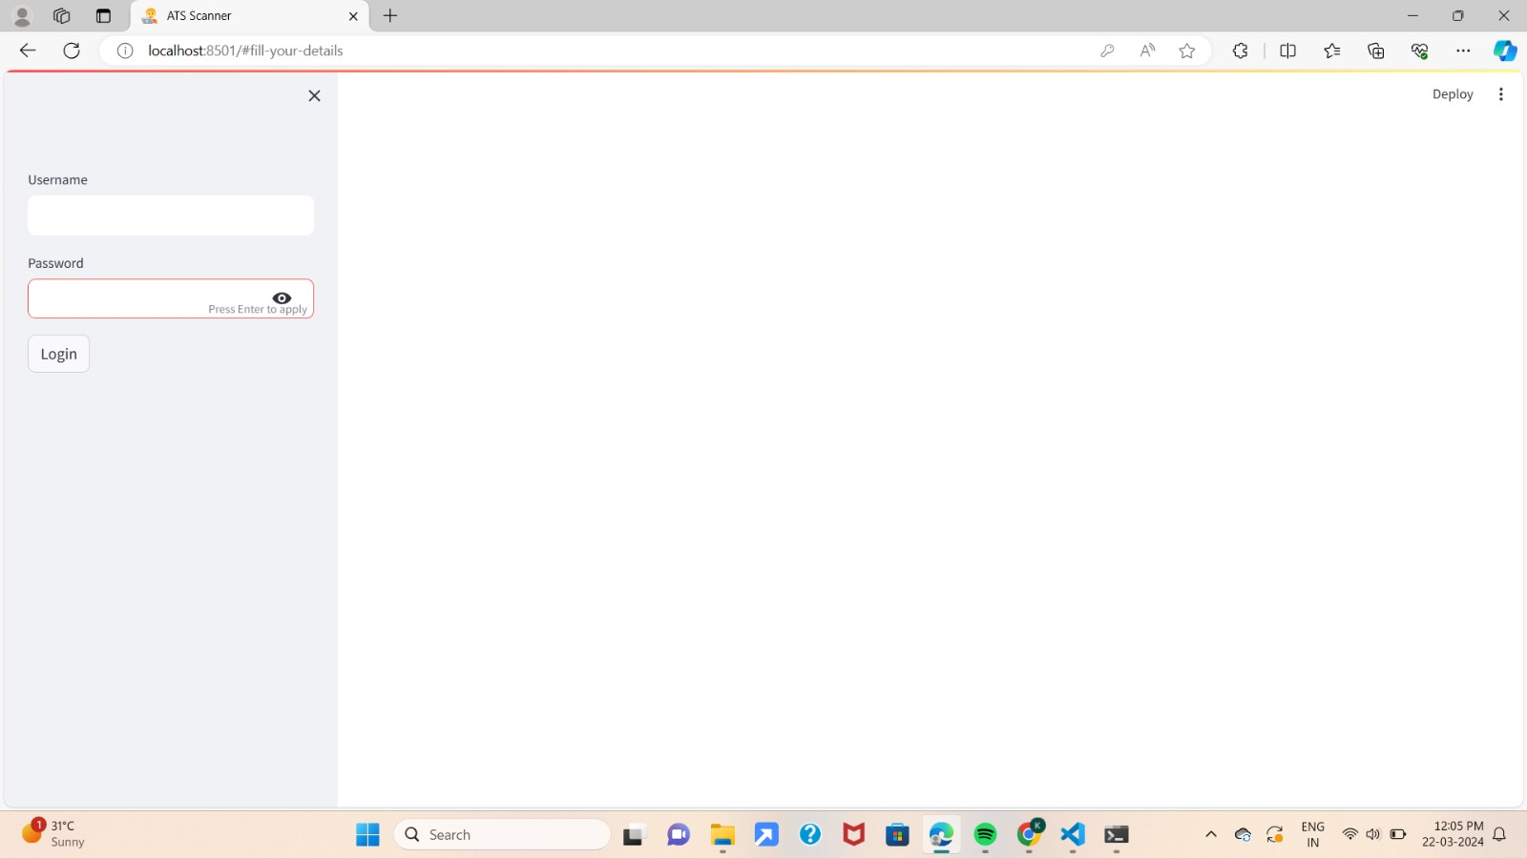
FIG 1 : LOGIN PAGE – Login interface is for users ,who are interested to apply for jobs

Slide 27
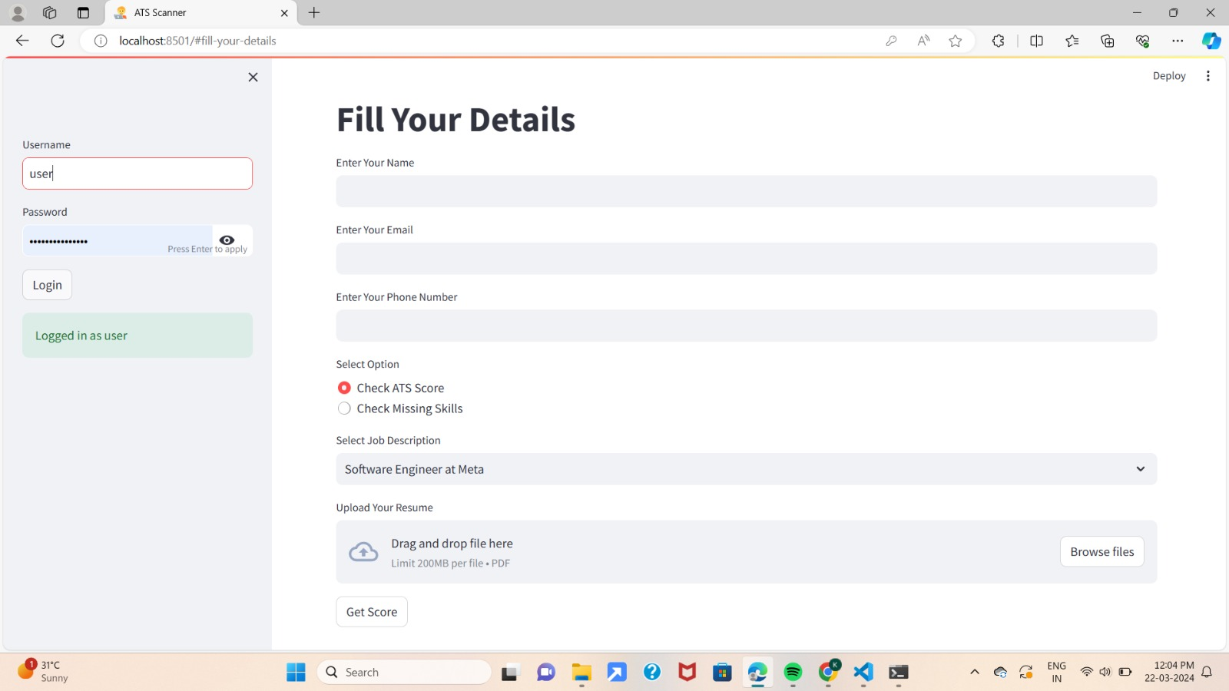
Fig 2: After the user login , It asks to fill the details

Slide 28
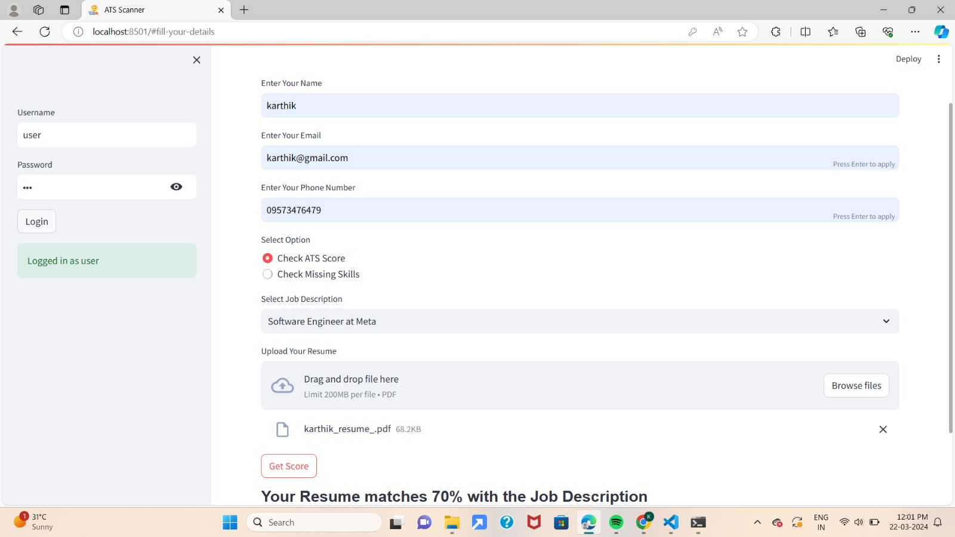
Fig 3 : Fill the form and select the option to check whether the missing skills or score and also available jobs in job description if the resume matches with job description it shows score

Slide 29
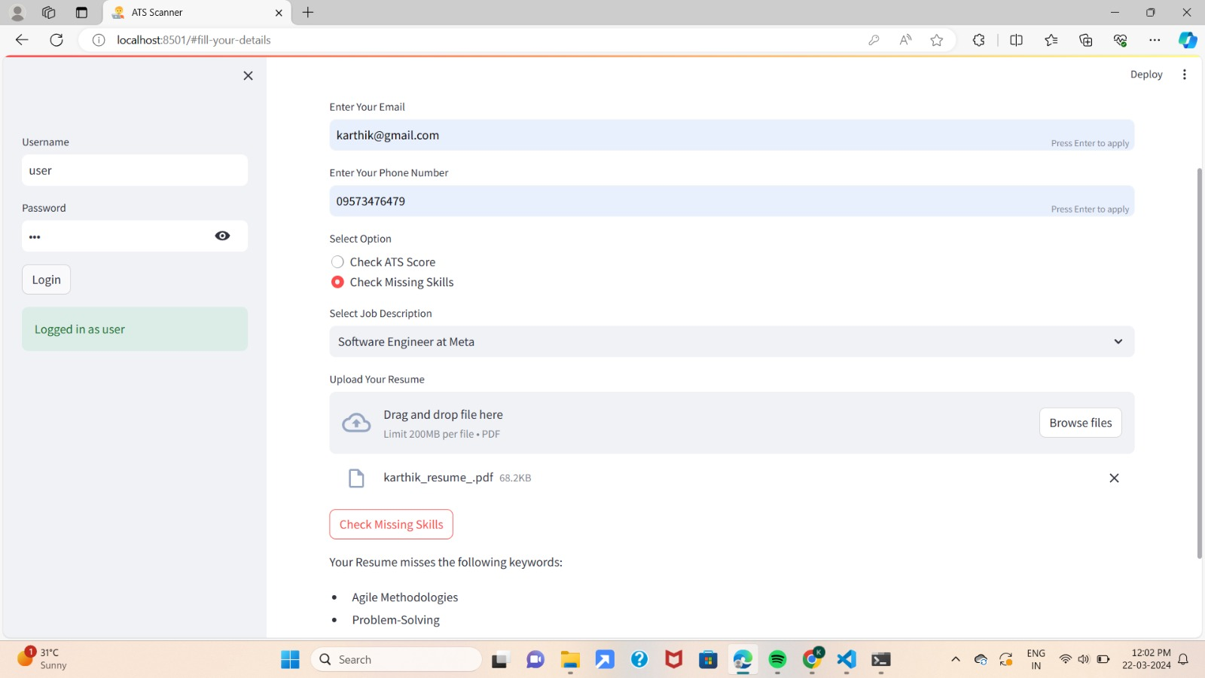
Fig 4 : We can also check the missing skills from job decription

Slide 30
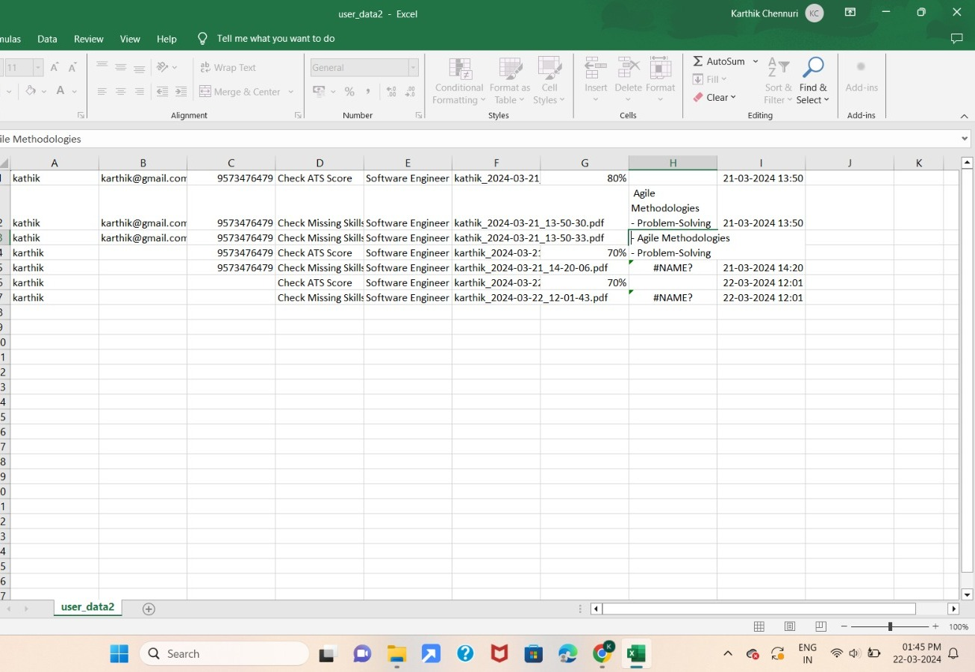
Fig 5 : The excel sheet is filled after the user login

Slide 31
Conclusion
Notes:
31

Slide 32
Conclusion
Automated resume analysis and skills suggestion using NLP has the potential to revolutionize recruitment. By enhancing efficiency and accuracy, it can save time and resources, improve candidate selection, and increase employee retention.
With careful implementation and monitoring, this approach can help companies stay ahead of the competition in today's fast-paced world.

Slide 33
Future Work
Notes:
33

Slide 34
Future work
The future scope for resume analysis and skills advisor is quite promising, especially as integration of Natural Language Processing (NLP) and K-Nearest Neighbors (KNN) algorithms holds immense potential for advancing resume analysis and skills advising. By harnessing NLP techniques, such as sentiment analysis and named entity recognition, the system can better understand the context and nuances within resumes, leading to more accurate skill identification and competency matching.
This future work promises to revolutionize talent acquisition and career guidance by providing personalized, data-driven insights to both job seekers and employers.

Slide 35
References
Notes:
35

Slide 36
References
Tumula Mani Harsha, Gangaraju Sai Moukthika, Dudipalli Siva Sai, Mannuru Naga Rajeswari Pravallika, Satish Anamalamudi, MuraliKrishna Enduri, “Automated Resume Screener using Natural Language Processing(NLP)”, 6th International Conference on Trends in Electronics and Informatics (ICOEI), 2022
M. Alamelu, D. Sathish Kumar, R. Sanjana, J. Subha Sree, A. Sangeerani Devi, D. Kavitha, “Resume Validation and Filtration using Natural Language Processing”, 10th International Conference on Internet of Everything, Microwave Engineering, Communication and Networks (IEMECON), 2022
M.F. Mridha, Rabeya Basri, Muhammad Mostafa Monowar, Md. Abdul Hamid, “A Machine Learning Approach for Screening Individual’s Job Profile Using Convolutional Neural Network”, International Conference on Science & Contemporary Technologies (ICSCT), 2021

Slide 37
Thank You!

