Slide 1
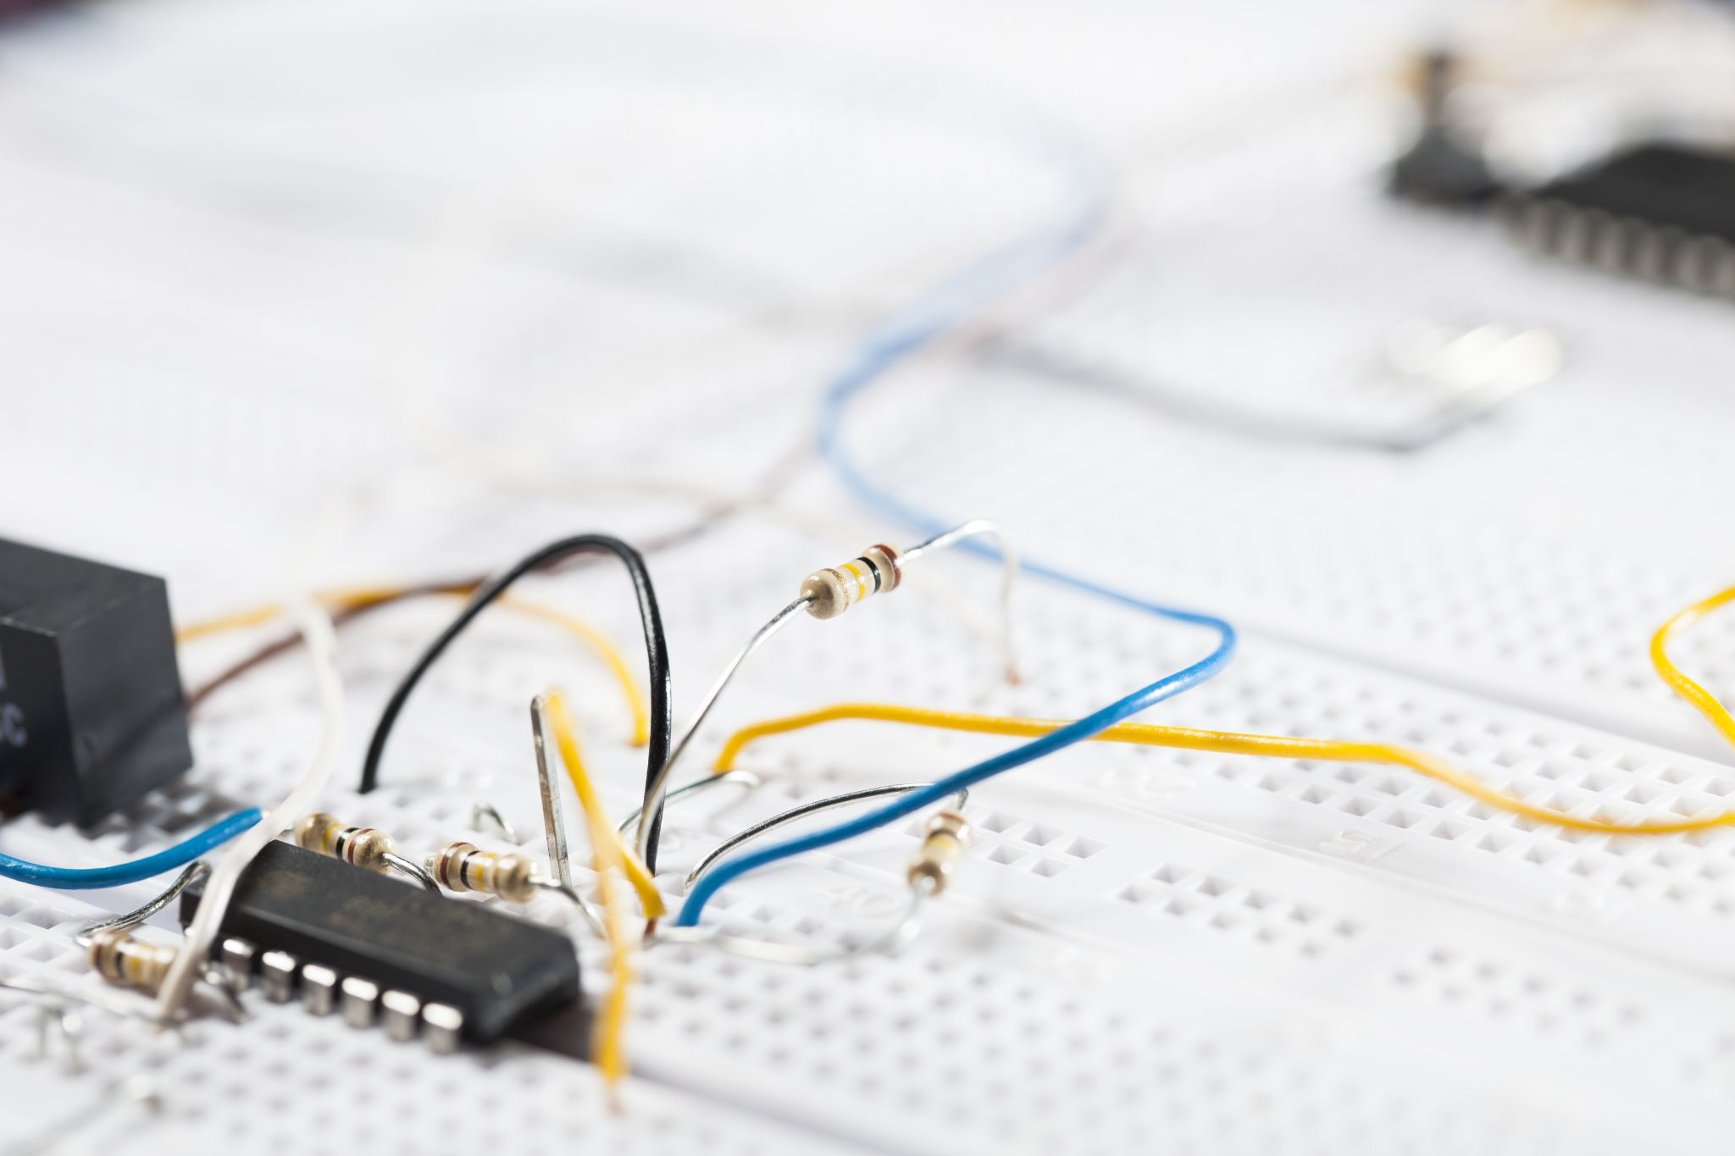


P33. Design of Primary and Secondary Controllers in HVDC systems
EE-493
B.TECH PROJECT
End-Semester Evaluation
Presented by- Maloth Karthikeya
220002047
Supervisor: Dr. Lokesh Kumar Dewangan
Assistant Professor
Co-supervisor: Dr. Sharad Kumar Singh
Assistant Professor
Department of Electrical Engineering, IIT Indore 21st November 2025
End-Semester Evaluation Maloth Karthikeya 1
Young Faculty Research Seed Grant Proposal Dr. Lokesh Kumar Dewangan

Slide 2
Outline
Introduction
Literature Review
Problem Statement and Motivation
Methodology
Results
Conclusions and Future scope
HVDC systems
Key points from explored references
Goals and Deliverables
Grid Connected converter and its control modelling
Simulation results of Grid connected converter system from PSCAD and its MATLAB validation.
Conclusion.
Control
Zhang Bei HVDC grid
4-Terminal system with Multi-level modular converter modelling
Research and future scope
Simulation results of 4-Terminal HVDC system from PSCAD.
Real life examples in India
Key words
End-Semester Evaluation Maloth Karthikeya 2

Slide 3
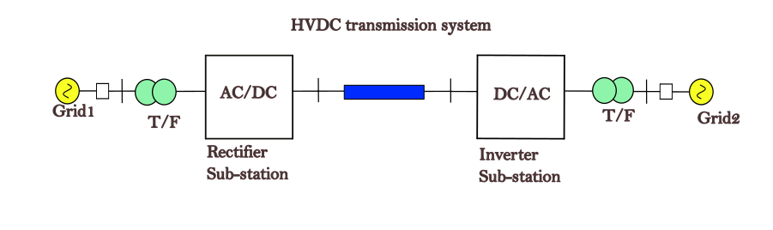
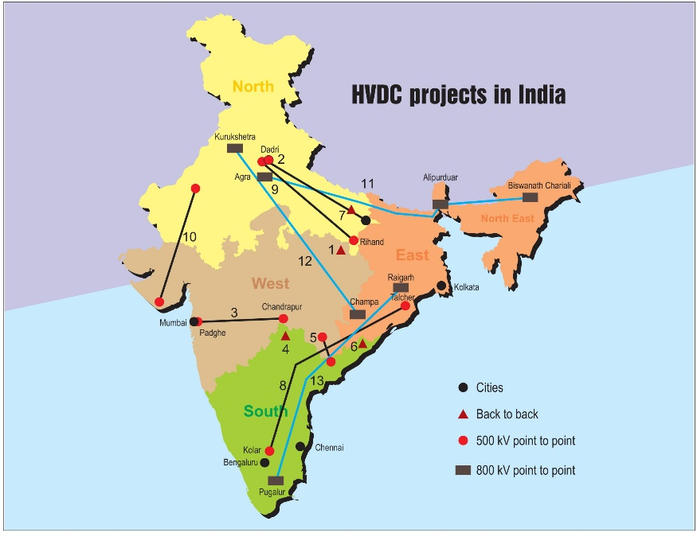
Introduction
HVDC systems?
Converters?
High Voltage Direct Current(HVDC) systems employ a hierarchical control structure to maintain stability and coordination across converter stations. Which includes,
Fig.1 HVDC system
The control architecture ensures fast, local regulation of active and reactive power, and DC voltage to stabilize the system during disturbances.
They enhance both the dynamic response and overall reliability of HVDC networks.
https://powerline.net.in/wp-content/uploads/2017/12/Pg-65-A.jpg
Fig.2 HVDC Projects in India
End-Semester Evaluation Maloth Karthikeya 3

Slide 4
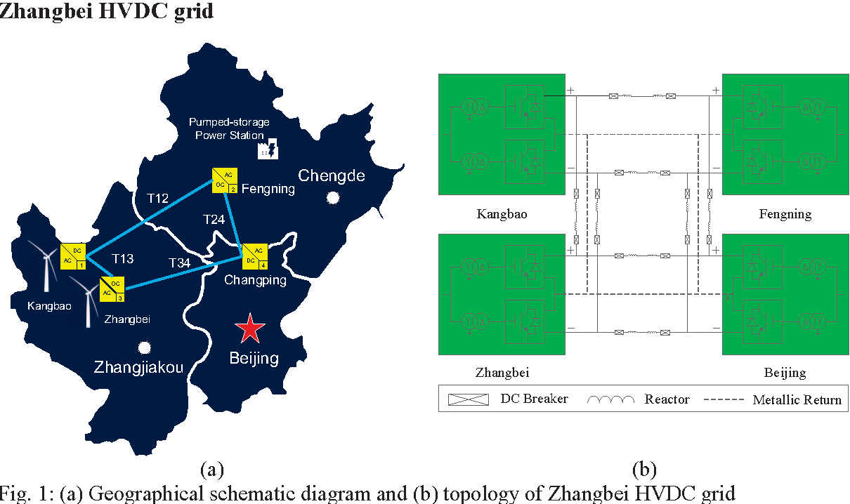
Literature Review
Hierarchical control, comprising primary and secondary levels—enhances reliability, coordination, and performance in both point-to-point and multi-terminal (MT-HVDC) systems.
Early studies, like Yazdani and Iravani (2010), established foundational VSC control for DC voltage and grid synchronization.
Later exploring research works advanced to Grid connected systems, MMC-based systems, multi-terminal configurations, voltage control schemes.
Key words:
Grid modelling
Converter modelling
Control Architecture of converter
PLL(Phase-Locked loop)
abc-dq transformation ,
Outer loop : Active and Reactive power control
Inner loop : Current control
https://figures.semanticscholar.org/1a6c11856e11eb58f1926cbf9bad2d270848466f/2-Figure1-1.png
Fig.3 Zhang Bei HVDC grid in China
End-Semester Evaluation Maloth Karthikeya 4

Slide 5
Problem Statement and Motivation
Goal:
Design HVDC systems with 2-level Voltage source converter(VSC) and Modular multi-level converter(MMC) with proper control architecture.
Simulation in PSCAD and MATLAB validation of the HVDC systems.
Deliverables:
The project outcomes should make a contribution towards increasing the stability, efficiency, and flexibility of HVDC transmission networks in future sustainable power systems.
End-Semester Evaluation Maloth Karthikeya 5

Slide 6
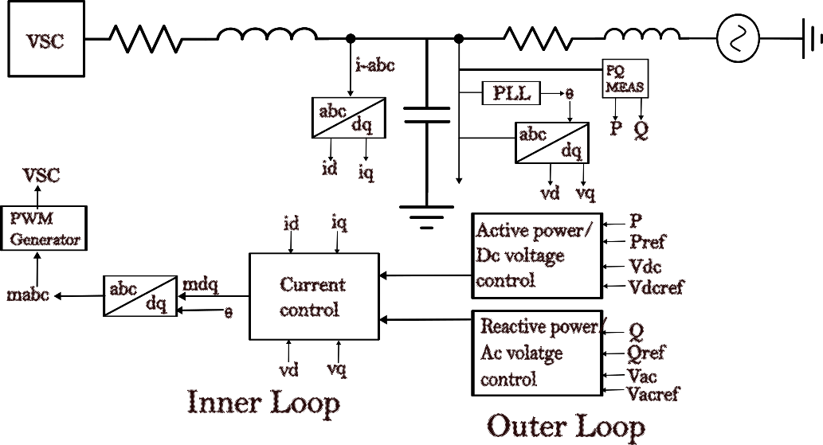
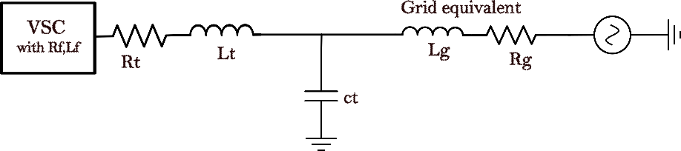
Methodology
Design of HVDC system, Grid connected converter which include 2-Level converter(Fig4).
Fig.4 Grid connected converter(HVDC system)
Fig.5 Total Control scheme of VSC
Converter Modelling
Fig. 2 shows details of VSC control at which is connected to a grid through filters and transformer along with its control.
A PLL(Phase-Locked loop) is used to estimate frequency of the grid which is also used for decoupling control design. The reference and measured values are given to the controller to control power.
The modulating signal in dq frame mdq is generated using current control. The mdq is converted into mabc using inverse Park transform and is given to the VSC.
End-Semester Evaluation Maloth Karthikeya 6

Slide 7
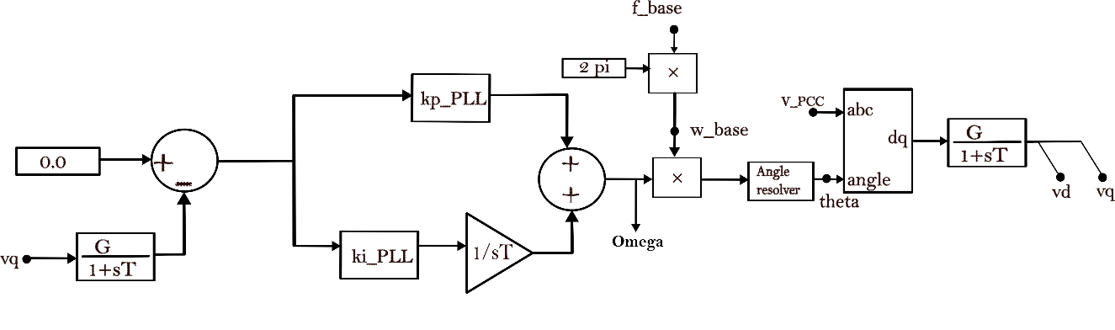
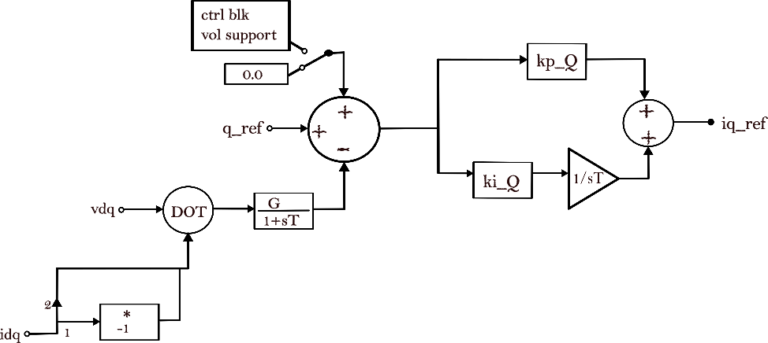
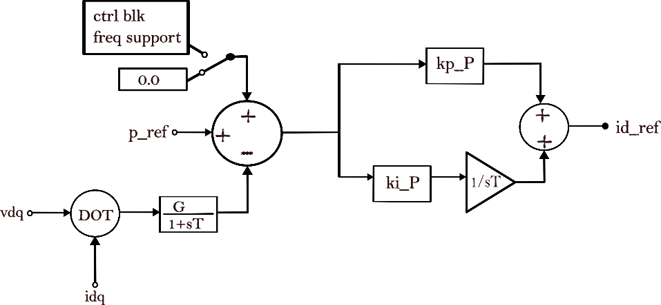
Methodology
Phase-Locked loop
Fig.6 Phase Locked loop
Outer control loop
Fig.7 Active power control
Fig.8 Reactive power control
The controller output provides the reference currents (idref, iqref) for the inner control loop.
End-Semester Evaluation Maloth Karthikeya 7

Slide 8
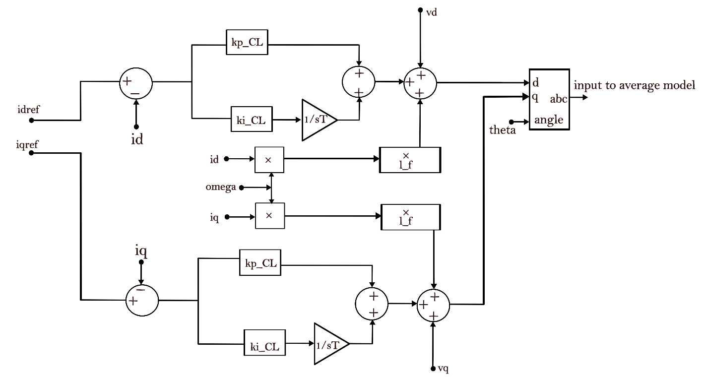
Methodology
Inner current control
This control loop regulates the converter’s output current, enabling rapid and precise tracking so that the actual current closely follows the reference value. See Fig9.
Fig.9 Inner current control
End-Semester Evaluation Maloth Karthikeya 8

Slide 9
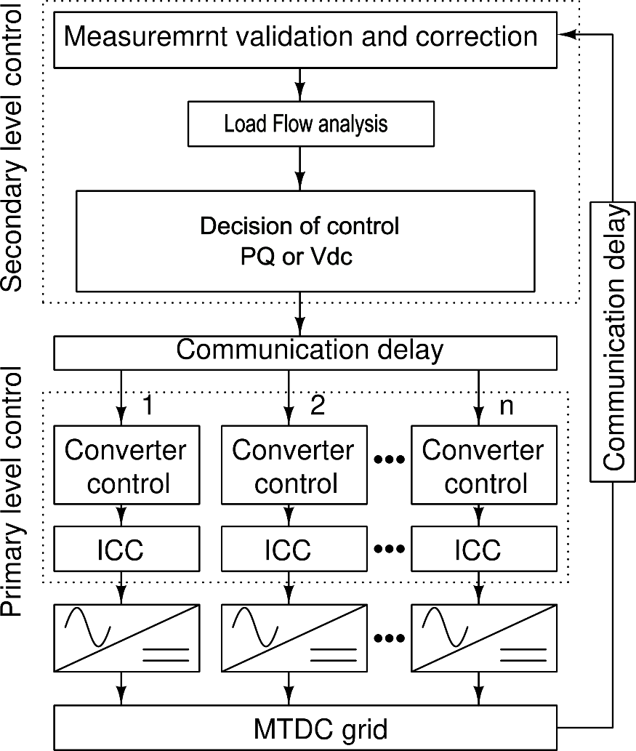
Methodology
Load flow analysis
Decision of Control mode
(PQ or Vdc)
Fig.10 Primary and secondary control flow diagram
End-Semester Evaluation Maloth Karthikeya 9

Slide 10
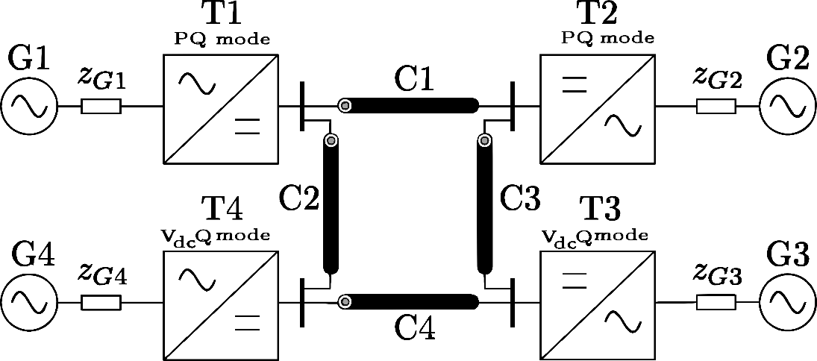
Methodology
Multi-terminal system with Modular multi-level converter(MMC)(Fig11).
Fig.11 Multi-terminal HVDC system
T1,2,3,4 are 4-MMCs in which 2 are in active reactive power control mode(PQ) and other two are in voltage control mode(VdcQ).
End-Semester Evaluation Maloth Karthikeya 10

Slide 11
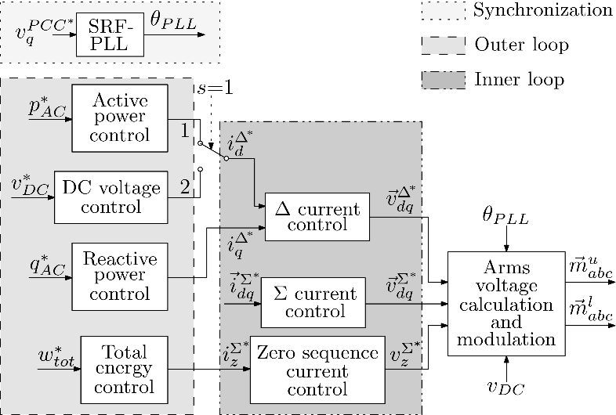
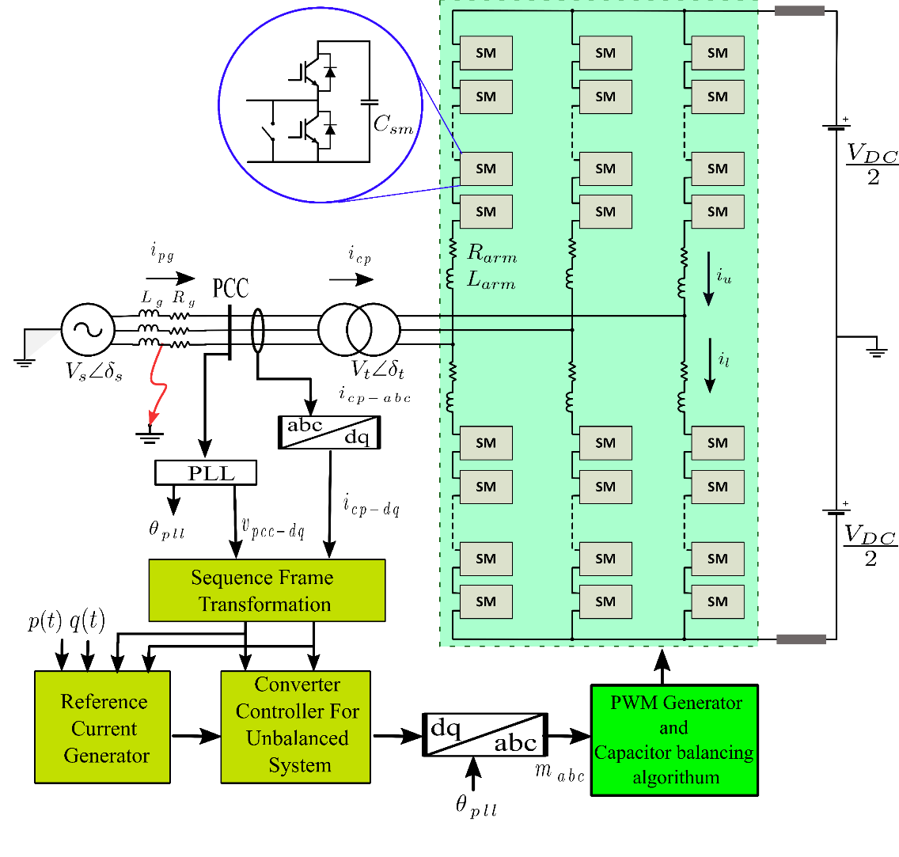
Methodology
Fig.13 Control Scheme of MMC
Follows same control architecture except it has submodules instead of one gate bridge like in VSC.
Fig.12 Structure of MMC
End-Semester Evaluation Maloth Karthikeya 11

Slide 12
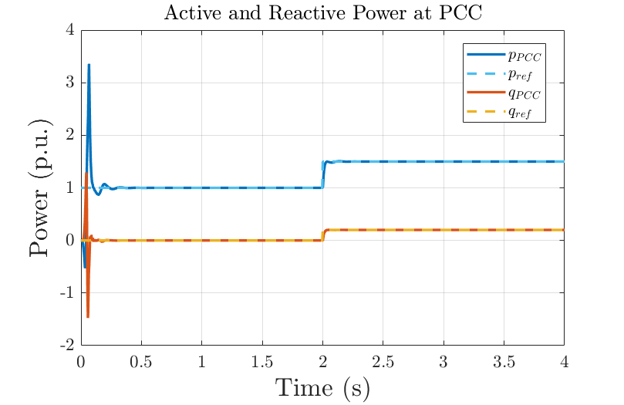
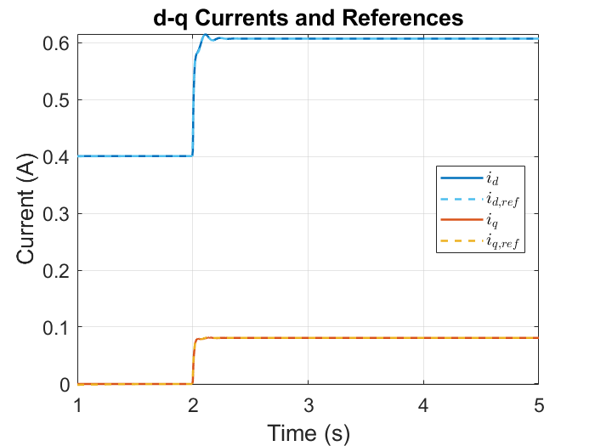
Results
In the PSCAD design of Grid Connected Converter, values of pref and qref are set to constant 1pu and 0pu up to 2-seconds then there is a step change of 1 to 1.5pu and 0 to 0.2pu from 2-seconds over simulation time, respectively.
See Fig.14 for power outputs at PCC. and Fig.15 below for the output waveforms of PCC currents id, iq and reference currents from active and reactive power control scheme idref, iqref follow each other.
Fig.14 PCC powers in PSCAD design
Fig.15 d-q currents and references
It is observed that Power outputs follow the inputs and actual currents accurately tracking reference currents.
End-Semester Evaluation Maloth Karthikeya 12

Slide 13
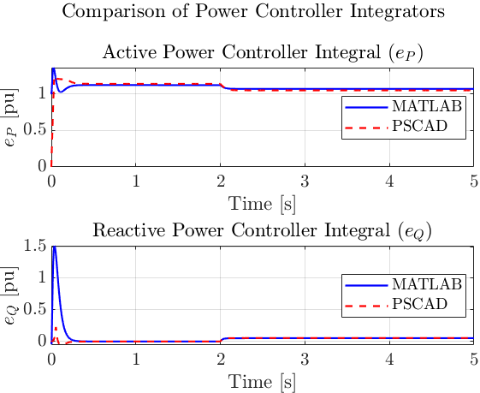
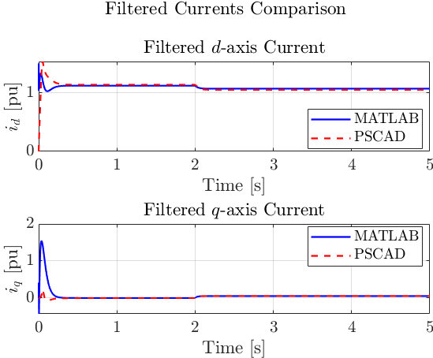
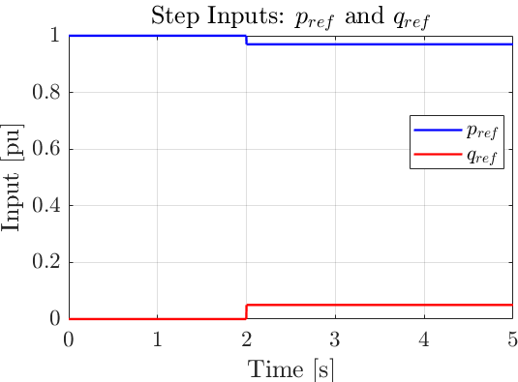
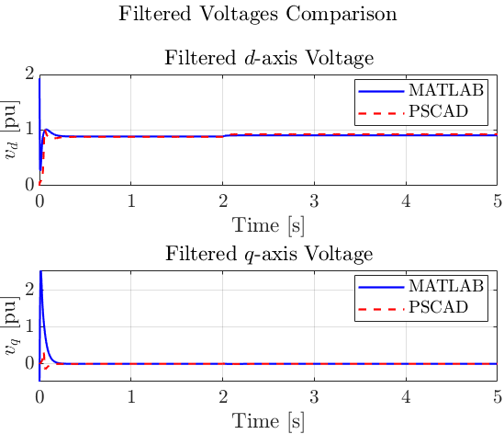
Results
Small-signal model MATLAB and PSCAD validation of the HVDC system
A small-signal linearized state-space model of the system is designed in MATLAB with the same parameters as in PSCAD design.
The outputs of Filtered currents, Filtered voltages and Power integrators are validated.
Fig.16 Inputs of Pref and Qref
Fig.17 Power control integrators
Fig.18 Filtered currents
It is observed that the results obtained from both the PSCAD
and MATLAB are accurately tracking each other.
This confirms that the both models are identical under specified parameters.
Fig.19 Filtered Voltages
End-Semester Evaluation Maloth Karthikeya 13

Slide 14
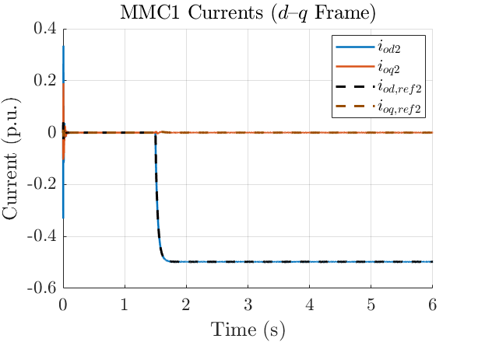
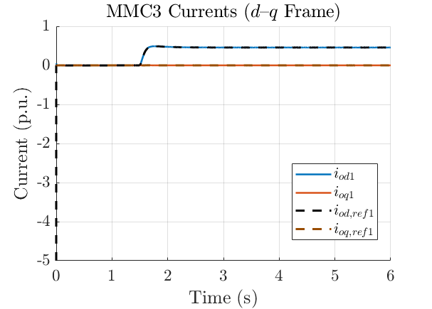
Results
Below are the MATLAB imported PSCAD simulation results of 4-terminal HVDC system.
Fig.20 Currents and reference currents in MMC1
Fig.21 Currents and reference currents in MMC3
Observe that the currents Iod,Ioq and reference currents Iodred,Ioqref follow each other in both the MMCs.
End-Semester Evaluation Maloth Karthikeya 14

Slide 15
Conclusions and Future scope
This project successfully designed and validated primary and secondary control structures for both VSC and MMC-based HVDC systems.
PSCAD simulations confirmed stable active/reactive power regulation, while MATLAB small signal model state-space models accurately matched the PSCAD responses.
The 4-terminal MMC-HVDC system demonstrated proper coordination between PQ-controlled and VdcQ-controlled terminals.
Overall, the work establishes a reliable modelling and control framework that improves the stability and flexibility of modern HVDC networks.
Research and future scope
There are many ideologies to develop from the design of HVDC systems.
Operating behavior of HVDC system
Interaction analysis involving HVDC converters and multi-terminal grids.
Small-Signal (Linearized) Stability Analysis
Frequency-domain stability analysis
State-space modelling.
End-Semester Evaluation Maloth Karthikeya 15

Slide 16


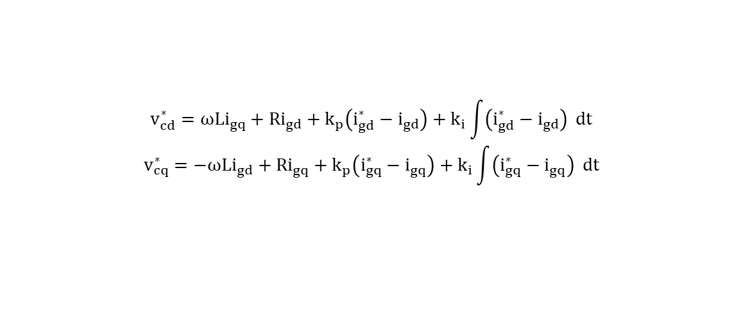

Appendix
Equations
abc-dq transformation
$$i_{dq0}=\left[\begin{matrix}cosθ & sinθ & 0 \\ −sinθ & cosθ & 0 \\ 0 & 0 & 1\end{matrix}\right].\frac{2}{3}.\left[\begin{matrix}1 & \frac{−1}{2} & \frac{−1}{2} \\ 0 & \frac{√3}{2} & \frac{−√3}{2} \\ \frac{1}{2} & \frac{1}{2} & \frac{1}{2}\end{matrix}\right].\left[\begin{matrix}ia \\ ib \\ ic\end{matrix}\right]$$
Three 3-phase time varying differential equations:
$${ L}_{c}\frac{d}{dt}i_{l,abc}=−R_{c}i_{l,abc}+V_{c,abc}−V_{o,abc}$$
$${ L}_{g}\frac{d}{dt}i_{o,abc}=−R_{g}i_{o,abc}+V_{o,abc}−V_{g,abc}$$
Three 2-phase time invariant differential equations :
$${ L}_{c}\frac{d}{dt}i_{l,dq}=−R_{c}i_{l,dq}+V_{c,dq}−V_{o,dq}±jωL_{c}i_{l,dq}$$
$${ L}_{g}\frac{d}{dt}i_{g,dq}=−R_{g}i_{g,dq}+V_{o,dq}−V_{g,dq}±jωL_{g}i_{g,dq}$$
Current control equations
$$v_{cd}^{∗}=ωLi_{gq}+Ri_{gd}+k_{p}\left(i_{gd}^{∗}−i_{gd}\right)+k_{i}\int{\left(i_{gd}^{∗}−i_{gd}\right)} dt$$
$$v_{cq}^{∗}=−ωLi_{gd}+Ri_{gq}+k_{p}\left(i_{gq}^{∗}−i_{gq}\right)+k_{i}\int{\left(i_{gq}^{∗}−i_{gq}\right)} dt$$
End-Semester Evaluation Maloth Karthikeya 16

Slide 17
Appendix
PLL
dvq_pll_dt = wf_PLL*(v_f(2) - vq_pll); % LPF the q-axis voltage
de_pll_dt = ki_pll*(0 - vq_pll); % PLL integrator
w_pll = kp_pll*(0 - vq_pll) + e_pll; % PLL frequency
dtheta_vsc_dt = wn*(w_pll - w); % Angular difference between frames
Power control loop
id_ref = kp_P*(p_ref - p_m) + e_P;
iq_ref = kp_Q*(q_ref - q_m) + e_Q; % Current references
Current control loop
de_CL_dt = ki_CL*(i_ref - i_f); % Integral action
vc_m = v_f + kp_CL*(i_ref - i_f) + e_CL + w_pll*l_f*Wpu*i_f; % PI + decoupling and FF
End-Semester Evaluation Maloth Karthikeya 17

