Slide 1
Data Storytelling & Statistical Validation
Data Analytics Internship – Final Presentation M.Karthikeya

Slide 2
agenda
• Business Objective
• Key Findings
• Dashboard Overview
• Hypothesis Testing
• Recommendations
• Conclusion

Slide 3
Objective
• Analyze customer billing and tipping behavior
• Identify trends from Tasks 1–3
• Present insights for business decisions
• Validate one key finding statistically

Slide 4
Key findings
• Higher bills resulted in higher tips
• Weekend revenue was highest
• Customer activity varied across days
• Dashboard KPIs highlighted major trends

Slide 5
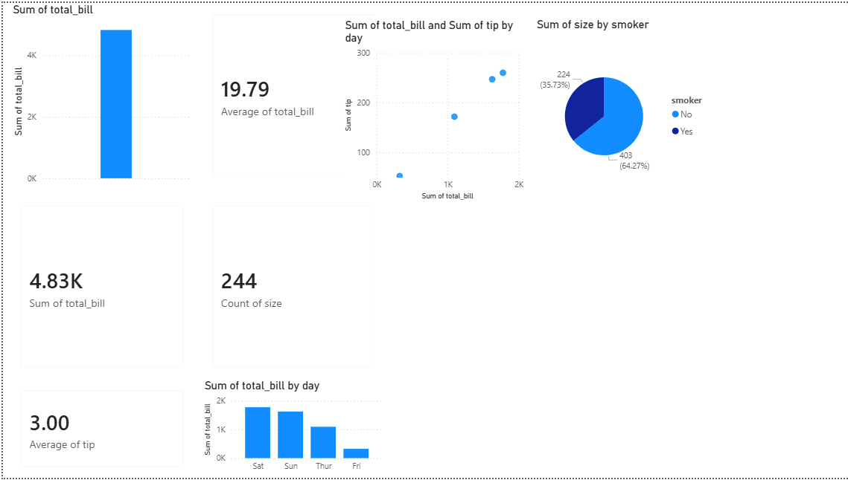
Interactive Dashboard Overview

Slide 6
HYPOTHESIS testing
Hypothesis:
Higher bill amounts lead to higher tips
Observation:
Positive relationship found
Conclusion:
Customers with larger bills generally tipped more

Slide 7
BUSINESS RECOMMENDATION
• Focus promotions on high-revenue days • Improve low-traffic day engagement • Monitor customer segments • Use dashboards for regular KPI tracking

Slide 8
CONCLUSION
• Analysis identified useful customer trends • Dashboard supported decision-making • Business insights were validated • Internship tasks improved practical analytics skills

Slide 9
Thank You Data Analytics Internship Maddipati Karthikeya

