Slide 1

CrimeReview CS 4 - March 25, 2025
Analysis of crime data for October 2024. This presentation covers data cleaning, visualization, and trend identification.

Slide 2

Data Loading and Preview
1
Load Dataset
2
Display Data
Loaded crime review dataset using pandas.
Previewed the first few rows of the dataset.

Slide 3
Missing Values Handling
Check for Missing Values
Handle Missing Values
Identified missing values in each column.
Filled missing 'Minor Head' values with 'Unknown'.

Slide 4

Data Type Conversion
Check Data Types
Convert Data Types
Verified data types of all columns.
Ensured crime count columns are integers.

Slide 5
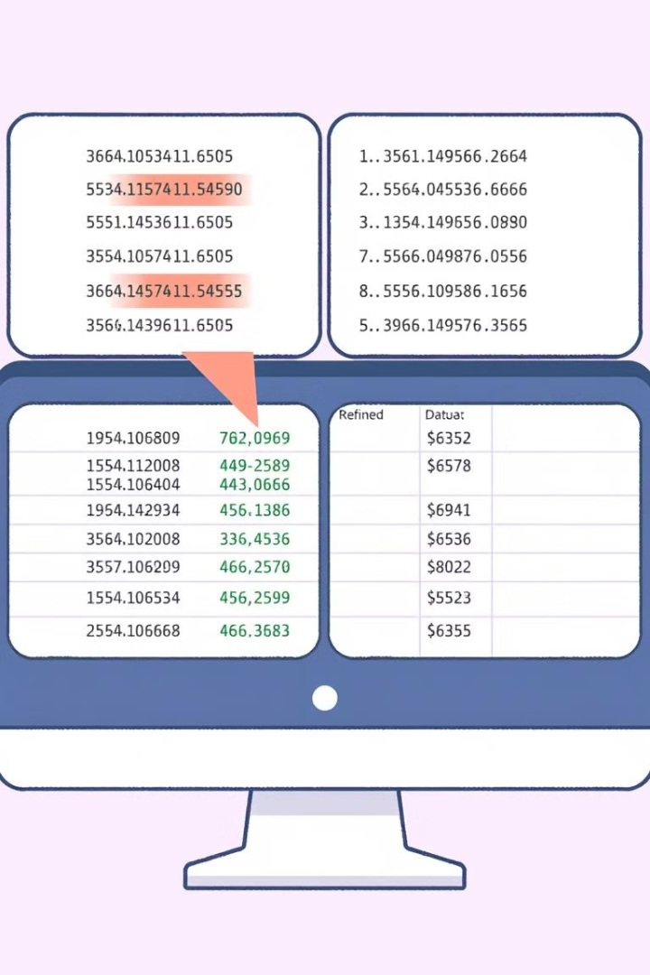


Column Removal and Duplicates
Column Removal
Duplicate Handling
Removed unnecessary columns.
Checked and removed duplicate rows.

Slide 6

Summary Statistics
Numerical Columns
Generated summary statistics.

Slide 7
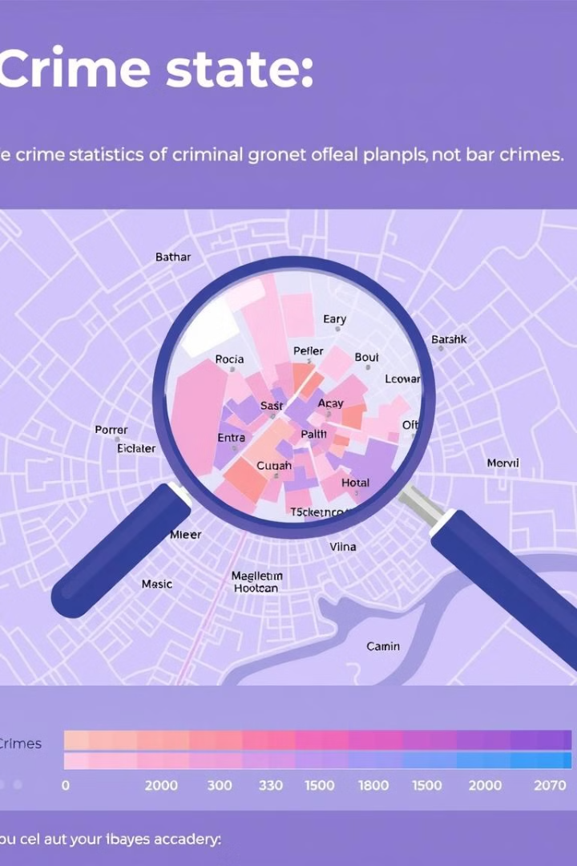


Crime Data Visualization
Time Periods
Summed crimes for each period.
Bar Chart
Visualized crimes over time.

Slide 8
Top 10 Crimes Analysis
Sort Data
1
Sorted by current month crimes.
Horizontal Bar Chart
2
Visualized top 10 crimes.

