Slide 1

Chocolate Sales Analysis
A data-driven deep dive into global chocolate sales — uncovering top brands, best-performing markets, and seasonal trends to boost supply chain and distribution strategy.
SQL · EDA · KAGGLE DATASET

Slide 2

Project Overview
Objective
Monitor and optimize a multi-country chocolate supply chain by analyzing sales data — tracking brands, products, countries, and revenue to enhance distribution and boost sales.
Dataset
500 transactions · 9 columns · sourced from Kaggle. Covers Brand, Product Type, Country, Sales Channel, Payment Method, Units Sold, Price, and Revenue.

Slide 3

Approach & Methodology
Data Preprocessing
Descriptive & Diagnostic
SQL Setup & EDA
Clean and standardize data in Excel
Analyze Revenue, Units, and Price
Import to SQL and explore key parameters
After preprocessing in Excel, a SQL database was created, data imported, and key parameters — Revenue, Units Sold, and Average Price — were analyzed across Brand, Product Type, Country, and Month.

Slide 4

Country-Wise Performance
🥇 France
$89,956.88 revenue · 6,410 units · 58 transactions
🔻 USA
$54,082.88 revenue · 4,358 units · 43 transactions

Slide 5
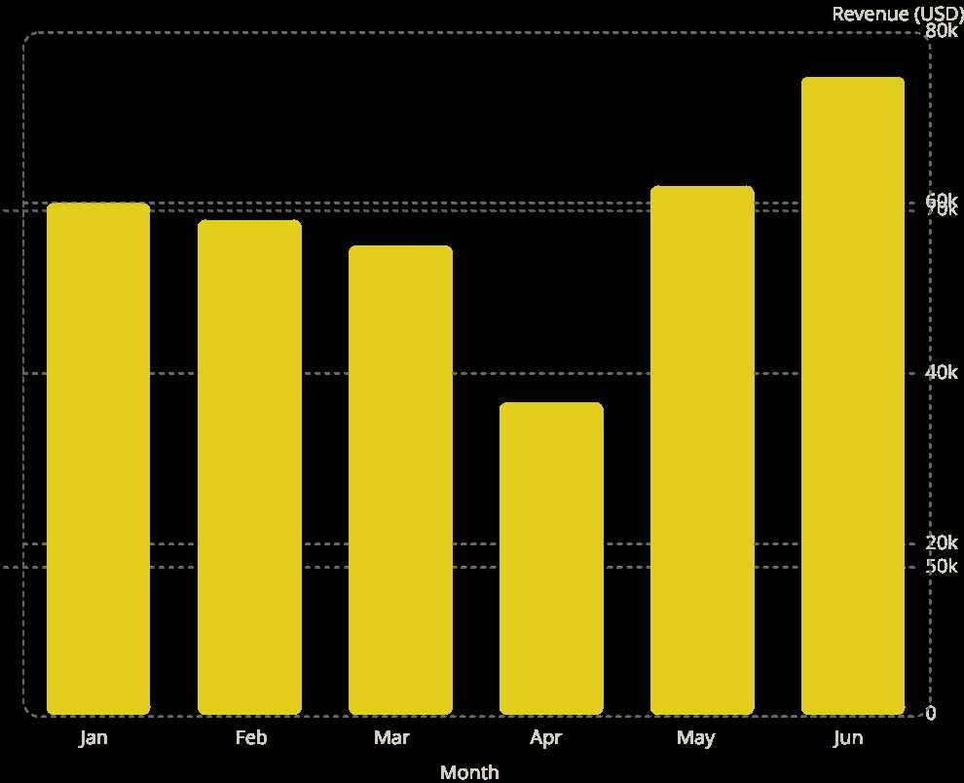
Monthly Sales Trends
Peak Month: June
74.8k
Revenue of $74,794.70 — driven by high volume (4,865 units) and the second-highest average price of $15.37.
Lowest Month: April
60k
58k
62k
Only $36,590.68 — just 28 transactions and 2,719 units sold, the fewest of any month.
55k
36.6k

Slide 6

Brand Performance
🏆 Top Brand: Toblerone
Highest revenue at $118,291.29
📉 Lowest Brand: Hershey
Lowest revenue at $91,088.73

Slide 7
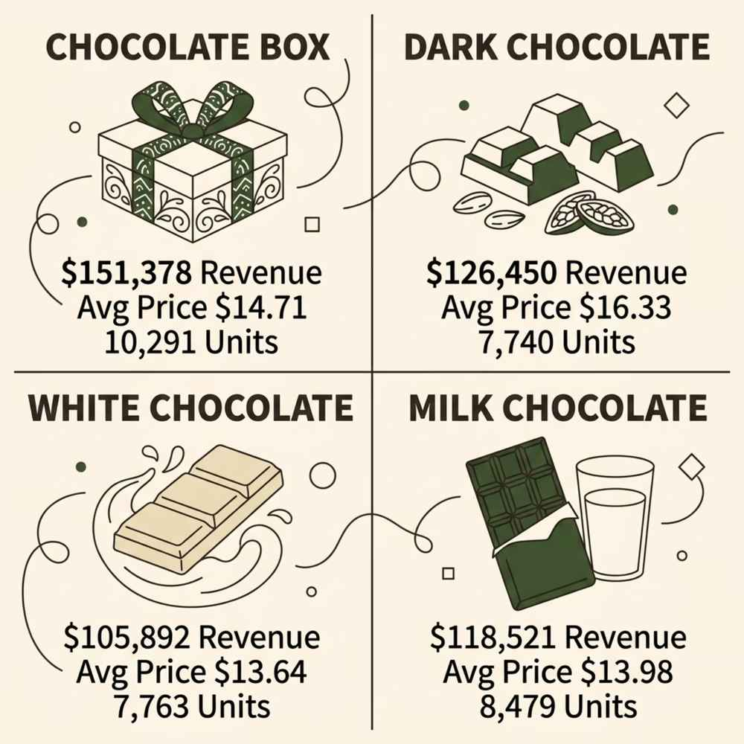

Product Type Performance
Best Performer: Chocolate Box
Revenue of $151,378.86 — highest average price ($14.71) combined with the most units sold (10,291).
Lowest Performer: White Chocolate
Revenue of $105,892.55 — second fewest units (7,763) and lowest average price ($13.64) dragged it below Dark Chocolate.

Slide 8
Key Findings at a Glance
$89.9K
$74.8K
France Revenue
June Revenue
Top country by sales
Best performing month
$118.3K
$151.4K
Toblerone
Chocolate Box
Highest brand revenue
Top product type

Slide 9

Root Cause Insights
April Slump
June Surge
Only 28 transactions and 2,719 units — the lowest volume of any month caused the revenue dip.
High volume (4,865 units) + second-highest avg price ($15.37) = peak revenue month.
France Leads
USA Lags
58 transactions and 6,410 units — more than any other country, despite a slightly lower avg price.
Only 43 transactions and 4,358 units — lowest engagement across all markets.

Slide 10

Conclusion & Takeaways
Focus on High-Volume Markets
Prioritize France and replicate its transaction volume strategy in underperforming markets like the USA.
Boost April Campaigns
Low transactions in April signal a need for targeted promotions to stimulate demand.
Double Down on Chocolate Boxes
The highest revenue product — expand distribution and visibility across all channels.

