Slide 1

IBM Employee Attrition Analysis
A data-driven diagnostic study of workforce attrition patterns — identifying who is leaving, when, and why — to enable targeted retention strategies.
WORKFORCE ANALYTICS
1,470 RECORDS
KAGGLE DATASET

Slide 2
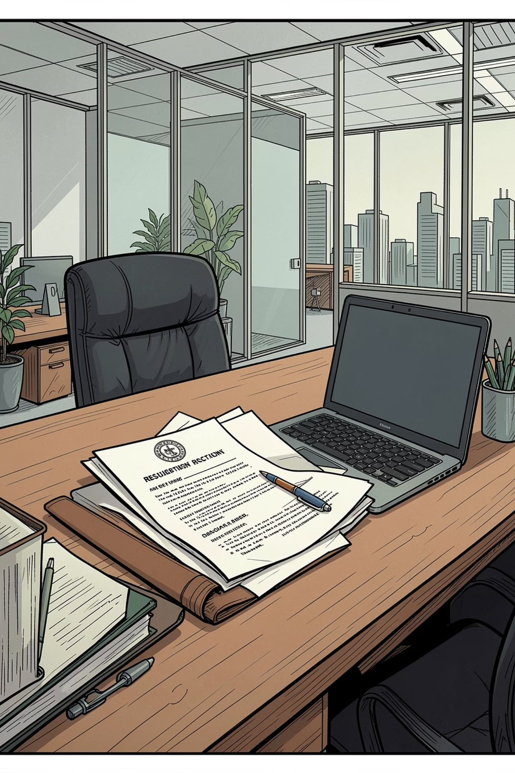
The Business Problem
~16% Attrition Rate
237 Employees Left
Approximately 16% of IBM employees experienced attrition during the analyzed period — a significant workforce loss requiring immediate attention.
Out of 1,470 records in the dataset, 237 employees exited — representing a critical impact on organizational stability and talent pipeline.
Core Objective
Identify key patterns, trends, and root causes of attrition through descriptive and diagnostic analysis to reduce costs and retain talent.

Slide 3

Dataset & Analytical Approach
Dataset Overview
1,470 records covering employee demographics, job details, compensation, and attrition status. Key variables include Age Category, Gender, Department, Job Level, Salary Hike, Overtime, Role Duration, and Environment Satisfaction.
Methodology
01
02
Preprocessing
SQL Setup
Data cleaning in Excel
IBM_Attrition database created
03
04
Descriptive Analysis
Diagnostic Analysis
Who, When & Why
Root cause investigation

Slide 4
Descriptive Analysis: Who Is Leaving?
63.29%
82.28%
56.12%
Male Employees
Basic Job Level
R&D Department
150 out of 237 attritions
195 out of 237 attritions
133 out of 237 attritions
Young employees showed the highest attrition by age category. Male employees, those at Basic Job Level, and R&D department staff represent the most affected segments — pointing to systemic issues at the junior level.

Slide 5

Descriptive Analysis: When & Why They Leave
⏱ When Are They Leaving?
💰 Why Are They Leaving?
77.22% of attrited employees had a Short Role Duration (≤4 years) — 183 out of 237. Employees are exiting early in their tenure, before reaching mid-level roles.
Poor Salary Hike — 84%
Overtime — 53.59%
200 out of 237 received hikes below 20% — the dominant driver across all segments.
127 out of 237 attrited employees were working overtime.

Slide 6




Diagnostic Analysis: Root Cause Framework
Diagnostic analysis investigated how and why attrition occurred by cross-analyzing multiple conditions. Three key parameters guided the investigation:
Attrition Count
Attrition %
Number of employees who left under specific conditions
Percentage of attrited employees meeting a condition
Cross-Analysis
Combining multiple conditions to identify concentration of attrition

Slide 7


Key Diagnostic Findings (Q1–Q4)
1
2
Poor Hike — 84% of Attrition
Overtime — 53.59%
104 of 200 poorly-hiked leavers also worked overtime. Compensation is the dominant root cause across all segments.
81% had Poor Hike and 85% were at Basic Job Level — a compounded burden making attrition nearly inevitable.
3
4
R&D — 56.12% of Attrition
Male Employees — 63.29%
87% of R&D leavers were Basic Level and 80% had Poor Hike — losing fresh technical talent.
85% had Poor Hike, 83% were Basic Level, 79% had Short Role Duration — triple stagnation.

Slide 8
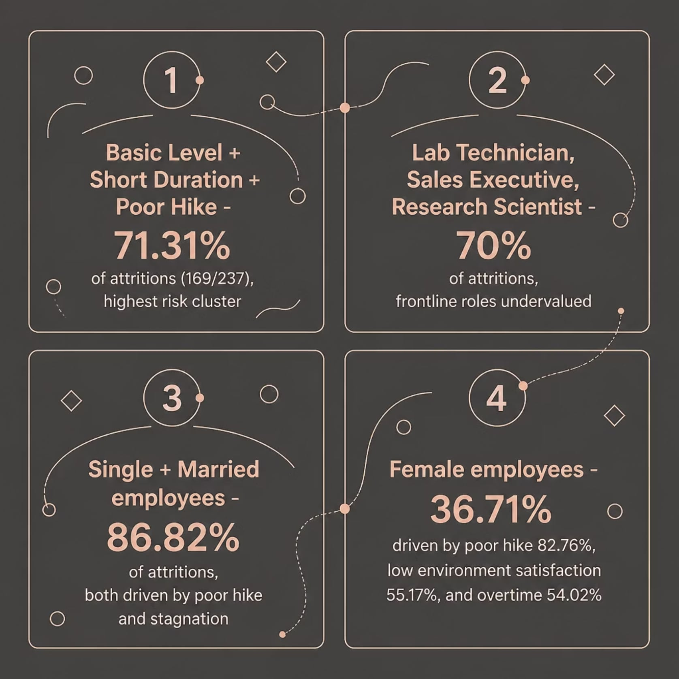
Key Diagnostic Findings (Q5–Q8)
Highest-Risk Clusters
Basic Level + Short Duration + Poor Hike is the most concentrated risk cluster — 169 out of 237 (71.31%) fall into this profile.
Three roles — Lab Technician, Sales Executive, Research Scientist — contribute 70% of attrition, reflecting systemic undervaluation of frontline roles.
Female attrition uniquely involves environment satisfaction (55.17%) and overtime (54.02%) beyond compensation — requiring targeted workplace improvements.

Slide 9


Diagnostic Summary: The Core Drivers
Poor Compensation is Universal
84% of all attrition linked to Poor Hike — the single most actionable driver across every segment.
Junior + Overtime = Highest Vulnerability
Among overtime leavers, 81% were poorly compensated and 85% were Basic Level.
R&D Talent Pipeline at Risk
56% of attrition from R&D, with 87% at Basic Level — threatening innovation capacity.
Frontline Roles Systematically Undervalued
Lab Technician, Sales Executive, and Research Scientist roles account for 70% of exits.

Slide 10




Recommendations
Revise Salary Hike Policy
Regulate Junior Overtime
R&D Retention Strategy
Targeted Interventions
Department-specific pay band revision and accelerated promotion cycles for R&D roles.
Role-specific incentives for Lab Technician, Sales Executive, Research Scientist. Flexible work and mentoring for female employees. Upskilling for single employees; family benefits for married employees.
Introduce merit-based compensation with a minimum 20% hike threshold for performers.
Introduce overtime compensation, compensatory leave, or a formal cap for Basic Level employees.

