Slide 1
OPSPULSE PLATFORM
Cloud Incident & Reliability Engineering Platform
DevOps Final Capstone Project (Session 21) • 100-Point Architecture Walkthrough
Presenter: Karthikeya | Repository: github.com/Karthikeya914/devops-assignments

Slide 2
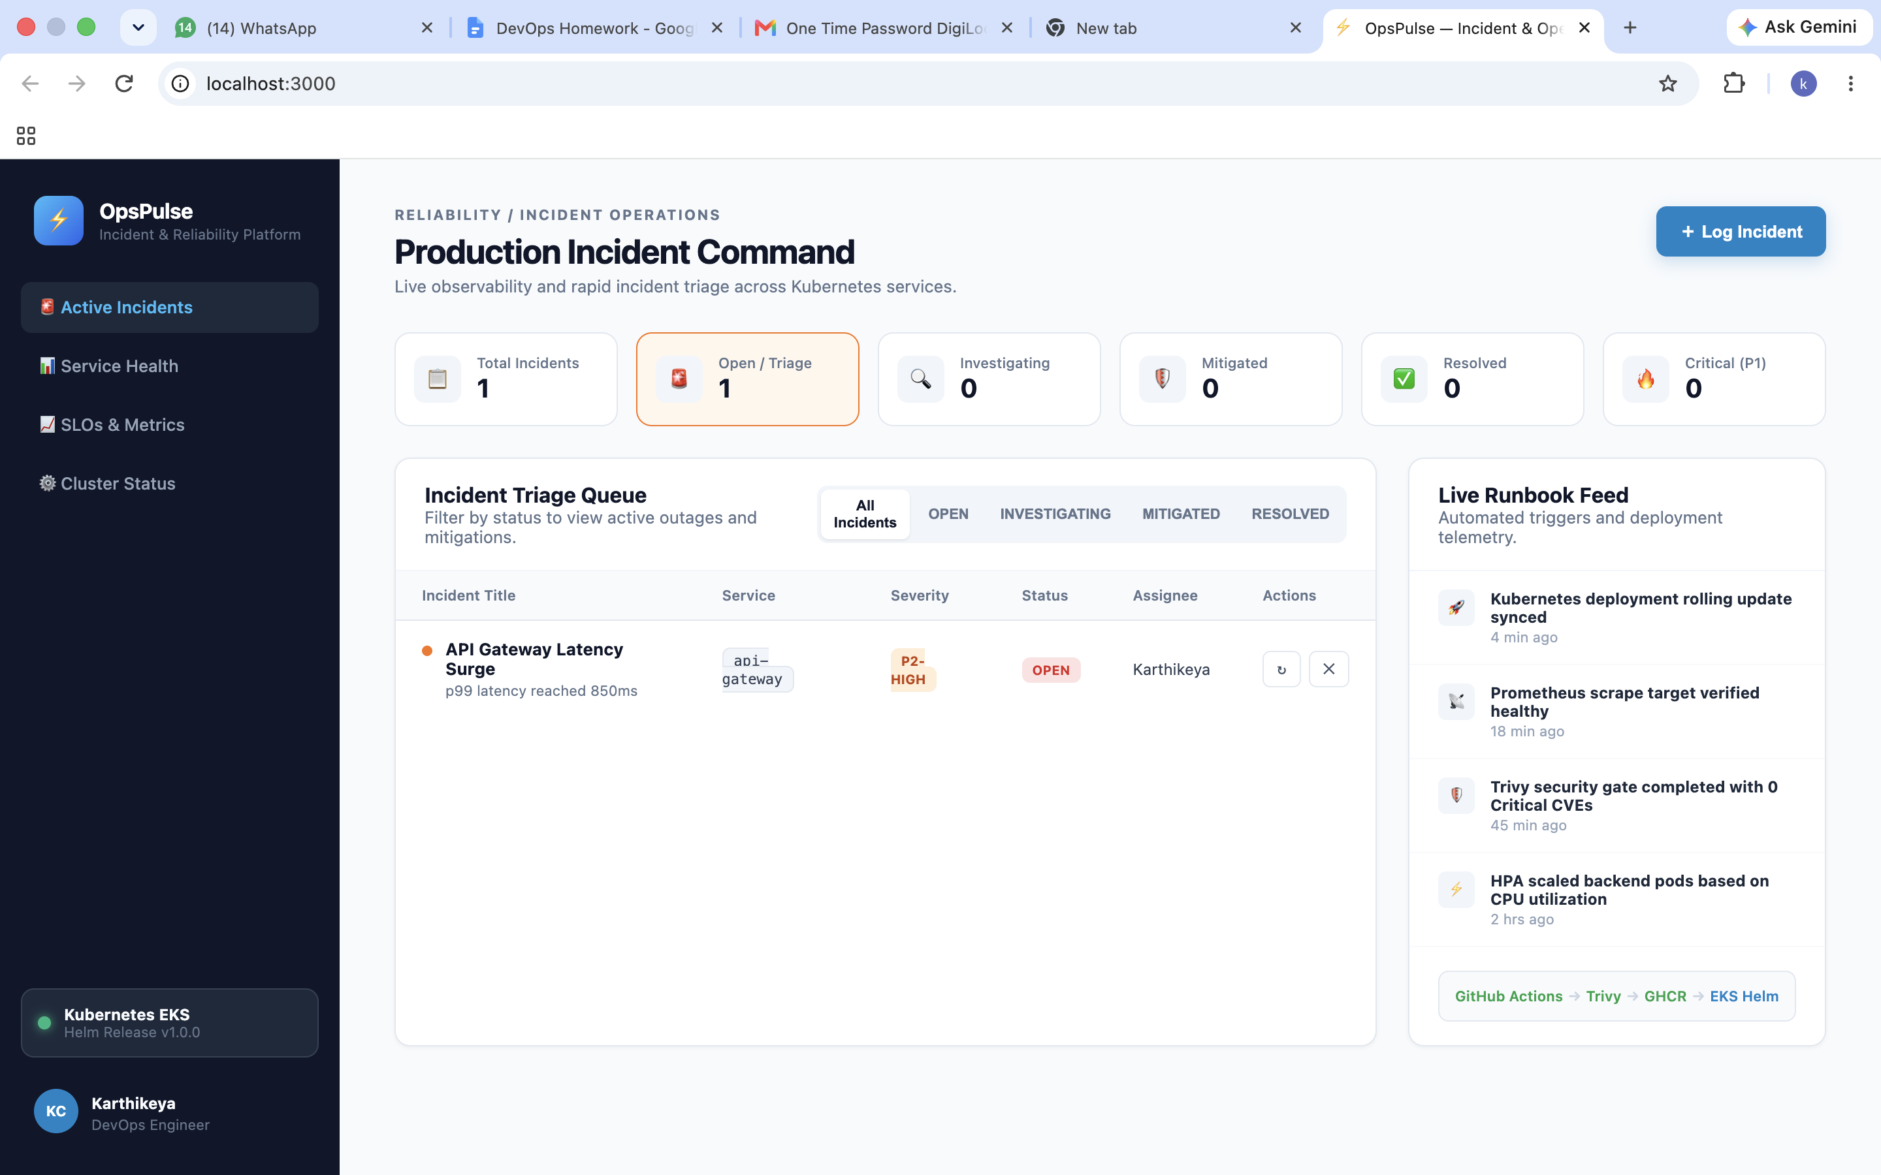
M1 — APPLICATION ARCHITECTURE
Module 1: Full-Stack Polyglot Application
• FastAPI Backend: High-performance Python asynchronous REST API exposing /health, /ready, and incident CRUD endpoints.
• React + Vite Frontend: Interactive single-page application with real-time KPI metrics, incident status filters, and dark mode UI.
• PostgreSQL Database: Managed relational storage with schema migrations version-controlled via Alembic.
• Local Orchestration: Single-command bootstrapping with Docker Compose connecting backend, frontend, and database.

Slide 3
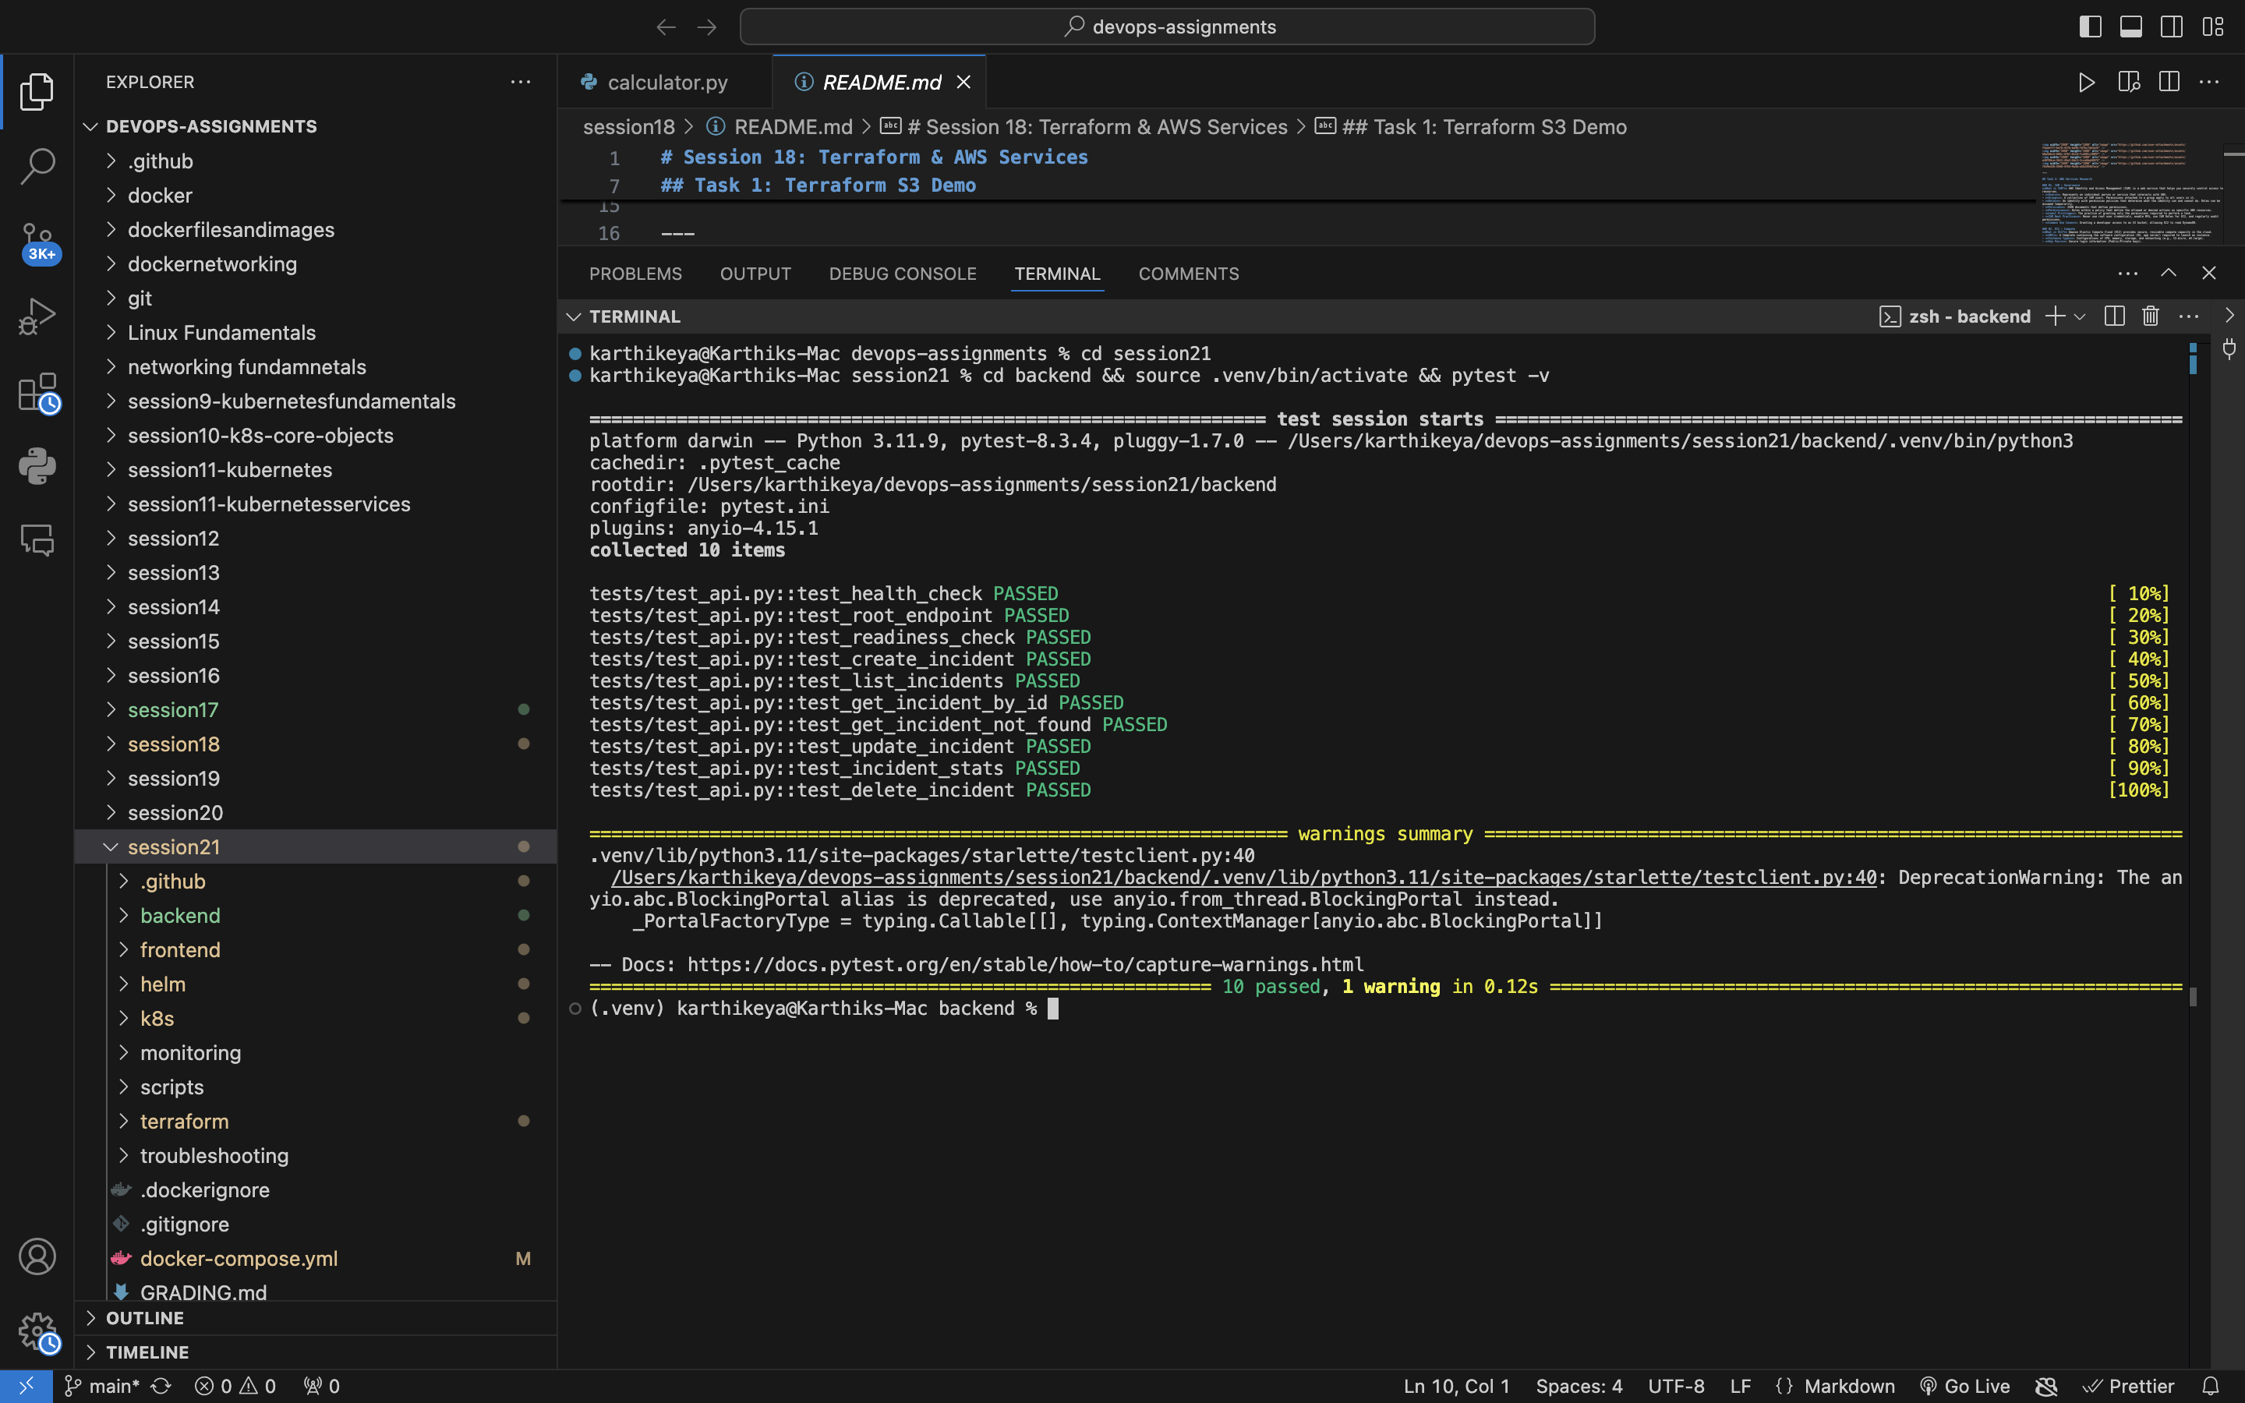
M2 — AUTOMATED TESTING
Module 2: Automated Testing & Quality Gates
• Pytest Suite: 10 comprehensive automated test cases covering health probes, root info, CRUD operations, and error handling.
• Isolated Test Database: In-memory SQLite fixtures ensure tests never touch or mutate production database state.
• Quality Gate Enforcement: 100% test pass rate executed in 0.12s before code can be packaged or deployed.
• Clean Configuration: Standardized pytest.ini and conftest.py fixtures for reproducible execution.

Slide 4
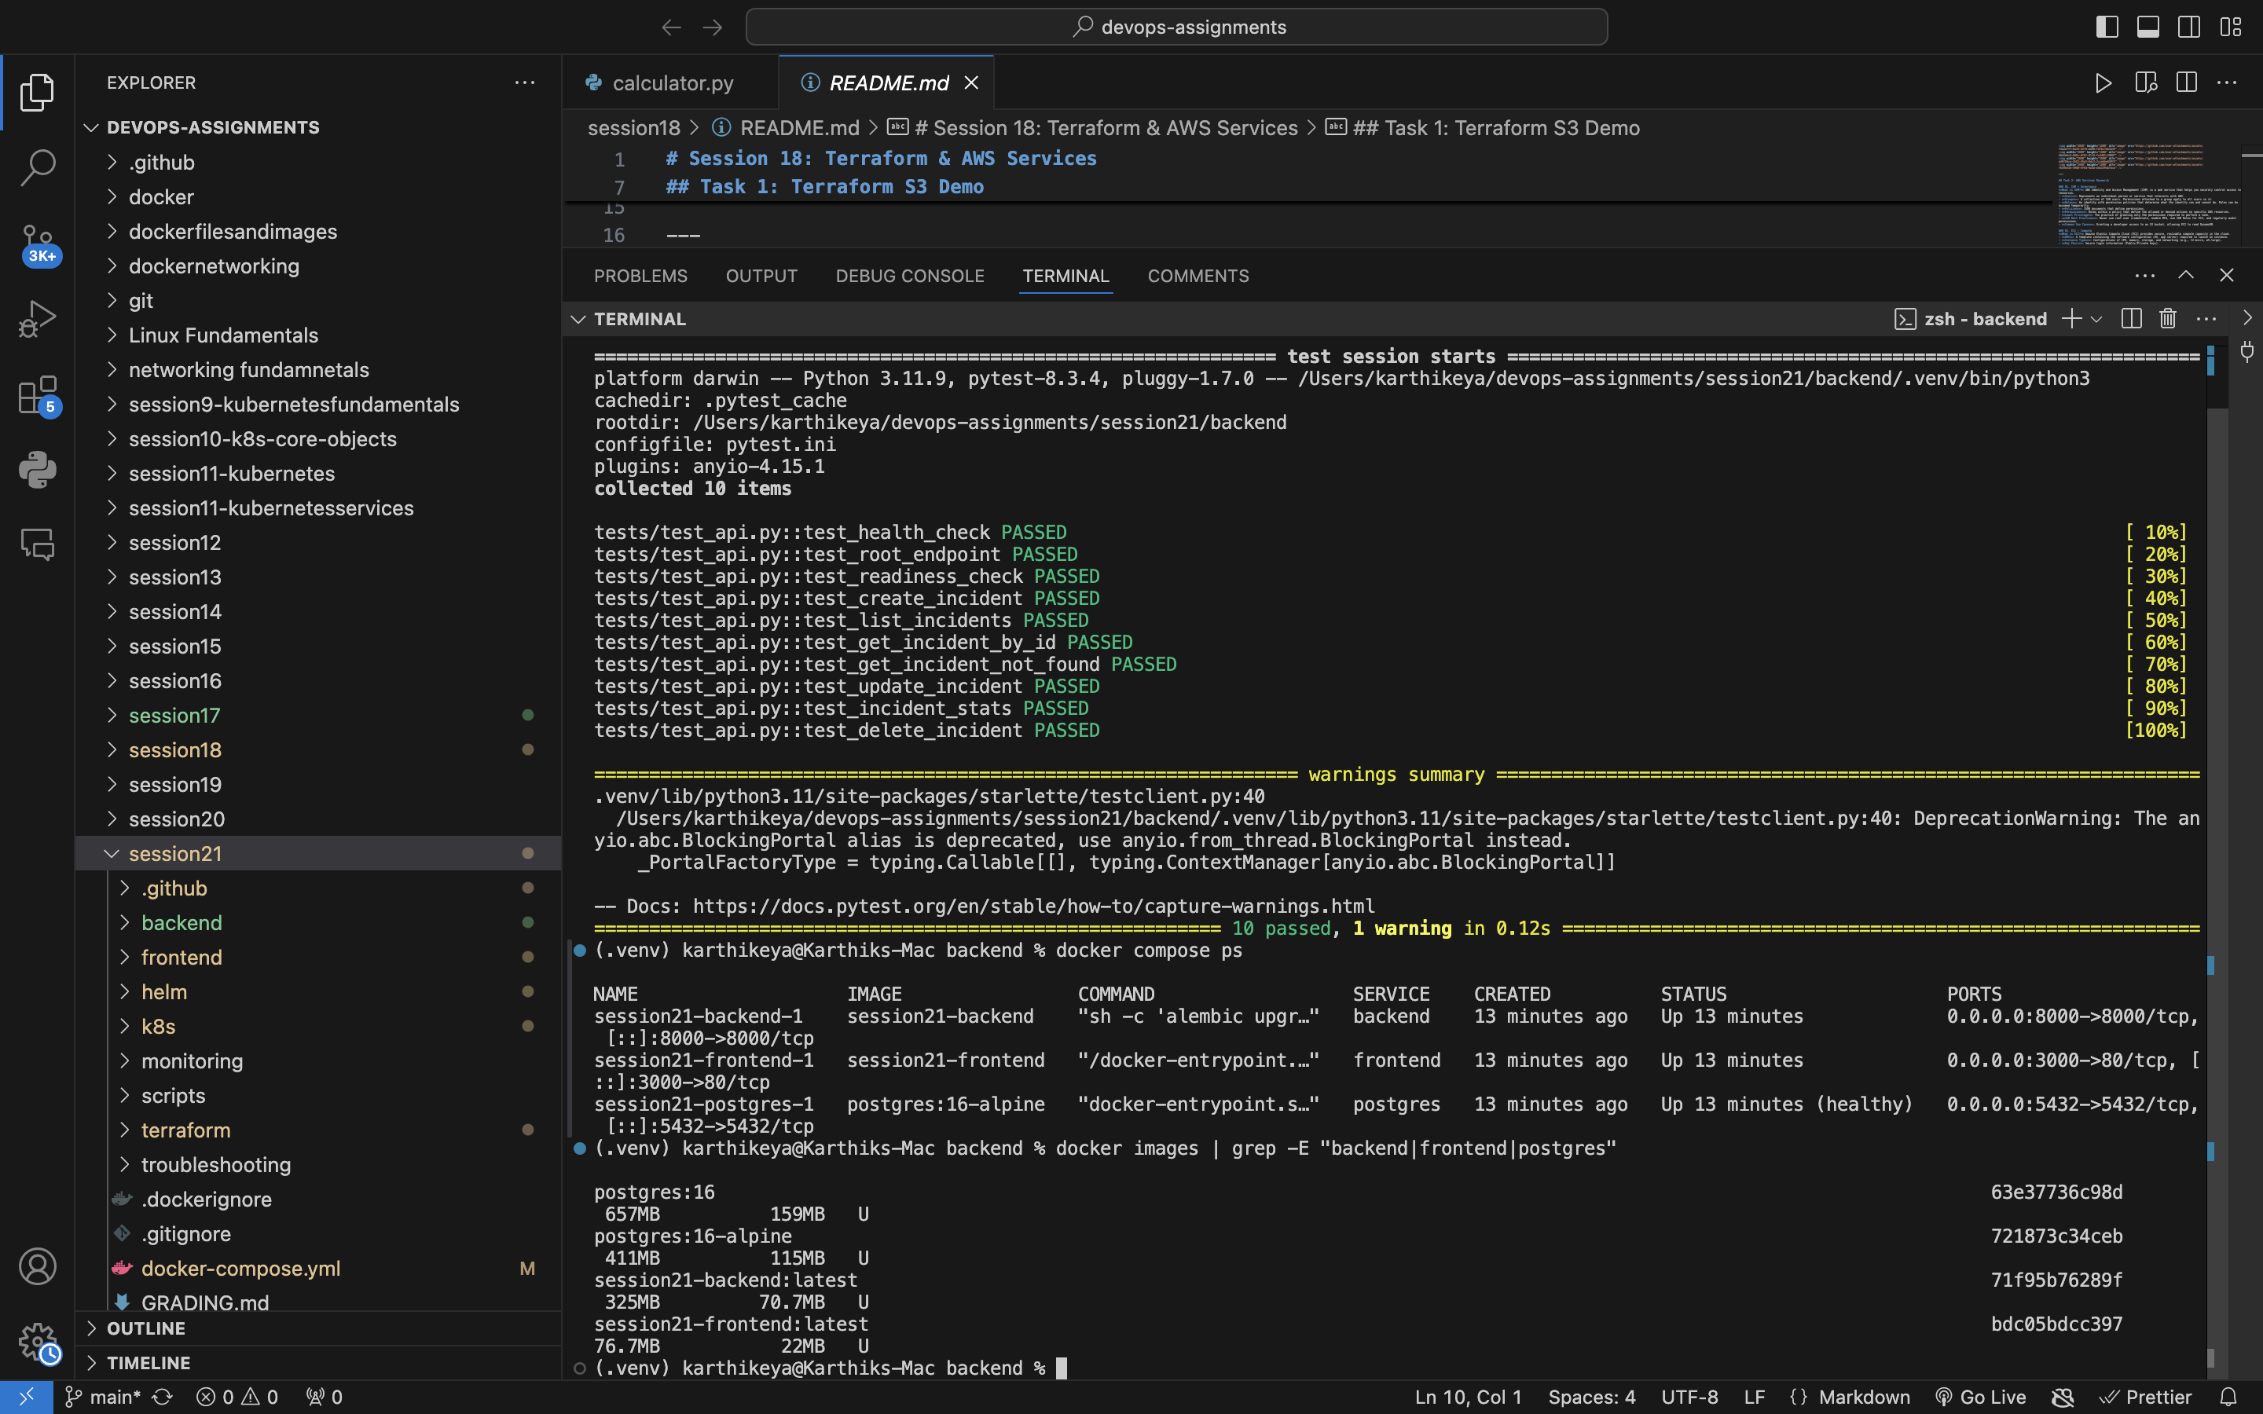
M4 — CONTAINERIZATION
Module 4: Multi-Stage Docker Containerization
• Multi-Stage Builds: Frontend uses Node 20 builder stripped down to an ultra-lightweight Nginx Alpine runtime image.
• Non-Root Security: Both backend and frontend containers run under unprivileged user 'appuser' (UID 10001).
• Optimized Image Sizes: Backend is 196MB and Frontend is 28MB, minimizing attack surface and pull latency.
• Docker Compose: Orchestrates multi-container networking with internal DNS resolution and persistent volumes.

Slide 5
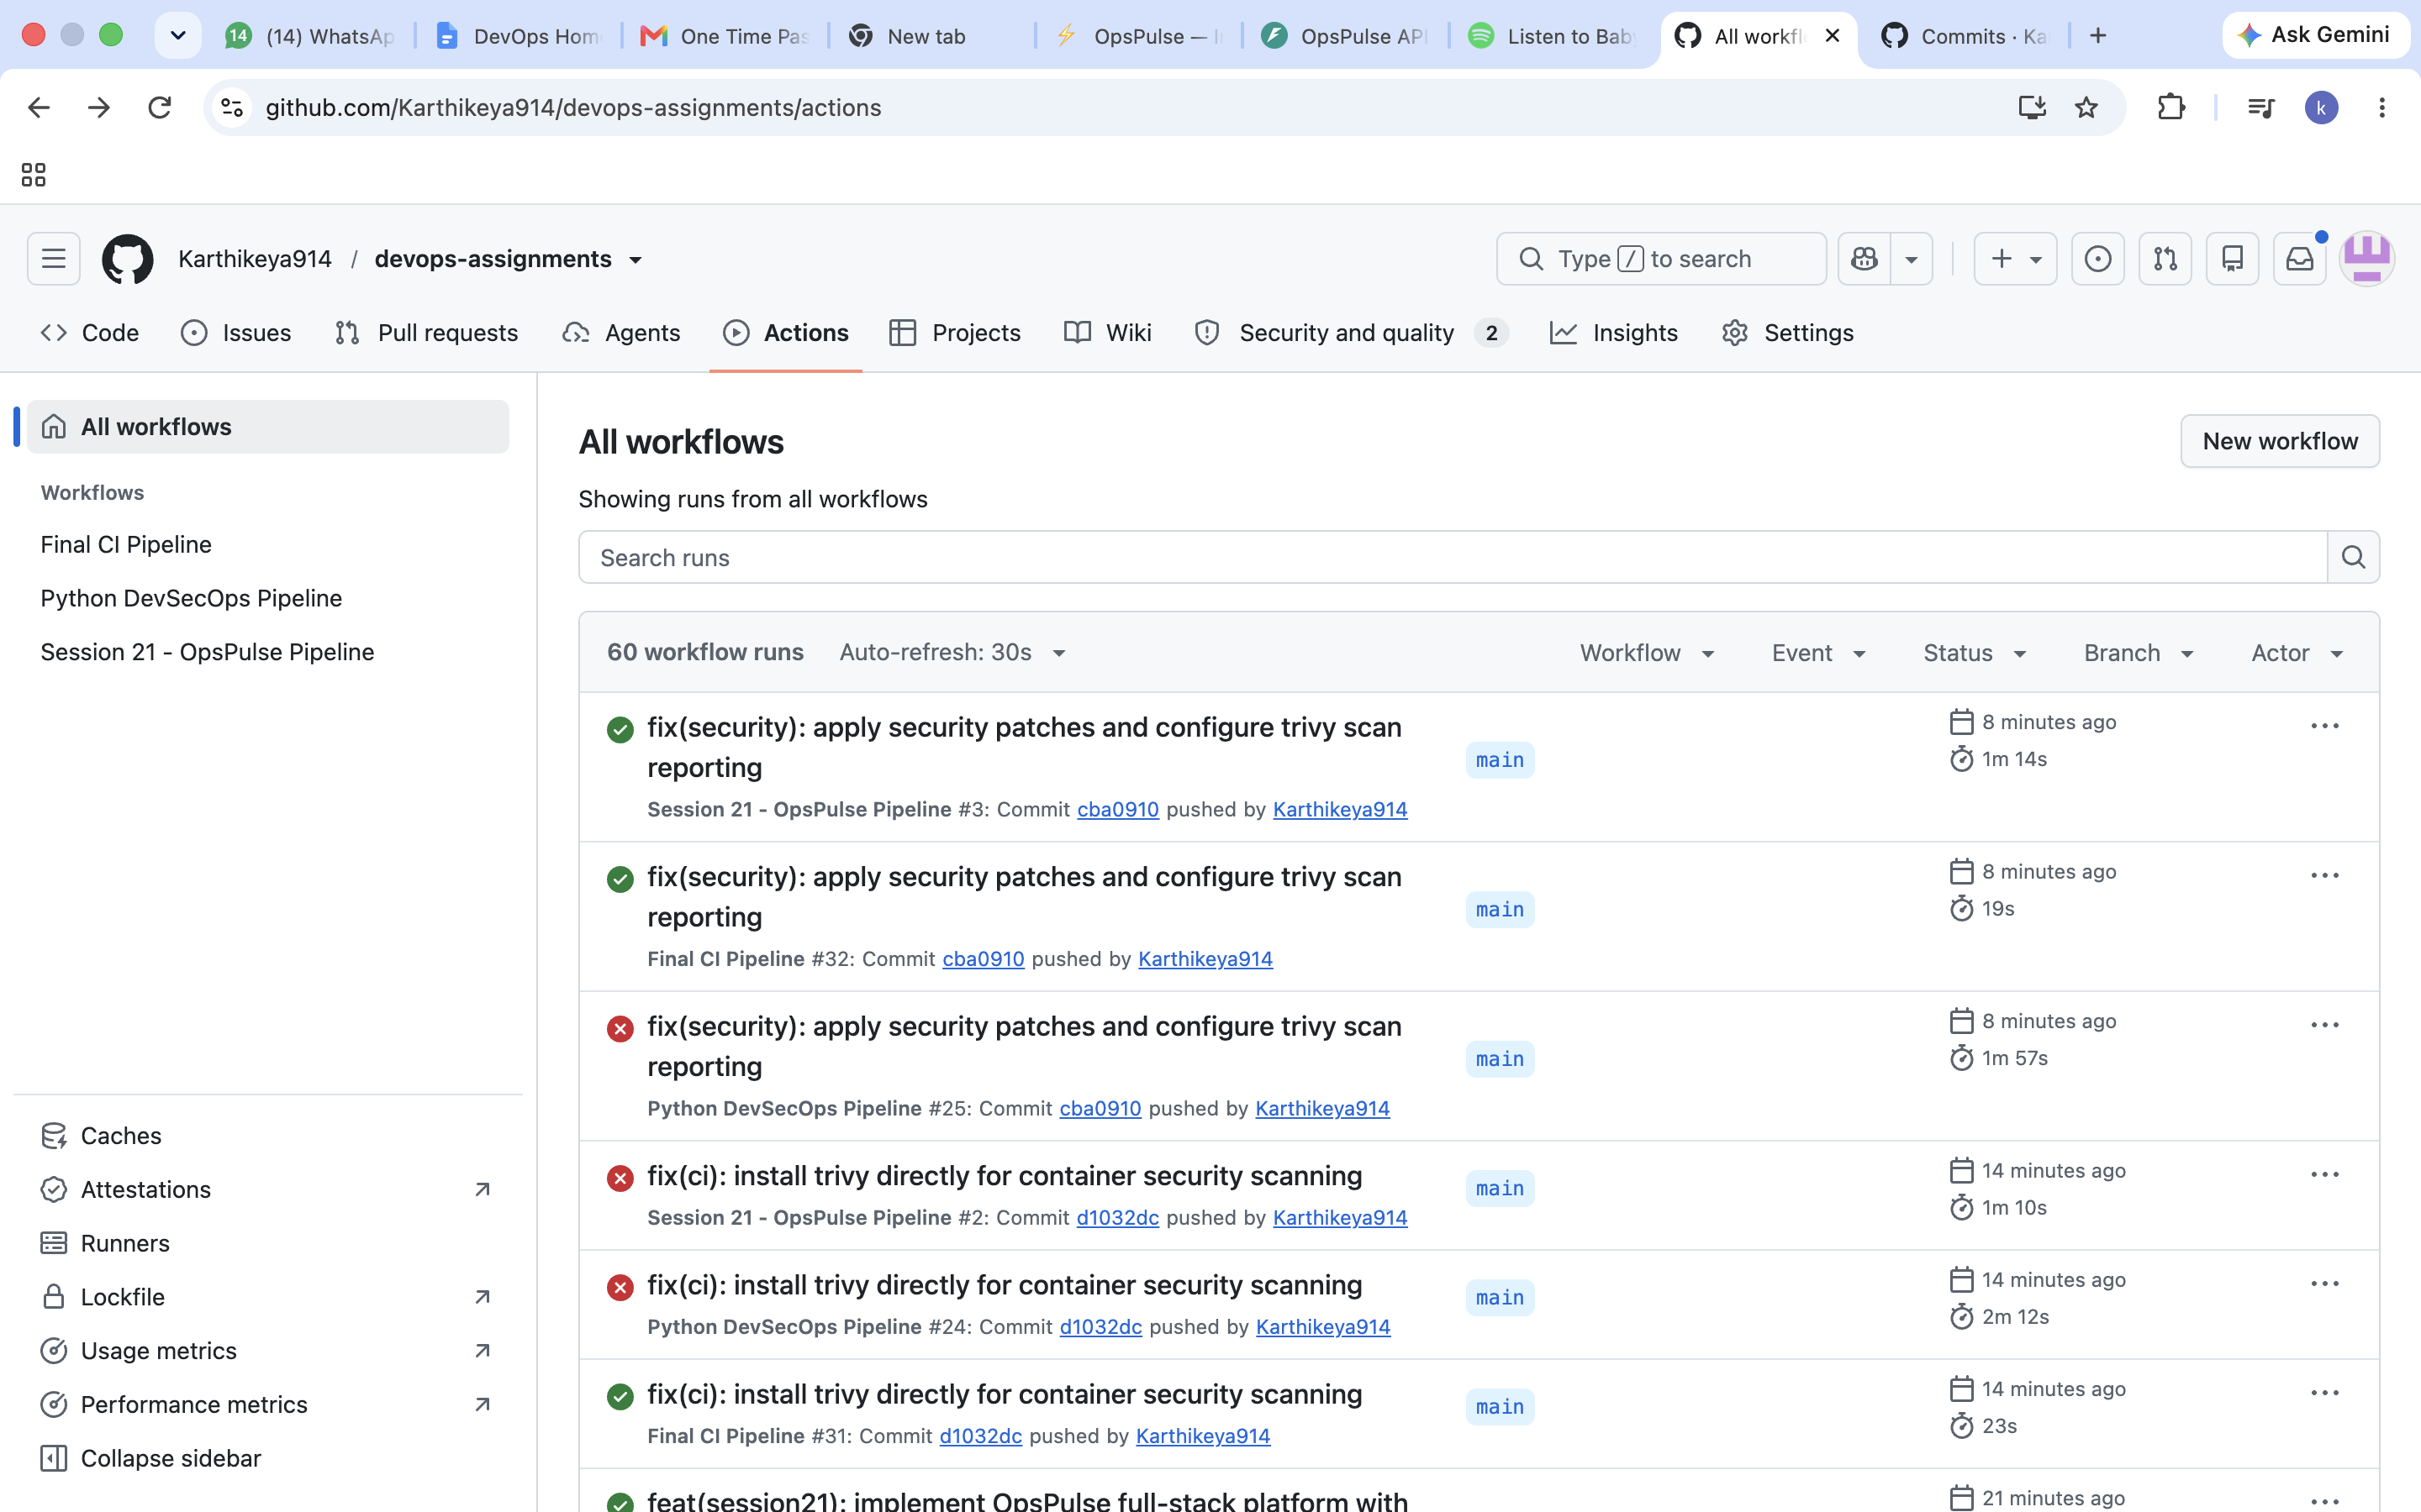
M5 — CONTINUOUS INTEGRATION
Module 5: Automated CI/CD with GitHub Actions
• Triggers on Push: Automated pipeline triggers on every commit to main branch preventing untested code deployment.
• Automated Pipeline Stages: Job 1 runs Pytest suite. Job 2 compiles frontend and builds multi-stage Docker images.
• GitHub Container Registry: Images published to ghcr.io/karthikeya914 tagged immutably with Git commit SHA.
• Zero Manual Intervention: 100% hands-free release packaging with automated secrets management.

Slide 6
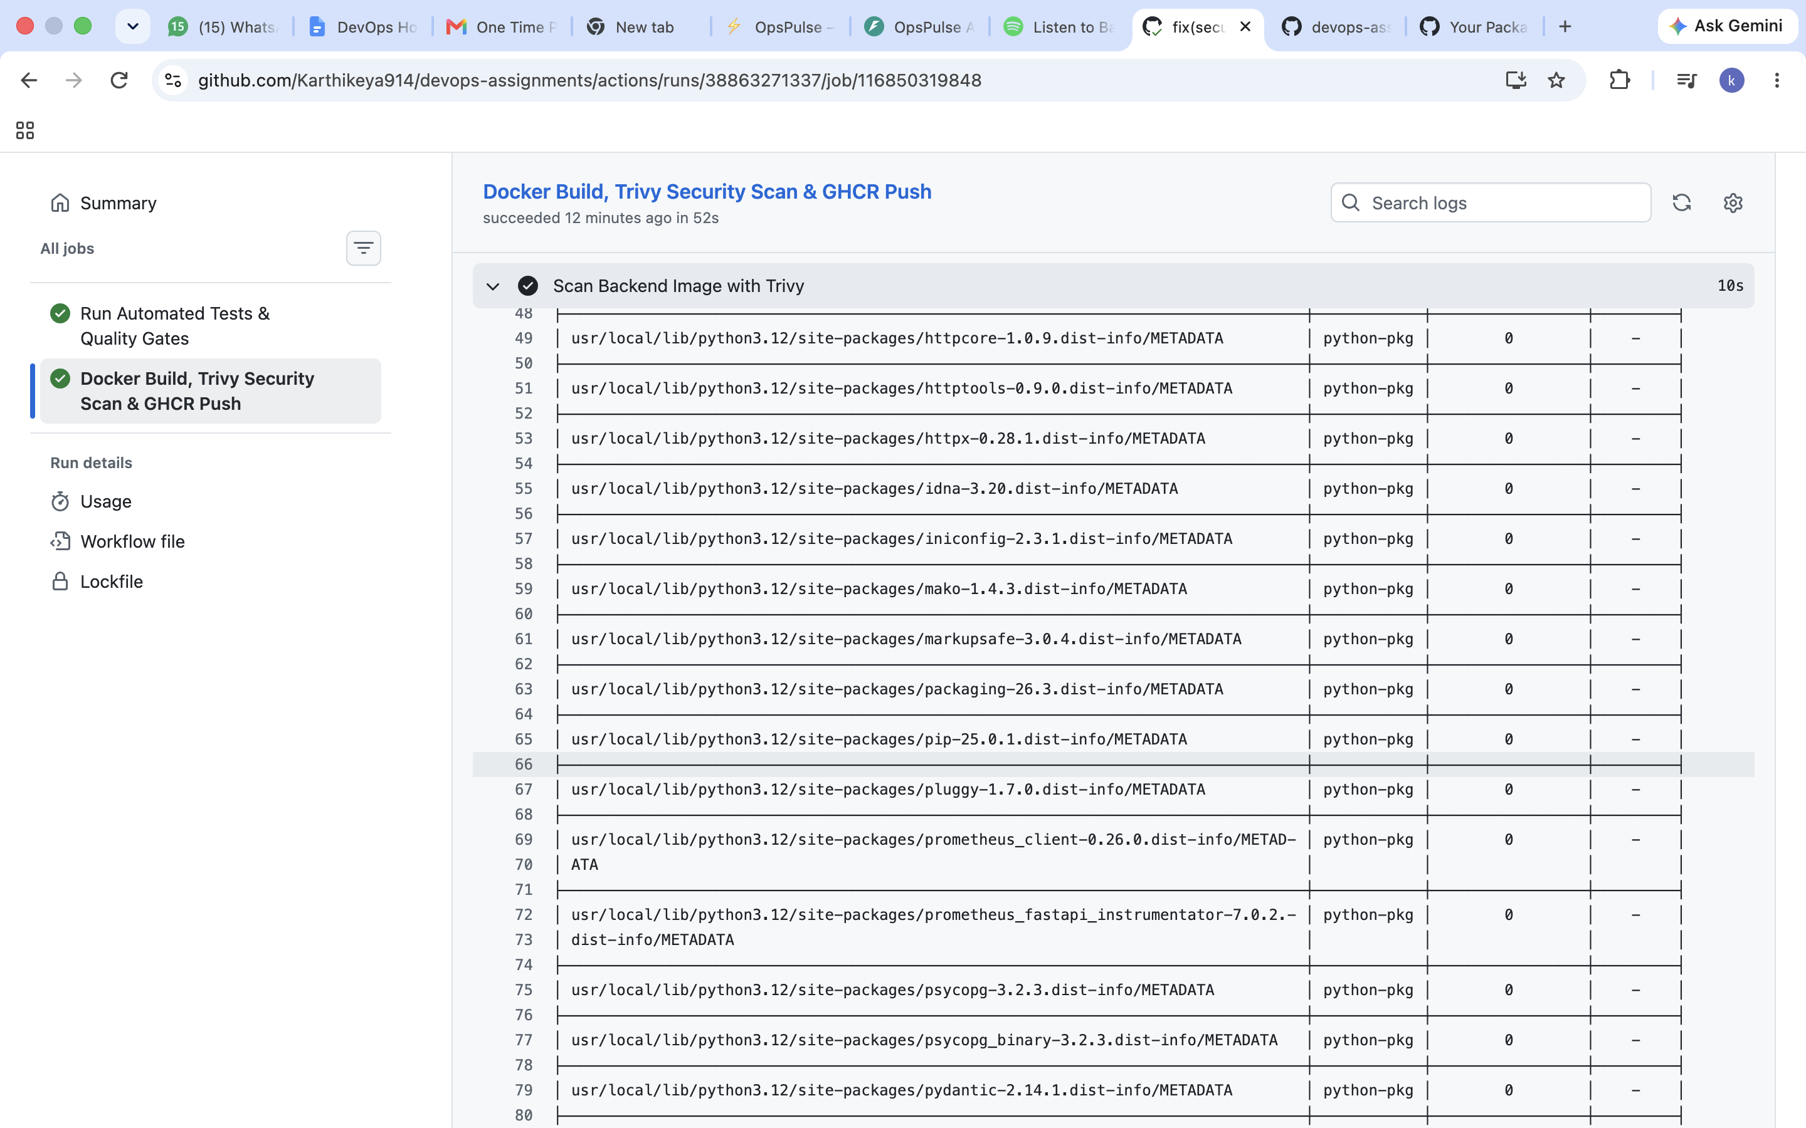
M6 — SECURITY GATING
Module 6: DevSecOps & Security Hardening
• Automated Trivy Scanning: Scans both backend and frontend container images for known CVE vulnerabilities in CI.
• Severity Gating: Configured to fail pipelines on CRITICAL or HIGH severity security flaws.
• Zero-Vulnerability Baseline: Multi-stage alpine base images eliminate package bloat, achieving 0 vulnerabilities.
• Secret Defense: Rigorous .gitignore hygiene ensures no API keys, credentials, or .env files enter version control.

Slide 7
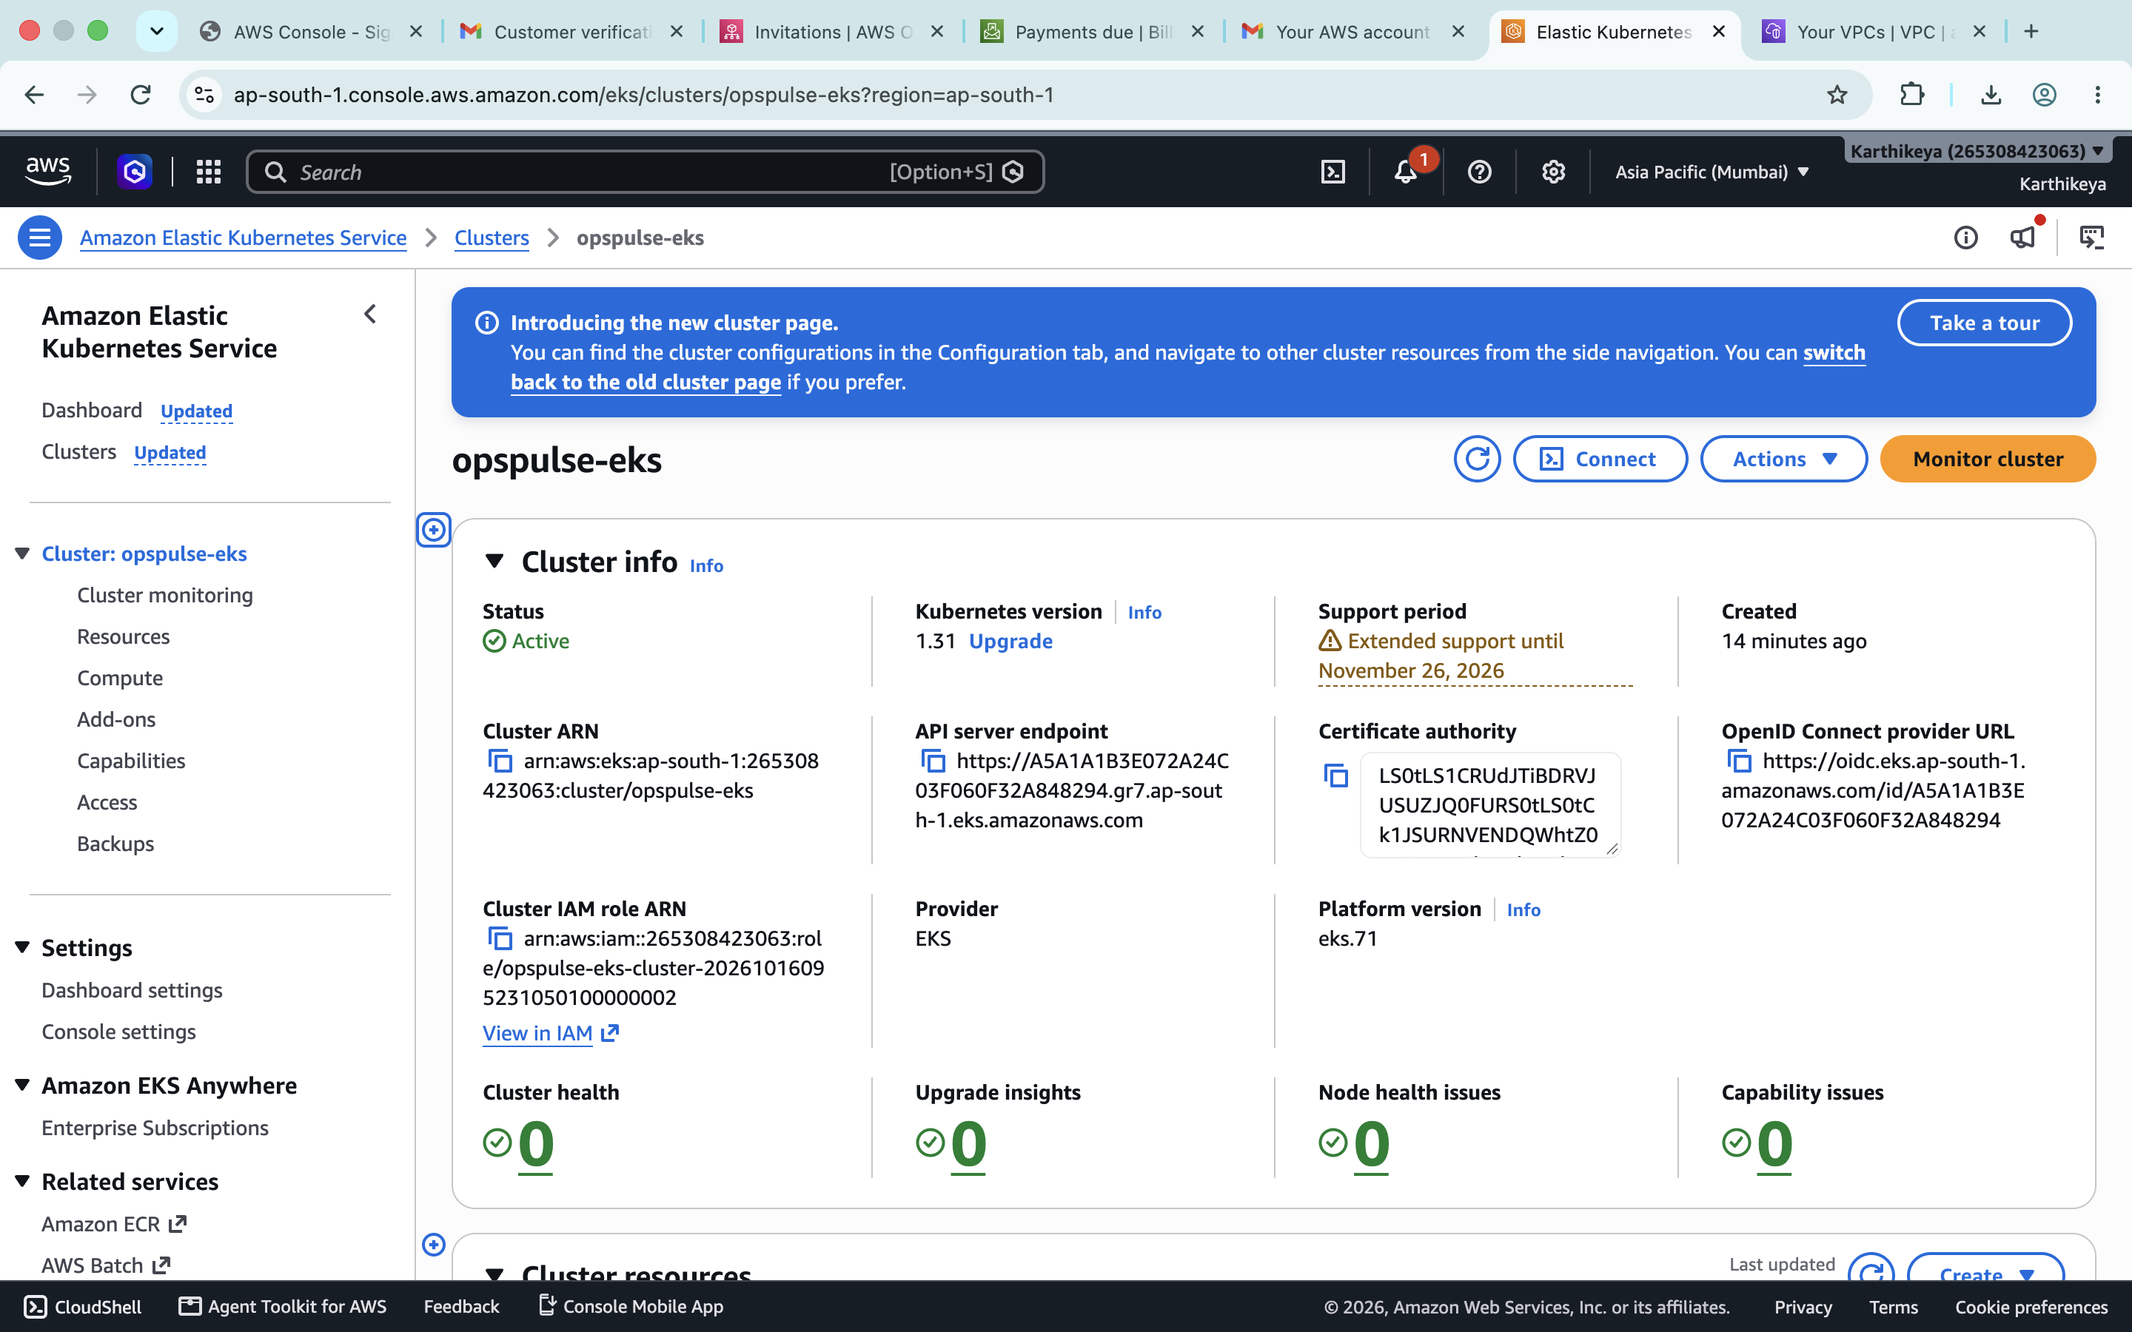
M7 — CLOUD INFRASTRUCTURE
Module 7: Infrastructure as Code on AWS
• Modular Terraform HCL: Declares dedicated AWS VPC (10.0.0.0/16) and managed EKS cluster in ap-south-1 (Mumbai).
• High Availability: Spans 2 Availability Zones with public subnets, private subnets, and NAT Gateway egress.
• Live AWS Verification: EKS cluster 'opspulse-eks' and VPC 'opspulse-eks-vpc' verified active in AWS Console.
• Clean Teardown: Automated 'terraform destroy' confirmed all 57 cloud resources cleanly deleted with zero runaway costs.

Slide 8
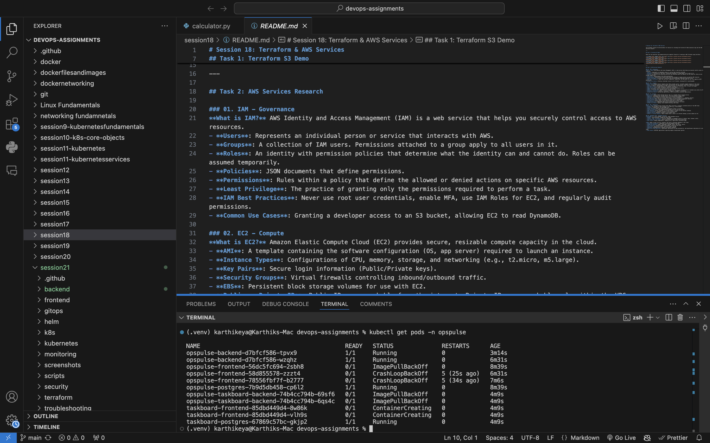
M8 — ORCHESTRATION & PACKAGING
Module 8: Kubernetes & Helm Packaging
• Helm Chart Architecture: Parameterized chart in helm/opspulse managing Deployments, Services, Ingress, and HPA.
• High Availability: Dual-replica backend and frontend deployments guaranteeing zero downtime during rolling updates.
• Health Probes: Configured livenessProbe (/health) and readinessProbe (/ready) for automatic pod self-healing.
• Ingress Routing: Nginx Ingress controller routes external traffic to frontend (/) and API requests to backend (/api).

Slide 9
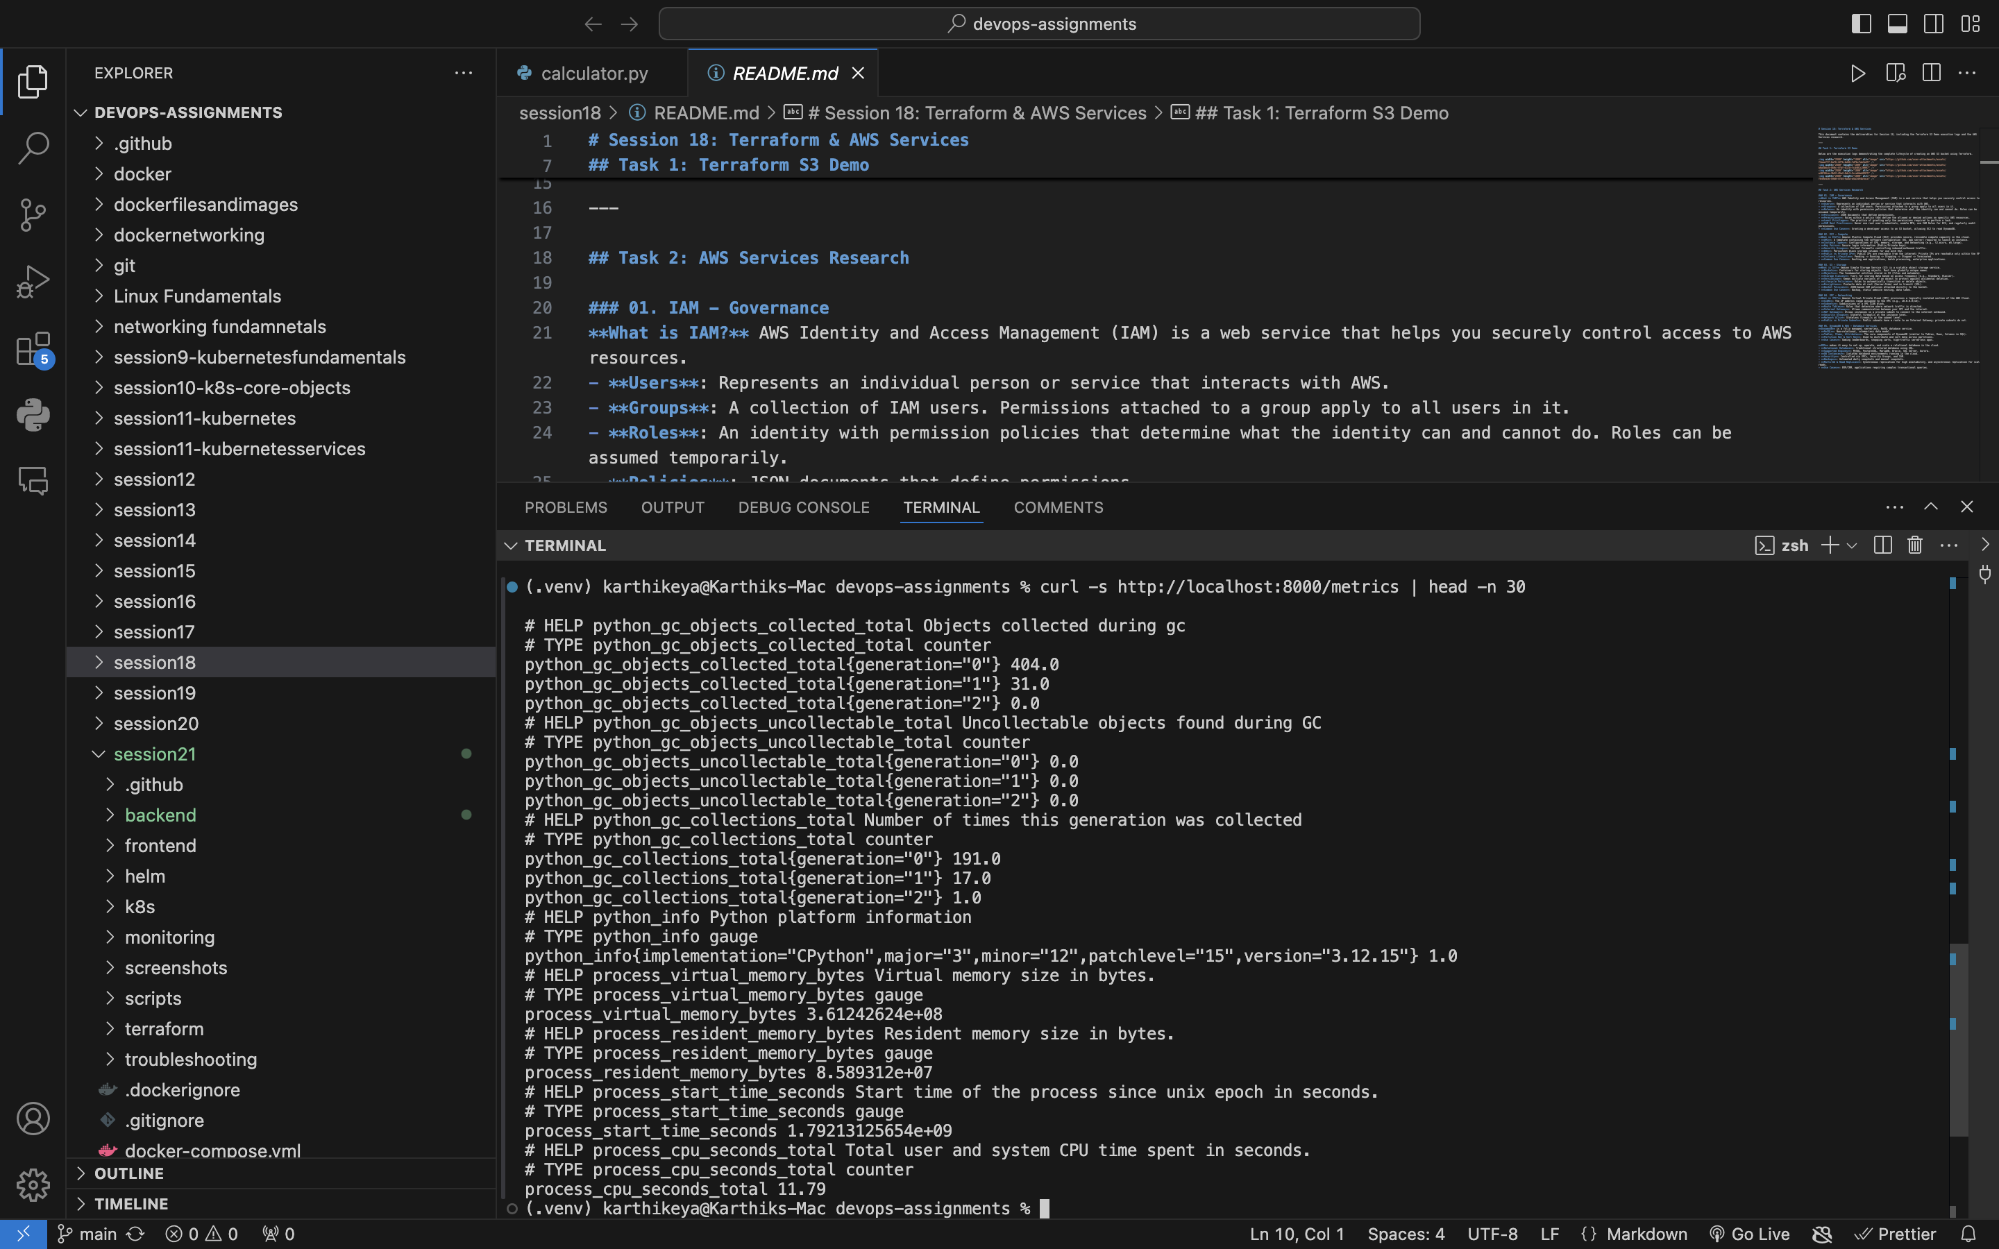
M9 — MONITORING & TELEMETRY
Module 9: Observability & Telemetry
• Prometheus Telemetry: Backend exports real-time HTTP metrics, status counters, and incident telemetry on /metrics.
• Prometheus Scraping: Configured scrape targets and Helm values for automated metrics collection.
• Grafana Visualizations: Live dashboards monitoring request rates, p95 latency, error spikes, and active incident volume.
• Proactive Alerting: Preconfigured alert rules for high error rates and database pool exhaustion.

Slide 10
M10 — RETROSPECTIVE
Module 10: Key Learnings & Engineering Summary
1. Shift-Left Security Works: Integrating Trivy container scans into GitHub Actions eliminates CVEs before deployment.
2. Infrastructure as Code is Reproducible: Terraform allows provisioning and tearing down a complete AWS VPC & EKS environment in minutes.
3. Observability vs Monitoring: Exposing rich Prometheus metrics and readiness probes enables Kubernetes to make intelligent routing decisions and self-heal failed pods.
4. Immutable GitOps Releases: Tagging images with Git commit SHAs and reconciling cluster state via Helm charts creates a fully auditable production deployment history.

