Slide 1
DSA PACKAGE
PYRAMID SOLITAIRE
using
GRAPH & STACK
KARTHIK K M – 20PW15
KARTHIKEYAN R – 20PW17

Slide 2
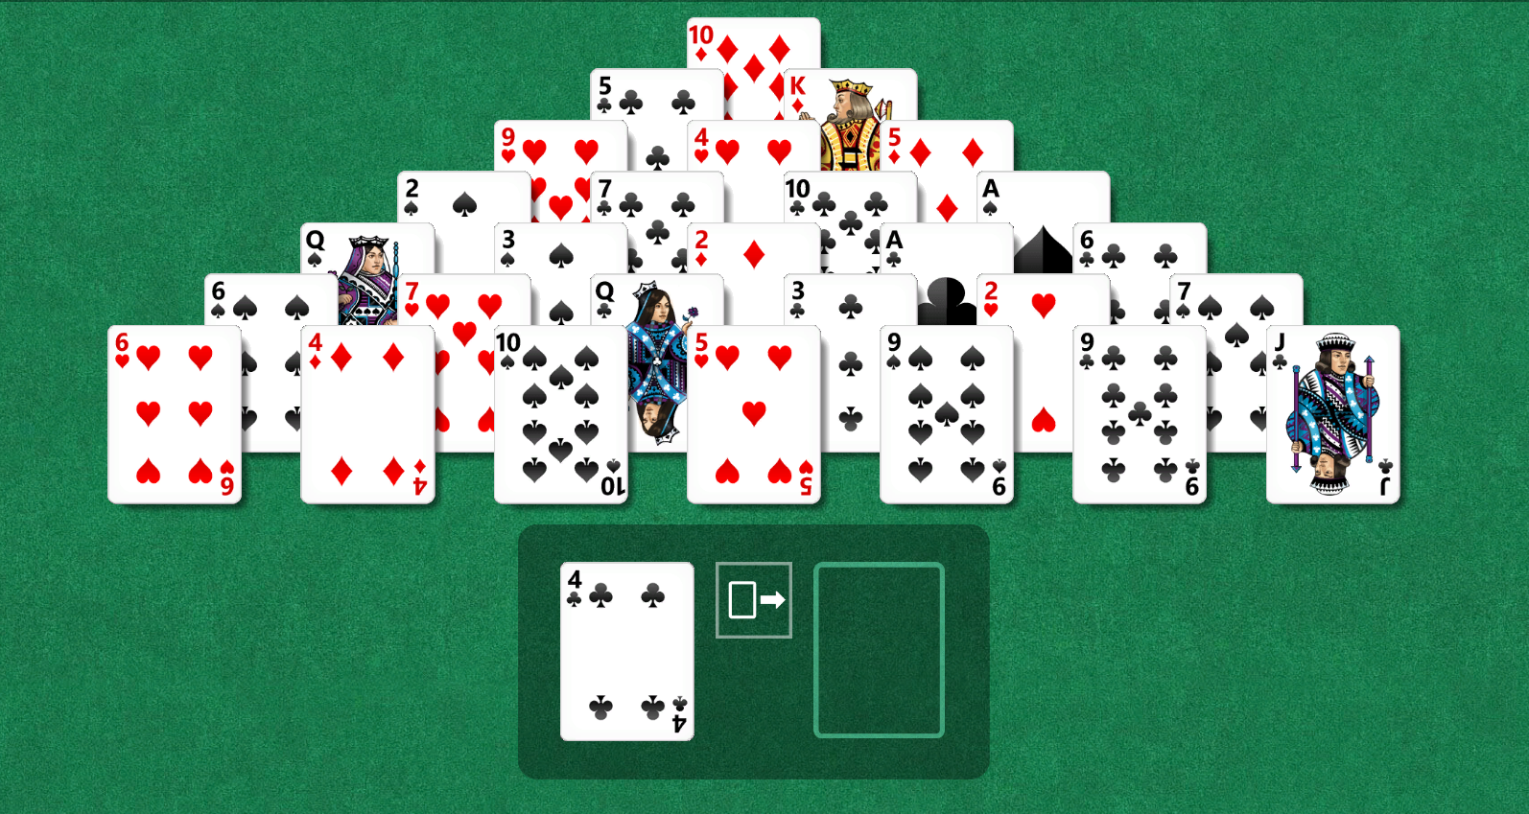
STOCK
PYRAMID
K=13
Q=12
J=11
A=1
WASTE

Slide 3
PYRAMID – GRAPH
4 POINTERS
Backward left
Backward right
CARD
Forward left
Forward right

Slide 4
STOCK
STOCK & QUEUE – STACK
CARD - 3
CARD – 4
CARD – 5
CARD – 6
CARD – 7
CARD – 2
CARD – 1
WASTE

