Slide 1
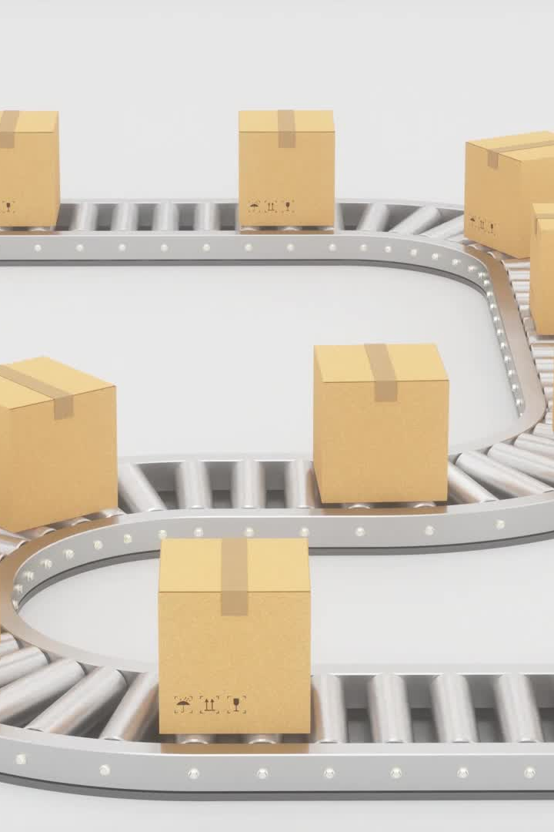
Introduction
Optimizing Delivery Efficiency in Supply Chain Logistics
A Data-Driven Approach to improve delivery KPIs.

Slide 2
Team Introduction
Team Member(s):
• Kanchan Devi(0836627) – Master’s in Mathematics
• Lakshmi Priya Armugan (0851437) – Bachelor of Engineering in Computer Science
• Sachin Ramasubramanian (0849986) – Bachelor in Information Technology
• Narendran Asokan (W0836723) – Computer Science Engineer, MBA in Marketing and Sales
• Karthikeyan (W0888796) – Bachelor in Engineering

Slide 3
Team Contributions
• Kanchan Devi (Mathematics):
Provided statistical insights and performed data analysis for delivery trends.
• Lakshmi Priya Armugan (Computer Science):
Assisted in data preprocessing and implemented key parts of the machine learning pipeline.
• Sachin Ramasubramanian (Information Technology):
Focused on feature engineering, data cleaning, and visualization of EDA results.
• Narendran Asokan (Computer Science, MBA):
Led the business interpretation of insights and designed actionable recommendations.
• Karthikeyan (Engineering):
Helped structure the dashboard design and integrated predictive model outcome into presentation format.

Slide 4
Problem Statement
Objective: Reduce delays and inefficiencies in last-mile delivery.
Identify key factors impacting delivery performance.

Slide 5

Project Proposal
Approach:
- Analyze delivery data
- Explore rider performance
- Build predictive models
- Recommend improvements

Slide 6
Dataset Source & Description
File: df11.csv
Source: Google Drive
Contains delivery timestamps, rider info, durations, and distances.
Ethical Considerations:
- No personal info
- No bias-inducing attributes

Slide 7
Analysis Questions
1. What are the peak order times?
2. How do delivery rates vary across riders?
3. What factors affect delivery duration?
4. Can we detect inefficiencies?
5. Are there top-performing outliers?
6. Can we predict delivery duration?

Slide 8
Methodology
Steps:
- Cleaned and transformed data
- Engineered time-based features
- Performed EDA and visualizations
- Built ML models (regression & clustering)

Slide 9
Dashboard
Dashboard (Optional):
- Use Power BI / Tableau if available
- Embed visualizations for delivery time, rate, peak hour
Else: Use charts from notebook

Slide 10

Models
1. Linear Regression (delivery duration)
2. KMeans Clustering (rider performance)
Evaluated with MAE, RMSE, silhouette score

Slide 11
Insights
- Peak hours: 12 PM - 4 PM
- High delivery rate plateau
- Some low-mileage orders take long
- Top riders show efficient patterns

Slide 12
Recommendations
- Increase riders in peak hours
- Optimize assignment in low-efficiency areas
- Use top riders' strategy to train others
- Predictive routing system

Slide 13
Conclusion
Delivery optimization is feasible using data-driven insights.
Modeling and dashboards support better planning.

Slide 14
Future Work
- Real-time tracking integration
- Add weather/traffic features
- Rider satisfaction insights

Slide 15
References
- Dataset: df11.csv from Google Drive
- Tools: Python (pandas, sklearn, matplotlib)
- Notebook Environment: Google Colab

