Slide 1
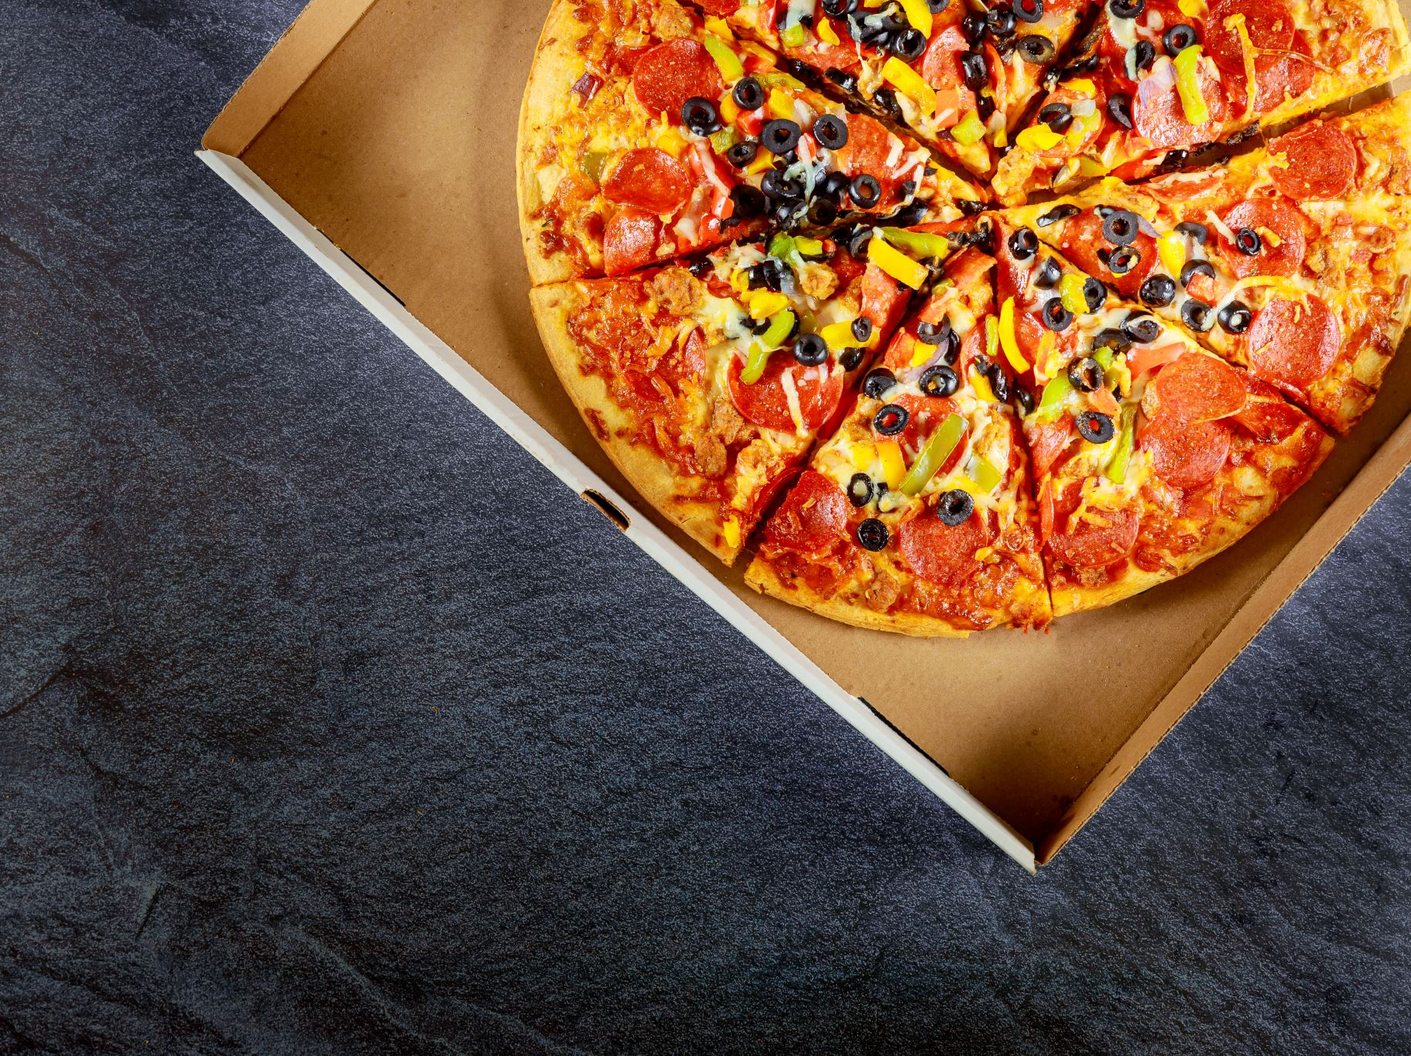
Food Delivery Insights: Online Delivery
Presented By: Group 5

Slide 2



Introduction – Background / Motivation
Food delivery apps like Swiggy and Zomato have revolutionized the food industry in India.
With growing urbanization and demand for convenience, analyzing customer behavior helps improve user experience.
This project explores patterns in food delivery orders to derive actionable business insights.

Slide 3

Problem Statement
The variability in delivery times, coupled with potential inefficiencies in rider performance and order processing, highlights the need for optimizing order assignment and route planning to improve delivery speed and consistency.

Slide 4
Project Proposal – Project Objectives
Analyze Order Patterns: Analyze historical order data to reveal patterns in order frequency, peak periods, and geographic spread.
Identify Factors Affecting Delivery Time and Cancellations: Examine factors such as rider efficiency, climatic conditions, order fulfillment durations, and restaurant readiness times. Evaluate how these elements affect delays in delivery and the cancellation of orders.
Evaluate User Behavior: Analyze user preferences considering food categories, restaurant ratings, and how often they order. Examine the relationship between these preferences and satisfaction with delivery as well as repeat purchases.
Derive Insights for Improvement: Deliver practical recommendations to enhance order distribution and route navigation. Suggest methods to enhance rider productivity and ensure consistent delivery performance. Propose enhancements in order handling to boost customer satisfaction and loyalty.

Slide 5
Dataset Source & Description
Dataset Source :
The dataset is sourced from Kaggle platform.
Dataset URL : https://www.kaggle.com/datasets/cbhavik/swiggyzomato-order-information/data
The dataset holds vital information like order processing times, rider performance, and delivery efficiency.
Contains 450,000 records covering timestamps, distances, and rider metrics.
Dataset Description :
Order timestamps: Order placement to delivery.
Delivery distances: First mile (restaurant to rider) & last mile (rider to customer).
Rider performance: Orders assigned, delivered, & undelivered.
Order status: Cancellations & reassignments.

Slide 6
Key Features & Data Dictionary
Data Dictionary :
Key Features Impacting Delivery Speed :
Order Timestamps : Tracks delays & inefficiencies.
First & Last Mile Distance : Impacts travel time.
Allotted & Delivered Orders : Measures rider efficiency.
Cancelled & Undelivered Orders : Highlights failures.
Session Time : Determines rider availability.
Columns | Data Dictionary
Order_time, delivered_time | Tracks Order Progress
First_mile_distance, last_mile_distance | Affects delivery time
Allotted_orders, delivered_orders | Rider workload & success
Cancelled, undelivered_orders | Failed deliveries
Session_time | Rider’s active hours

Slide 7
Analysis Questions
Avg. Delivery Time & Rider Variation? (Focuses on efficiency and rider differences)
Distance vs. Delivery Time? (Examines impact of distance)
Process Bottlenecks? (Identifies inefficiencies)
Lifetime Impact on Delivery & Cancellations? (Explores total order time)
Reassignment Rate & Time? (Addresses assignment issues)
Delivery/Rider Outliers? (Identifies exceptional cases)
Cancellations vs. Delivery/Lifetime? (Examines cancellation relationships)

Slide 8

References (APA Style)
Bhavik, C. (n.d.). Swiggy & Zomato Order Information Dataset. Kaggle. https://www.kaggle.com/datasets/cbhavik/swiggyzomato-order-information/data
Sharma, A., & Goyal, P. (2020). Consumer behavior towards online food ordering: An empirical study. Journal of Retailing and Consumer Services, 57, 102224.
Kumar, V. (2021). Big data analytics in food delivery services. International Journal of Data Science, 6(2), 87-95.

