Slide 1

Bus Ticketing & Monitoring System

Slide 2
Abstract
Due to the reasons Like Increase in Emission of CO2 and Other Harmful Gases, Cost Effectiveness, Increase in Traffic, Fuel Requirement. Its Encouraged and Preferable to use Public Transportation like Bus rather than Personal Transport Like Cars/Auto.
Even though There are Appropriate Timings of Arrival and Leaving for Bus there is a lot of inconsistency and Un-organization. Which Makes it Really Unreliable for Traveling to a New Location
The total system consist of two Main subsystems: The Ticketing system and the Monitoring system. Ticketing system is used by passengers locally at bus stop or online to purchase tickets. And the monitoring system is associated with the bus. Both systems exchange information with each other.
The ticketing and monitoring systems exchange information with each other to operate on data regarding passenger count, vacancies etc. The passengers who have purchased the ticket only are allowed to board the bus; this checking will be performed by monitoring system.
The ticketing system will receive information regarding passenger count and vacancies from monitoring system, so that it can indicate the passengers about the availability of seats, timings etc. The monitoring system also checks on the capacity of bus and this information is transferred to the ticketing system.

Slide 3

Literature Review
Due to non-availability of prior information about bus arrival schedule people are required to wait longer on bus stops. The operating scales of public transport providers are finding it difficult to meet the demands of the expanding volume of passengers.
Buses are stuck in traffic and are hampered by the passage of junctions which makes the management of the bus schedule in the base stations a difficult task. Timings of the buses depend on the current traffic scenario and the number of passengers.
With the help of this technology the administrator can monitor the buses traffic while increasing the satisfaction of passengers and reducing cost through efficient operations. Hardware implementations are to be done at bus stops for the people who do not have digital devices to view the bus timings.
The system checks the passengers for the ticket and allows them inside only if they have a ticket, this simultaneously monitors the capacity of the bus. This helps in prioritising and organising the procedure of boarding the transport.
The system can be realized in the form of a finite state machine, where each state represents some action, like passenger entering with/without ticket, passenger leaving and travelling of the bus.

Slide 4
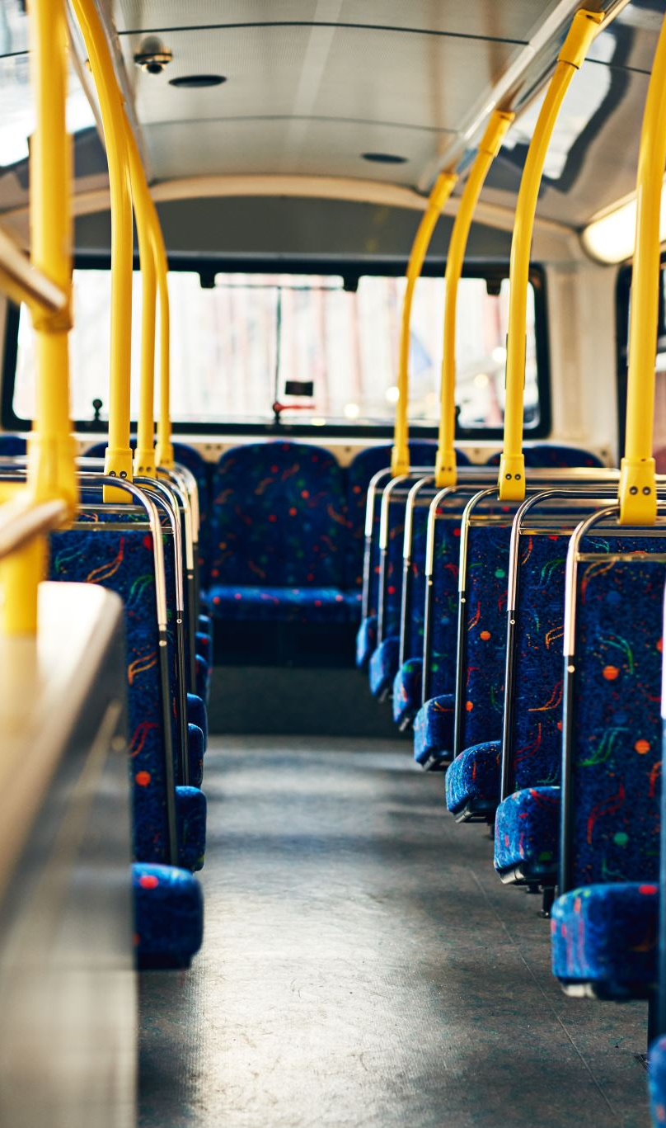
Novelty of Work
The Project has a different scale of Implementation and can be done starting with a Small Network of Buses.
The Ticketing System is available at the Bus stops & Passengers can purchase their Tickets and the details can be checked live.
Data from our System can be Fused with sources like G-Maps along with GPS to Estimate the precise ETA of the Vehicle
•The Whole System is Implemented using the Port F of the Tiva TM4C123GH6PM with the Help of Inbuilt Switches
•The System also uses a Nokia5110 monitor as a Screen due the Software Limitations

Slide 5
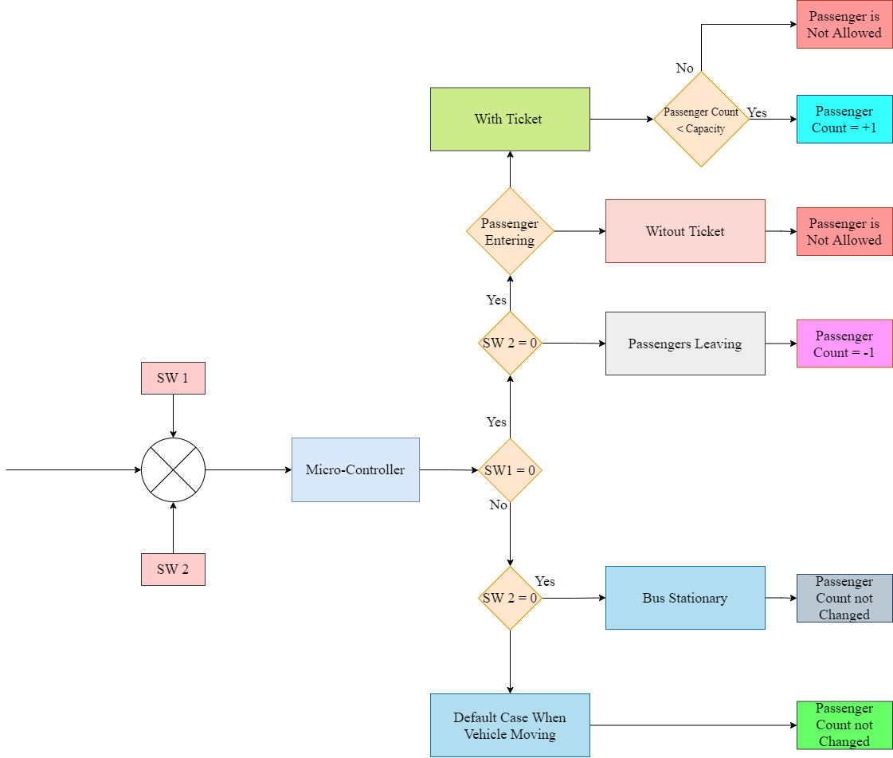
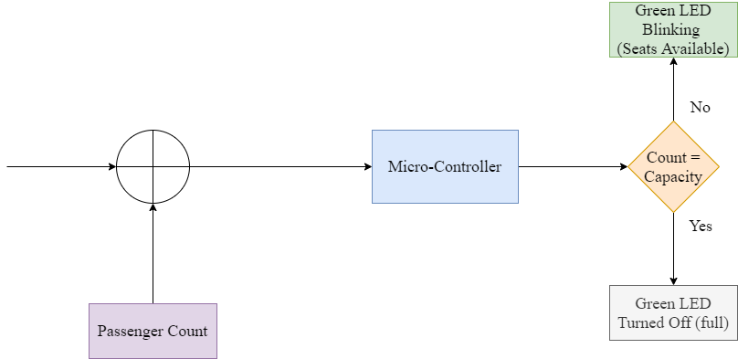
Schematic Representation

Slide 6
Working Principle
The system consists of a ticket counter and a bus control and monitoring system.
The ticket counter is used by the passengers to purchase the ticket. The passengers who have purchased the ticket are only allowed to board the bus. The ticket counter only provides the number of tickets which is equal to the seats available in the bus. No more tickets can be purchased.
The control and monitoring system is a finite state machine and traverses between states depending upon the input given through on-board switches. ON state of a switch is represented by 0 and OFF state is represented by 1. The case that control and monitoring system is handling depends upon the input value of switches and is shown in the above table.
The Bus Stationed state represents the idle state of the bus where it is stationed in the bus stop, in the Passenger Entering the system checks for the ticket of passenger and allows only if they have their ticket and blocks otherwise, passenger count is incremented if passenger is allowed. In Passenger Leaving state passengers leave the bus and the count is decremented. Bus is Empty or Bus is Full message is displayed whenever passenger count reaches 0 and bus capacity, respectively. In Bus Moving state bus is travelling and no passengers are allowed to enter/exit.

Slide 7
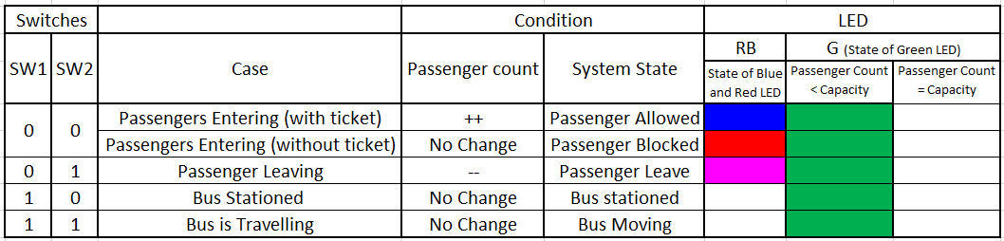
Working Principle
Blue LED - Passenger Enters with ticket
Red LED - Passenger Enters without ticket
Pink LED – Passenger Leaves
Green LED – Bus is free I.e., passenger count < capacity
Red, Blue and Green LED glow in combination depending upon the conditions stated above .

Slide 8
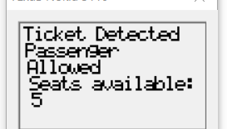
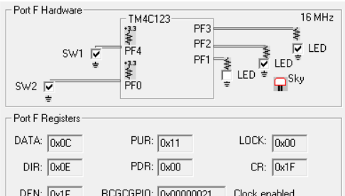
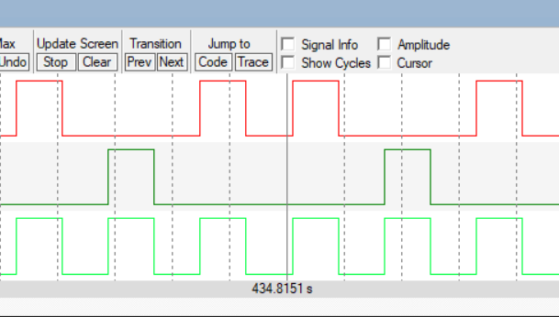
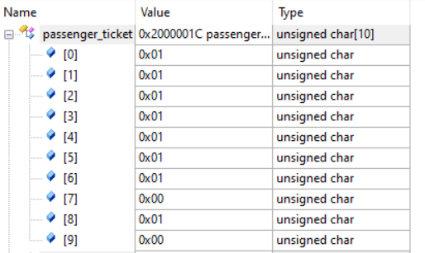
Simulation Results:
Passenger Entering state
Ticket Detected, passenger allowed.
State of the system :

Slide 9
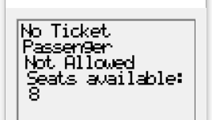
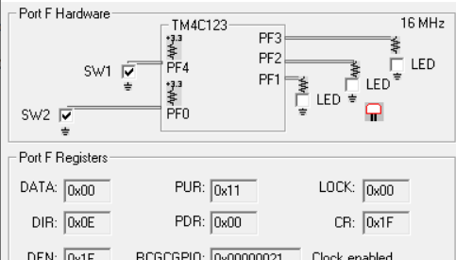
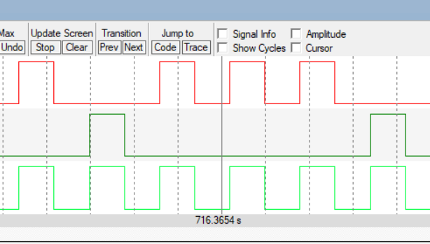
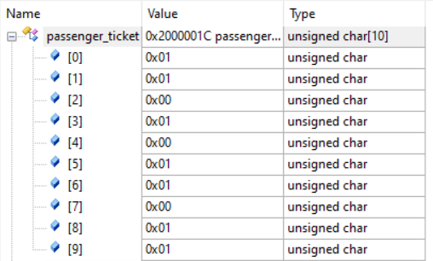
Simulation Results:
Passenger Entering state
No Ticket Detected, passenger not allowed
State of the system :

Slide 10
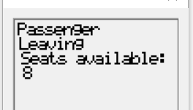
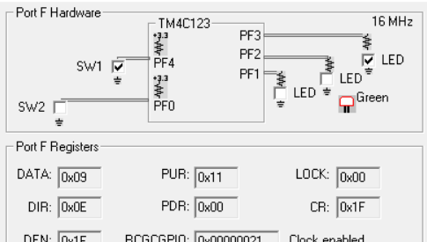
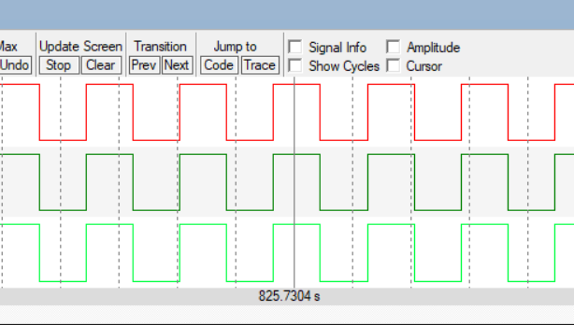
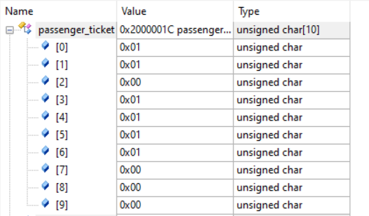
Simulation Results:
Passenger Leaving State
State of the system :

Slide 11
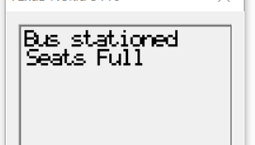
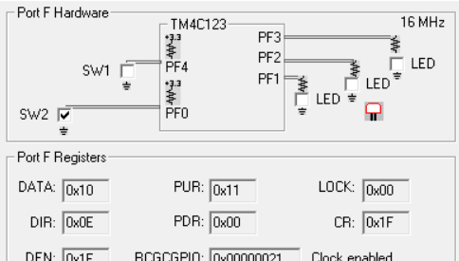
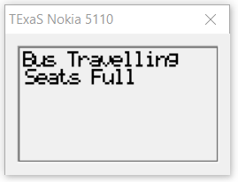
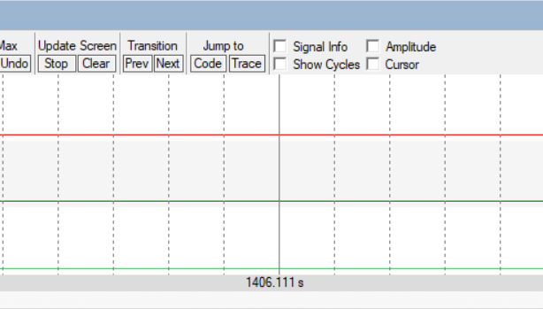
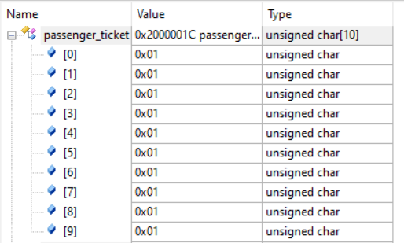
Simulation Results:
Seats Full
Passenger Count = Capacity
Case where bus is full:

Slide 12
Future Scope
The ticketing system can also be implemented in the form of a web server which reduces the hardware required to make a physical ticketing system.
The passengers could book their ticket from the web server and the monitoring system implemented at the bus can then query the web server for information related to the passengers and their tickets.
The seats available and other information can also be updated to the web server which helps the passengers during booking tickets. This implementation would come under internet of things (IOT) framework.
A real time position tracking system can be implemented for the buses, which help in determining the exact timing of the bus. This will help the passengers to get to know the exact timing for a particular stop.

