Slide 1

Segmenter: Transformer for Semantic Segmentation
Presenter: Karthikeyan Mohanraj (AI21MTECH14007)
Faculty:
Prof. C Krishna Mohan
Dept. of CSE, IIT Hyderabad
Teaching Assistant:
Aveen Dayal
Ph.D Research Scholar
Authors:
Robin Strudel, Ricardo Garcia, Ivan Laptev, Cordelia Schmid

Slide 2
Motivation:
The aim of this paper is to propose a convolutional free architectural model for semantic segmentation.

Slide 3
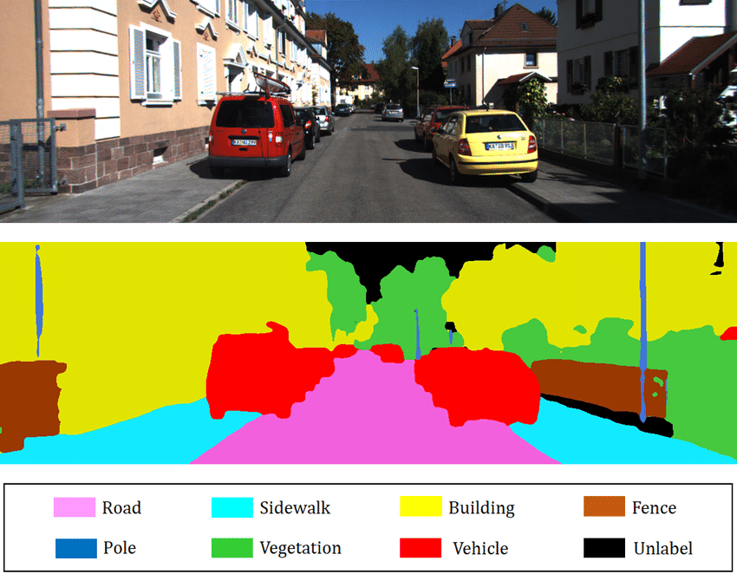
What is semantic segmentation?

Slide 4
Need for Transformer
Image segmentation remains a challenging problem due to rich intra-class variation.
Current CNN based model is not adequate.

Slide 5
Related Work
Fully Convolutional Networks for semantic segmentation[1]
A deep convolutional encoder-decoder architecture for image segmentation[4]
DeepLabv3+
End-to-end panoptic segmentation with mask transformers[5]
Vision Transformer - DeiT[6]

Slide 6
Proposed Architecture :
A fully transformer-based encoder-decoder architecture mapping a sequence of patch embeddings to pixel-level class annotations.
Main Components:
Encoder
Decoder

Slide 7
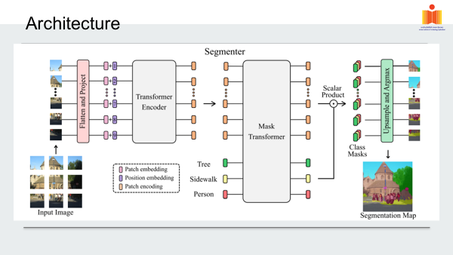

Slide 8
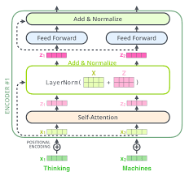
Encoder:
Components in each layer of encoder consist of :
1. Multi-headed self-attention (MSA) block.
2. Multi Layer perceptron
3. Layer normalization and residual connection

Slide 9
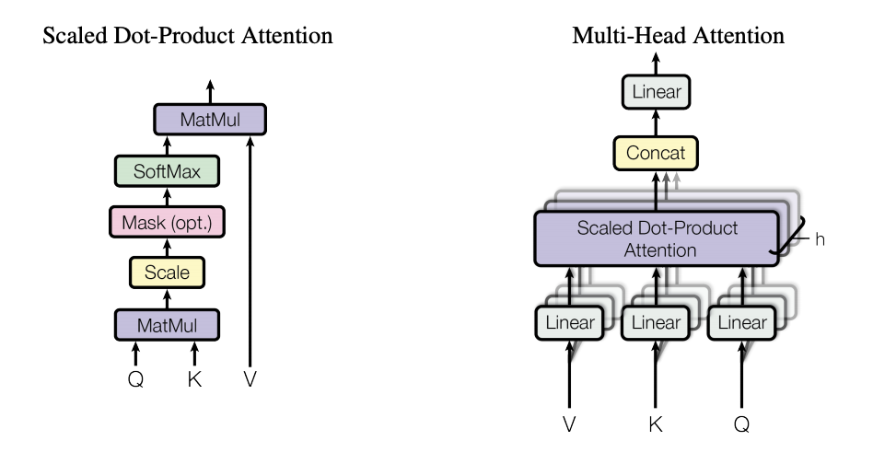

Encoder (cont…):
Multi head self attention
Mathematical representation of each self attention layer:

Slide 10
Decoder:
Two types of decoders are used
linear decoder
Mask transformer

Slide 11
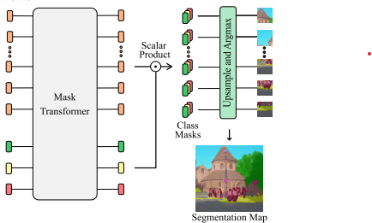

Mask Transformer:

Slide 12
Dataset:
The authors used standard datasets available online such as:
ADE20K
Pascal Context
Cityscapes

Slide 13
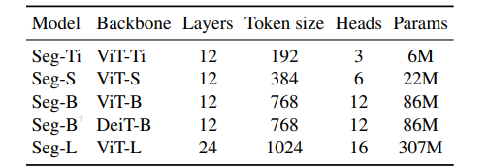
Model Variants:
Transformer encoder models:
Pretraining model with Optimization and data augmentation

Slide 14
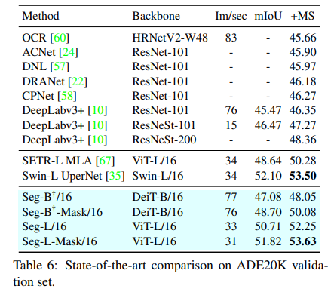
Comparison with state of the art model:
ADE20K

Slide 15
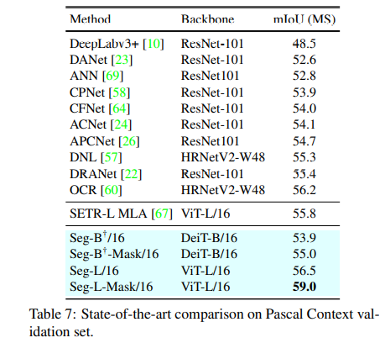
Pascal Context

Slide 16
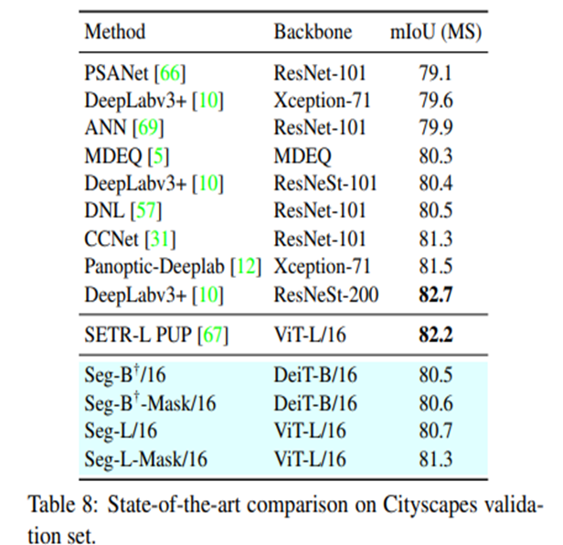
Cityscapes:

Slide 17
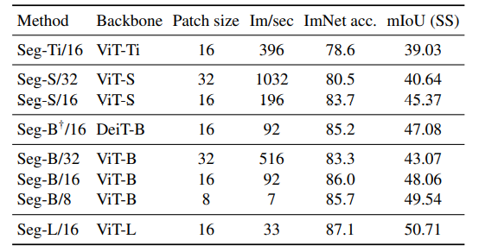
Ablation study:
Patch size

Slide 18
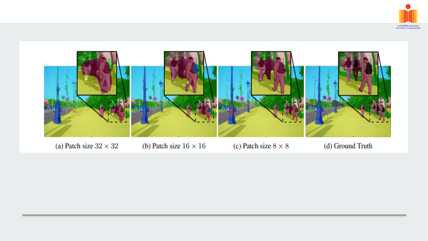

Slide 19
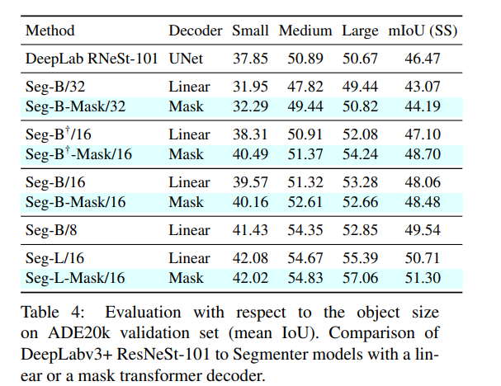
Transformer Decoder:

Slide 20
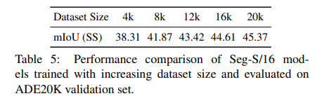
Dataset size:

Slide 21
Conclusion:
This paper introduces a pure transformer approach for semantic segmentation.
Decoding with a mask transformer further improves the performance.
It outperforms state of the art models.

Slide 22
Reference:
[1]Jonathan Long, Evan Shelhamer, and Trevor Darrell. Fully Convolutional Networks for semantic segmentation. In CVPR, 2015
[2] Ashish Vaswani, Noam Shazeer, Niki Parmar, Jakob Uszkoreit, Llion Jones, Aidan N Gomez, Ł ukasz Kaiser, and Illia Polosukhin. Attention is all you need. In NeurIPS, 2017.
[3] Anurag Arnab, Mostafa Dehghani, Georg Heigold, Chen Sun, Mario Lucic, and Cordelia Schmid. ViViT: A video vision transformer. In ICCV, 2021.
[4] Lei Jimmy Ba, Jamie Ryan Kiros, and Geoffrey E. Hinton. Layer normalization. arXiv preprint, 2016. 6
[5] V. Badrinarayanan, A. Kendall, and R. Cipolla. SegNet: A deep convolutional encoder-decoder architecture for image segmentation. TPAMI, 2017. 2
[6] Huiyu Wang, Yukun Zhu, Hartwig Adam, Alan L. Yuille, and Liang-Chieh Chen. MaX-DeepLab: End-to-end panoptic segmentation with mask transformers. arXiv preprint, 2020
[7] Hugo Touvron, Matthieu Cord, Matthijs Douze, Francisco Massa, Alexandre Sablayrolles, and Herve J ´ egou. Training ´ Data-Efficient image Transformers and distillation through attention. arXiv preprint, 2020.
[8]Jonathan Long, Evan Shelhamer, and Trevor Darrell. Fully Convolutional Networks for semantic segmentation. In CVPR, 2015

Slide 23
THANK YOU

