Slide 1

Service Orchestrator

Slide 2
Automation vs Orchestration
Automation is a way to eliminate the manual effort/human intervention involved in activities and bring in an ability to perform the same repeatedly, consistently and with better efficiency.
Orchestration is executing the automation/manual ability of various modules in harmony as a consolidated process or workflow to accomplish the desired tasks.

Slide 3
Service Orchestrator
The SO provides the highest level of service orchestration in the ONAP architecture. SO is implemented via BPMN flows that operate on Models distributed from SDC that describe the Services and associated VNFs and other Resource components.
The orchestration engine is a reusable service. Any component of the architecture can execute process workflows. Orchestration services can consume a process workflow and execute it
Orchestration processes interact with other platform components or external systems via standard and well-defined APIs.

Slide 4
BPMN
The primary goal of BPMN is to provide a notation that is readily understandable by all business users, from the business analysts that create the initial drafts of the processes, to the technical developers responsible for implementing the technology that will perform those processes, and finally, to the business people who will manage and monitor those processes.
BPMN creates a standardized bridge for the gap between the business process design and process implementation.

Slide 5
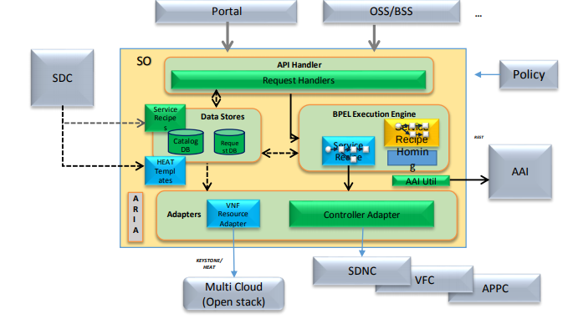
SO Software Architecture

Slide 6
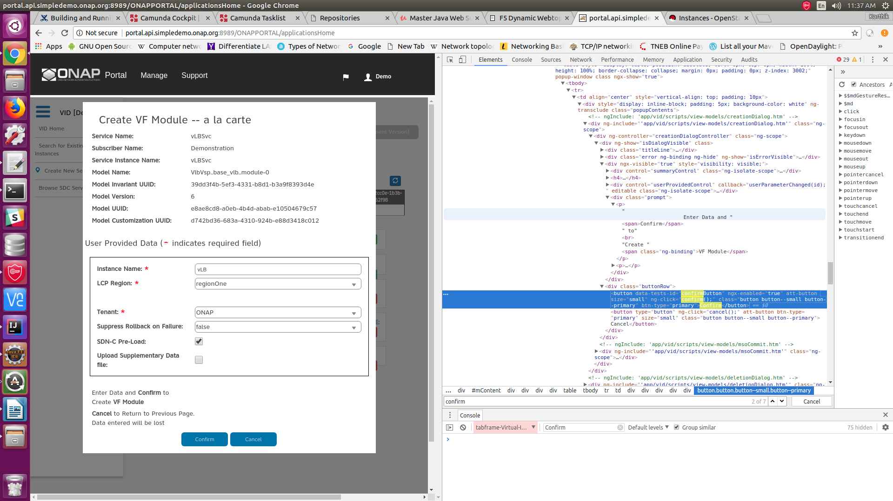

Slide 7
Service Instantiation Flow
API
SO
AAI
BPMN
VNF ADAPTER
Cloud
(Openstack)
SDNC
APPC

Slide 8
BPMN Flow
1. Save the Requests
2. Call APP-C VNF start (run APPc Command) Action.HealthCheck
3. Do Create Vf Module
  - Validation of Orchetration Status,VF Module Name, Cloud Region, Volume Group Tenant
  - Create AAI Vf Module: Adding VF module to AAI (POST request)
  - Need to query SDNC for VNF Topology? (v1707)
    ~ call to SDNC Adapter : VNF Topology GET
  - Call SDNC Adapter: VF Module Topology Assign Call
  ~ SvcAction>${action}</sdncadapter:SvcAction> | action : assign
- Is Phase 2 Design ?
~ true --> OrchestrationStatus = “PendingActivation”
~ False --> OrchestrationStatus = “Assigned”
- Update AAI VF Module Assigned
- Call SDNC Adapter: VF Module Topology GET
~ SvcAction>query</sdncadapter:SvcAction>
- Pre Process VNF Adapter Request
~ Get SDNC Response Data for VF Module Topology
~ Get SDNC Response Data for Vnf Topology
~ vfModuleParams = buildVfModuleParamsFromCombinedTopologies (vnfParamsMap, vnfSdncGetResponse, vfModuleSdncGetResponse,vnfId, vnfName,vfModuleId, vfModuleName, vfModuleIndex, environmentContext, workloadContext)

Slide 9
- Call VNF Adapter to create VF Module
~ PayLoad
def createVnfARequest = """
<createVfModuleRequest>
<cloudSiteId>${cloudSiteId}</cloudSiteId>
<tenantId>${tenantId}</tenantId>
<vnfId>${vnfId}</vnfId>
<vnfName>${vnfName}</vnfName>
<vfModuleName>${vfModuleName}</vfModuleName>
<vfModuleId>${vfModuleId}</vfModuleId>
<vnfType>${vnfType}</vnfType>
<vfModuleType>${vfModuleModelName}</vfModuleType>
<vnfVersion>${asdcServiceModelVersion}</vnfVersion>
<modelCustomizationUuid>${modelCustomizationUuid}</modelCustomizationUuid>
<requestType></requestType>
<volumeGroupId>${volumeGroupId}</volumeGroupId>
<volumeGroupStackId>${volumeGroupStackId}</volumeGroupStackId>
<baseVfModuleId>${baseVfModuleId}</baseVfModuleId>
<baseVfModuleStackId>${baseVfModuleStackId}</baseVfModuleStackId>
<skipAAI>true</skipAAI>
<backout>${backoutOnFailure}</backout>
<failIfExists>true</failIfExists>
<vfModuleParams>
${vfModuleParams}
</vfModuleParams>
<msoRequest>
<requestId>${requestId}</requestId>
<serviceInstanceId>${svcInstId}</serviceInstanceId>
</msoRequest>
<messageId>${messageId}<messageId>
<notificationUrl>${notificationUrl}</notificationUrl>
</createVfModuleRequest>"""

Slide 10
- Post Process VNF Adapter Request
execution.setVariable("DCVFM_vnfVfModuleCreateCompleted", true)
"Received heat stack id from VNF Adapter: "
execution.setVariable("DCVFM_heatStackId", heatStackId)
- Need to create network policies in AAI?
Query AAI for this network policy , If already there no need to add ,else add the policy to AAI
- Need to update Generic VNF in AAI?
If yes, Construct and send a PUT request to AAI to update the Generic VNF.
- Update AAI Vf-Module
execution.setVariable("DCVFM_orchestrationStatus", "Created")
Construct and send a PATCH request to AAI to update the VF Module.
- SDNC Activate Request
String activateSDNCRequest = buildSDNCRequest(execution, svcInstId, "activate")
Invoke SDNC – Adapter
- Create AAI VfModule VolumeGroup , if volume_group_id specified
- Update Infra request
<statusMessage>VF Module successfully created</statusMessage>
<requestStatus>COMPLETE</requestStatus>
- MSO Completion Handler
statusMessage = "Resource Completed Successfully"
Update DB

Slide 11
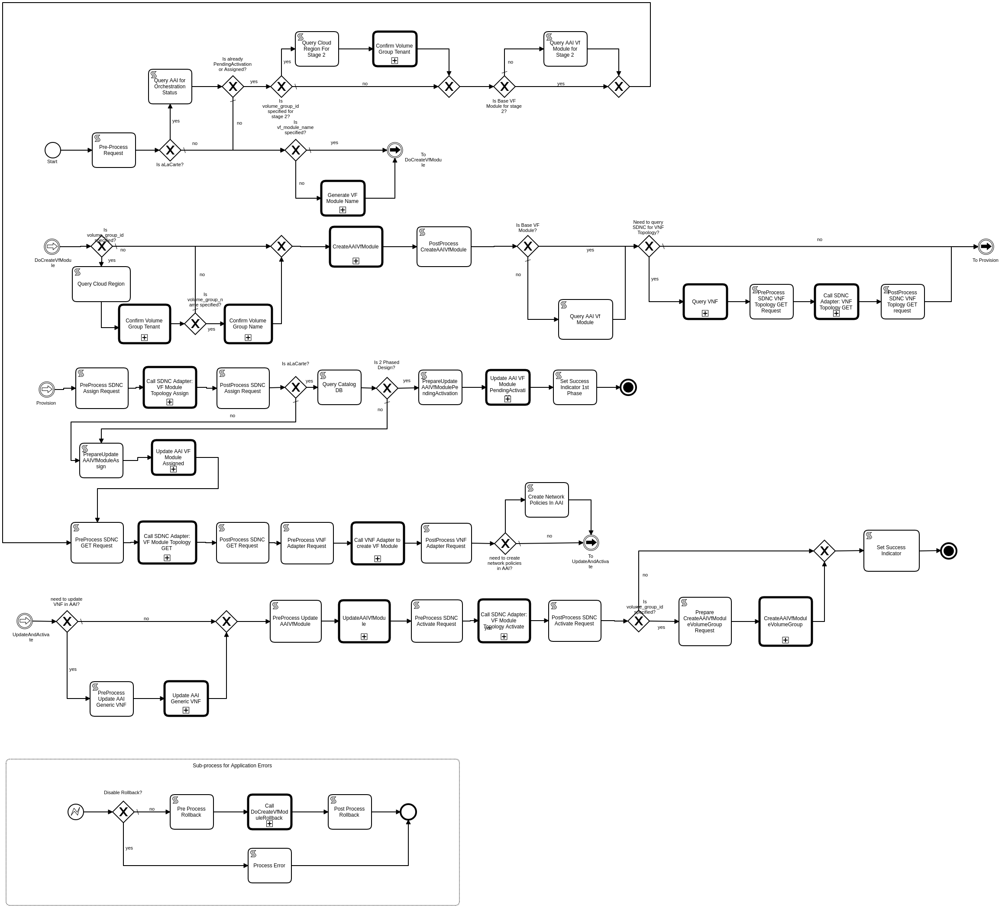

Slide 12
Thank You

