Slide 1

LIGHTWEIGHT CLOAKING WALL MODEL FOR CLOUD DATA STORAGE WITH LEAKAGE CONTROL
MEENAKSHI COLLEGE OF ENGINEERING
BY
D. KARTHIKEYAN
II MCA - 311422622024
GUIDE NAME
Mrs. V. SOMA SUNDARI
A.P / M.C.A DEPARTMENT

Slide 2
ABSTRACT
Cloud computing transforms organizational operations with on-demand resource access.
Cross-organization data sharing faces challenges requiring agreement on data processing.
Primary concern in information security and cloud computing.
Focus on developing Cloaking Wall Model for cloud storage.
Four methods: Long-Term, Multi-Region, Time-based, and Geolocation-based Cloaking.
Cloaking identifies user types, ensuring content distribution to the right target.
The Camouflage Data Disguise technique enhances security using Chaffing and
Winnowing with ChaCha20 encryption, distributing disguised data selectively.

Slide 3
OBJECTIVES
To design and conceptualize the components of the Cloaking Wall Model.
To Integrate Camouflage Techniques.
To design and implement access control mechanisms.
To implement leakage-suppressed techniques.
To minimize the computational overhead associated with access control operations.
Assess the model’s effectiveness in terms of speed, security, and resource usage.
Identify potential enhancements for better scalability and robustness.
Integrate data cloaking methods to enhance security and privacy.

Slide 4
COMPANY PROFILE
Nineteen Hour IT is ambitious and innovative, 21st century Telecom &
Software Services Company started by group of young.
Nineteen Hour IT was started with the aim of helping customers and business
to save their rising IT cost without impacting the quality.
Established in 2004 as Headquarter.
Global Delivery Center in Patna, India
The state-of-the-art development center is equipped with latest technology.
We deliver end-to-end solutions through valuable strategy development,
consulting services.
Highly skilled engineering execution.

Slide 5
SOFTWARE REQUIREMENTS
Server Side : Python 3.7.4(64-bit) or (32-bit)
Client Side : HTML, CSS, Bootstrap
IDE : Flask 1.1.1
Back end : MySQL 5
Server : Wampserver 2i
Operating systems : Windows® 10, macOS*, and Linux*
HARDWARE REQUIREMENTS
Processors : Intel® Core™ i5 processor
Memory : 8 GB
DRAM Disk space : 320 GB

Slide 6
INTRODUCTION
In cloud computing, where seamless accessibility coexists with concerns about data protection.
The Cloaking Wall introduces a robust protective barrier.
This methodology is designed to safeguard sensitive information stored in the cloud by concealing access patterns.
Fortifying the mechanisms governing data interactions.
This methods contributes a unique layer of defense, collectively establishing a fortified shield around cloud-stored data.
The Camouflage Data Disguise technique represents an advanced cryptographic approach
That seamlessly integrates Chaffing and Winnowing with the formidable ChaCha20 encryption algorithm.

Slide 7
LITERATURE SURVEY
TITLE | AUTHOR | DESCRIPTION
Stargazer: Long-Term and Multiregional Measurement of Timing/Geolocation-Based Cloaking (2023) | Shota Fujii , Takayuki Sato , Sho Aoki | The primary objective is to investigate and understand the characteristics of cloaking techniques, with a focus on geofencing and time-based cloaking.
Marketing Data Security and Privacy Protection Based on Federated Gamma in Cloud Computing Environment (2023) | Caixia Zhang , Zijian Pan | The data security and user privacy in cloud-based systems by proposing a novel approach that combines the logit link function with a longitudinal joint learning framework for the gamma regression model.
Secure Data Storage and Sharing Techniques for Data Protection in Cloud Environments (2022) | Ishu Gupta, Ashutosh Kumar Singh, Chung-Nan Lee, Rajkumar Buyya | The paper aims to conduct a comparative and systematic study, providing an in-depth analysis of leading techniques for secure data sharing and protection in cloud environments.

Slide 8
LITERATURE SURVEY
TITLE | AUTHOR | DESCRIPTION
Security and Privacy Aspects of Cloud Computing: A Smart Campus Case Study (2021) | Sajid Habib Gill , Mirza Abdur Razzaq , Muneer Ahmad | The primary objective is to conduct a detailed analysis of privacy and security challenges in cloud computing, with a specific emphasis on a case study set in a smart campus scenario.
Multi-class Privacy-Preserving Cloud Computing Based on Compressive Sensing for IoT (2021) | Gajraj Kuldeep, Qi Zhang | The multi-level data privacy in IoT applications by designing a Multi-class Privacy-Preserving Cloud Computing (MPCC) scheme.
:An Integrated Knowledge Graph to Automate Cloud Data Compliance (2020) | Karuna Pande Joshi, Lavanya Elluri, Ankur Nagar | The data protection concerns by developing an integrated, semantically rich knowledge graph that captures various data compliance regulations related to cloud data.

Slide 9
EXISTING SYSTEM
Encryption Techniques:
  Utilization of encryption algorithms to protect data in transit and at rest.
  Common encryption methods include AES (Advanced Encryption Standard) and RSA (Rivest-Shamir-Adleman).
Access Controls and Identity Management:
  Implementation of access control mechanisms to regulate user permissions.
  Identity and access management solutions ensure only authorized users have access to sensitive data.
Intrusion Detection and Prevention Systems (IDPS):
  Utilization of IDPS to detect and respond to potential security threats.
  Helps in real-time monitoring and protection against malicious activities.

Slide 10
DISADVANTAGES OF EXISTING SYSTEM
Encryption complexity may impact system performance.
Traditional authentication methods may be vulnerable to attacks.
Relying on cloud providers' security exposes risks.
Human-related risks persist despite security training.
Firewalls may not cover all sophisticated attack vectors.

Slide 11
PROPOSED SYSTEM
Long-Term Cloaking:
  This method focuses on providing extended protection for sensitive data over prolonged durations.
  It involves concealing access patterns and data usage trends over an extended timeframe, ensuring persistent confidentiality.
Multi-Region Based Cloaking:
  Recognizing the global nature of cloud services, multi-region-based cloaking.
  Involves implementing security measures that transcend geographical boundaries.
Time-Based Cloaking:
  Time-based cloaking introduces temporal restrictions on data access
  Allowing organizations to define specific time windows during which data can be accessed.
Geolocation-Based Cloaking:
  Geolocation-based cloaking involves tailoring data protection measures based on the geographical location of users.

Slide 12
PROPOSED SYSTEM
Conditional Disguise:
  Disguise data selectively based on specific conditions or user roles.
  The Camouflage Data Disguise Generator module, integrating Chaffing and Winnowing with the robust ChaCha20 encryption algorithm.
Chaffing and Camouflage Process:
  Chaffing, which adds decoy or chaff data.
  Camouflage, which further disguises non-compliant data through additional obfuscation techniques.
ChaCha20 Encryption:
  Genuine, chaff, and camouflaged data undergo encryption using the ChaCha20 algorithm.
Winnowing Process:
  At the recipient's end, the winnowing process disentangles the genuine data from the chaff and camouflage layers.

Slide 13
ADVANTAGES OF PROPOSED SYSTEM
Integrates advanced security measures for comprehensive data protection.
Ensures data confidentiality at rest, in transit, and during processing.
Reduces administrative workloads through efficient certificate management.
Enhances security through defined time windows for data access.
No encryption standards.
The ChaCha20 decryption algorithm, combined with the appropriate key, unveils the original, non-compliant data.
  This is strategically designed to elevate the security and privacy of data.

Slide 14




SYSTEM ARCHITECTURE
Login
Cloaking Wall Model
Upload Data
Long Term Cloaking
Add and Manage User
Region based Cloaking
Data Owner
Configure Cloaking Wall
Location based Cloaking
Access Monitoring
Time Based Cloaking
Enterprise Cloud Server
Cloaking Area
Request File
Response File
Bogus File
Request File
Data User
Malicious User

Slide 15
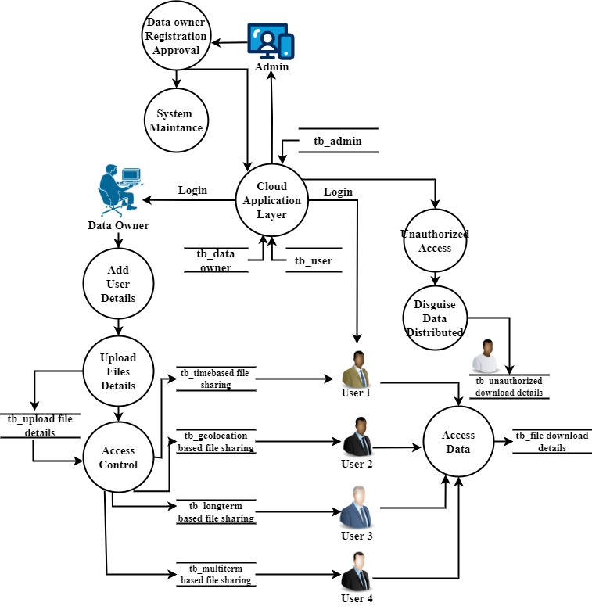
DATA FLOW DIAGRAM

Slide 16
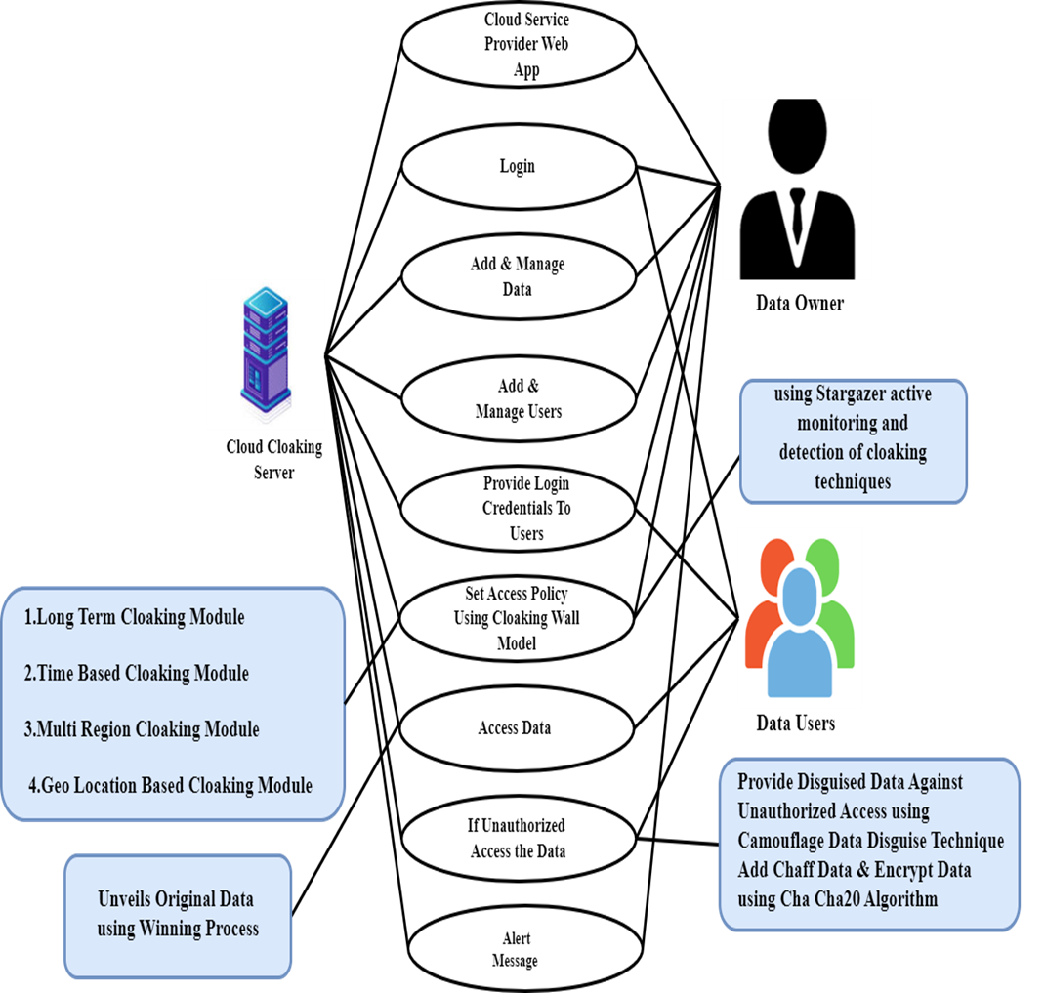
USECASE DIAGRAM

Slide 17
MODULES
Cloud Service Provider Web App
End User Interface
Cloaking Wall Model
Access Policy Configurator
Bot Identification and Data Distribution
Disguise Data Generator
Monitoring and Auditing
Alerts and Notification

Slide 18
CLOUD SERVICE PROVIDER WEB APP
The design and development of a Cloud Consumer Web App using Python, Flask and MySQL and Bootstrap.
The user authentication module serves as the entry point, ensuring secure access through robust registration.
Authentication processes, including multi-factor authentication for enhanced security.
The dashboard module, at the core of the application, seamlessly integrates the Cloaking Wall Model.
This provides users with an intuitive interface for cloud resource management while ensuring global consistency in security measures.

Slide 19
END USER INTERFACE
Admin or Data Owner Interface
  Login Module
    The login module provides a secure authentication process for Admins or Data Owners, ensuring only authorized access to the cloud management interface.
  Add and Manage Data
    Admins can add, organize, and manage data within the cloud storage.
  Add and Manage Users
    Admins have the capability to add new users to the system, defining their roles and permissions.
  Provide Login Credentials to Users
    This ensures a secure onboarding process for new users.
  Set Access Policy using Cloaking Wall Model
    Leveraging the Cloaking Wall Model, this module enables Admins to set access policies.
  Monitoring Data Access
    Admins can monitor and audit data access patterns using this module.

Slide 20
END USER INTERFACE
Data User Interface
Login Module
  Similar to the Admin interface, the login module provides secure authentication for Data Users, ensuring that only authorized individuals can access the cloud resources.
Access Data
  Data Users can use this module to access the data allocated to them.
  The interface provides a user-friendly environment for retrieving, modifying, or analyzing data based on their permissions.
Monitoring Data Access
  Data Users have limited access to monitoring tools to track their own data access.
  This module allows them to review their activity and ensures transparency in usage.

Slide 21
CLOAKING WALL MODULES
Long-Term Cloaking
  The Long-Term Cloaking module ensures persistent confidentiality of data access patterns over extended durations.
Multi-Region Based Cloaking
  This module facilitates a unified security approach across diverse geographical regions.
  Measures globally addressing challenges related to multi-region data access.
Time-Based Cloaking
  Time-Based Cloaking empowers Admins to set temporal restrictions on data access.
Geolocation-Based Cloaking
  The Geolocation-Based Cloaking module tailor’s data protection based on user location.
  Admins can define security policies that vary depending on the physical location of Data Users, adding a location-sensitive layer to access controls.

Slide 22
ACCESS POLICY CONFIGURATOR
The Access Policy Configuration module is to define and customize access policies for the Cloud Consumer Web App.
This module plays a crucial role in tailoring the security measures based on four cloaking principles.
This module provides a centralized dashboard for administrators to configure comprehensive access policies.
They can set parameters, thresholds, and exceptions to align with the security requirements of the organization.

Slide 23
BOT IDENTIFICATION AND DATA DISTRIBUTION
The Bot Identification Mechanism within the Cloaking Wall Model ensures that automated bots attempting to access the data.
Also in violation of access policies are promptly identified.
This module ensures that benign content is delivered to authentic users, while malicious content is selectively distributed to identified bots.
Policy Adherence Assessment.
Each user, including potential bots, is assessed against the defined access policies.
Legitimate Data Users are expected to follow the specified four cloaking rules.
Any entity not adhering to these policies is flagged for further scrutiny.

Slide 24
DISGUISE DATA GENARATOR
Chaffing and Camouflage Process
  Chaffing, which adds decoy or chaff data, and Camouflage, which further disguises non-compliant data through additional obfuscation techniques.
ChaCha20 Encryption
  Genuine, chaff, and camouflaged data undergo encryption using the ChaCha20 algorithm.
Winnowing Process
  At the recipient's end, the winnowing process disentangles the genuine data from the chaff and camouflage layers.
  The ChaCha20 decryption algorithm, combined with the appropriate key, unveils the original, non-compliant data.

Slide 25
MONITORING AND AUDITING
In real-time, the module monitors and captures a spectrum of activities, including user interactions, data access, and system operations.
It maintains a meticulous log of policy enforcement instances, detailing the invocation of access policies defined by the Cloaking Wall Model.
They along with outcomes and responses to policy violations.
Furthermore, the module diligently tracks all data access and modification events.
Also providing insights into who accessed specific data and the nature of their interactions, aiding in forensic analysis.

Slide 26
ALERTS AND NOTIFICATIONS
Upon detection of a policy violation, the module triggers immediate alerts
swiftly notifying administrators through various channels such as email, SMS, in-app messages, or other preferred communication methods.
These alerts are designed to provide administrators with detailed information about the nature of the policy violation.
Offering insights into unauthorized access attempts, data modifications beyond permitted levels.
Breaches of temporal and geolocation constraints.
This proactive alerting mechanism minimizes the latency between the occurrence of a policy violation
The notification to administrators, facilitating a rapid and targeted response.

Slide 27
PSEUDO CODE
# LOGIN FUNCTION
FUNCTION login():
IF request method is POST:
GET username and password from request
EXECUTE SQL query to check credentials in data_owner table
IF account exists:
SET session username
REDIRECT to upload page
ELSE:
SET message as 'Incorrect username/password!'

Slide 28
CONCLUSION
In Conclusion, the project introduces a robust solution to enhance data security in cloud computing.
The Cloaking Wall Model, with features like Long-Term Cloaking and Geolocation-based Cloaking.
That ensures persistent confidentiality and global consistency.
The Camouflage Data Disguise technique, integrating Chaffing and Winnowing with ChaCha20 encryption, adds an extra layer of defense.
The Cloud Consumer Web App's modular design caters to both administrators and users
Also offering secure functionalities like user authentication, data management, and monitoring.
The project's testing phase, outlined in the test report, demonstrates a rigorous approach to quality assurance.
The innovative Bot Identification Mechanism, coupled with the Disguise Data Generator module, adds an intelligent layer to the security framework.
By accurately identifying potential bot activity and simulating non-compliant data instances, the system actively responds to emerging threats.

Slide 29
FUTURE ENCHANCEMENT
The future evolution of the system holds exciting possibilities, with key areas of focus.
Integrating machine learning algorithms stands out as a potential enhancement.
That enables dynamic analysis of access patterns to adeptly respond to evolving security threats.
Behavioral analytics is another avenue, offering a nuanced understanding of user behavior to distinguish normal activities from potential risks.
Additionally, exploring blockchain integration is on the horizon.
That aiming to enhance data integrity and transparency by leveraging the decentralized and tamper-resistant nature of blockchain technology.
These enhancements collectively propel the system towards a more adaptive, context-aware, and secure future.

Slide 30
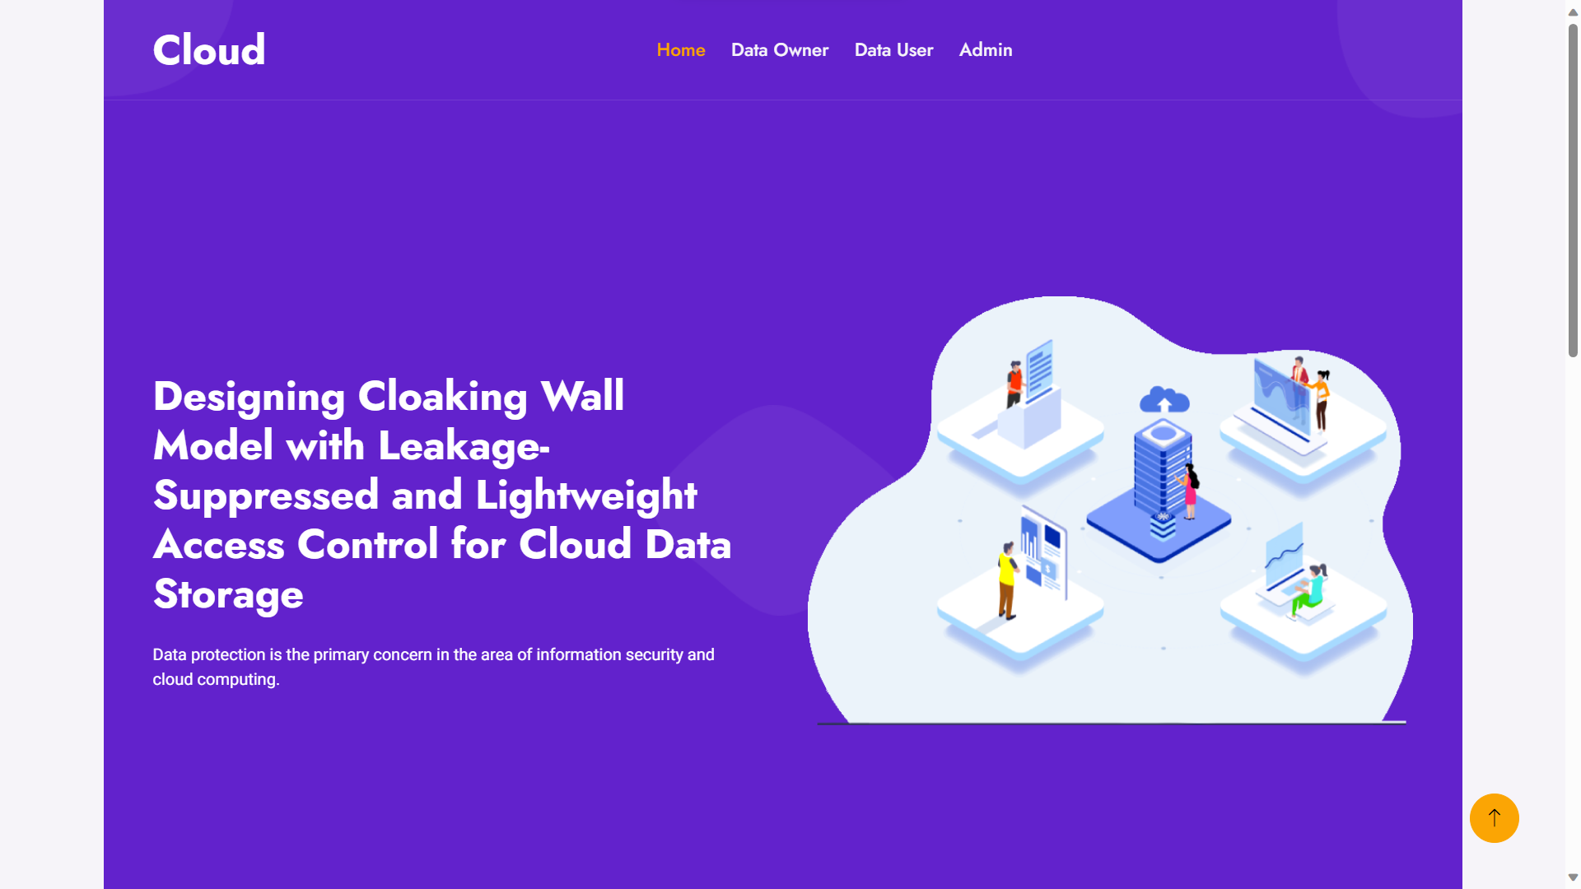
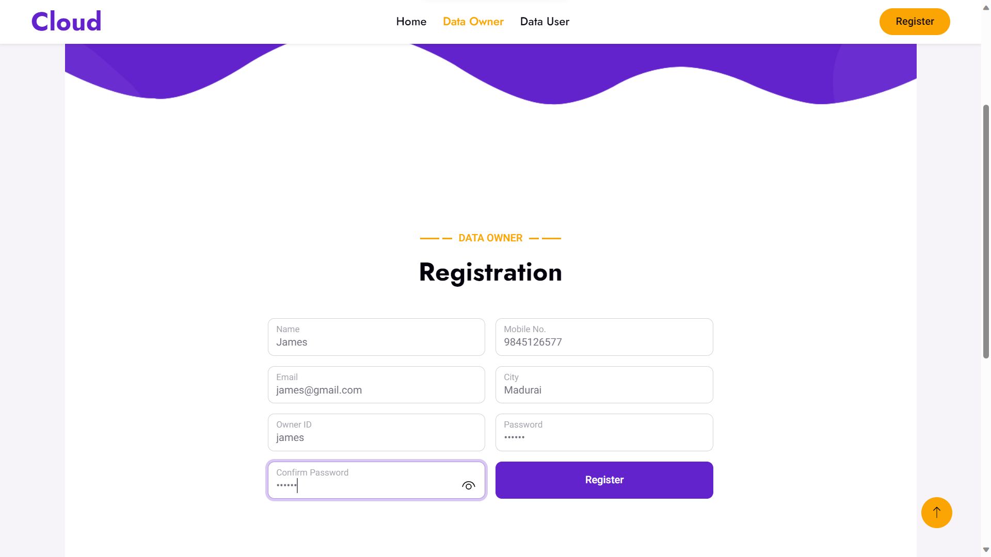
SAMPLE SCREENS
HOME PAGE
DATA OWNER REGISTRATION PAGE

Slide 31
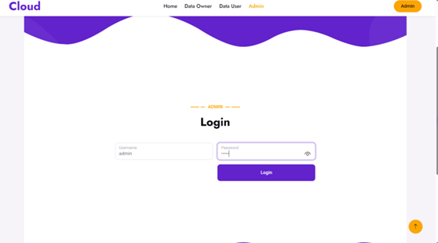
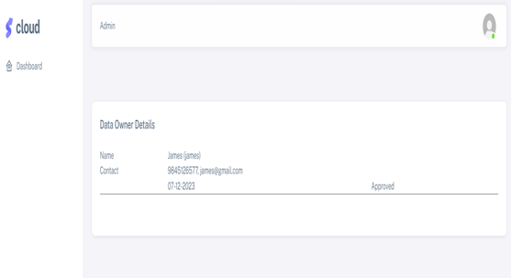
ADMIN LOGIN PAGE
DATA OWNER DETAILS

Slide 32
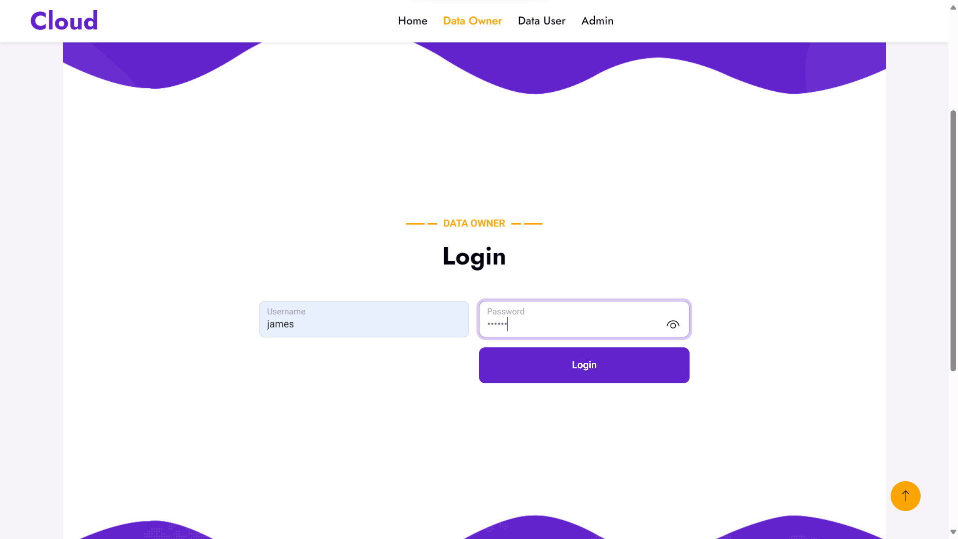
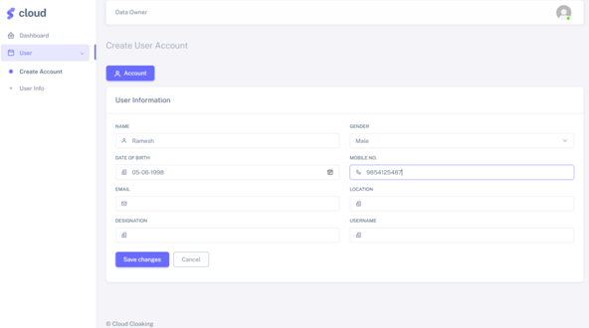
DATA OWNER LOGIN PAGE
CREATE ACCOUNT (DATA USER)

Slide 33
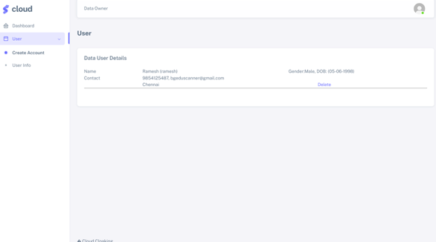
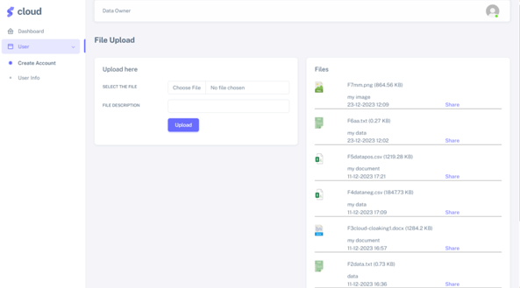
FILE UPLOAD (DATA OWNER)
DATA USER DETAILS

Slide 34
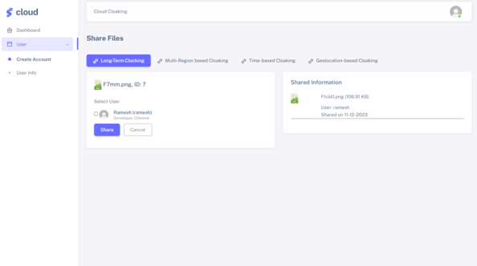
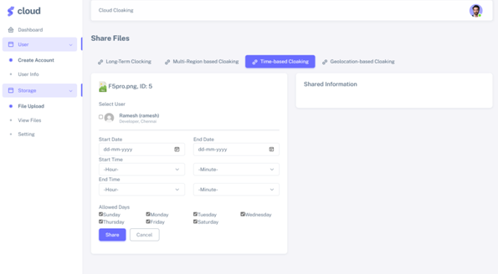
SHARE FILES (LONG TERM CLOAKING)
SHARE FILES (TIME BASED CLOAKING)

Slide 35
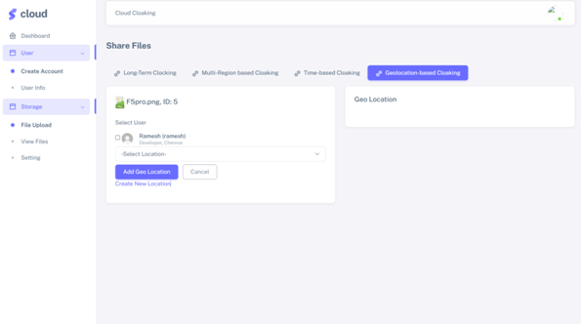
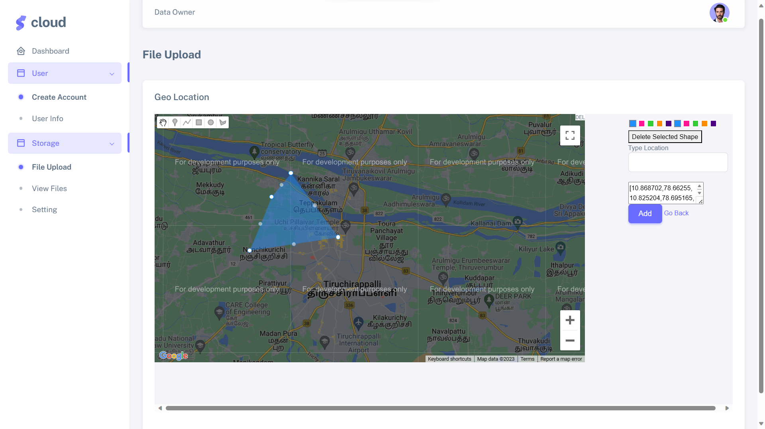
SHARED FILES (GEO LOCATION BASED)
ADDING GEO LOCATION

Slide 36
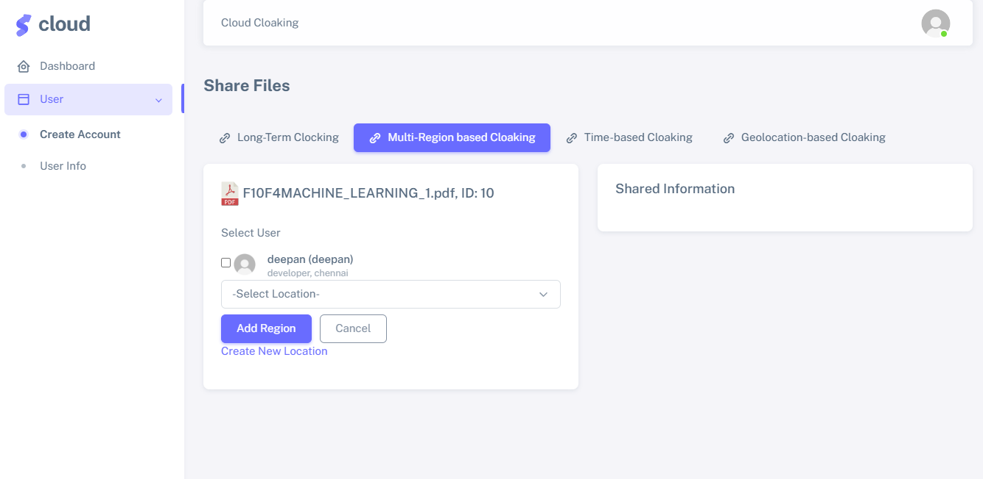
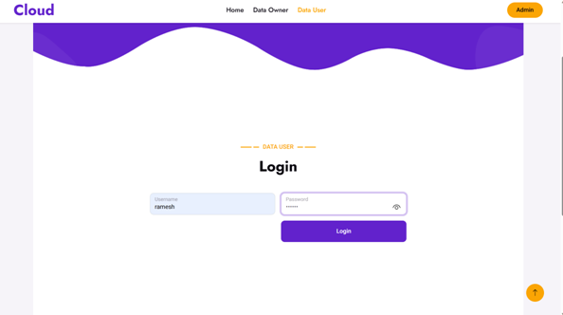
SHARED FILES (MULTI REGION BASED)
DATA USER LOGIN PAGE

Slide 37
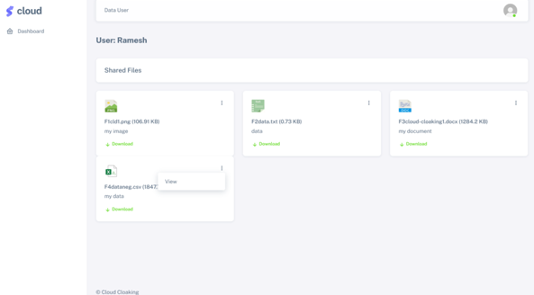
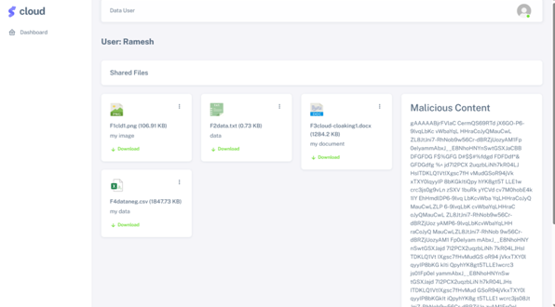
SHARED FILES (DATA USER)
MALICIOUS CONTENT (DATA USER)

Slide 38
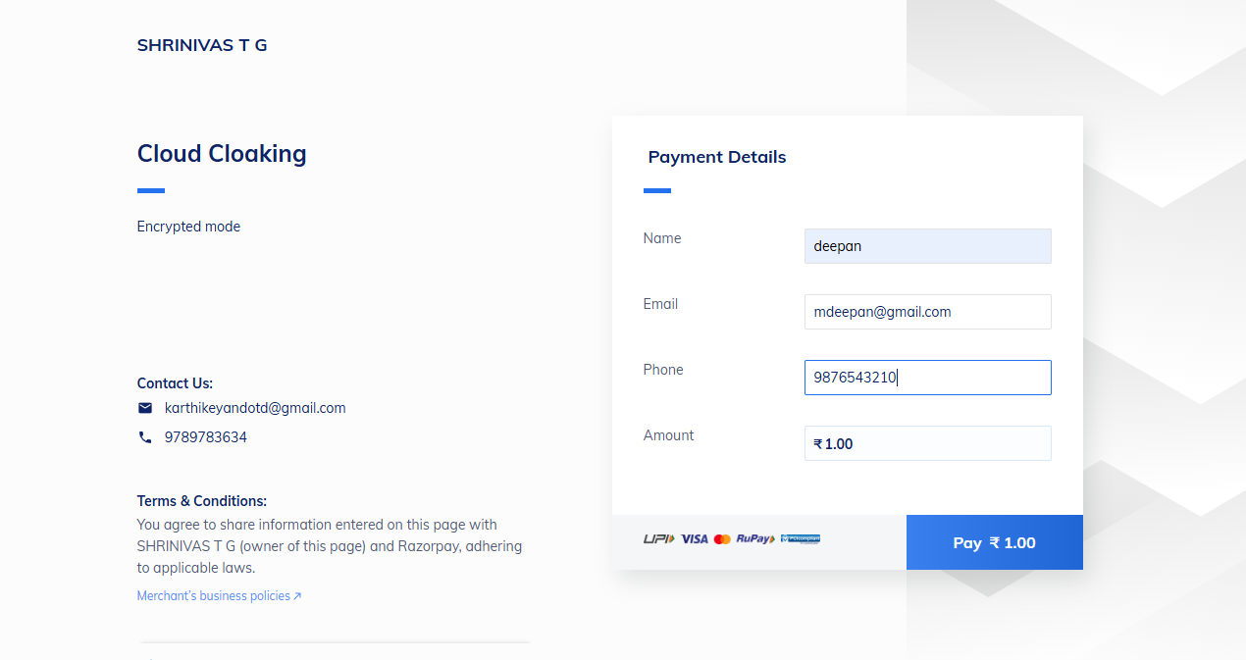
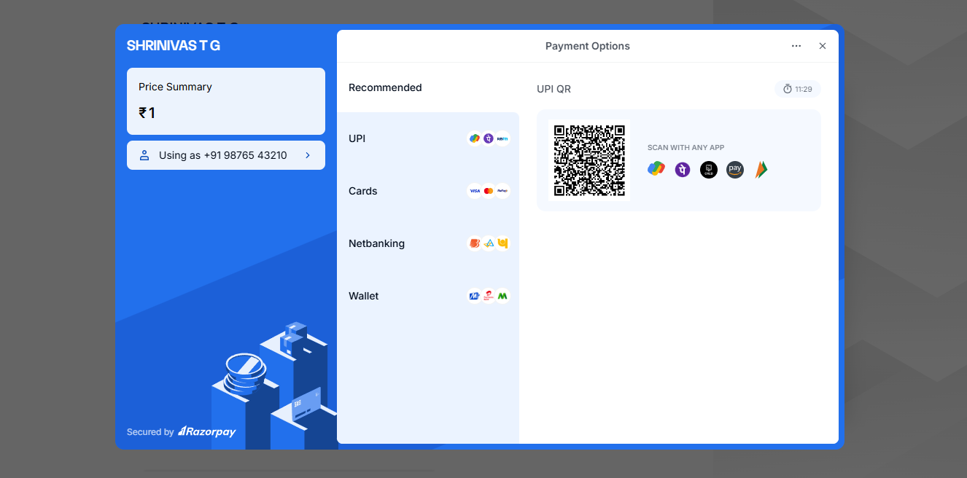
PAYMENT PAGE
PAYMENT PAGE ( UPI PAGE )

Slide 39
REFERENCES
E. Alowaisheq, P. Wang, S. Alrwais, X. Liao, X. Wang, T. Alowaisheq, X. Mi, S. Tang, and B. Liu, ‘‘Cracking the wall of confinement: Understanding and analyzing malicious domain take-downs,’’ in Proc. Netw. Distrib. Syst. Secur. Symp., 2019.
G. Zhang, X. Chen, B. Feng, X. Guo, X. Hao, H. Ren, C. Dong, and Y. Zhang, ‘‘BCST-APTS: Blockchain and CP-ABE empowered data supervision, sharing, and privacy protection scheme for secure and trusted agricultural product traceability system,’’ Secur. Commun. Netw., vol. 2022, pp. 1–11, Jan. 2022, doi: 10.1155/2022/2958963.
E. Zagan and M. Danubianu, ‘‘ADLS Gen 2 for web server log data analysis,’’ in Proc. Int. Conf. Develop. Appl. Syst. (DAS), Suceava, Romania, 2022, pp. 161–166, doi: 10.1109/DAS54948.2022.9786071.
Y. J. Wang, C. T. Cao, and L. You, ‘‘A novel personal privacy data protection scheme based on blockchain and attribute-based encryption,’’ J. Cryptol. Res., vol. 8, no. 1, pp. 14–27, 2021, doi: 10.13868/j.cnki.jcr. 000416.

Slide 40
REFERENCES
P. Zeng, Z. Zhang, R. Lu, and K.-K.-R. Choo, ‘‘Efficient policy-hiding and large universe attribute-based encryption with public traceability for Internet of Medical Things,’’ IEEE Internet Things J., vol. 8, no. 13, pp. 10963–10972, Jul. 2021.
P. Patil and M. Sangeetha, "Blockchain-based decentralized KYC verification framework for banks", Proc. Comput. Sci., vol. 215, pp. 529-536, Jan. 2022.
6.S. Fugkeaw, "A lightweight policy update scheme for outsourced personal health records sharing", IEEE Access, vol. 9, pp. 54862-54871, 2021.
J. Sun, D. Chen, N. Zhang, G. Xu, M. Tang, X. Nie, et al., "A privacy-aware and traceable fine-grained data delivery system in cloud-assisted healthcare IIoT", IEEE Internet Things J., vol. 8, no. 12, pp. 10034-10046, Jun. 2021.

Slide 41
THANK YOU

