Slide 1
IBM University Engagement Project Submission
“Exploring the Power of Agentic AI with IBM Granite and IBM Bob”

Slide 2

Project Tile – Intelligent Classification of Rural Infrastructure Projects
Domain of Project – Rural Development / Infrastructure
Student Name | Recent Passport Photo | Email ID | Mobile number [WhatsApp]
Karthikeyan M |  | karthikeyamadhesh4@gmail.com | 8122056360

Slide 3
Problem Statement -
Problem statement - Intelligent Classification of Rural Infrastructure Projects
The Challenge
The Pradhan Mantri Gram Sadak Yojana (PMGSY) is a flagship rural development program in India, initiated to provide all-weather road connectivity to eligible unconnected habitations. Over the years, the program has evolved through different phases or schemes (PMGSY-I, PMGSY-II, RCPLWEA, etc.), each with potentially distinct objectives, funding mechanisms, and project specifications. For government bodies, infrastructure planners, and policy analysts, efficiently categorizing thousands of ongoing and completed projects is crucial for effective monitoring, transparent budget allocation, and assessing the long-term impact of these schemes. Manual classification is time-consuming, prone to errors, and scales poorly. Your specific task is to design, build, and evaluate a machine learning model that can automatically classify a road or bridge construction project into its correct PMGSY_SCHEME based on its physical and financial characteristics.
The Objective
Build an AI-powered Intelligent Classification System that automatically classifies rural road and bridge infrastructure projects into the correct PMGSY scheme based on their physical and financial characteristics.
The solution should:
Automated Scheme Classification – Predict the appropriate PMGSY scheme such as PMGSY-I, PMGSY-II, PMGSY-III, RCPLWEA, or PM-JANMAN.
ML-Based Prediction – Analyze project characteristics such as road works, road length, bridges, sanctioned cost, expenditure, completed works, and balance works.
Accurate & Scalable Classification – Reduce manual classification effort and improve consistency when handling large numbers of projects.
AI-Powered Explanation – Use IBM Granite to provide a clear, natural-language explanation of the predicted PMGSY scheme.
Interactive Dashboard – Provide a user-friendly interface to enter project details and view the predicted scheme, confidence, probabilities, and model insights.

Slide 4
Proposed Solution -
Proposed Solution: AI-Powered PMGSY Classification System
The proposed solution is an AI-powered Intelligent Classification System built using IBM Bob, IBM watsonx.ai, and Granite Models to automatically classify rural road and bridge infrastructure projects into the appropriate PMGSY scheme. The system addresses the challenges of manual project classification through an intelligent, scalable, and data-driven approach.
At its core, the solution uses a machine learning classification pipeline to analyze physical and financial characteristics of PMGSY projects. Project attributes such as the number of road works, road length, bridges, sanctioned cost, expenditure, completed works, and balance works are processed and provided to a trained classification model to predict the appropriate scheme.
The system uses a Random Forest classification model trained on the PMGSY dataset to identify patterns in historical project data and classify projects into schemes such as PMGSY-I, PMGSY-II, PMGSY-III, RCPLWEA, and PM-JANMAN.
The solution consists of three key components:
ML Classification Module predicts the appropriate PMGSY scheme based on project characteristics.
IBM Granite AI Module generates a clear, natural-language explanation of the model's prediction and provides context about the selected scheme.
Interactive Web Application allows users to enter project details and view the predicted scheme, confidence/probability, model performance, and AI-generated explanation.
IBM Bob is used to develop the frontend, backend, machine learning pipeline, and application workflow, while watsonx.ai provides the environment for integrating IBM Granite models. Granite models power the AI-based explanation of classification results.
Overall, this solution delivers an end-to-end intelligent PMGSY classification system that reduces manual effort, improves consistency in scheme classification, and provides transparent AI-assisted insights for rural infrastructure project monitoring and planning.

Slide 5
Technology Used
IBM Bob platform -For designing and orchestrating multi-agent workflows visually
IBM Granite 4 H Small – For natural language understanding, reasoning, and generating clear explanations of PMGSY classification results.
IBM Cloud – It provides the infrastructure to build, deploy, and scale the Nutrition Agent efficiently. IBM Cloud enables a reliable, secure, and scalable environment for deploying the Nutrition Agent.
IBM Watsonx.ai - For model deployment, embeddings, and AI governance

Slide 6
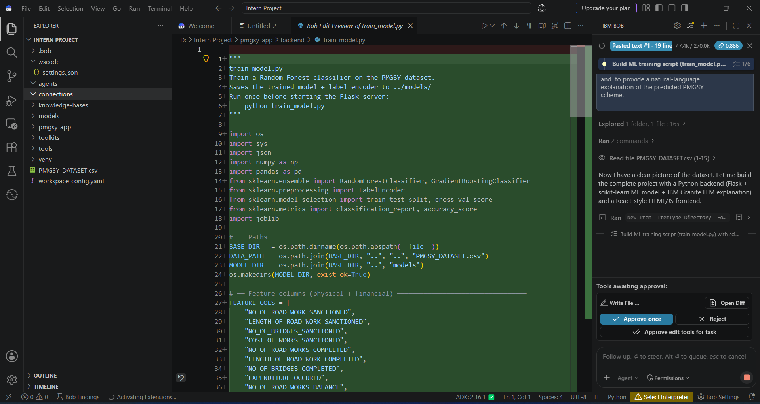
Required Files created using IBM bob -

Slide 7
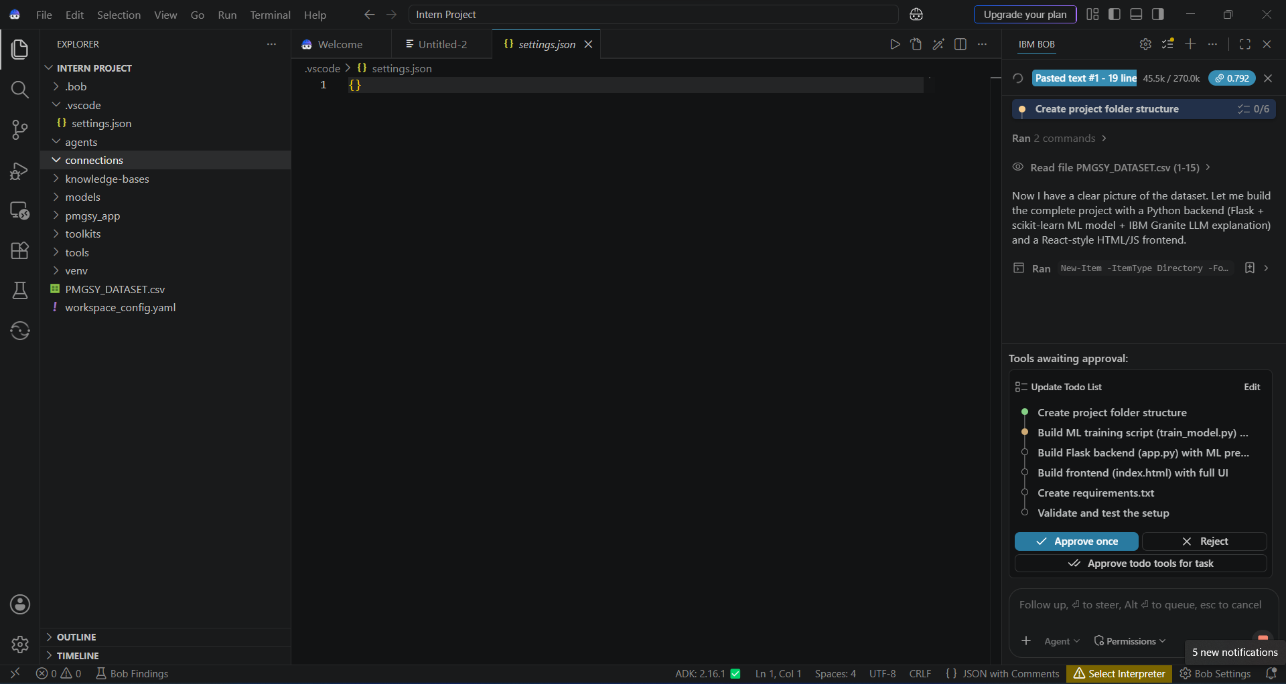
IBM Bob Screenshots:

Slide 8
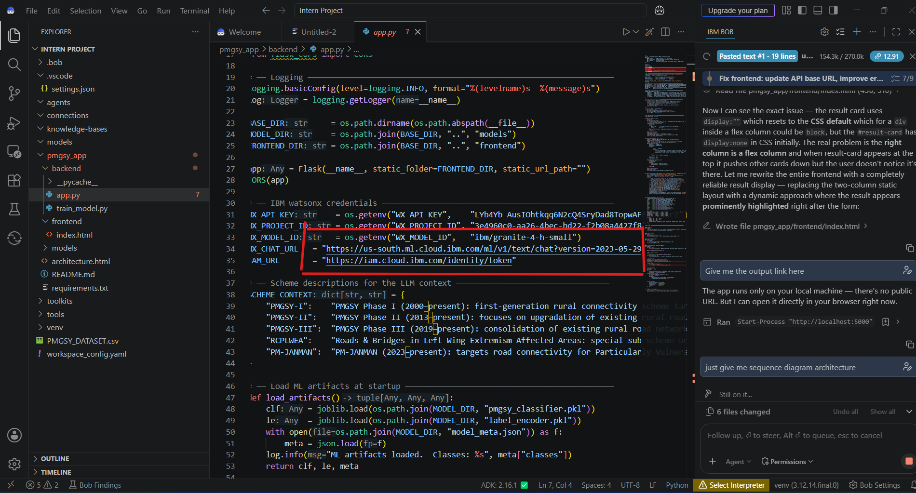

Slide 9
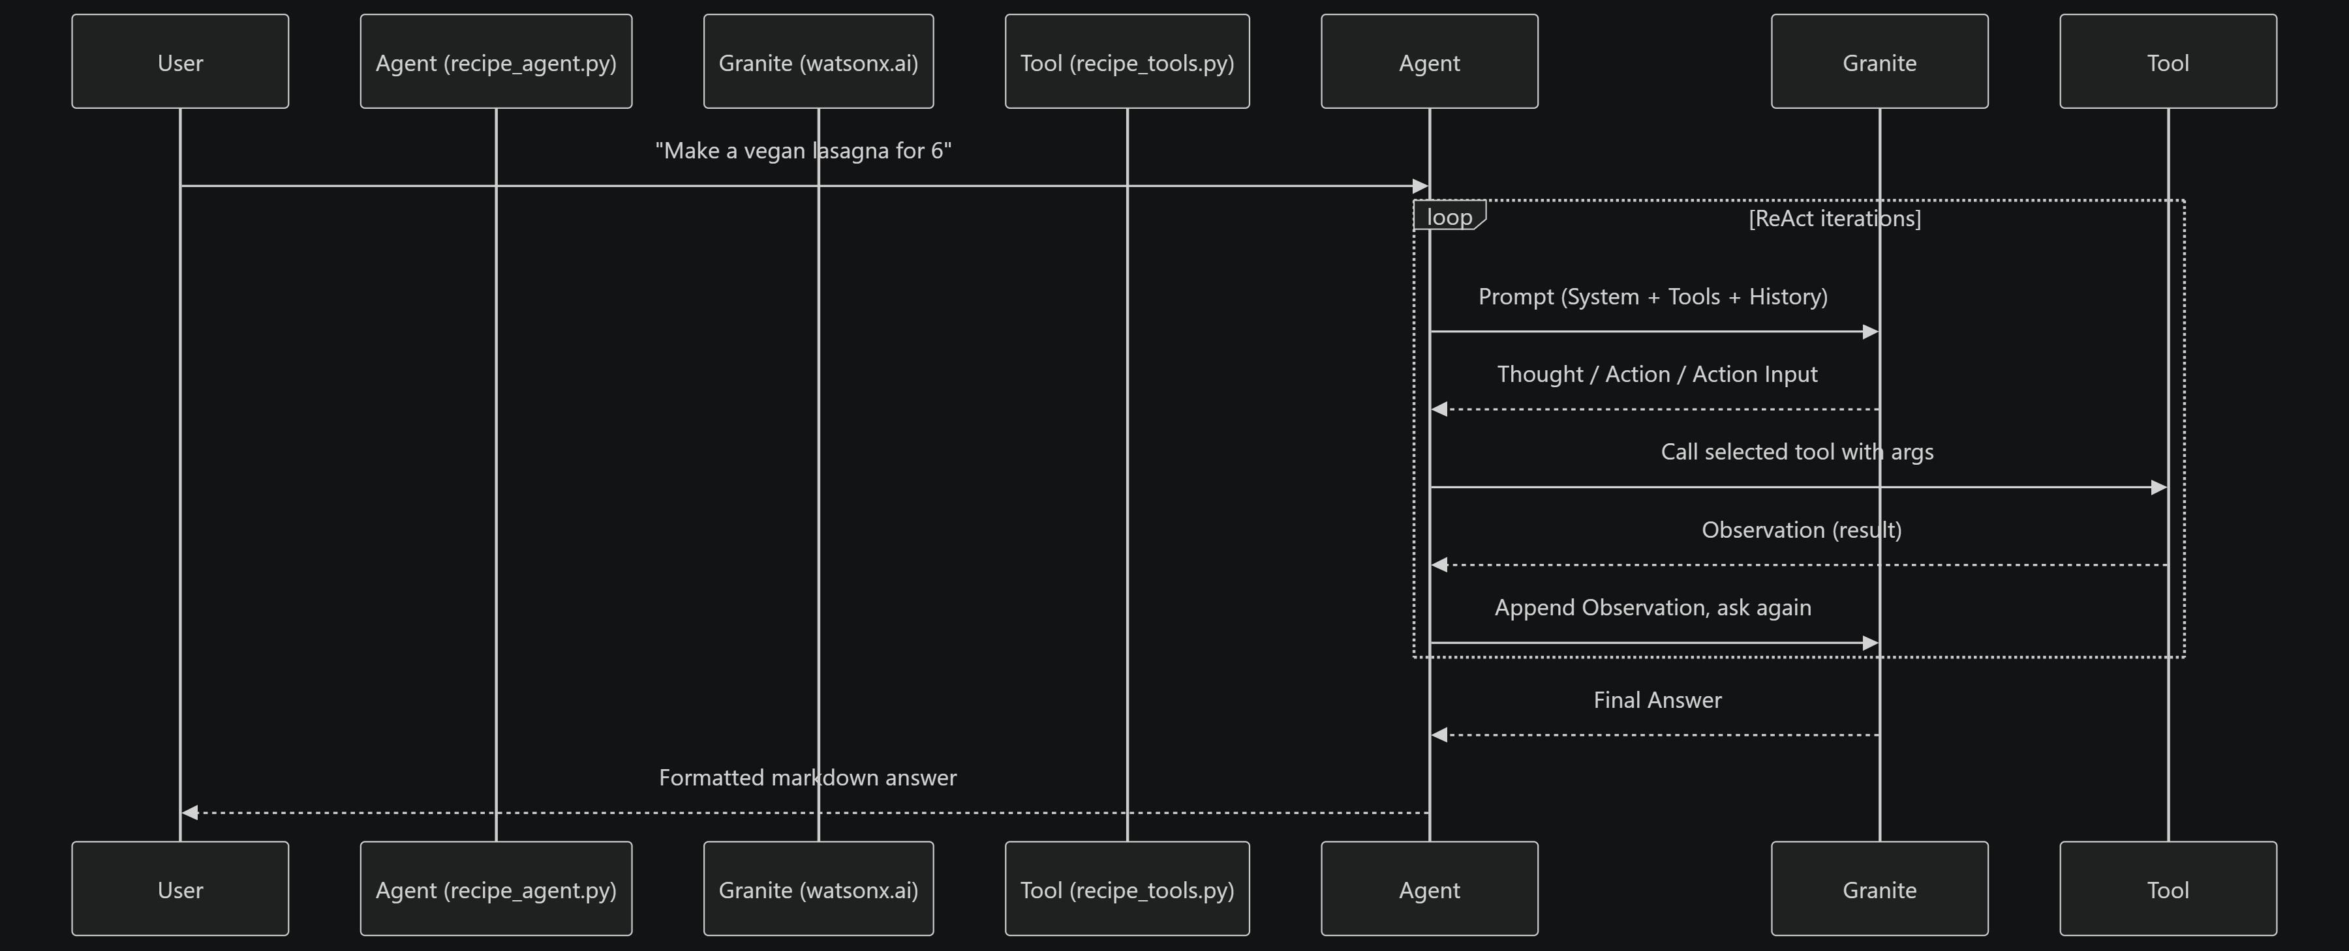
Architecture blueprint for IBM bob:

Slide 10
Role of AI in the PMGSY Classification System
AI-Powered Classification
enables the PMGSY system to automatically analyze rural infrastructure project data and classify each project into the appropriate PMGSY scheme. The system uses a Random Forest machine learning model to identify patterns in project characteristics and predict the scheme.
The system analyzes key project attributes such as road works, road length, bridges, sanctioned cost, expenditure, completed works, and balance works to make the classification.
IBM Granite 4 H Small is integrated as an AI explanation layer. After the Random Forest model predicts the scheme, Granite generates a clear, natural-language explanation of the prediction, helping users understand the classification result.
The system also provides confidence/probability scores and model insights, making the prediction more transparent and easier to interpret.
Overall, the AI-powered approach makes the system automated, data-driven, scalable, and explainable, reducing manual effort in PMGSY scheme classification and supporting better project analysis.

Slide 11
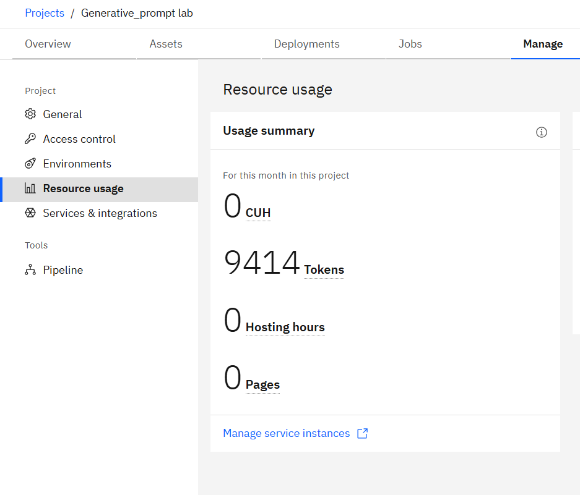
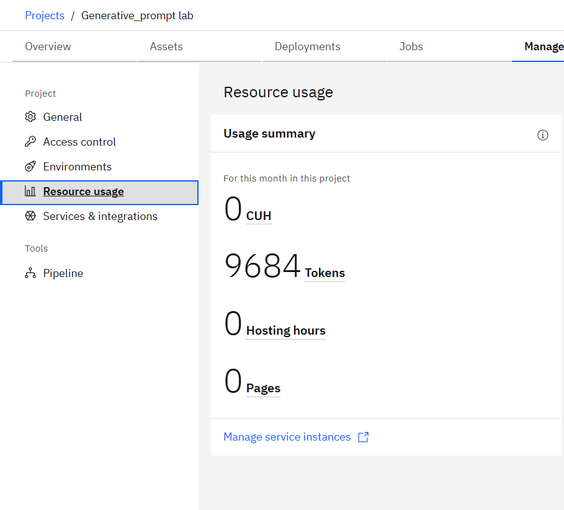
Token Usage
Before Prompt
After the Prompt
·
·
·

Slide 12
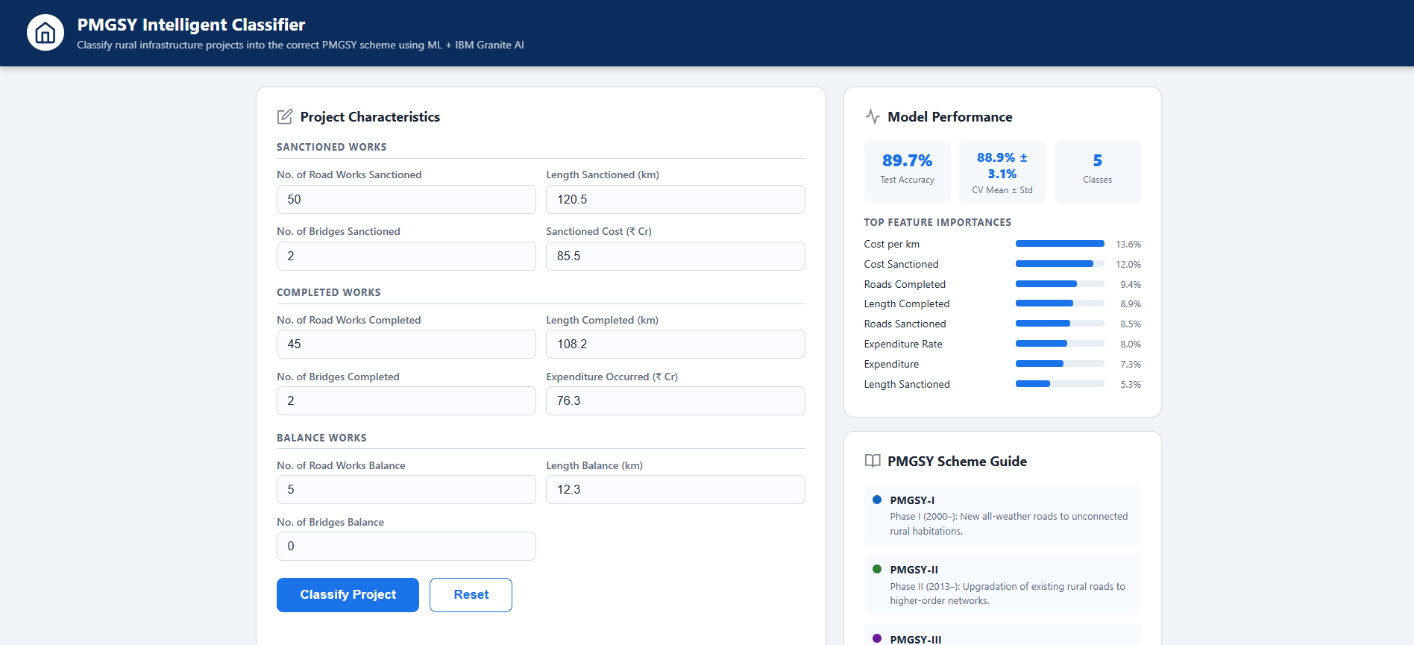
Project Output Screenshot
·
·
·

Slide 13
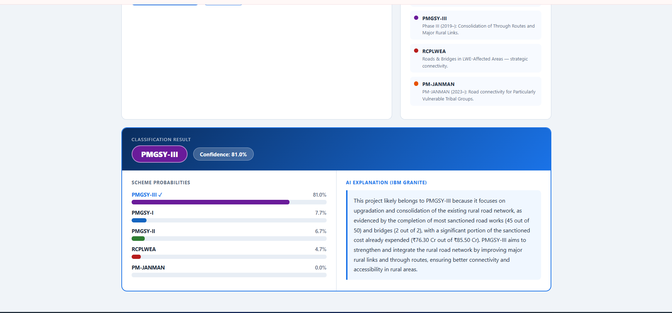
Project Output Screenshot

Slide 14
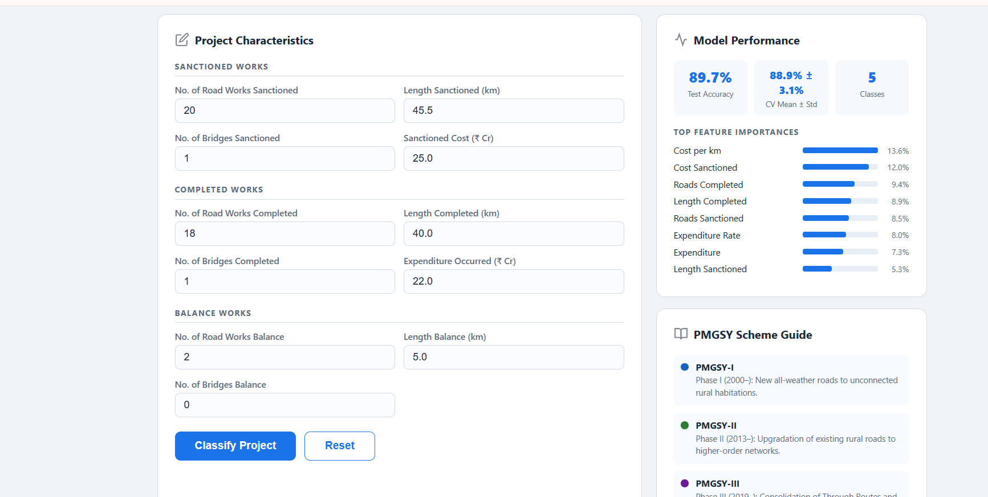
Project Output Screenshot
·
·
·

Slide 15
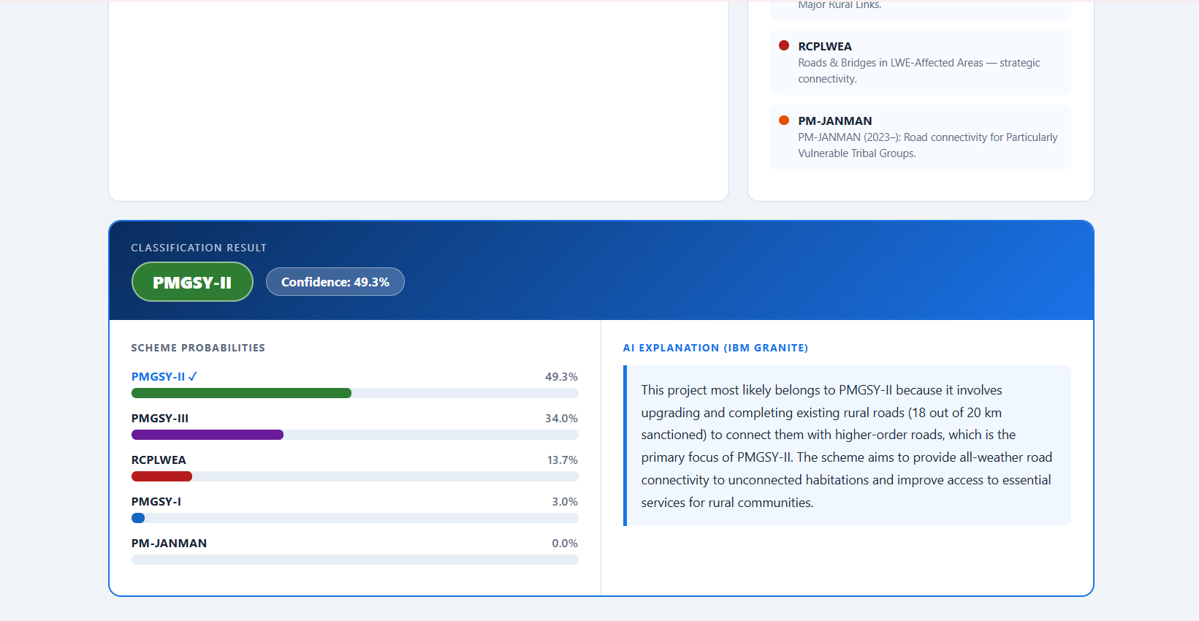
Project Output Screenshot
·
·
·

Slide 16
Novelty and Uniqueness
The proposed PMGSY Intelligent Classification System stands out by combining Machine Learning, IBM Granite, and automated project analysis into a single intelligent classification solution.
Automated Scheme Classification – Uses a Random Forest classifier to automatically classify rural infrastructure projects into PMGSY-I, PMGSY-II, PMGSY-III, RCPLWEA, or PM-JANMAN.
Data-Driven Prediction – Analyzes project characteristics such as road works, road length, bridges, sanctioned cost, expenditure, completed works, and balance works to identify classification patterns.
AI-Powered Explanation – Uses IBM Granite 4 H Small to generate clear, natural-language explanations for the predicted PMGSY scheme.
Transparent Predictions – Provides confidence/probability scores along with the predicted scheme, making the ML decision easier to understand.
End-to-End Automation – Integrates the ML model, Flask backend, web interface, and Granite into one complete workflow, reducing manual classification effort.
Scalable Solution – Can process large numbers of rural infrastructure projects and provide consistent scheme classification.
Overall, the solution provides a smart, automated, data-driven, and explainable PMGSY classification system, rather than relying on manual scheme identification.

Slide 17
Git Hub Link
https://github.com/Karthikeyanmatesh/pmgsy-intelligent-classifier
·
·
·

Slide 18
Future Scope
Integration with Real-Time PMGSY Data
The system can be integrated with updated government and PMGSY datasets to collect real-time information such as project progress, expenditure, road completion, and bridge status. This will enable the system to provide more accurate and up-to-date scheme classification and project analysis.
2. AI-Powered Multilingual Support
Enhancing the system with multilingual AI support will improve accessibility for government officials and users across different regions. IBM Granite can be extended to generate classification explanations in regional Indian languages, making the solution more inclusive and easier to understand.
·
·
·

Slide 19
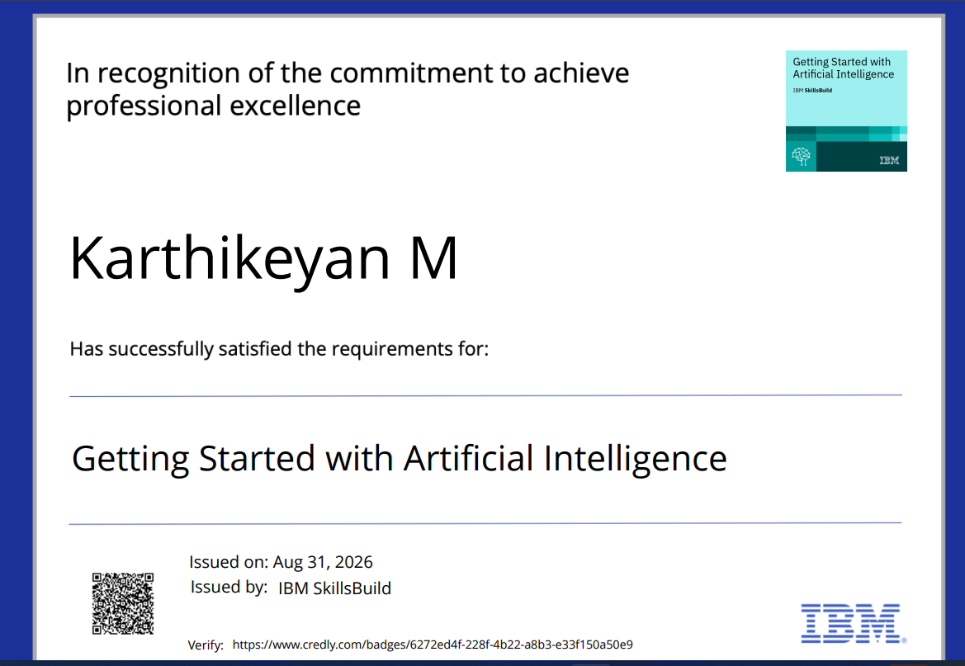
Certificates Earned:
Getting Started with Artificial Intelligence

Slide 20

Getting Started with Cybersecurity

Slide 21

Level up with cybersecurity with generative ai

Slide 22
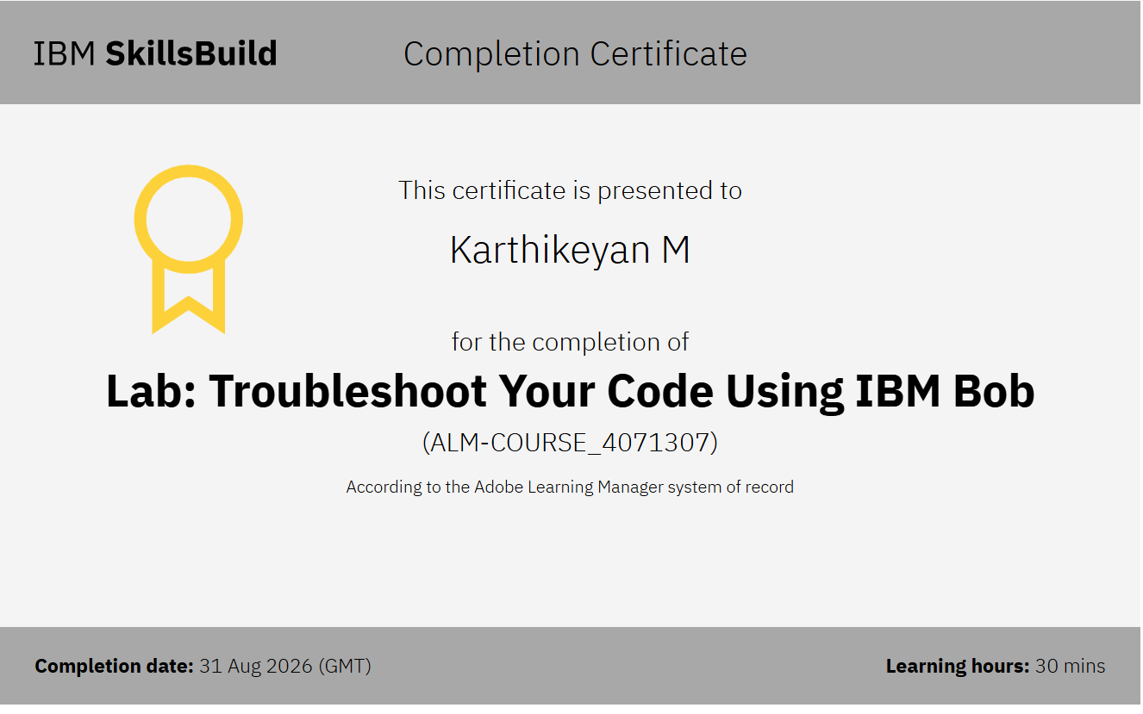
Troubleshoot your code using Ibm Bob

Slide 23


