Slide 1



COFEE_CAN-PORTFOLIO_270722
View in Power BI
Last data refresh:
27-07-2022 06:37:01 UTC
Downloaded at:
27-07-2022 07:33:38 UTC

Slide 2
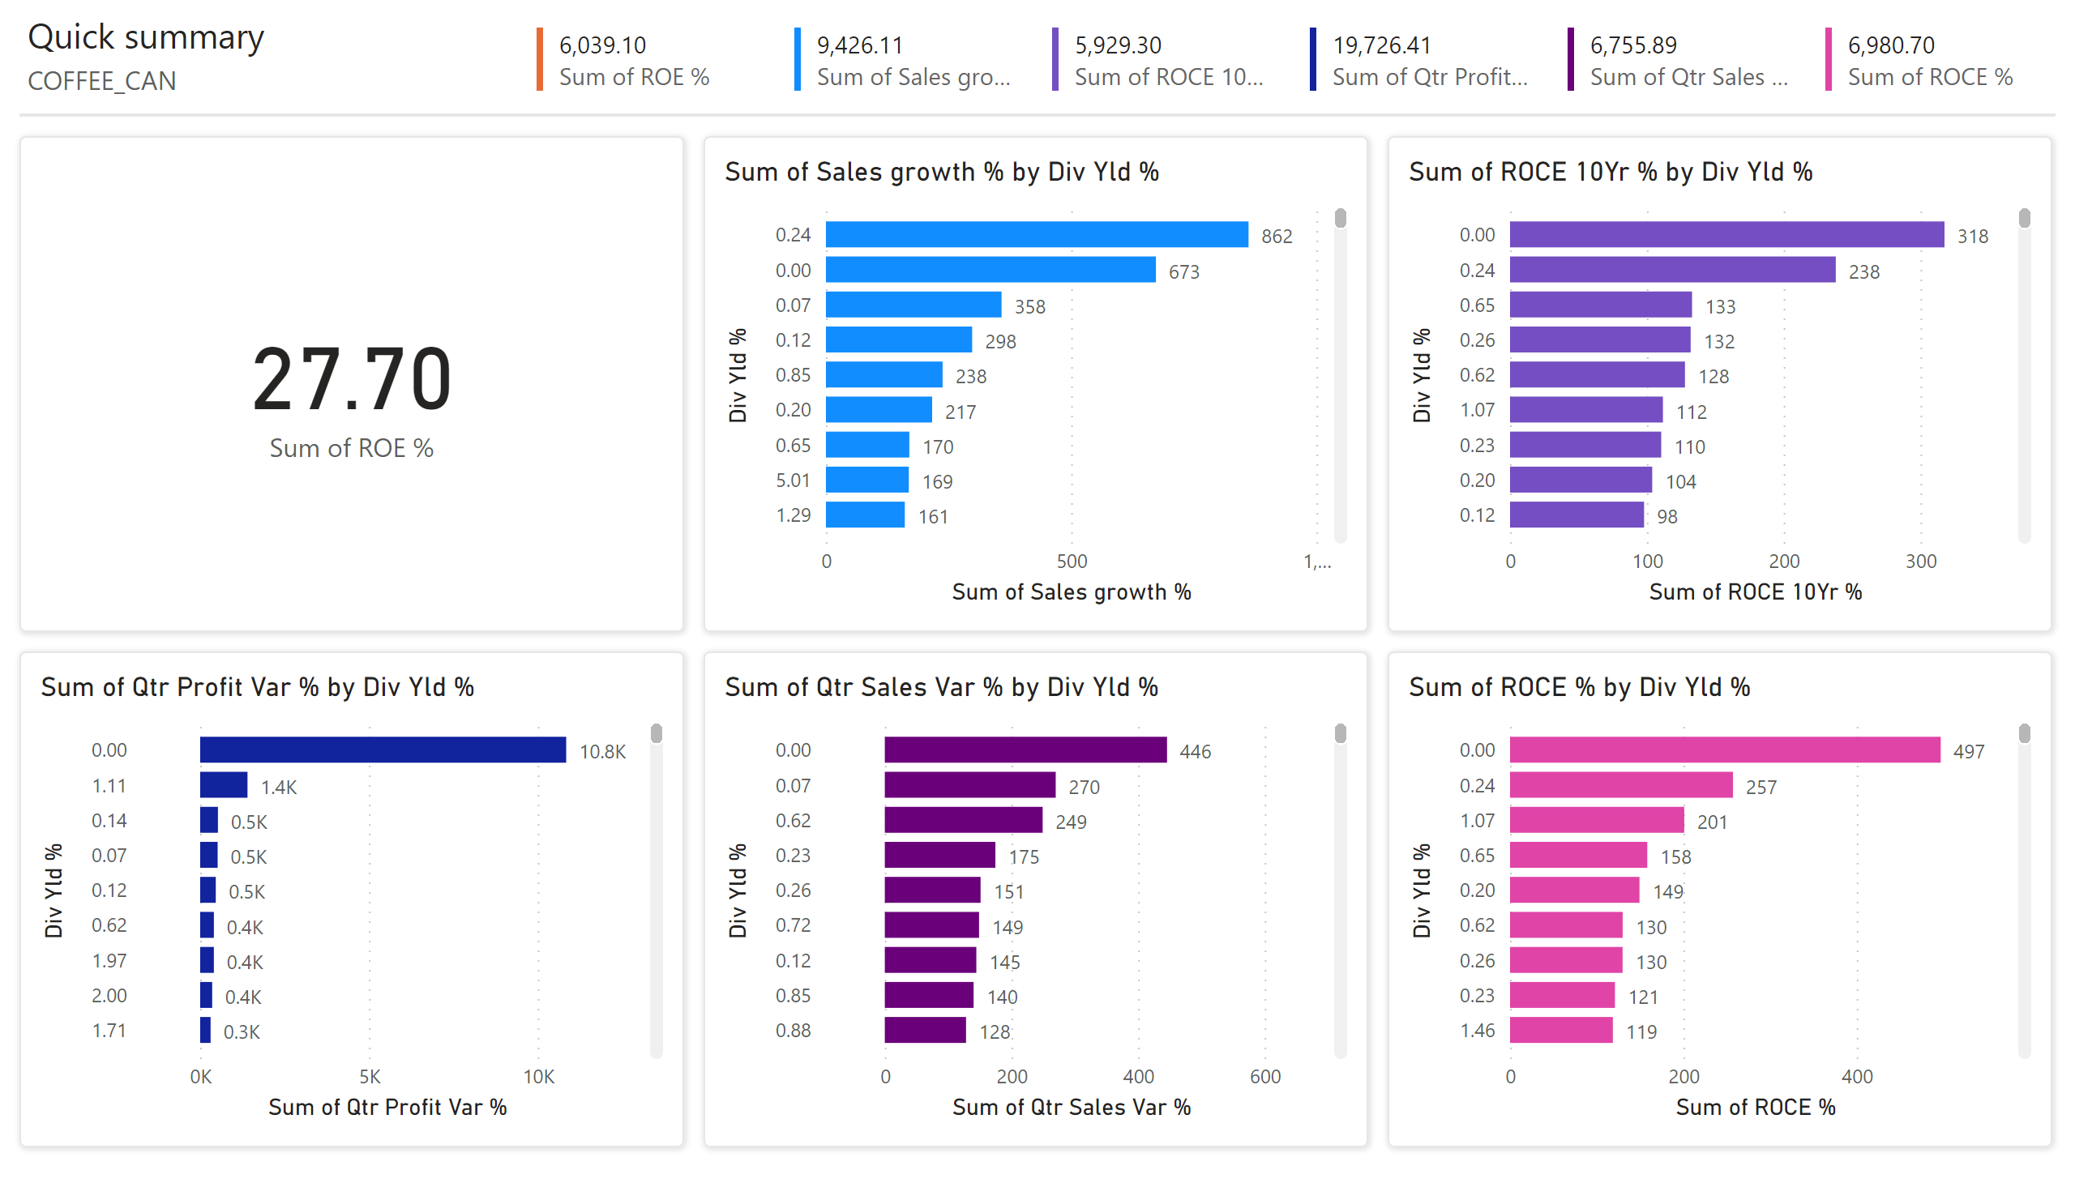
Page 1
Notes:
multiRowCard
No alt text provided
multiRowCard
No alt text provided
multiRowCard
No alt text provided
multiRowCard
No alt text provided
multiRowCard
No alt text provided
card
No alt text provided
clusteredBarChart
No alt text provided
clusteredBarChart
No alt text provided
clusteredBarChart
No alt text provided
clusteredBarChart
No alt text provided
clusteredBarChart
No alt text provided
shape
No alt text provided
shape
No alt text provided
shape
No alt text provided
shape
No alt text provided
shape
No alt text provided
shape
No alt text provided
textbox
No alt text provided
textbox
No alt text provided
shape
No alt text provided
multiRowCard
No alt text provided

