Slide 1
INDUCTION MOTOR CONTROLLER AND PROTECTION SYSTEM
GOVERNMENT COLLEGE OF ENGINEERING, SALEM-11
DEPARTMENT OF ELECTRICAL AND ELECTRONICS ENGINEERING
TEAM MEMBERS
GOPINATH K (2041013)
RAHULRAJ V (2041029)
THATCHANAMOORTHY S (61772141L10)
ARAVINTH K (61772141T302)
SUPERVISOR NAME
Dr. P. MARUTHUPANDI
(M.E., Ph.D., MISTE)
ASSOCIATE PROFESSOR
Year/Semester : Final / Seventh
Review No. : First Review
Review Date : 08/09/2023
Notes:
MPOO

Slide 2
CONTENT
INTRODUCTION
OBJECTIVE
LITERATURE SURVEY
BLOCK DIAGRAM
PROPOSED WORK
ADVANTAGES
EXPECTED OUTPUT
CONCLUSION
REFERENCES

Slide 3
INTRODUCTION
In this introduction, we will delve into the fundamental principles behind the control of induction motor’s speed and direction which used in modern industrial automation and machinery.
Induction motors are the workhorses of various applications, due to their robustness and reliability.
There are many methods available to control the speed of the induction motor, but the variable frequency drives (VFDs) is the most sophisticated and advanced control method.

Slide 4
OBJECTIVE
To control the speed and direction of the induction motor.
To protect the induction motor from the various parameters like Temperature and vibration using sensors.
And to monitor and display the real-time data to the ground floor workers in LCD display.

Slide 5
LITERATURE SURVEY
TITLE | OBSERVATION
P. S. Bimbra “Power Electronics” Khanna Publishers, New Delhi 2016. | To study an overview of power electronic devices.
Theodore S.Rappaport. "Wireless Communications: Principles and Practice", 2" Edition, Pearson, 2009. | To gain idea about wireless communication system.
muhammad ali mazidi, sepehr naimi, and sarmad naimi“The avr microcontroller and embedded systems using assembly and c, second edition: based on atmega328 and arduino boards, 2009” | Atmega family microcontroller(atmega 168/328) uses and desired operating system.

Slide 6
LITERATURE SURVEY
TITLE | OBSERVATION
D.P. Kothari, I.J. Nagrath, “Electric Machines”, 3rd edition, Tata McGraw-Hill Company Ltd., New Delhi, 2010. | To gain the knowledge on construction and principles of operation of transformers.
D.P. Kothari, I.J. Nagrath “Electric machines 4th edition, 2016” | To obtain knowledge about the induction motor and its running mechanism.

Slide 7
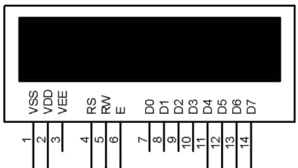
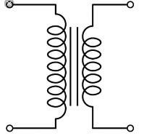

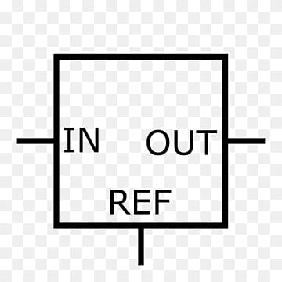

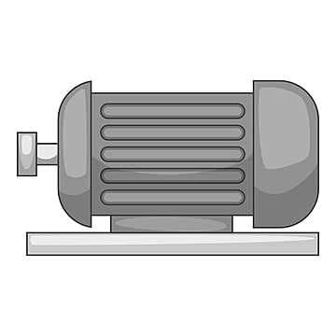
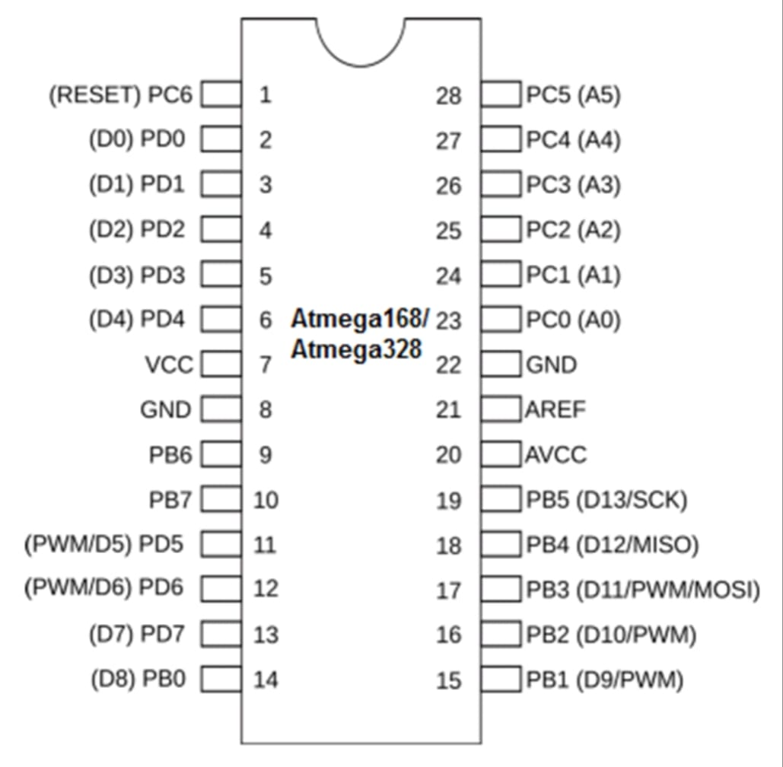
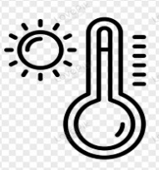
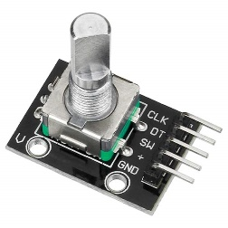


BLOCK DIAGRAM
LCD DISPLAY 16*2
TRANSFORMER
RECTIFIER
REGULATOR
VIBRATION SENSOR
VFD
INDUCTION MOTOR
TEMPERATURE SENSOR
ROTARY ENCODER
SENDER MOBILE
BLUETOOTH
MODULE
MICROCONTROLLER (Atmega 168)

Slide 8
PROPOSED WORK
Induction motors have been used widely in industrial machinery. The necessitates a speed control mechanism that is efficient and is also safe to use.
Also the induction motor can be run in either of the two directions which is quite useful in many applications. Along with it motors are the most vulnerable parts to get damaged as they product the desired motion in any machine.
So we also integrate a temperature and vibration detection alert in the system.

Slide 9
PROPOSED WORK
If the motor vibrates beyond a certain limit the system turns off the motor to avoid any damage to machine or motor.
Induction motors do not run at synchronous speed, they are generally fixed speed motors. In Industries mechanical loads should not only be driven but should also be driven at desired speed. Therefore, the need of speed control methods for induction motor arises.
Induction motors serve as the workhorses of various industries, driving essential processes across manufacturing, automation, and more.
This proposal aims to delve into the critical aspects of induction motor control and protection.

Slide 10
ADVANTAGES
Induction Motor Switching using App.
Induction Motor Speed Control.
Motor Direction Control (Clockwise/Anticlockwise).
Motor temperature Protection and vibration alert.

Slide 11
EXPECTED OUTPUT
By using DHT-11 and SW-420 sensors it could easy to monitor the temperature and vibration created by the induction motor through the LCD display .
In Industries mechanical loads should not only be driven but should also be driven at desired speed, so that speed of the induction motor is controlled by VFD(variable frequency drive) method.
In some industrial applications, Direction control should be required depend upon the industrial requirement.

Slide 12
CONCLUSION
It protect the induction motor from single phasing, overloading, overvoltage, under voltage and overheating.
So, It provides the smooth running of the induction motor expands its lifetime and also efficiency.
Thus the system provides a complete induction motor controlling as well as protection system for industrial applications.

Slide 13
REFERENCE
[1] R.J.Kerkman, G.L.Skibinski, D.W. Schlegel, “AC drives”; Year 2000 and Beyond, Record of IEEE-APEC ’99, March, 1999.
[2] H.Sequenz, “The Windings of Electric Machines, vol.3.: A.C. Machines”, Springer Verlag, Vienna, 1950 (in German).
[3] “AC induction motor fundamentals” - Rakesh Parekh Microchip Technology Inc, 2015.
[4] “Electrical machines, 2nd edition, 2017” - S. K.Sahdev.

Slide 14
THANK YOU

