Slide 1
Credit card fraud detection- Advance Data science Capstone Karthikeyan Mani

Slide 2
AGENDA
Use case
Data set
Data Exploration & Feature Engineering
Model Creation
Summary

Slide 3
Use CASE
It is important that credit card companies are able to recognize fraudulent credit card transactions so that customers are not charged for items that they did not purchase.
We want to classify whether the credit card transaction is fraudulent or not

Slide 4
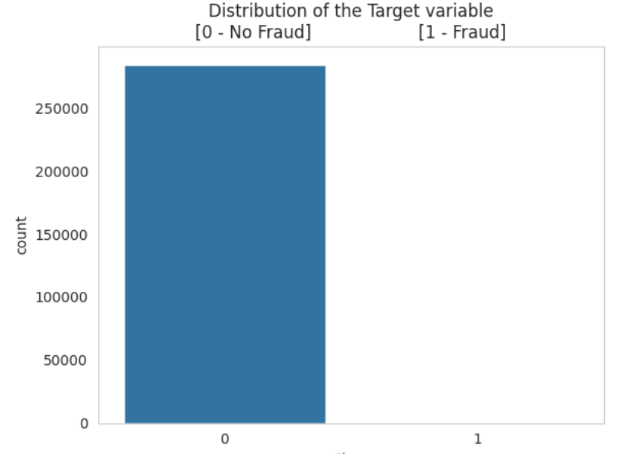

DataSET
The dataset contains transactions made by credit cards in September 2013 by European cardholders.
we have 492 frauds out of 284,807 transactions. The dataset is highly unbalanced, the positive class (frauds) account for 0.172% of all transactions.
Public data :https://www.kaggle.com/datasets/mlg-ulb/creditcardfraud?resource=download

Slide 5
Data exploration & Feature engineering

Slide 6
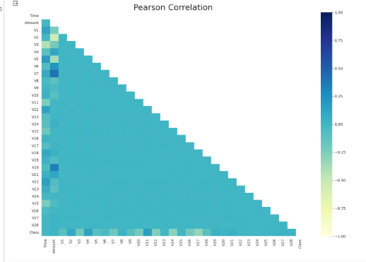
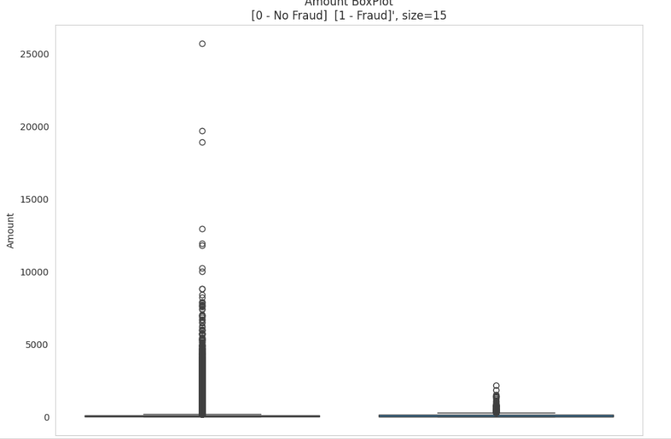
Data Exploration
Dataset has 30 features and 1 target
28 features are confidentials (Vl - V28} generated by PCA
The others 2 are Time and Amount
Extremely unbalanced
No missing values
Drop few outliers
Amount with value 00.8
Data is all clean

Slide 7
Feature engineering
The variable Time contains the seconds elapsed between each transaction and the first transaction in the dataset.
Since the dataset was collected for two days. We can convert the variable Time to Hours between 00h - 23h
We can get more insights like: What are the hours that fraudulent transactions most occurred.

Slide 8
Model Creation

Slide 9
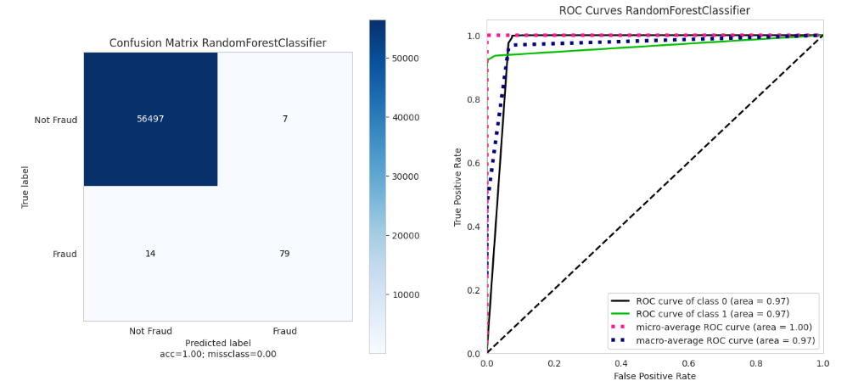
Random Forest
Standard parameters
Final scores was generated by cross validate with 5 folds
Results:
Ace: 1.0
Precision: 0.94
Recall: 0.74
Fl: 0.83
AUC: 0.96

Slide 10
Xg boost
Standard parameters
Final scores was generated by cross validate with 5 folds
Results:
Ace: 1.0
Precision: 0.95
Recall: 0.76
Fl: 0.84
AUC: 0.99

Slide 11
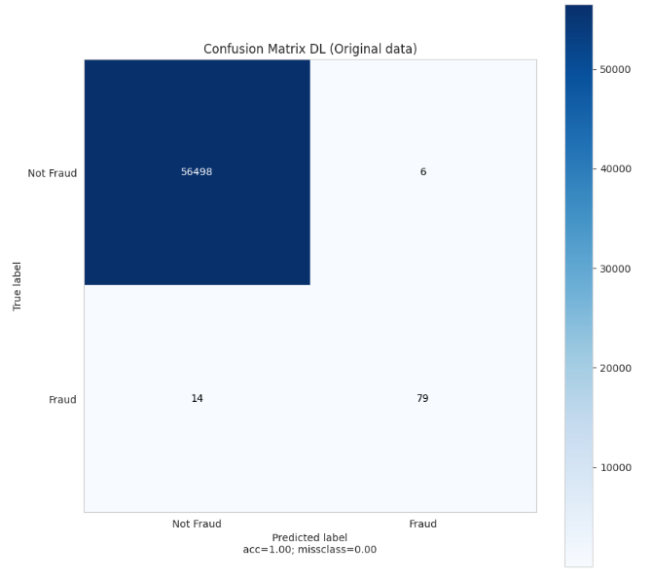
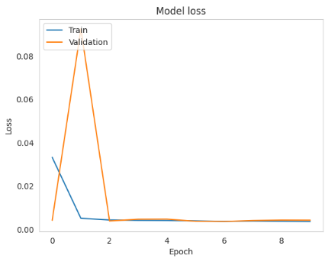
Deep Feed Foward Neural Network
● Preprocessing the data
● Early stopping: 10 patience
● Batch size: 64
● Epochs: 100
● Optimizer: Nadam
● Loss: Binary CrossEntropy

Slide 12
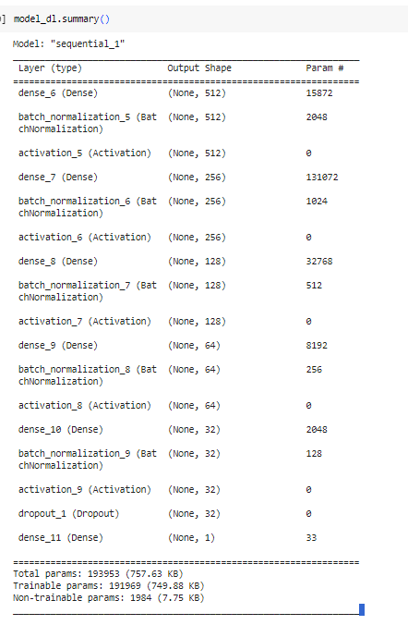
Summary
Best model: XGBoost
DL model with just few epochs achieved viable performance, however, the falses positives and negatives are relatively high.
Future work:
Experiment algorithms to deal with unbalanced dataset like:
SMOTE, ADASYN
Cost sensitive learning

Slide 13
THANK YOU

