Slide 1
DIPLOMA IN PYTHON PROGRAMMING
KARTHIK PALATHANAM
4240Z

Slide 2
INTRODUCTION
Diploma In Python Programming
The course offers total Python programming instruction which fits both new learners and people who want to boost their coding capabilities.. Students will examine project setup in Python and learn to receive user input while conducting variable operations on dates and times.

Slide 3
COURSE OBJECTIVES
Acquire fundamental programming skills coupled with knowledge of Python benefits.
Master developing and handling Python projects with Visual Studio software.
Programmers should employ input functions together with output functions for interacting with end-users.
Program with variables while handling numeric data and date/time functions.
Loops provide an optimal approach to writing automated code.
The program should support CSV file operations by both reading and writing data.
Studying graphical programming will include work with the Turtle library.

Slide 4
MODULE AND STUDY HOURS
This course consists of 12 modules including practices,handling errors and course assessment.
The estimated time duration of this course is 10-15 hours.

Slide 5
WHY THIS COURSE
Career Advancement
Beginner-Friendly
Flexible Learning
Certification
Practical Skills

Slide 6
ADVANTAGES
Free & Accessible
Recognized Certification
Comprehensive Curriculum
Hands-On Practice
Industry-Relevant Skills

Slide 7
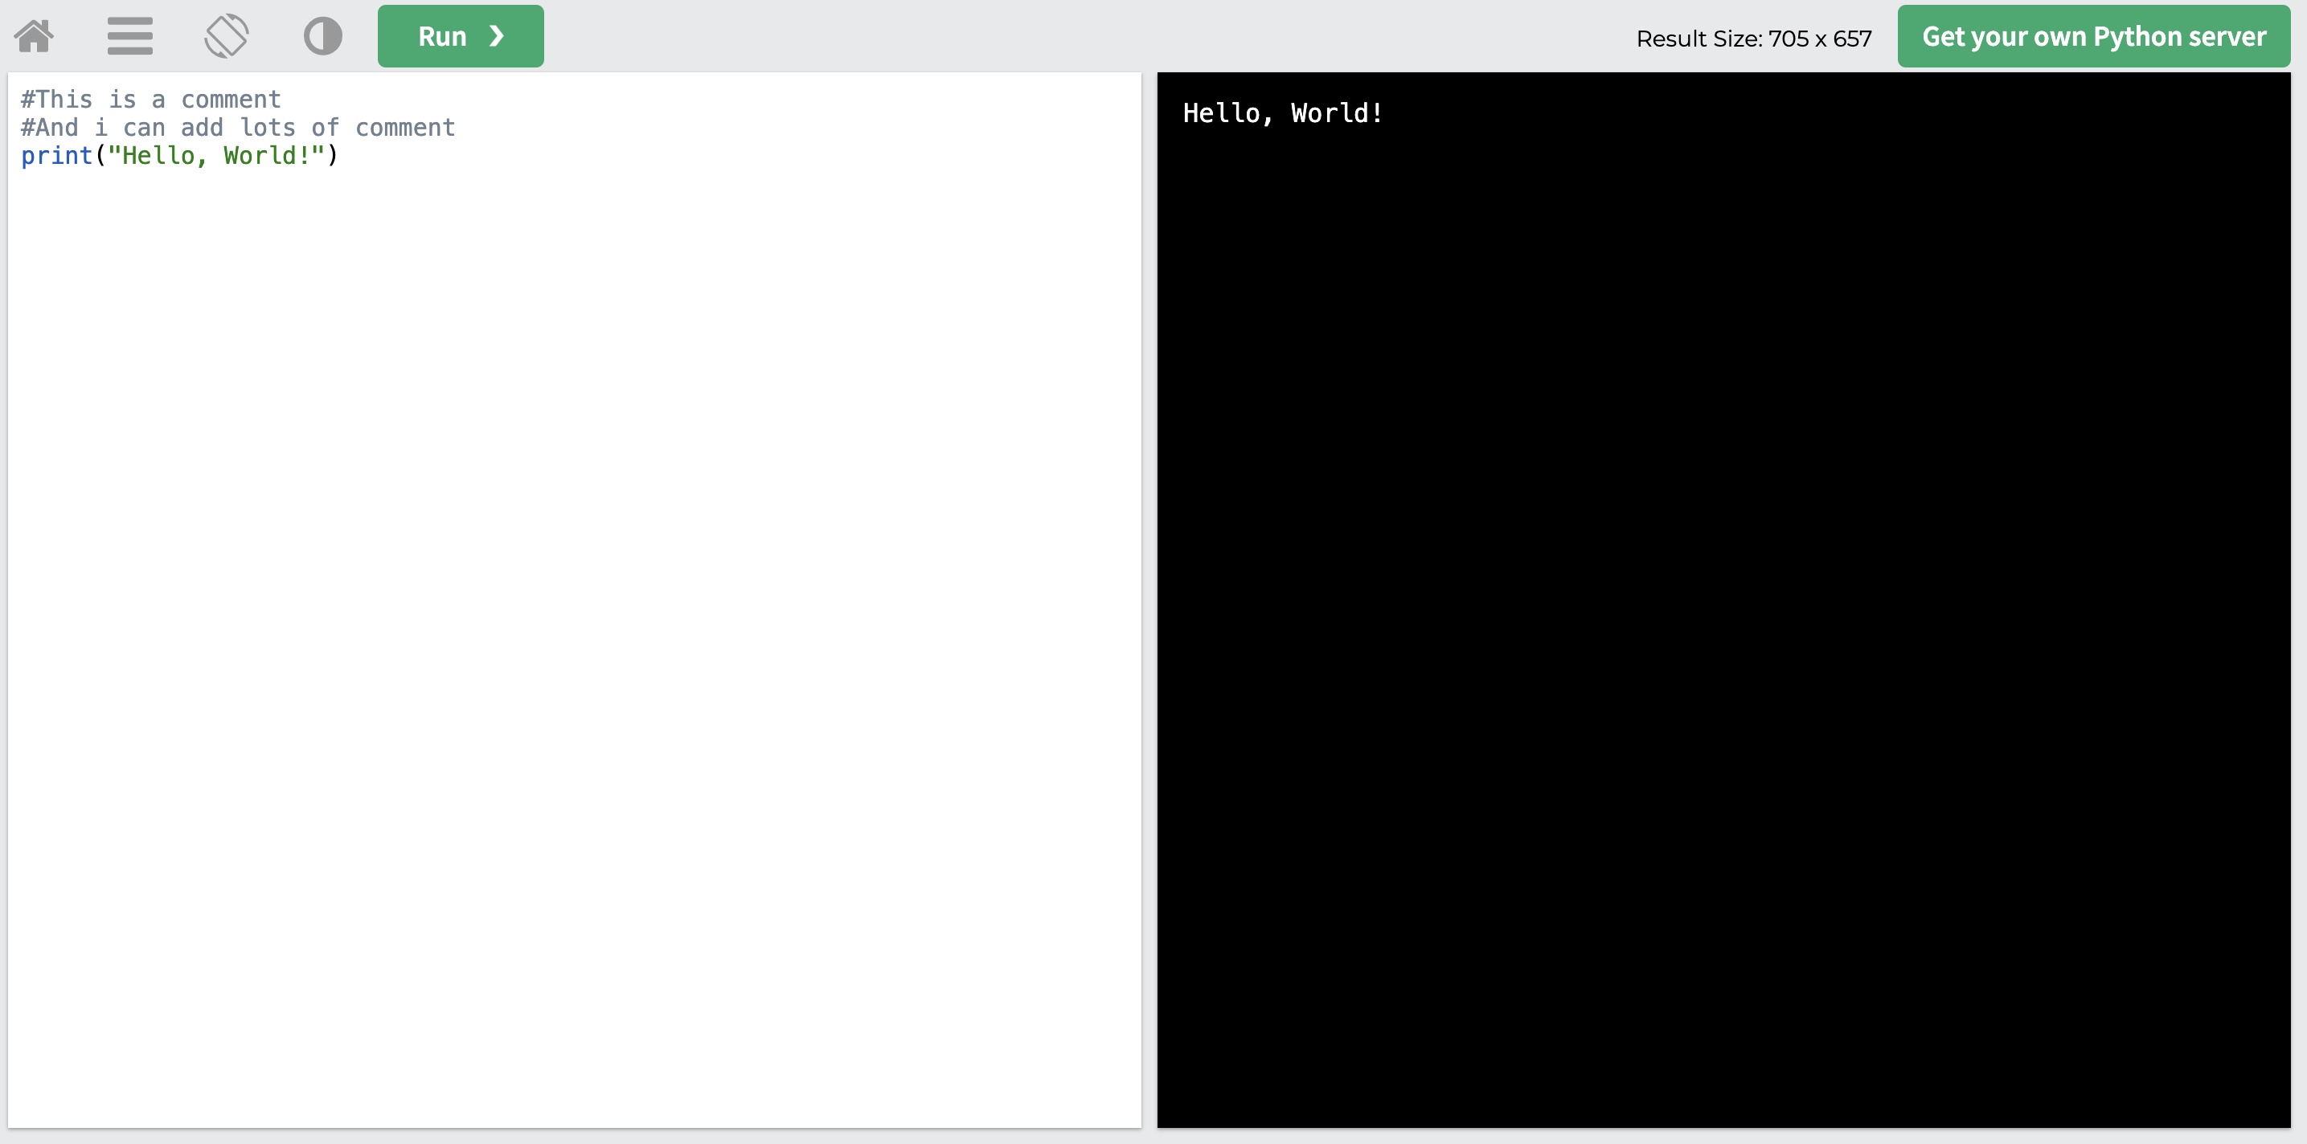
SCREENSHOTS

Slide 8
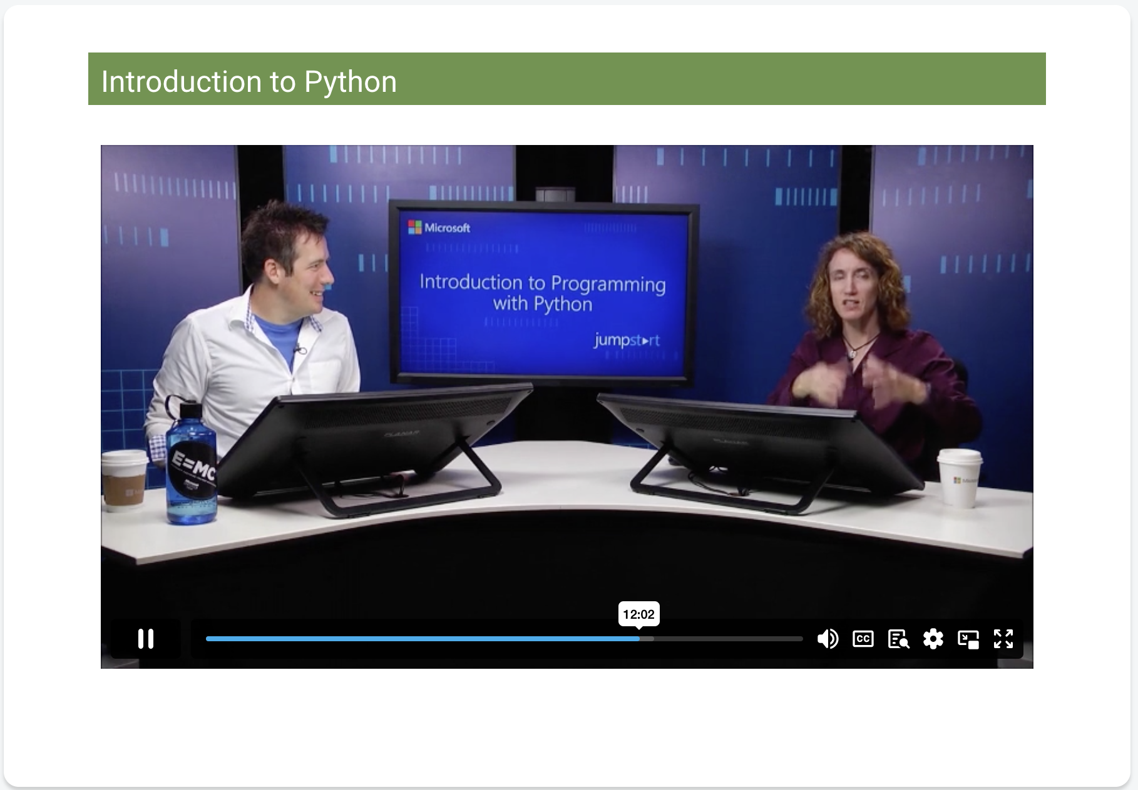

Slide 9
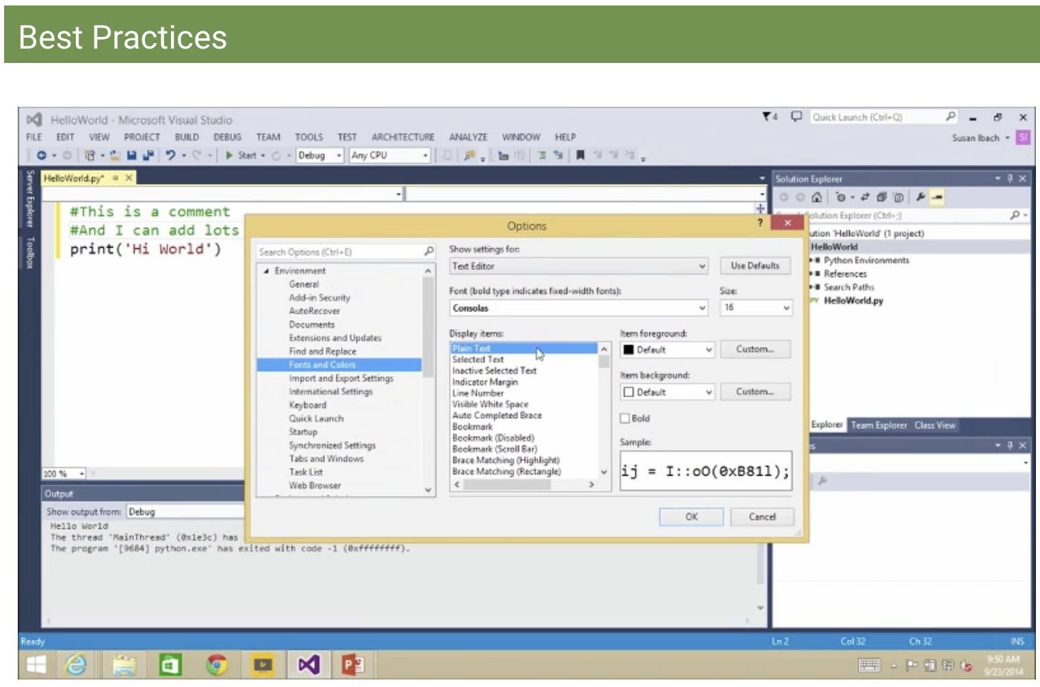

Slide 10
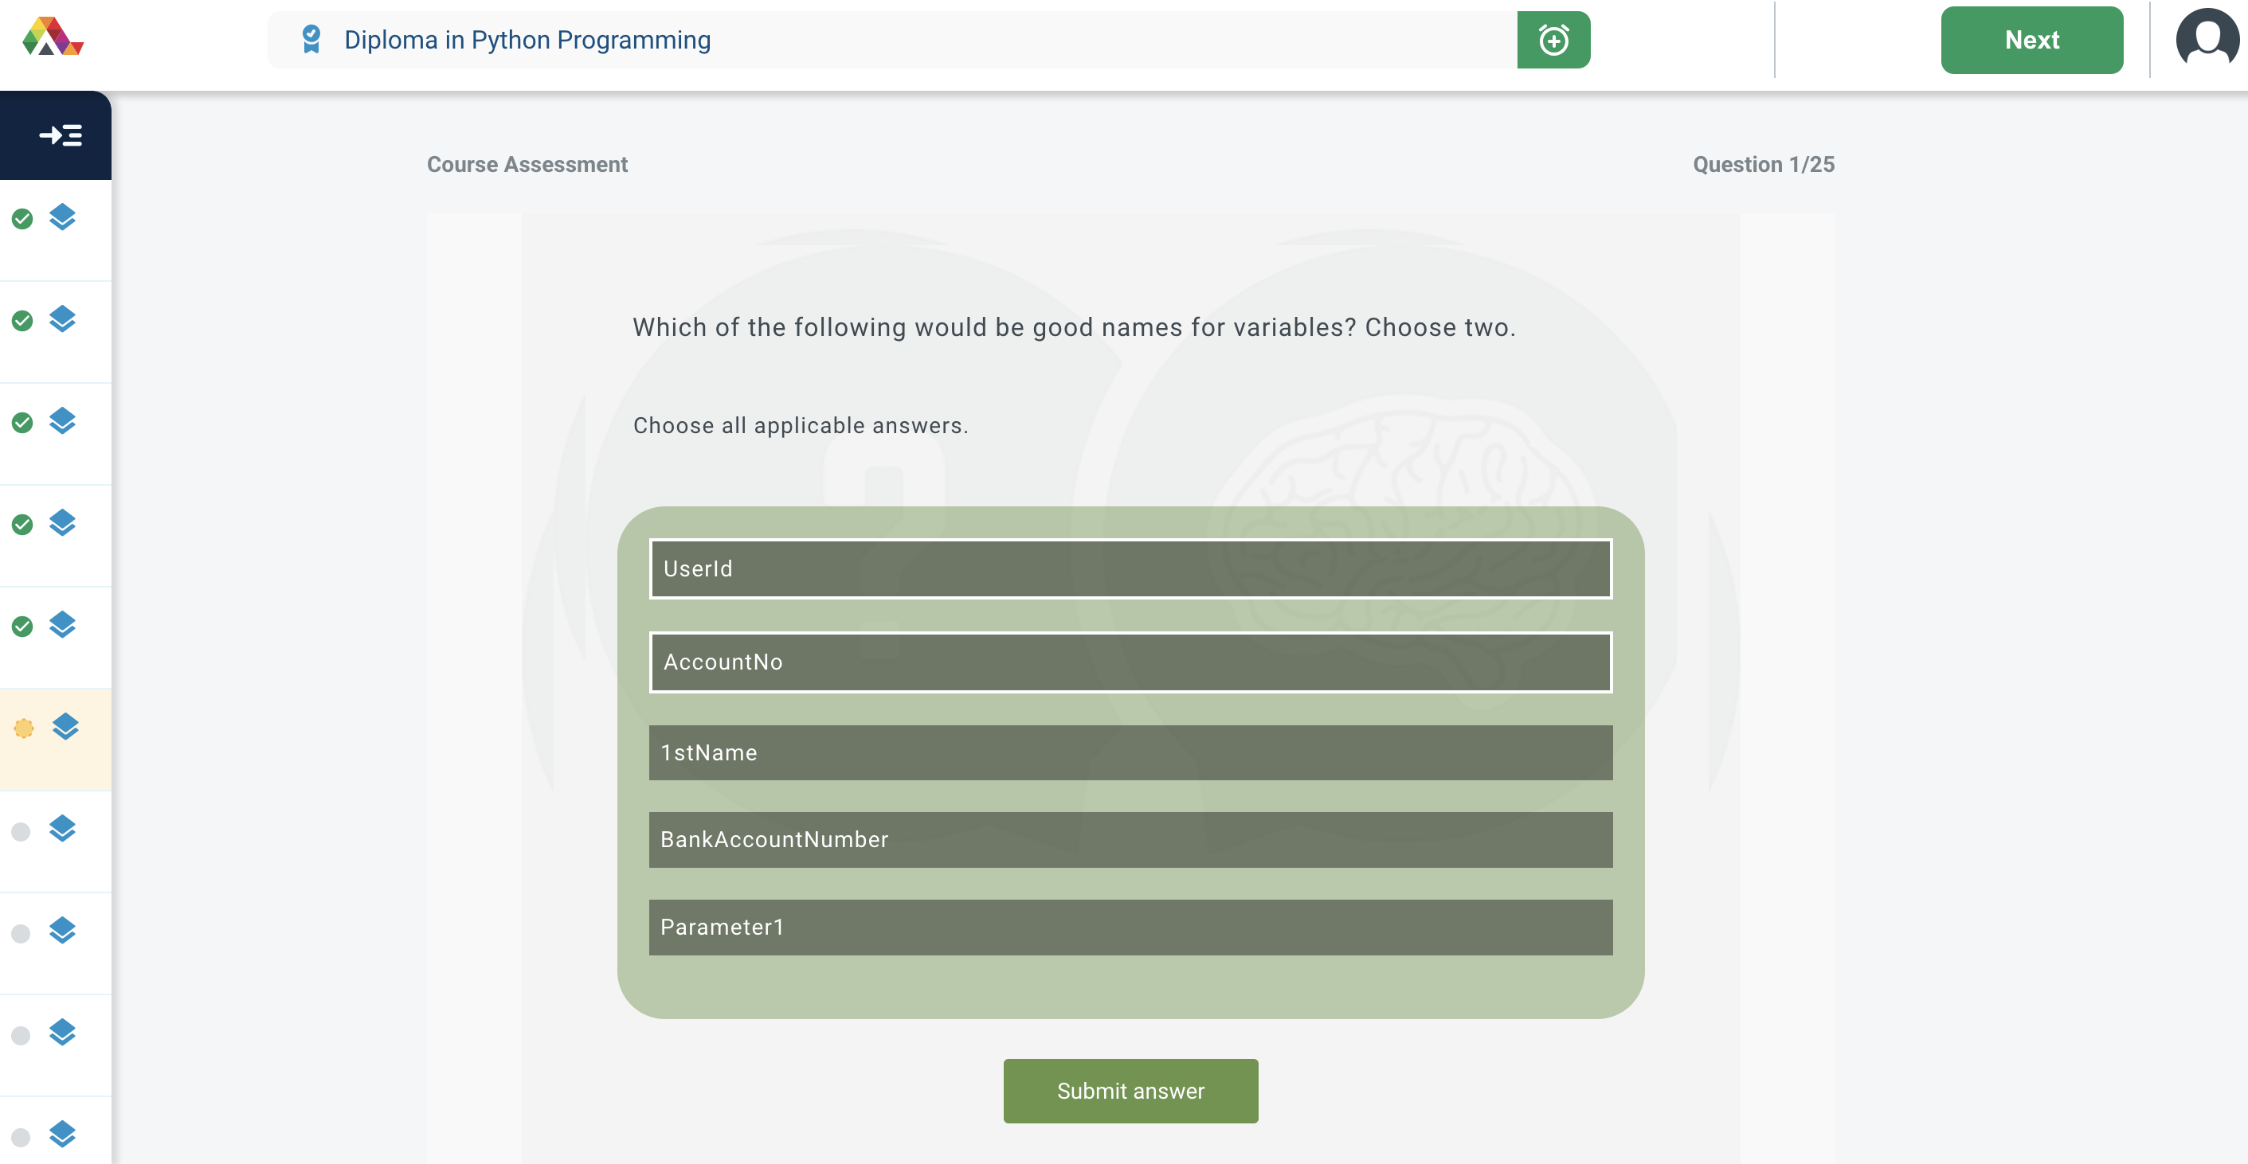
MODULE ASSESSMENT

Slide 11
THANK YOU

