Slide 1
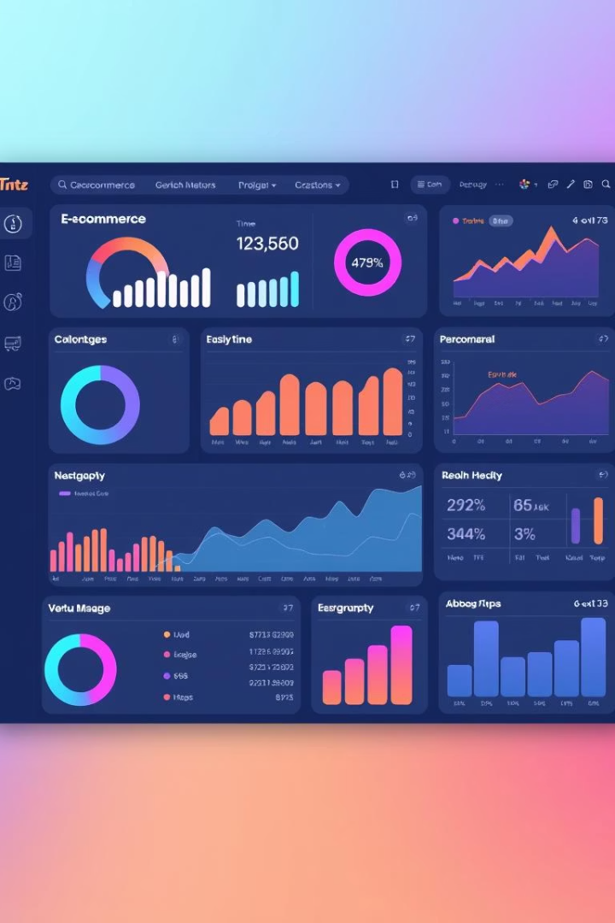
Unlocking Insights:
Olist E-commerce Dashboard Analysis
A comprehensive overview of key data and actionable insights from the Olist platform.
Presented by: Neha Patwardhan
Swathi C
Suraj
Vidhya Srinivas
Karthik
Parikshit Budihal

Slide 2

Introduction: Actionable Insights from Olist Data
The Olist Dashboard Analysis project focuses on deriving actionable business insights from the e-commerce platform Olist.
Using customer, order, product, payment, geolocation, sellers, category ,items and review data, this project aims to explore key performance indicators such as delivery timelines, customer satisfaction, sales performance, and payment behavior.
The analysis was performed using Excel, SQL, Power BI and Tableau, allowing dynamic and interactive dashboards that help uncover trends, identify operational gaps, and support data-driven decision-making.
We explored key metrics such as customer behavior, delivery performance, product pricing, review trends, and payment methods, helping stakeholders identify growth opportunities and improve operational efficiency.
1
2
3

Slide 3
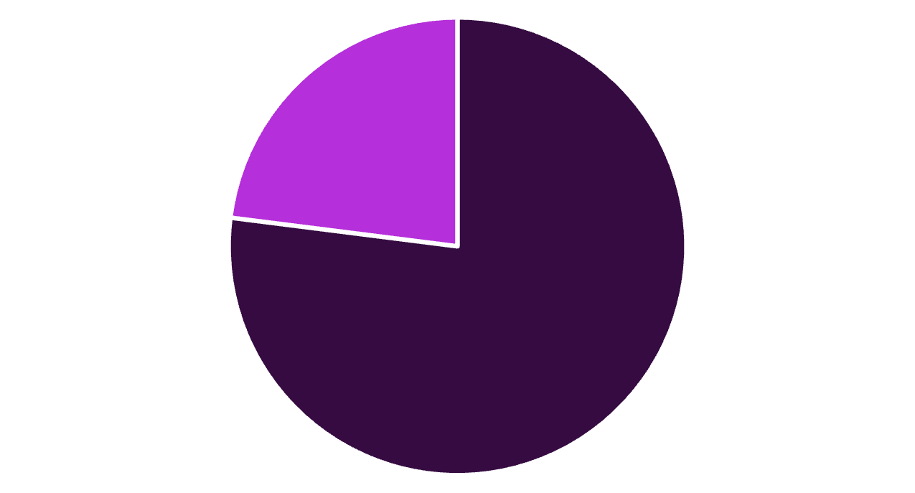
KPI 1:Weekday vs. Weekend Payment Statistics
A significant 77% of payments were made on weekdays, highlighting that most customer purchases occur during the workweek.
Only 23% of orders were placed during weekends, indicating relatively lower shopping activity on Saturdays and Sundays.
This trend suggests that weekday marketing campaigns or promotions may yield higher engagement and sales.
Businesses can optimize inventory, staffing, and delivery logistics more heavily during weekdays to align with demand patterns.
The weekend drop may present an opportunity to boost sales through targeted weekend offers or limited-time discounts.
Weekdays
Weekends

Slide 4

KPI 2:Credit Card Payments & 5-Star Reviews
A total of 40,000 orders received a perfect review score of 5 and were paid using credit cards, indicating a strong correlation between customer satisfaction and the credit card payment experience
This suggests that credit card users tend to have smoother purchase and delivery experiences, possibly due to faster processing or better financial security
The trend reinforces the importance of offering reliable and seamless payment methods to improve customer satisfaction.
Businesses can optimize their offerings in São Paulo by promoting bundled deals, loyalty programs, or same-day delivery services to further increase conversion

Slide 5

KPI 3: Average number of days taken for an
order delivered customer date for the pet shop
On average, it takes 11 days for pet shop products to be delivered from purchase to the customer.
Pet shop items may not be in high demand compared to others, potentially resulting in slower logistics or fewer sellers.
If this is higher than other categories, it signals a need for faster inventory turnover or better supply chain management.
If customer satisfaction is low in this segment, delivery delays might be a contributing factor.

Slide 6
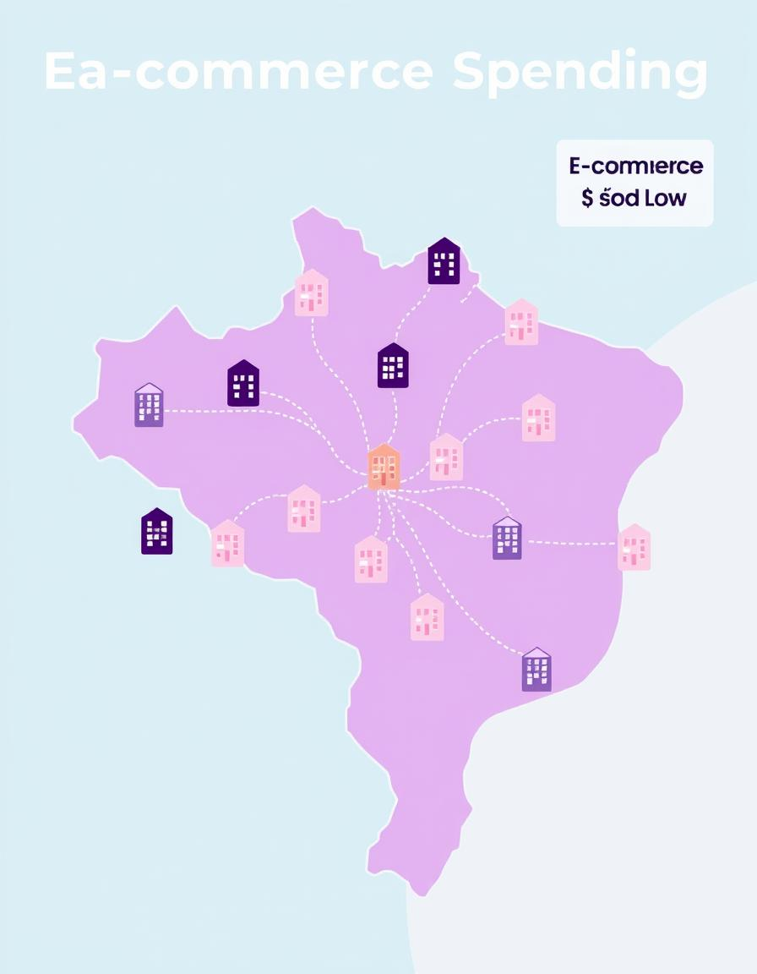
KPI 4: Average price and payment values from
customers of sao paulo city
Customers from São Paulo city spend an average of R$134 per order, while the average payment value is R$107.
This difference suggests that São Paulo buyers may frequently purchase discounted or promotional items, or may be using split payments/installments.
Analysis of Olist data shows that orders delivered within 7 days receive the highest customer review scores, mostly 4 and 5 stars, reflecting timely delivery satisfaction
When shipping days extend beyond 10 days, review scores tend to drop significantly, indicating customer dissatisfaction with delayed deliveries.
The average review score decreases as the shipping time increases, highlighting the critical role of efficient logistics in Olist’s customer experience

Slide 7
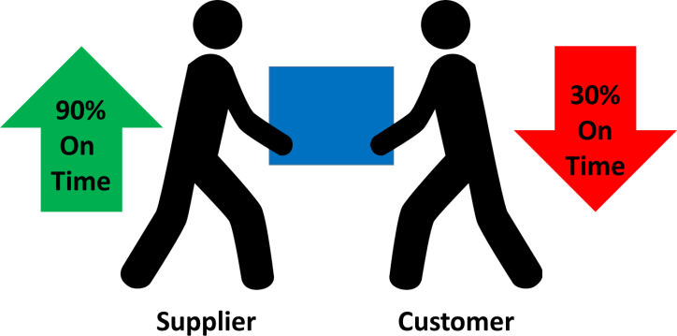
KPI 5: Relationship between shipping days v/s
review Score
Average of Shipping Days and Average of Review Score
Approx. 35K orders analyzed; review scores are not clearly shown.
Suggests a focus on delivery speed vs. customer satisfaction.
If the review score is low despite high shipping speed, quality/service needs review.
Useful to correlate delays with lower customer ratings.

Slide 8
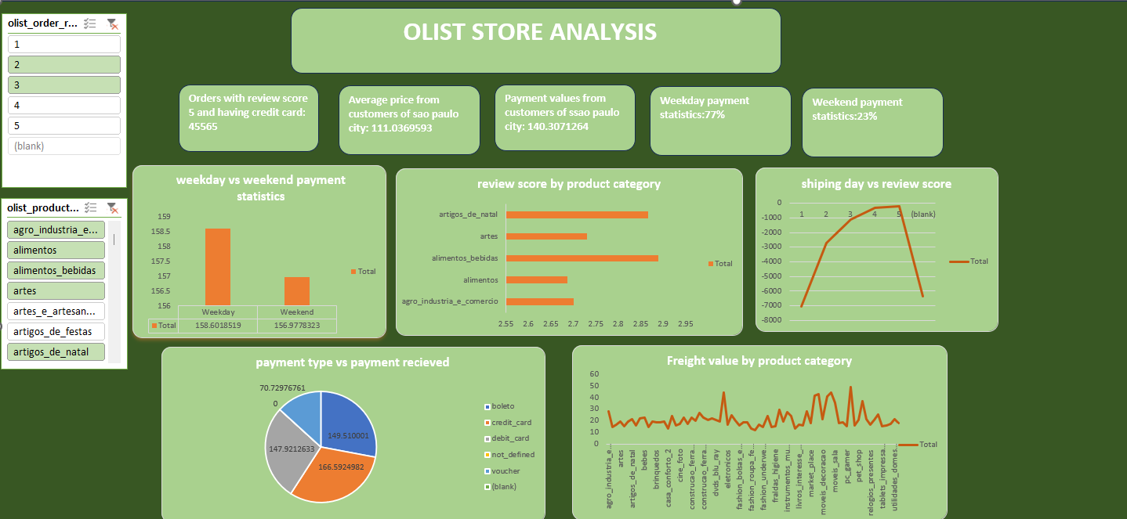
Dashboard in Excel

Slide 9
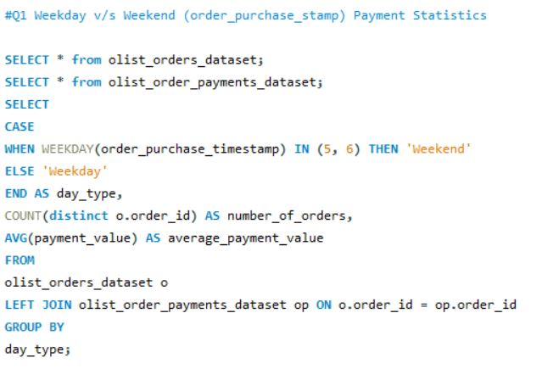
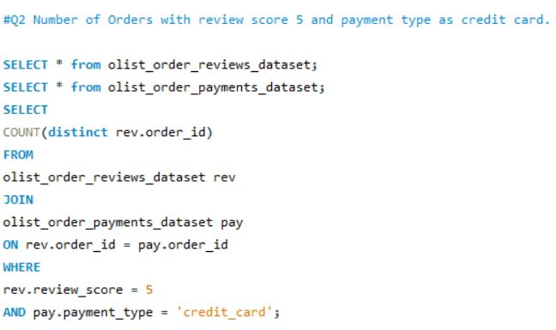
SQL Queries

Slide 10
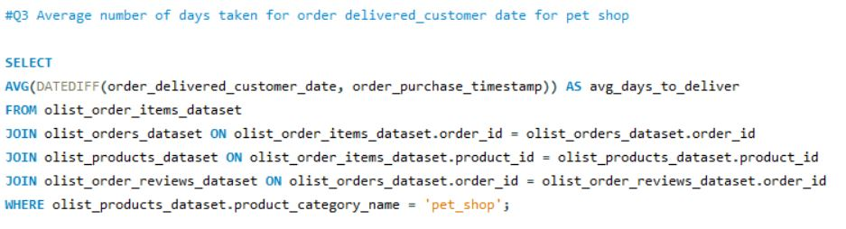
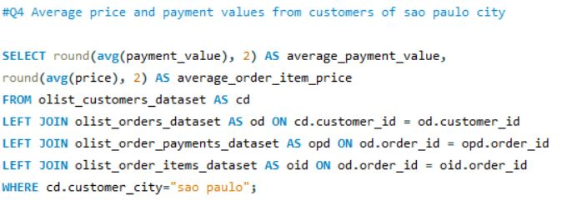
SQL Queries

Slide 11
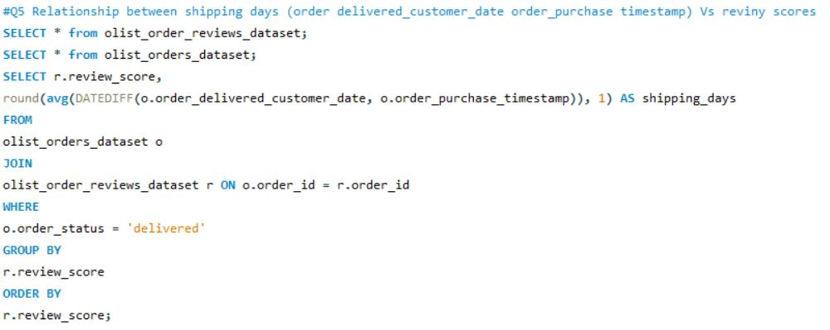
SQL Queries

Slide 12
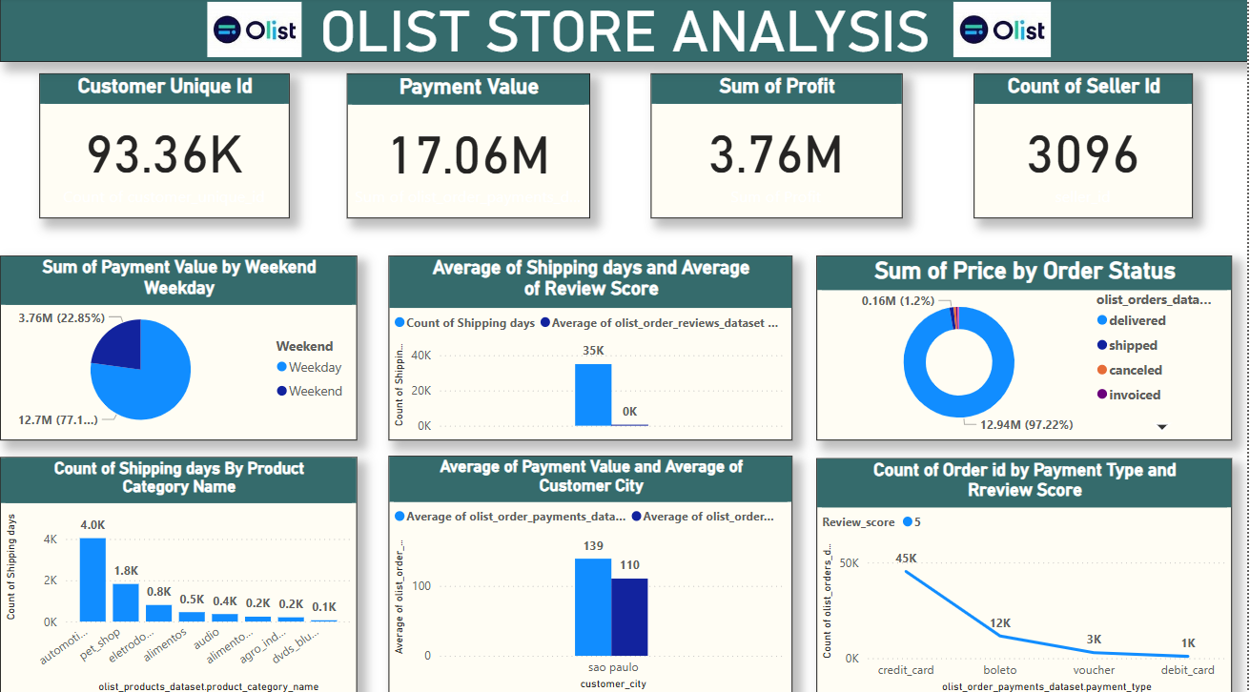
Dashboard in Power BI

Slide 13
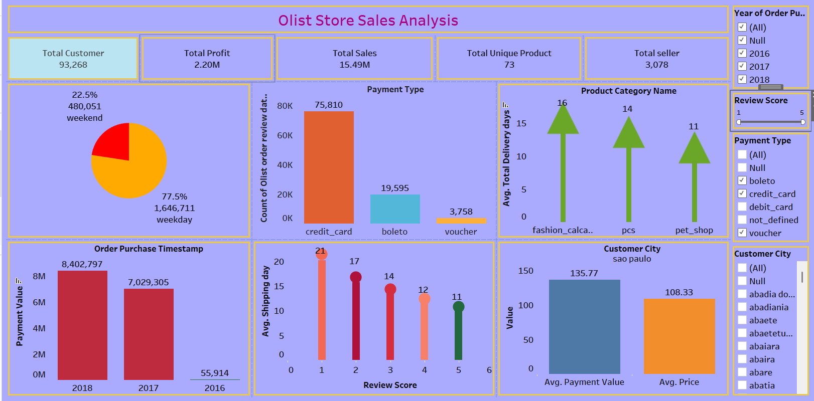
Dashboard in Tableau

Slide 14
Final Takeaway:
Olist's dashboard highlights solid sales performance and delivery reliability, but also reveals improvement opportunities in shipping efficiency for specific categories and weekend engagement strategies. Strategic focus on optimizing logistics and targeted marketing can further enhance customer satisfaction and growth.

Slide 15
Thank You!

