Slide 1



INTRODUCTION
LiFi, or Light Fidelity, is a wireless communication technology that uses light to transmit data. Unlike traditional WiFi, which relies on radio waves, LiFi employs visible light, ultraviolet, and infrared light to transfer information. This is achieved through modulation of light intensity, allowing for high-speed data transmission. LiFi offers several advantages, including faster speeds, reduced interference, and enhanced security, as light cannot penetrate walls, making it difficult for unauthorized users to access the network.

Slide 2
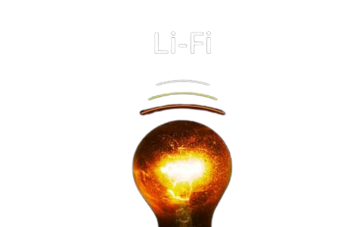
HISTORY
Early Concepts (1880s): Alexander Graham Bell invented the photophone, transmitting sound using light.
Term Coined (2011): Professor Harald Haas introduced "LiFi" during a TED talk, showcasing LED-based data transmission.
Initial Research (2012): Research into LiFi gained momentum, exploring its applications and capabilities.
Prototype Development (2013): University of Edinburgh researchers demonstrated speeds exceeding 10 Mbps using standard LEDs.
Commercial Interest (2015): Startups and companies began investing in LiFi technology.
Standardization Efforts (2018-2020): Organizations like IEEE worked on developing standards for LiFi.
Ongoing Advancements (2020-present): Continued research aims to enhance LiFi's speed and practicality for various industries.

Slide 3
ADVANTAGES
High Speed: LiFi can achieve data transmission speeds significantly faster than traditional WiFi.
Reduced Interference: LiFi is less susceptible to interference from electronic devices, making it reliable in crowded environments.
Enhanced Security: Since light cannot penetrate walls, LiFi networks are more secure from unauthorized access.
Energy Efficiency: LiFi can utilize existing LED lighting infrastructure, potentially reducing energy consumption.
High Capacity: The visible light spectrum is much larger than the radio frequency spectrum, allowing for more simultaneous users and devices.
Improved Performance in Dense Environments: LiFi works well in areas with high device density, such as stadiums or airports.
No Electromagnetic Interference: Ideal for sensitive environments like hospitals and aircraft, where radio waves can cause interference.

Slide 4
DISADVANTAGES
Line of Sight Requirement: LiFi requires a direct line of sight between the transmitter and receiver, limiting mobility and coverage.
Limited Range: The effective range is generally shorter than WiFi, as light cannot penetrate walls or obstacles.
Ambient Light Interference: LiFi can be affected by ambient light conditions, which may disrupt communication.
Infrastructure Costs: Implementing LiFi may require significant investment in new lighting systems and technology.
Device Compatibility: Not all devices are equipped with LiFi receivers, limiting immediate widespread adoption.
Environmental Sensitivity: Performance can be impacted by environmental factors, such as fog, rain, or dust.
Complex Installation: Setting up a LiFi network may be more complex than traditional wireless systems, requiring specialized knowledge.

Slide 5
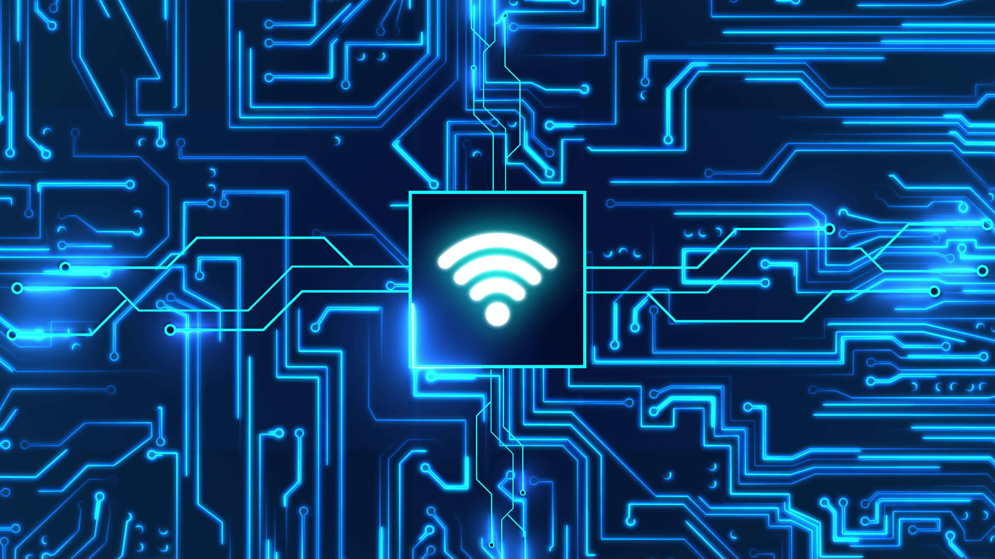
APPLICATIONS
High-Speed Data Transmission: LiFi can deliver significantly faster internet speeds compared to traditional WiFi, enhancing user experience.
Utilization of Existing Infrastructure: By using LED lighting for data transmission, LiFi can leverage existing lighting systems, reducing the need for additional infrastructure.
Reduced Congestion: With the ability to support multiple connections simultaneously using the visible light spectrum, LiFi alleviates congestion in crowded areas.
Secure Connectivity: LiFi’s limited range and inability to penetrate walls enhance security, making it suitable for providing secure internet access in sensitive environments.

Slide 6
APPLICATIONS
Healthcare:
Secure Communication: LiFi provides secure data transmission, reducing the risk of eavesdropping, which is crucial for patient confidentiality in hospitals.
Interference-Free Environment: Unlike WiFi, LiFi does not interfere with medical equipment, making it ideal for use in sensitive areas like operating rooms and ICU.
Real-Time Data Sharing: LiFi enables quick and reliable sharing of patient data and imaging files among medical staff, improving collaboration and decision-making.
Enhanced Patient Monitoring: LiFi can facilitate real-time monitoring of patients through connected devices, ensuring timely alerts and responses to critical conditions.

Slide 7
APPLICATIONS
Education:
High-Speed Data Transfer: Li-Fi offers faster internet, enabling smooth access to educational materials and seamless streaming of videos and lectures.
Improved Classroom Connectivity: It enhances connectivity between multiple devices, supporting smart, interactive classrooms with real-time data sharing.
Secure Data Transmission: Since light cannot penetrate walls, Li-Fi offers a more secure connection, reducing external interference and data breaches.
Supporting Remote and Blended Learning: Li-Fi improves the quality of virtual learning environments by offering reliable and fast internet for students at home and in blended settings.

Slide 8
APPLICATIONS
Energy Efficiency:
Dual-Purpose Technology: Li-Fi combines lighting and data transmission in one, reducing the need for separate power-consuming devices.
Energy-Efficient LEDs: Li-Fi uses low-power LEDs, which consume less energy compared to traditional light sources.
Localized Data Transmission: Focused light beams reduce the energy required to transmit data over short distances compared to Wi-Fi.
Reduced Infrastructure: Li-Fi eliminates the need for additional wireless infrastructure (like routers), lowering overall power consumption.

Slide 9
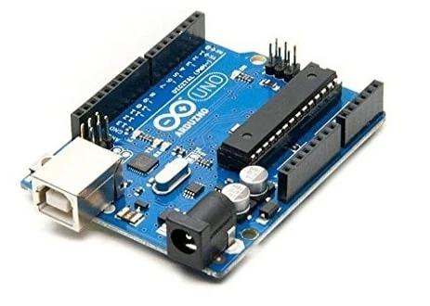
ARDUINO UNO
Uno is a microcontroller board based on 8-bit ATmega328P microcontroller. Along with ATmega328P, it consists other components such as crystal oscillator, serial communication, voltage regulator, etc. to support the microcontroller.
The Arduino Uno comes with USB interface, 6 analog input pins, 14 I/O digital ports that are used to connect with external electronic circuits. Out of 14 I/O ports, 6 pins can be used for PWM output. It allows the designers to control and sense the external electronic devices in the real world

Slide 10
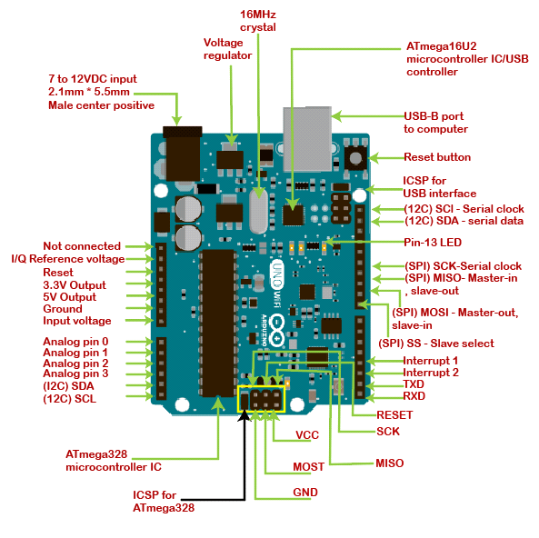
PIN CONFIGURATION
Vin: This is the input voltage pin of the Arduino board used to provide input supply from an external power source.
5V: This pin of the Arduino board is used as a regulated power supply voltage and it is used to give supply to the board as well as onboard components.
3.3V: This pin of the board is used to provide a supply of 3.3V which is generated from a voltage regulator on the board
GND: This pin of the board is used to ground the Arduino board.
Reset: This pin of the board is used to reset the microcontroller. It is used to Resets the microcontroller.
Vin: This is the input voltage pin of the Arduino board used to provide input supply from an external power source.
5V: This pin of the Arduino board is used as a regulated power supply voltage and it is used to give supply to the board as well as onboard components.
3.3V: This pin of the board is used to provide a supply of 3.3V which is generated from a voltage regulator on the board
GND: This pin of the board is used to ground the Arduino board.
Reset: This pin of the board is used to reset the microcontroller. It is used to Resets the microcontroller.

Slide 11
PIN CONFIGURATION
Analog Pins: The pins A0 to A5 are used as an analog input and it is in the range of 0-5V.
Digital Pins: The pins 0 to 13 are used as a digital input or output for the Arduino board.
Serial Pins: These pins are also known as a UART pin. It is used for communication between the Arduino board and a computer or other devices. The transmitter pin number 1 and receiver pin number 0 is used to transmit and receive the data resp.
External Interrupt Pins: This pin of the Arduino board is used to produce the External interrupt and it is done by pin numbers 2 and 3.
PWM Pins: This pins of the board is used to convert the digital signal into an analog by varying the width of the Pulse. The pin numbers 3,5,6,9,10 and 11 are used as a PWM pin.
SPI Pins: This is the Serial Peripheral Interface pin, it is used to maintain SPI communication with the help of the SPI library.
Vin: This is the input voltage pin of the Arduino board used to provide input supply from an external power source.
5V: This pin of the Arduino board is used as a regulated power supply voltage and it is used to give supply to the board as well as onboard components.
3.3V: This pin of the board is used to provide a supply of 3.3V which is generated from a voltage regulator on the board
GND: This pin of the board is used to ground the Arduino board.
Reset: This pin of the board is used to reset the microcontroller. It is used to Resets the microcontroller.

Slide 12
FEATURES:
More frequency and number of instructions per cycle: Atmega328 microcontroller is placed on the board that comes with a number of features like timers, counters, interrupts, PWM, CPU, I/O pins and based on a 16MHz clock that helps in producing more frequency and number of instructions/cycle.
Built-in regulation: This board comes with a built-in regulation feature which keeps the voltage under control when the device is connected to the external device.
Flexibility & Ease of use: There are 14 I/O digital and 6 analog pins incorporated in the board that allows the external connection with any circuit with the board. These pins provide the flexibility and ease of use to the external devices that can be connected through these pins.
Configurable pins: The 6 analog pins are marked as A0 to A5 and come with a resolution of 10bits. These pins measure from 0 to 5V, however, they can be configured to the high range using analogReference() function and AREF pin.
USB interface: Arduino Uno comes with USB interface i.e. USB port is added on the board to develop serial communication with the computer.
Power alternatives: Apart from USB, battery or AC to DC adopter can also be used to power the board.
More Storage: There is a provision of Mirco SD card to be used in the boards to make them store more information.

Slide 13
APPLICATIONS:
Arduino Uno comes with a wide range of applications. Following are some of the main applications of the board.
Parking Lot Counter
Arduino Uno is used in Do-it-Yourself projects prototyping.
Traffic Light Count Down Timer
Emergency Light for Railways
Embedded System
In developing projects based on code-based control
Medical Instrument
Security and Defense System
Weighing Machines
Home Automation
Industrial Automation
Development of Automation System
Digital Electronics and Robotics

Slide 14
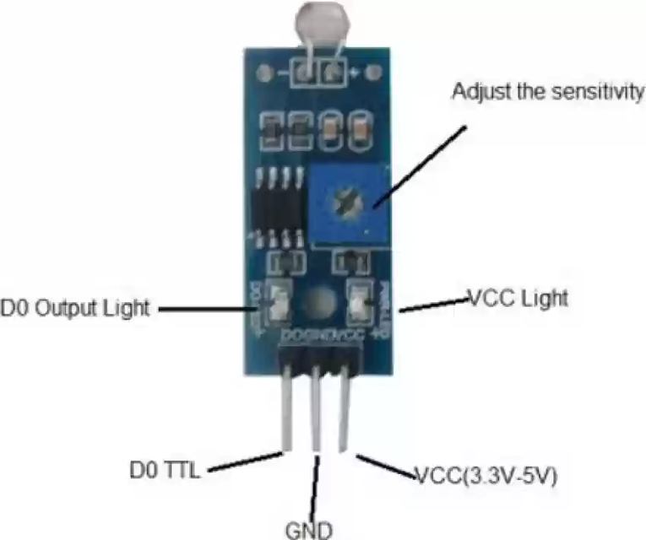
LDR SENSOR MODULE:
The LDR (Light Dependent Resistor) Sensor Module is commonly used in electronics to detect light levels. Here are some key details about it:
1. Working Principle
LDR is a resistor whose resistance decreases with increasing light intensity. In the dark, its resistance is high, and as light falls on it, the resistance drops, allowing more current to flow through.
It works on the principle of photo-resistance, making it ideal for light-sensing applications.
2. Structure
The LDR is typically made of a semiconductor material such as cadmium sulfide.
The sensor module may include an operational amplifier (comparator) to convert the analog light intensity changes into a digital signal.

Slide 15
3. Specifications
Operating Voltage: 3.3V to 5V (depending on the module).
Output: Can provide both analog and digital outputs.
Analog output: Provides a continuous signal corresponding to the light intensity.
Digital output: Provides either a HIGH or LOW signal based on a preset threshold of light intensity (can be set using a potentiometer).
4. Connections
VCC: Connect to 3.3V or 5V depending on the module.
GND: Connect to ground.
DO (Digital Out): Connect to a microcontroller pin to receive the digital signal.
This module is highly versatile and can be used in various DIY projects. You can integrate it with Arduino or ESP32 for projects like light-sensitive robots, automatic lighting, or environmental monitoring systems.

Slide 16
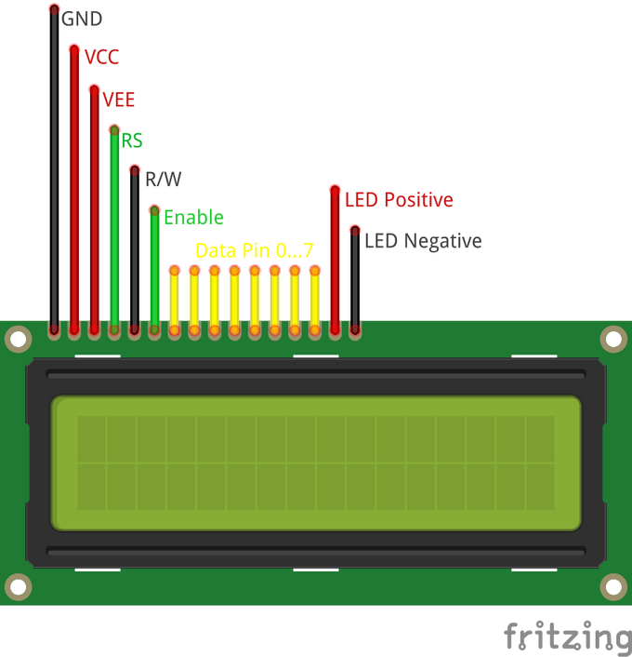
LCD
A 16x2 LCD is a liquid crystal display module that can display 16 characters per line and has 2 lines.
It is commonly used in embedded systems, Arduino projects, and for displaying information in various applications.
Connection with Arduino
Wiring: Connect the LCD pins to the Arduino as follows:
RS → Digital Pin (e.g., 12)
RW → Ground
E → Digital Pin (e.g., 11)
D0-D7 → Digital Pins (e.g., 5-10)
VSS → Ground
VDD → +5V
VO → Contrast adjust (via potentiometer)

Slide 17
