Slide 1

HANDWRITTEN TEXT RECOGNITION
(A Convolutional Neural Network Approach)
Presented by:
H Puneeth shetty 1NT18CS049
Karthik P S 1NT18CS068
Nikhil Rajkoti L 1NT18CS107

Slide 2
MAIN GOAL
Handwritten text recognition is used to recognize the characters which are written by hand.
This system is used to visualize artificial neural networks.

Slide 3
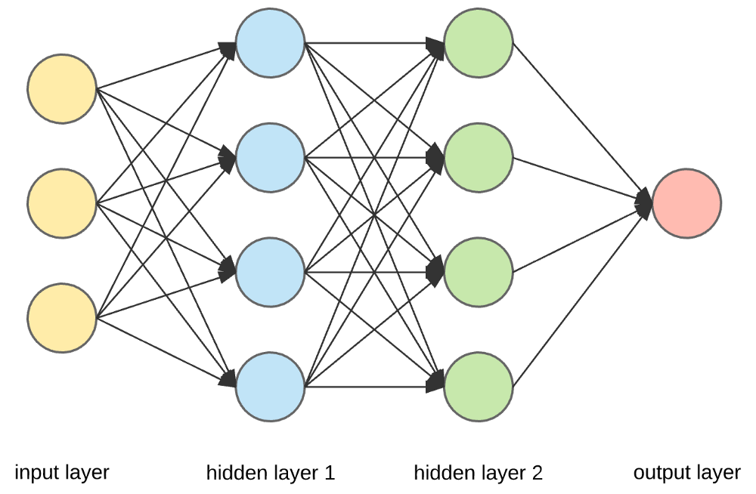
What are Neural Networks?
Artificial neural networks, usually called neural networks (NNs), are interconnected systems composed of many simple processing elements (neurons) operating in parallel whose function is determined by -
Network Structure
Connection Strengths
The Processing performed
at Computing elements or nodes.

Slide 4
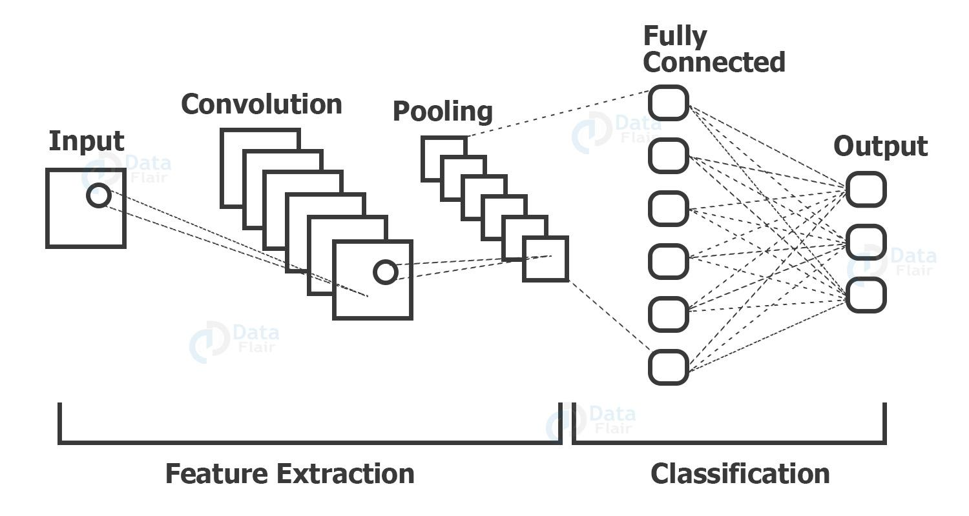
Convolutional Neural Networks(CNN)
CNN stands for Convolutional Neural Networks that are used to extract the features of the images using several layers of filters.

Slide 5
Convolutional Neural Networks
This model's architecture consists of three main parts, two convolutional blooks and one fully connected neural network layer. The inputs to this model are 28x28 images.
First Convolutional Block:
A 28x28 image is taken as input to this block. A padding of 2 units is added to the image so as to retain its dimensions after a convolution operation on the image by 16 5x5 filters/kernels.
The output of the convolution gives 16x28x28 volume, which is then input to a RelU activation function followed by a MaxPool operation. ReLU activation is used to introduce some non-linearity.
The block outputs a 16x14x14 volume.

Slide 6
Second Convolutional Block:
First step is again a convolution operation on 16x14x14 by 325x5 kernels with padding of 2 units, obtaining a 32x14x14 volume. It is passed through a ReLU activation followed by a MaxPool operation. Second convolutional block outputs a 32x7x7 volume.
Fully connected Neural Layer:
Here, a singe hidden layer of 10 nodes is taken as the fully connected layer. Finally, the output of the fully connected layer is passed to a softmax function to obtain the output result of recognition.

Slide 7
Training dataset
The dataset contains 26 folders (A-Z) containing handwritten images in size 2828 pixels, each alphabet in the image is centre fitted to 2020 pixel box.
Each image is stored as Gray-level
Kernel CSVToImages contains script to convert .CSV file to actual images in .png format in structured folder.

Slide 8
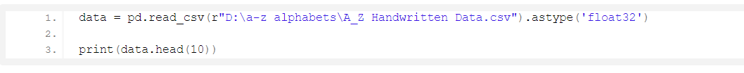
WORKING
Read the data :
Now we are reading the dataset using the pd.read_csv() and printing the first 10 images using data.head(10)

Slide 9
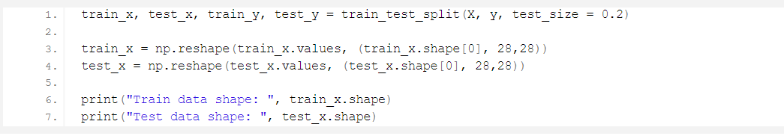
Split data into images and their labels:
Splitting the data read into the images & their corresponding labels. The ‘0’
contains the labels, & so we drop the ‘0’ column from the data dataframe read
& use it in the y to form the labels.
Reshaping the data in the csv file so that it can be displayed as an image
.
X = data.drop('0',axis = 1)
y = data['0']

Slide 10
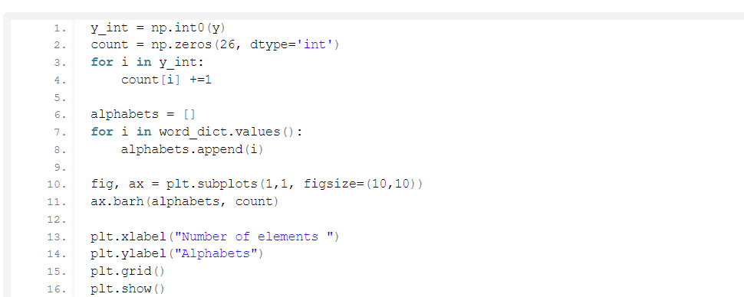
Plotting the number of alphabets in the dataset
Here we are only describing the distribution of the alphabets.
Firstly we convert the labels into integer values and append into the count list according to the label. This count list has the number of images present in the dataset belonging to each alphabet.
Now we create a list – alphabets containing all the characters using the values() function of the dictionary.

Slide 11
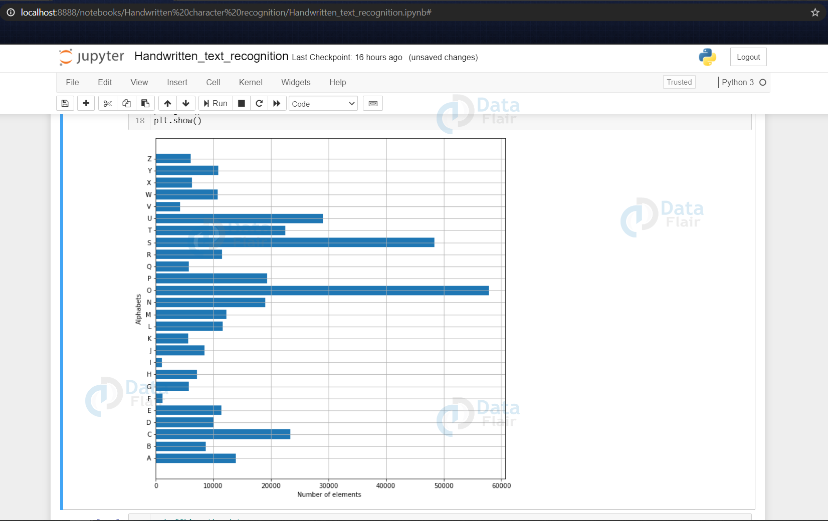
Now using the count & alphabets lists we draw the horizontal bar plot

Slide 12
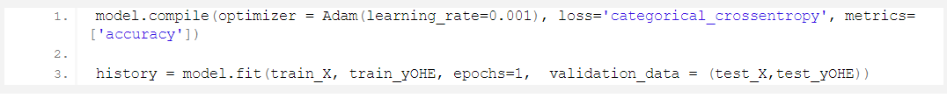
Compiling & Fitting Model
Here we are compiling the model, where we define the optimizing function & the loss function to be used for fitting.
The optimizing function used is Adam, that is a combination of RMSprop & Adagram optimizing algorithms.
Now we are getting the model summary that tells us what were the different layers defined in the model & also we save the model using model.save() function.

Slide 13
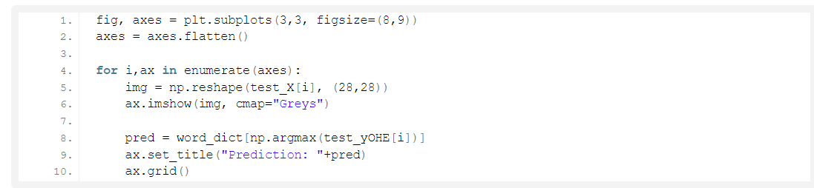
Doing Some Predictions on Test Data
Here we are creating 9 subplots of (3,3) shape & visualize some of the test dataset alphabets along with their predictions, that are made using the model.predict() function for text recognition.

Slide 14
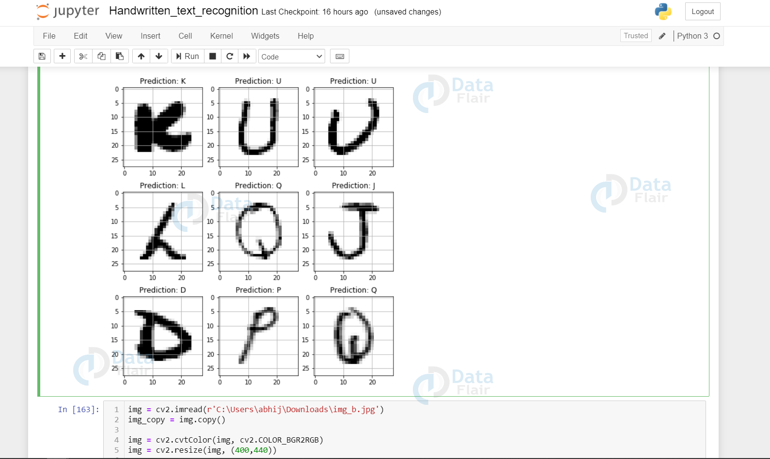

Slide 15
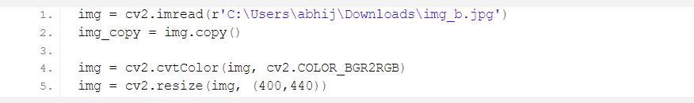
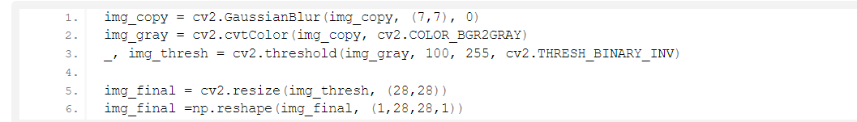
Doing Prediction on External Image
Here we have read an external image that is originally an image of alphabet ‘B’ and made a copy of it that is to go through some processing to be fed to the model for the prediction that we will see in a while.
The img read is then converted from BGR representation (as OpenCV reads the image in BGR format) to RGB for displaying the image, & is resized to our required dimensions that we want to display the image in.

Slide 16
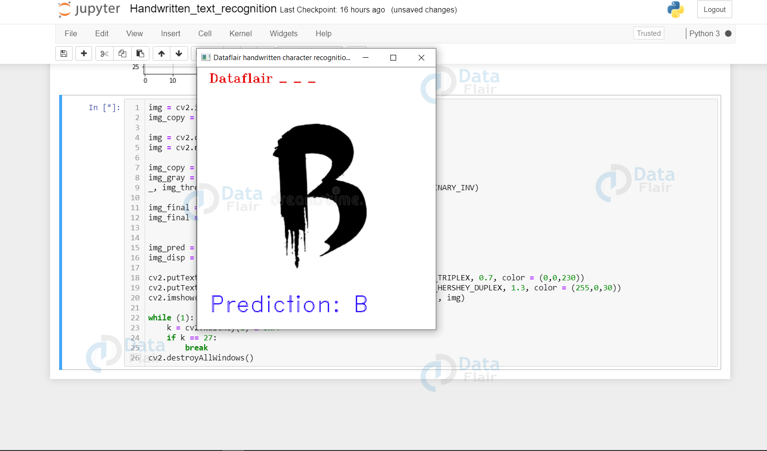
Here we are setting up a waitKey in a while loop that will be stuck in loop until Esc is pressed, & when it gets out of loop using cv2.destroyAllWindows() we destroy any active windows created to stop displaying the frame.

Slide 17
CONCLUSION
We have successfully developed Handwritten character recognition (Text Recognition) with Python, Tensorflow, and Machine Learning libraries.
Handwritten characters have been recognized with more than 97% test accuracy. This can be also further extended to identifying the handwritten characters of other languages too.

