Slide 1






























K-MEANS CLUSTERING

Slide 2
INTRODUCTION- What is clustering?
● Clustering is the classification of objects into different groups, or more precisely, the partitioning of a data set into subsets (clusters), so that the data in each subset (ideally) share some common trait - often according to some defined distance measure.

Slide 3


Common Distance measures:
● Distance measure will determine how the similarity of two elements is calculated and it will influence the shape of the clusters.
They include:
The Euclidean distance (also called 2-norm distance) is given by:
The Manhattan distance (also called taxicab norm or 1- norm) is given by:

Slide 4
K-MEANS CLUSTERING
The k-means algorithm is an algorithm to cluster n objects based on attributes into k partitions, where k < n.
It is similar to the
expectation-maximization algorithm for mixtures of Gaussians in that they both attempt to find the centers of natural clusters in the data.
It assumes that the object attributes form a vector space.

Slide 5

● An algorithm for partitioning (or clustering) N data points into K disjoint subsets S_{j} containing data points so as to minimize the sum-of-squares criterion
where x_{n} is a vector representing the the n^{th} data point and u_{j} is the geometric centroid of the data points in S_{j}.

Slide 6
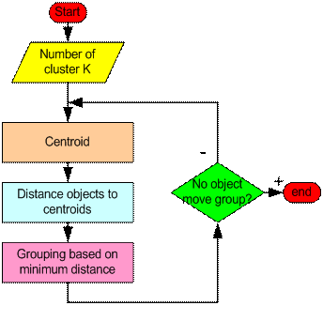
How the K-Mean Clustering algorithm works?

Slide 7
Step 1: Begin with a decision on the value of k = number of clusters .
Step 2: Put any initial partition that classifies the data into k clusters. You may assign the training samples randomly,or systematically as the following:
Take the first k training sample as single- element clusters
Assign each of the remaining (N-k) training sample to the cluster with the nearest
centroid. After each assignment, recompute the centroid of the gaining cluster.

Slide 8
Step 3: Take each sample in sequence and compute its distance from the centroid of each of the clusters. If a sample is not currently in the cluster with the closest centroid, switch this sample to that cluster and update the centroid of the cluster gaining the new sample and the cluster losing the sample.
Step 4 . Repeat step 3 until convergence is achieved, that is until a pass through the
training sample causes no new assignments.

Slide 9
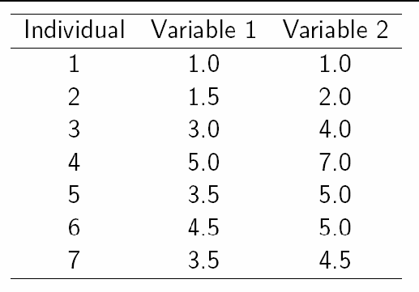
A Simple example showing the implementation of k-means algorithm (using K=2)

Slide 10
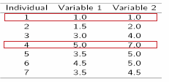
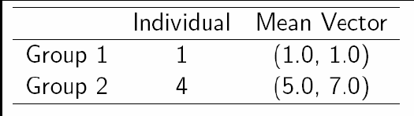
Step 1:
Initialization: Randomly we choose following two centroids (k=2) for two clusters.
In this case the 2 centroid are: m1=(1.0,1.0) and m2=(5.0,7.0).

Slide 11
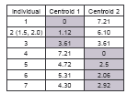



Step 2:
Thus, we obtain two clusters containing:
{1,2,3} and {4,5,6,7}.
Their new centroids are:

Slide 12
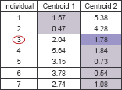
Step 3:
Now using these centroids we compute the Euclidean distance of each object, as shown in table.
Therefore, the new clusters are:
{1,2} and {3,4,5,6,7}
Next centroids are: m1=(1.25,1.5) and m2 = (3.9,5.1)

Slide 13
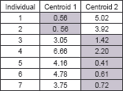
Step 4 :
The clusters obtained are:
{1,2} and {3,4,5,6,7}
Therefore, there is no change in the cluster.
Thus, the algorithm comes to a halt here and final result consist of 2 clusters
{1,2} and {3,4,5,6,7}.

Slide 14
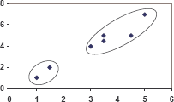
PLOT

Slide 15
Applications of K-Mean Clustering
It is relatively efficient and fast. It computes result at O(tkn), where n is number of objects or points, k is number of clusters and t is number of iterations.
k-means clustering can be applied to machine learning or data mining
Used on acoustic data in speech understanding to convert waveforms into one of k categories (known as Vector Quantization or Image Segmentation).
Also used for choosing color palettes on old fashioned graphical display devices and Image Quantization.

Slide 16
CONCLUSION
● K-means algorithm is useful for undirected knowledge discovery and is relatively simple. K-means has found wide spread usage in lot of fields, ranging from unsupervised learning of neural network, Pattern recognitions, Classification analysis, Artificial intelligence, image processing, machine vision, and many others.

Slide 17

