Slide 1

ELECTRICITY USAGE ANALYSIS BY HOUSEHOLD AND MONTH USING MYSQL

Slide 2
MY SQL
It is a popular database management system That uses SQL to manage and manipulate data.
Advantages:
Cross platform : supports multiple operating system
Open source
Widely used
Structured query language is a programming language (standard language) used to interact with database like MySQL.
It allows end users to communicate with databases and perform tasks like creating, deleting, and updating databases.

Slide 3
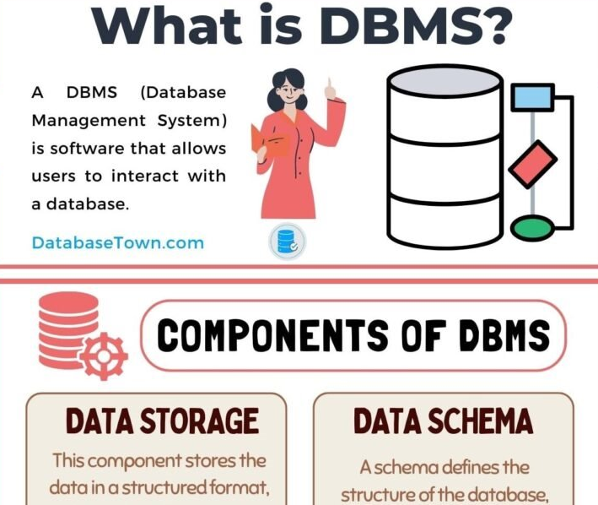
DBMS
What is DBMS?
A Database Management System (DBMS) is a software program that allows users to interact with a database in order to store, retrieve, and manipulate data. The DBMS serves as an interface between the database and the users or application programs. It enables users to create, modify, and maintain the database, as well as control access to the data.

Slide 4
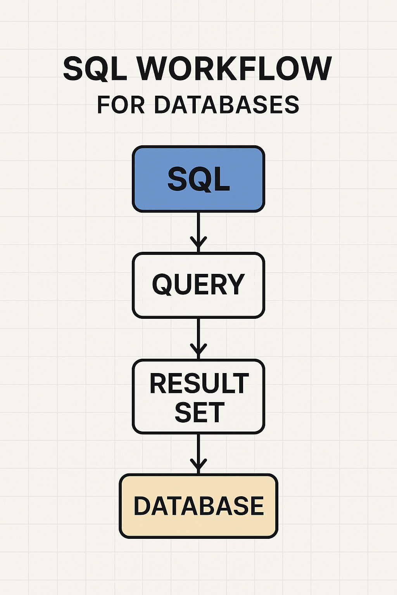
WORK FLOW
SQL (Structured Query Language):
This is the language used to communicate with and manage relational databases.
Query:
An SQL query is a specific command written in SQL to retrieve, insert, update, or delete data from a database.
Result Set:
After executing a query, the database returns a result set, which is the data that matches the criteria specified in the query.
Database:
This is the organized collection of data where the SQL operations are performed.

Slide 5
OBJECTIVES
Identify and analyze monthly electricity usage patterns for each household to detect trends and seasonal variations.
Compare energy consumption between different households to find high, medium, and low usage groups.
Determine the months with peak electricity demand to support efficient energy planning and load management.
Use consumption data to estimate monthly bills and assist households in budgeting their energy expenses.
Highlight households with unusually high usage to recommend potential energy-saving measures.

Slide 6
DATA SET
Household info
Appliances usage
Billing info
Calculated metrics
Environmental data
These are the data set given to us. Which has to be imported first into workbench then using SQL we process the data set to generate reports on different perspective.

Slide 7
TASK 1 Update the payment_status in the billing_info table based on the cost_usd value. Use CASE...END logic.
QUERY:
delimiter ==
create procedure update_payment_status()
begin
update billing_info set payment_status =
case
when cost_usd > 200 then "High"
when cost_usd > 100 and cost_usd < 200 then "Medium"
else "Low"
end;
select * from billing_info;
end ==
delimiter ;
call update_payment_status();

Slide 8
Task 1 explanation:
Purpose
This stored procedures is designed to automatically classify and update the payment_status field in the billing_info table based on the cost_usd amount. It helps in categorizing billing records into “High”, “Medium”, or “Low” payment statuses without manual updates.
Benefits:
Automates billing categorization for financial analysis.
Reduces manual errors by applying consistent rules.
Can be scheduled or triggered after billing updates to keep data up to date.

Slide 9
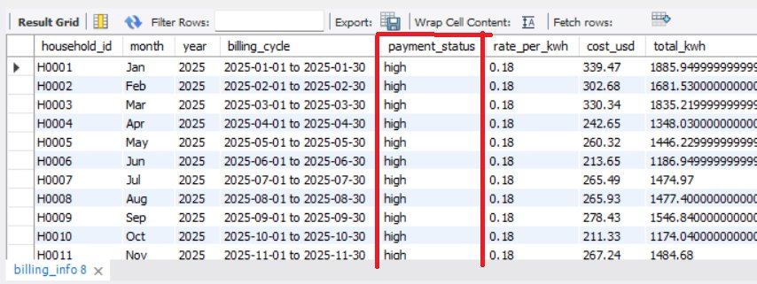
TASK 1 - OUTPUT

Slide 10
TASK 2 (Using Group by) For each household, show the monthly electricity usage, rank of usage within each year, and classify usage level.
Needed Tables:
household_info,
billing_info
Query
select household_id, year, month, total_kwh, rank() over(
partition by year order by total_kwh desc) as usage_rank,
case
when sum(total_kwh) > 500 then "High“
else "Low“
end as usage_lvl
from billing_info group by household_id, year, month, total_kwh;

Slide 11
Task 2 explanation
Purpose
This query ranks households by their electricity usage (total_kwh) within each year and classifies their overall usage level as “High” or “Low ” based on consumption.
Usage & Benefits:
Helps identity top energy-consuming households in each year using the RANK() window function.
Enables year-wise comparative analysis of consumption patterns.
Adds a consumption-level label ("High"/"Low") to assist in reporting, billing tiers, or energy-saving initiatives.
Supports energy providers in targeting high-usage households for awareness programs or discounts

Slide 12
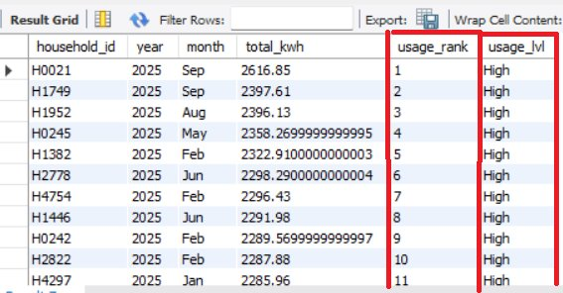
TASK 2 OUTPUT

Slide 13
TASK 3 Create a monthly usage pivot table showing usage for January, February, and March.
Needed tables:
household_info,
billing_info
Query:
select household_id,
sum(case when month = 'Jan' then cost_usd else 0 end) as Jan_uasage,
sum(case when month = 'Feb' then cost_usd else 0 end) as Feb_usage,
sum(case when month = 'Mar' then cost_usd else 0 end) as Mar_usage
from billing_info group by household_id;

Slide 14
Task 3 explanation
Purpose
This query calculates and compares the monthly electricity costs (Jan, Feb, Mar) for each household by pivoting the cost_usd values into separate columns.
Usage & Benefits
Provides a month-wise breakdown of electricity spending per household.
Enables trend analysis across months to detect unusual spikes or drops in billing
Useful for generating tabular reports or visual charts in dashboards.
Helps in identifying seasonal usage patterns for energy planning or billing adjustments.

Slide 15
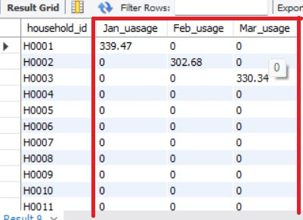
TASK 3 OUTPUT

Slide 16
TASK 4 Show average monthly usage per household with city name.
Needed tables:
household_info,
billing_info
Query
select
bi.household_id, bi.month, hi.city, avg(total_kwh) as avg_uasge
from billing_info bi
join household_info hi on hi.household_id = bi.household_id
group by bi.household_id, bi.month, hi.city;

Slide 17
Task 4 explanation
Purpose
This query calculates the average monthly electricity usage per household along with the corresponding city information, by joining billing and household data.
Benefits & Usage
Combining billing and location data to provide a geo-level view of energy consumption.
Useful for Identifying city-wise consumption trends and regional usage behaviors.
Helps energy providers with area-specific planning, subsides , or infrastructural decisions.
Supports monthly performance tracking at both household and city levels.

Slide 18
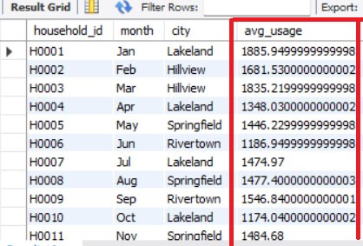
TASK 4 OUTPUT

Slide 19
TASK 5 Retrieve AC usage and outdoor temperature for households where AC usage is high.
Needed tables:
household_info,
appliance_usage
Query
select
au.household_id, au.kwh_usage_AC, ed.avg_outdoor_temp
from appliance_usage au
join
environmental_data ed on
au.household_id = ed.household_id
where au.kwh_usage_AC > 100;

Slide 20
Task 5 explanation
Purpose
To retrieve the AC electricity usage and corresponding average outdoor temperature for households where AC usage is high (above 100 kWh).
Usage & Benefits
Helps analyze the impact of outdoor temperature on high AC usage.
Useful for energy consumption studies in hot climates or summer months.
Supports targeted energy-saving recommendations for high-usage households.
Can aid in correlating environmental factors with appliance-level energy behavior.

Slide 21
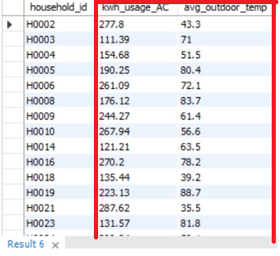
TASK 5 OUTPUT

Slide 22
TASK 6 Create a procedure to return billing info for a given region.
Needed tables:
household_info,
appliance_usage
Query
delimiter //
create procedure getby_region(in place varchar(30))
begin
select bi.household_id, bi.month, bi.year, hi.region, bi.billing_cycle,
bi.payment_status, bi.rate_per_kwh, bi.cost_usd, bi.total_kwh
from billing_info bi join household_info hi
on bi.household_id = hi.household_id
where hi.region = place;
end
//delimiter ;
call getby_region(South');

Slide 23
Task 6 explanation
Purpose
Created a stored procedure that retrieves detailed billing information for households based on any specific region input (e.g., 'North‘, ‘South’, etc...).
Usage & Benefits
Allows quick access to region-specific billing records for reporting or auditing.
Improves reusability by letting users call the procedure with different region names.
Helps in analyzing regional electricity trends or payment behaviors.
Simplifies queries for non-technical users through a named procedure getby_region.

Slide 24
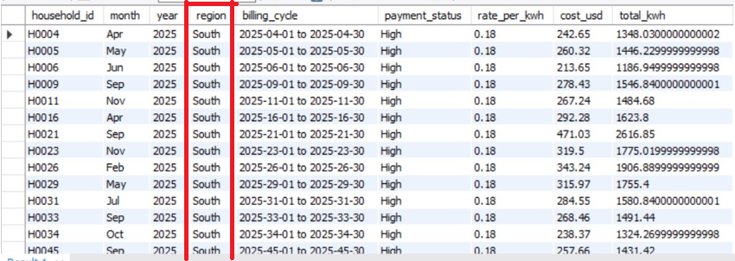
TASK 6 OUTPUT

Slide 25
TASK 7 Create a procedure to calculate total usage for a household and return it.
Needed tables:
household_info,
billing_info
Query
delimiter ^^
create procedure get_total_usage(in id text, inout total_usage decimal(10, 3))
begin
select round(sum(cost_usd), 3) from billing_info bi
where bi.household_id = id into total_usage;
end ^^
delimiter ;
call get_total_usage('H0001', @total_usage);
select @total_usage;

Slide 26
Task 7 explanation
Purpose
To create a stored procedure that calculates and returns the total electricity cost
(cost_usd) for a specific household, based on its household_id.
Usage & Benefits
Enables quick retrieval of household-wise billing summaries.
Useful for personalized reports or bill generation for individual users.
Improves efficient by reusing the logic without rewriting the query each time.
Supports parameterized access, making it suitable for dashboards or admin tools.

Slide 27
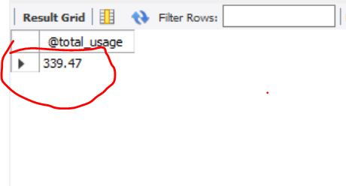
TASK 7 OUTPUT

Slide 28
TASK 8 Automatically calculate cost_usd before inserting into billing_info.
Query
delimiter $$
create trigger cal_cost_usd before insert
on billing_info for each row
begin
if new.cost_usd is null then set
new.cost_usd = round(new.rate_per_kwh * new.total_kwh, 2);
end if;
end $$
delimiter ;
show triggers;
insert into billing_info values
('H5001', 'Dec', 2025, '2025-01-01 to 2025-01-30', 'High', 0.18, null, 1277.6),
('H5002', 'Jan', 2025, '2025-01-01 to 2025-01-30', 'High', 0.18, null, 1874.93);

Slide 29
Task 8 explanation
Purpose
Create a trigger that automatically calculates and sets the cost_usd value before inserting data into the billing_info table based on rate_per_kwh * total_kwh.
Usage & Benefits
Ensures data consistency and accuracy by auto-calculating missing cost_usd values.
Eliminates manual calculation errors during data entry.
Simplifies insert operations, when users forgot to provide cost_usd.
Automates business logic directly within the database layer for better reliability.

Slide 30
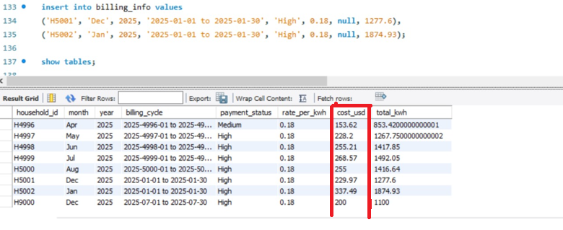
TASK 8 OUTPUT

Slide 31
TASK 9 After a new billing entry, insert calculated metrics into calculated_metrics
,
Pre-requisite
House hold_id = new.house_hold_id
Kwh_per_occupant = total_kwh /Num_occupants
Usage category = total_kwh > 600 set “High” else “Moderate”
Needed tables:
household_info,
billing_info
calculated_metrics

Slide 32
Task 9
Query
delimiter !!
create trigger get_updated_metrics
after insert on billing_info for each row
begin
declare house_num_count int;
declare kwh_num_result decimal(10, 2);
declare case_end_result varchar(10);
select num_occupants from household_info
where household_id = new.household_id
into house_num_count;
set kwh_num_result = new.total_kwh / house_num_count;
set case_end_result = case
when new.total_kwh > 600 then "High"
else "Moderate"
end;
insert into calculated_metrics (household_id, kwh_per_occupant, usage_category) values
(new.household_id, kwh_num_result, case_end_result);
end !!
delimiter ;

Slide 33
Task 9
checking present/not
show triggers;
Testing our trigger
insert values into household table (bcz of num_occupant)
insert into household_info values
('H9000', 'South', 'Lakeland', 12345, 'Apartment', 2793, 4, 'Yes');
insert values into billing_info table (actual insertion)
insert into billing_info values
('H9000', 'Dec', 2025, '2025-07-01 to 2025-07-30', 'High', 0.18, 200.00, 1100);
Review the calculated_metrics table
select * from calculated_metrics;

Slide 34
Task 9 explanation
Purpose
Created a trigger an After Insert trigger that automatically calculates and stores usage metrics (like kwh_per_occupant, usage_category) into the calculated_metrics table after a new billing entry is added.
Before that we need to insert a new entry into household table because it has total_occupants field by using that we gonna calculating this kwh_per_occupant field in calculated_metrics.
Usage & Benefits
Automates the generation of data insights (e.g., energy efficiency per person) without manual processing.
Enhances reporting by classifying usage as “High” or “Moderate”, based on actual energy consumption.
Ensures real-time metric tracking for every new household billing entry.
Encourages smart energy analysis and optimization using backend logic – makes no need for external scripts or tools to debug.

Slide 35
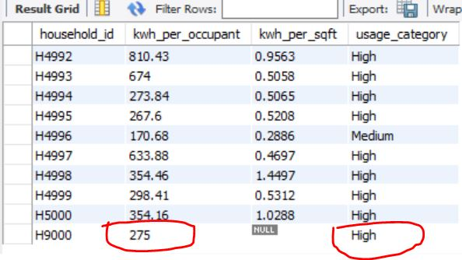
TASK 9 OUTPUT

Slide 36
.
THANK YOU

