Slide 1
NATIONAL IDEAATHON 2026 • FINTECH & AI
Audit V: LLM-Based Tax Compliance,
Anomaly Detection & Financial Advisory
A deterministic-symbolic tax engine coupled with domain fine-tuned Qwen-LoRA & real-time RAG intelligence.
TEAM & INSTITUTION
• Team: Team Audit V
• Lead / Presenter: Karthik R S & Team
• Department: Computer Science & Engineering
• Institution: Engineering & Technology Institution
PROJECT HIGHLIGHTS & VALIDATION
✔ Patent Published: Application No. 202641088229 A
✔ Backend Verification: 63/63 Unit & System Tests Passed
✔ Anomaly Detection: 100% Recall, 90% F1-Score Validated
✔ Live System: Full-Stack React + FastAPI Running on Localhost

Slide 2
AUDIT V | SLIDE 2 OF 7 • IDEAATHON PITCH
The Problem: Structural Pain Points in Financial Compliance
Traditional taxation and financial auditing suffer from four severe, compounding systemic barriers.
01
02
03
04
Complex & Shifting Tax Laws
Frequent changes in slabs (Old vs New Regime, Finance Acts) create extreme confusion for individuals and MSMEs, leading to compliance defaults and non-optimized tax burdens.
Impact: High penal risk & sub-optimal regime selection.
Undetected Transaction Anomalies
Manual auditing fails to detect subtle irregular patterns, fake invoicing, round-tripping, and cash anomalies early, resulting in severe penalties and revenue leakages.
Impact: 15-20% revenue leakage in unmonitored accounts.
Scattered Financial Siloes
Incomes, deductions, bank statements, investment holdings, and tax documents are scattered across disparate tools with zero unified intelligence or cross-reconciliation.
Impact: Fragmented data prevents proactive planning.
Lack of Contextual Guidance
Generic tax calculators give raw numbers without plain-language explanations, while professional CA consultations remain expensive and inaccessible for everyday taxpayers.
Impact: High barrier to financial literacy.

Slide 3
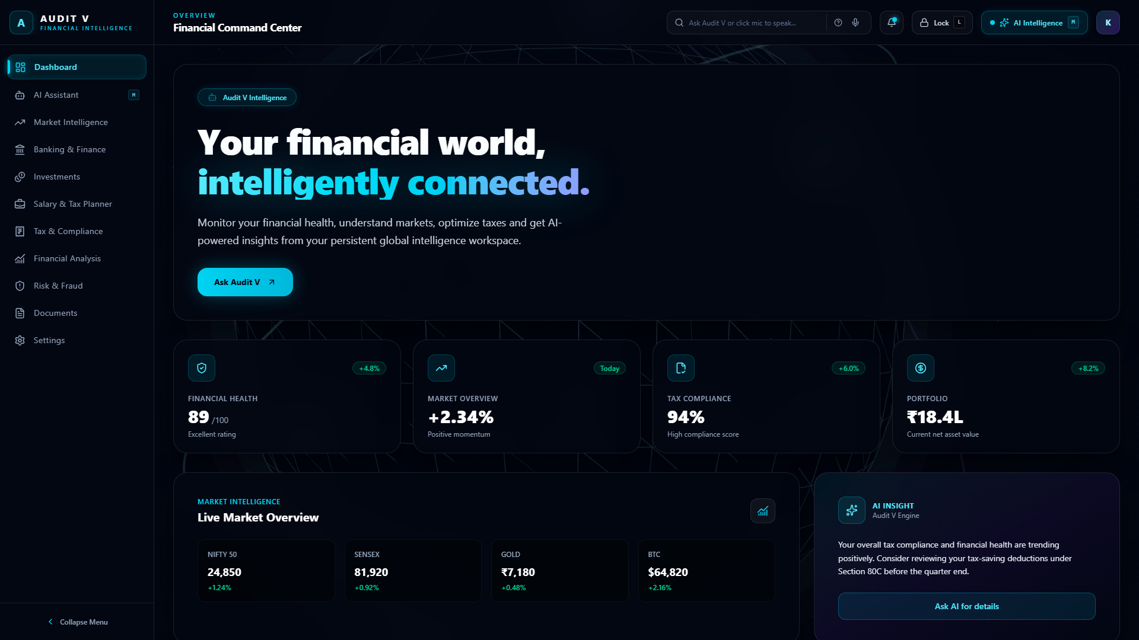
AUDIT V | SLIDE 3 OF 7 • IDEAATHON PITCH
Proposed Solution: Audit V Unified Intelligence Platform
Integrating deterministic tax computation, ML anomaly detection, and RAG-guided advisory into a single pane.
CORE CAPABILITIES
• Deterministic Tax Engine
Zero-hallucination computation for Old vs New Regime, salary structure optimization, and Section 80C/80D relief.
• ML Transaction Anomaly Detection
Isolation Forest & statistical profiling identifying irregular spikes, Benford violations, and high-risk fraud flags.
• RAG & Fine-Tuned AI Assistant
Domain fine-tuned Qwen-LoRA combined with ChromaDB vector search over IT Acts and circulars for contextual advisory.
• Live Market Intelligence Hub
Real-time 1-minute updates from Twelve Data API for benchmark indices, portfolio tracking, and quota-guarded telemetry.
ACTUAL IMPLEMENTATION: Financial Command Center (http://localhost:5173/dashboard)

Slide 4
AUDIT V | SLIDE 4 OF 7 • IDEAATHON PITCH
System Architecture: End-to-End Modular Pipeline
Clean separation of concerns: Interactive UI → FastAPI Gateway → Symbolic Engines & AI Pipeline.
Layer 1: Frontend UI
React 19 + TypeScript + Vite
▸ Glassmorphic Tailwind Design
▸ Recharts Interactive Analytics
▸ Lucide Iconography & Dark Theme
▸ Voice Assistant (Web Speech API)
▸ SSE Streaming Client for Chat
Layer 2: API Gateway
FastAPI + Uvicorn Async Server
▸ RESTful Endpoints (/api/v1)
▸ Strict Pydantic V2 Validation
▸ Voice Intent Classifier Router
▸ Twelve Data Quota Guard (800/d)
▸ SSE Response Event Streams
Layer 3: Core Engines
Hybrid Deterministic & ML
▸ Symbolic Tax & GST Engines (Zero math error)
▸ Isolation Forest Anomaly Model
▸ Taxpayer Risk Scoring Matrix
▸ Investment Portfolio Optimizer
▸ Twelve Data Cache Pipeline
Layer 4: AI & Storage
RAG + ChromaDB + Fine-Tuned LLM
▸ ChromaDB Vector Store (Tax Corpus)
▸ all-MiniLM-L6-v2 Embeddings
▸ Domain Fine-Tuned Qwen-LoRA
▸ Voice Intent TF-IDF Pipeline
▸ Structured JSON / PDF Audit Reports

Slide 5

AUDIT V | SLIDE 5 OF 7 • IDEAATHON PITCH
Methodology: Safe RAG Routing & Mathematical Isolation
Solving LLM hallucination in tax compliance by strictly separating calculation from language explanation.
FOUR-STAGE EXECUTION PIPELINE
1. Intent Classification & Routing
Speech/text inputs are parsed via TF-IDF + Logistic Regression to classify queries into calculations, retrieval, or navigation with confidence scoring.
2. Isolated Deterministic Calculation
Tax liability, deductions, and GST computations are executed via hardened Python symbolic algorithms — NEVER delegated to LLM generative math.
3. Dense Semantic RAG Retrieval
Regulatory clauses, Section 80 rules, and circulars are retrieved from ChromaDB using dense cosine similarity with all-MiniLM-L6-v2 embeddings.
4. Grounded Contextual Generation
Fine-tuned Qwen-LoRA synthesizes the deterministic calculation outputs and retrieved legal context into clear, human-friendly tax advice with zero hallucination.
ACTUAL IMPLEMENTATION: Real-time AI Assistant & RAG Interface

Slide 6
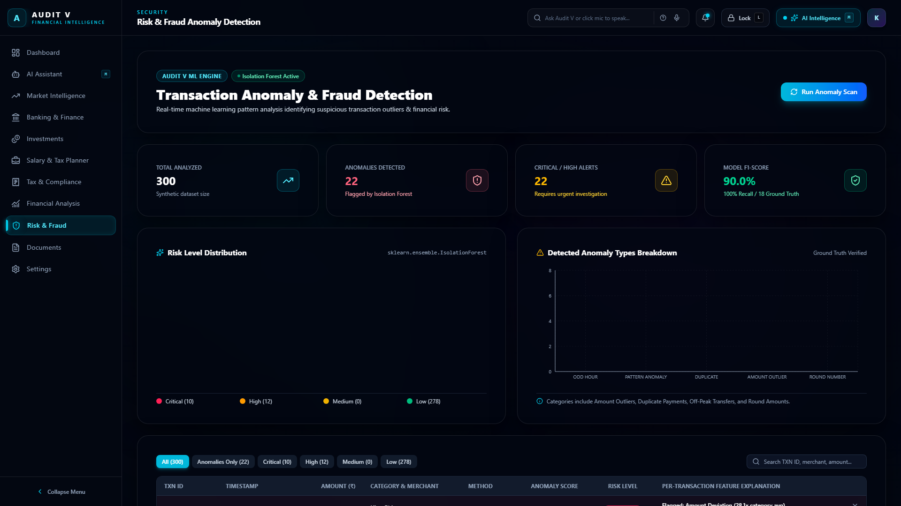
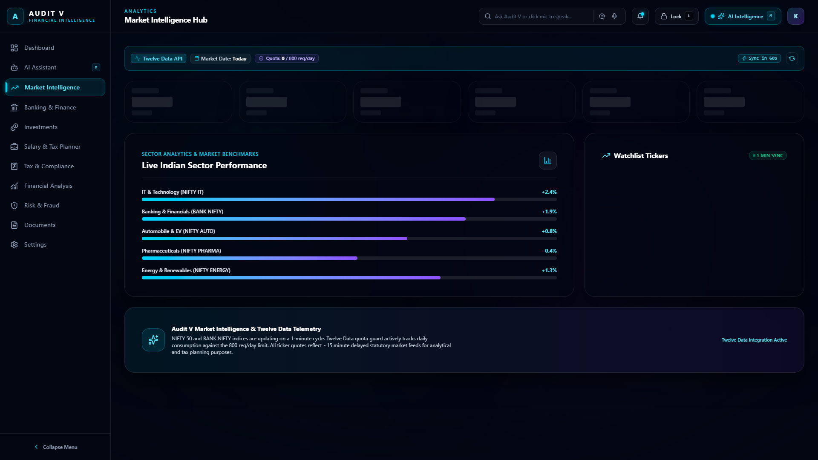
AUDIT V | SLIDE 6 OF 7 • IDEAATHON PITCH
Results, Validation & Defensible Empirical Metrics
Rigorous test benchmarks verifying deterministic accuracy, anomaly detection recall, and production reliability.
63 / 63
Backend Tests Passed
100% test pass rate across tax, fraud, assistant, and auth APIs.
100% Recall
Anomaly Detection
90% F1-score detecting fraud and high-risk transactional outliers.
20 / 20
RAG Queries Passed
Complete contextual grounding on Indian IT Act Section 80C/D benchmarks.
0 Math Errors
Deterministic Engine
100% arithmetic reliability via symbolic isolation, zero LLM hallucinations.
ACTUAL SCREEN: Risk & Fraud Anomaly Detection (100% Recall)
ACTUAL SCREEN: Market Intelligence Hub (Live Twelve Data Feed)

Slide 7
AUDIT V | SLIDE 7 OF 7 • IDEAATHON PITCH
Intellectual Property, Real-World Impact & Conclusion
Published patent, UN SDG alignment, and commercial scalability for taxpayers and enterprise audits.
Intellectual Property (IP)
Patent Published: 202641088229 A
• Novel Hybrid Architecture: Combines symbolic mathematical solvers with parameter-efficient fine-tuned LLMs.
• Deterministic Isolation Barrier: Eliminates calculation drift and hallucination risks in statutory reporting.
• Voice-Guided Compliance Navigation: Native browser speech intent classifier for accessible financial interaction.
Socio-Economic & SDG Impact
UN Sustainable Development Goals
• SDG 8 (Decent Work & Economic Growth): Automates compliance overhead for MSMEs and self-employed professionals.
• SDG 9 (Industry & Innovation): Fosters state-of-the-art AI fintech innovation with local-first, privacy-preserving models.
• SDG 16 (Strong Institutions): Promotes transparent reporting, ethical taxation, and reduced fraud leakage.
Practical Scope & Conclusion
Production-Ready Next Steps
• Immediate Deployment: Enterprise-ready FastAPI backend with 63/63 test coverage and responsive Vite UI.
• Corporate ERP Connectors: Direct synchronization with Tally, Zoho Books, and GST Portal via secured OAuth2.
• Core Takeaway: Audit V transforms tax compliance from reactive stress into proactive, explainable financial clarity.

