Slide 1
Experimental Study of Memory (Membench)‏
Microbenchmark for memory system performance
s
for array A of length L from 4KB to 8MB by 2x
for stride s from 4 Bytes (1 word) to L/2 by 2x
time the following loop
(repeat many times and average)‏
for i from 0 to L by s
load A[i] from memory (4 Bytes)‏
time the following loop
(repeat many times and average)‏
for i from 0 to L
load A[i] from memory (4 Bytes)‏
1 experiment
Notes:
CS267 Lecture 2

Slide 2
Membench: What to Expect
average cost per access
memory
time
size > L1
cache hit time
total size < L1
s = stride
Consider the average cost per load
  Plot one line for each array length, time vs. stride
  Small stride is best: if cache line holds 4 words, at most ¼ miss
  If array is smaller than a given cache, all those accesses will hit (after the first run, which is negligible for large enough runs)‏
  Picture assumes only one level of cache
  Values have gotten more difficult to measure on modern procs
Notes:
CS267 Lecture 2

Slide 3
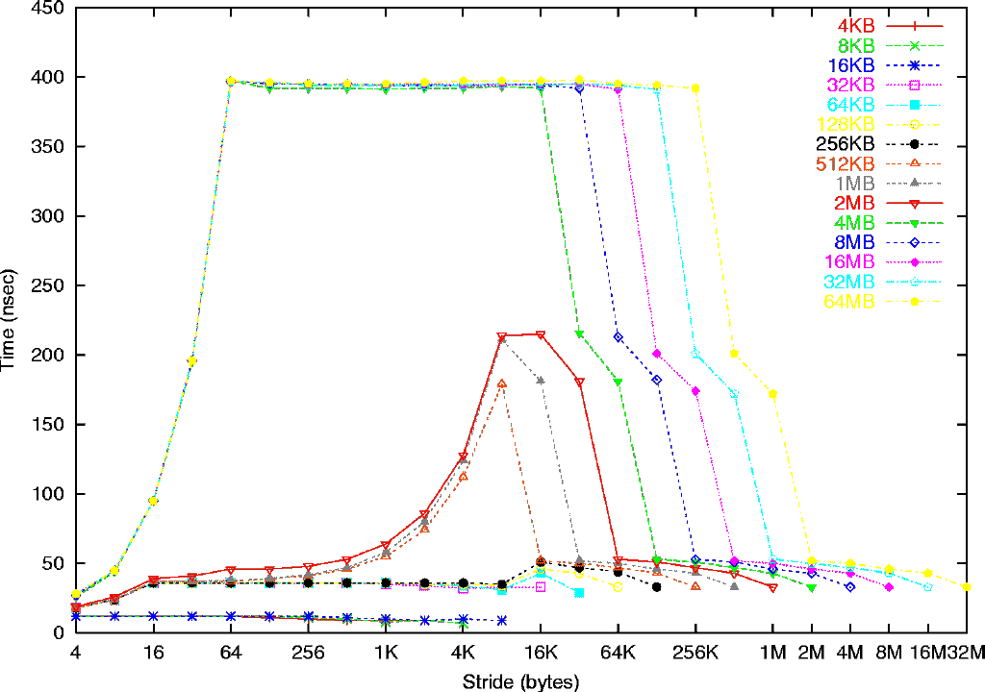
Memory Hierarchy on a Sun Ultra-2i
Sun Ultra-2i, 333 MHz
Array length
Mem: 396 ns
(132 cycles)‏
L2: 2 MB,
12 cycles (36 ns)‏
L1:
16 KB
2 cycles (6ns)‏
L1: 16 B line
L2: 64 byte line
8 K pages, 32 TLB entries
See www.cs.berkeley.edu/~yelick/arvindk/t3d-isca95.ps for details
Notes:
CS267 Lecture 2
Each symbol is an experiment, vertical axis is time/load
Experiments with same length array share symbol, color, joined by line
Such experiments differ only in stride in bytes (horizontal axis)‏
note that minimum stride = 4 bytes = 1 word
4) Main Observation 1: complicated, depending on array length and stride
5) Main Observation 2: time/load ranges from 6 ns to 396 ns, 66x difference – important!
6) Detail 1: bottom 3 lines (4KB to 16KB) take 6 ns = 2 cycles, but 32KB and larger take longer
deduce that L1 cache is 16 KB, takes 2 cycles/word (yes, according to hardware manual)‏
7) Detail 2: next 6 lines (32 KB to 1MB) take 36ns = 12 cycles for small stride (2MB a little more)‏
but 4MB takes much longer:
deduce that L2 cache is 2MB, takes 12 cycles/word (yes)‏
8) Detail 3: remaining lines take 396 ns = 132 cycles for medium stride,
deduce that main memory takes 132 cycles/word
9) Detail 4: look at 32KB to 1MB lines, speed halves from stride 4 to 8 to 16, then constant
deduce that L1 line size is 16 bytes
10) Detail 5: look at 4MB to 64MB lines, speed halves from stride 4 to 8 to … to 64, then constant
deduce that L2 line size is 64 bytes
11) Detail 6: look at lines 32KB-256KB, vs 512 KB-2MB, increase up to 8KB stride of latter
deduce that page size is 8 KB, and TLB has 256KB/8KB = 32 entries

Slide 4
Memory Hierarchy on a Pentium III
Katmai processor on Millennium, 550 MHz
Array size
L2: 512 KB
60 ns
L1: 64K
5 ns, 4-way?
L1: 32 byte line ?
Notes:
CS267 Lecture 2

Slide 5
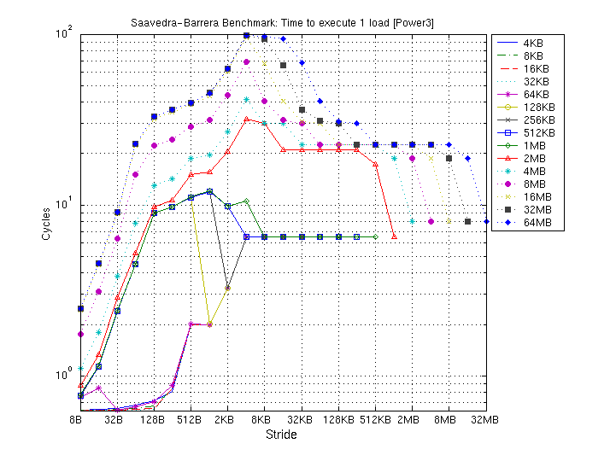
Memory Hierarchy on a Power3 (Seaborg)‏
Power3, 375 MHz
Array size
Mem: 396 ns
(132 cycles)‏
L2: 8 MB
128 B line
9 cycles
L1: 32 KB
128B line
.5-2 cycles
Notes:
CS267 Lecture 2

Slide 6
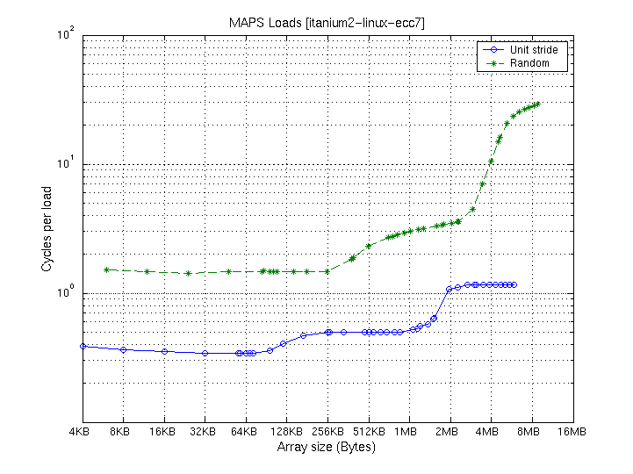
Memory Performance on Itanium 2 (CITRIS)‏
Itanium2, 900 MHz
Array size
Mem:
11-60 cycles
L3: 2 MB
128 B line
3-20 cycles
L2: 256 KB
128 B line
.5-4 cycles
L1: 32 KB
64B line
.34-1 cycles
Uses MAPS Benchmark: http://www.sdsc.edu/PMaC/MAPs/maps.html
Notes:
CS267 Lecture 2

