Slide 1


Internship / Professional Practice Presentation on “TEXT SUMMARIZATION”
Karthik B N
USN: 1RN18CS050
Internal Guide:
Dr. Shashidhar H R
Associate professor Dept. of CSE, RNSIT
New Age Solutions Technologies
External Guide
Mr. Aman Upadhyay
Professor Company-Nastech
Department of Computer Science and Engineering
RNS Institute of Technology
2021-22

Slide 2
CONTENTS
Abstract
About the Company
Introduction
Literature Survey
Requirements
System Design
Detailed Design
Implementation
Testing
Conclusion and Future Enhancements
References
Q & A

Slide 3
ABSTRACT
Text summarization is the process of reducing a text Document with a computer program in order to create a summary that retains the most important points of the original document. As The problem of information overload has grown, and as the quantity of data has in. It is very difficult for human beings to manually summarize large documents of text. creased, so has interest in automatic summarization
Text Summarization methods can be classified into extractive and abstractive summarization. An extractive summarization method consists of selecting important sentences, paragraphs etc. from the original document and concatenating them into shorter form. The importance of sentences is decided based on statistical and linguistic features of sentences. Extractive methods work by selecting a subset of existing words, phrases, or sentences in the original text to form the summary.

Slide 4
About the Company
NASTECH is formed with the purpose of bridging the gap between Academia and Industry.
Nastech is one of the leading Global Certification and Training service providers for technical and management programs for educational institutions.
We collaborate with educational institutes to understand their requirements and form a strategy in consultation with all stakeholders to fulfill those by skilling , reskilling and upskilling the students and faculties on new age skills and technologies.

Slide 5
INTRODUCTION
Text summarization is the problem of creating a short, accurate, and fluent summary of a longer text document. Automatic text summarization methods are greatly needed to address the ever-growing amount of text data available online to both better help discover relevant information and to consume relevant information faster.
There is an enormous amount of textual material, and it is only growing every single day. Think of the internet, comprised of web pages, news articles, status updates, blogs and so much more. The data is unstructured and the best that we can do to navigate it is to use search and skim the results. There is a great need to reduce much of this text data to shorter, focused summaries that capture the salient details, both so we can navigate it more effectively as well as check whether the larger documents contain the information that we are looking for.

Slide 6
Hardware & Software Requirements:
processor : Pentium 4 processor
Processor Speed : 2.4 GHz
RAM : 1GB
Storage Space : 40GB
Monitor : 1024x768 or 1280x1024
IDE : Jupyter Notebook or Google Colab
Operating system : Windows

Slide 7
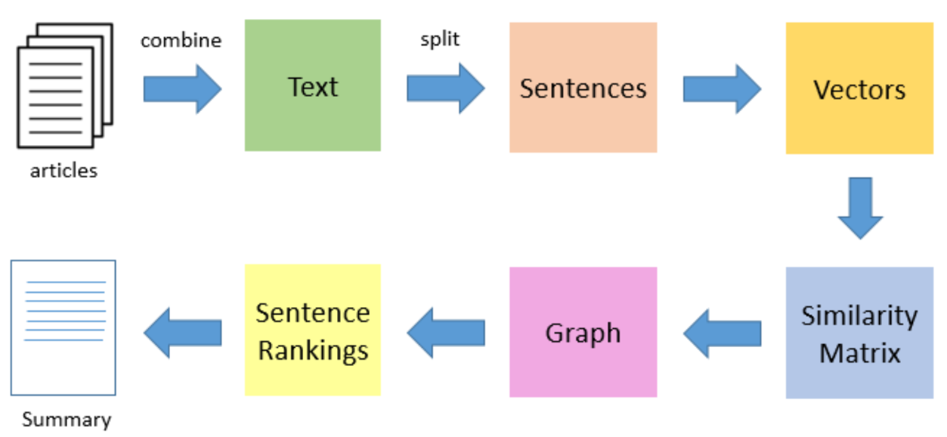
SYSTEM ARCHITECTURE
ARCHITECTURE

Slide 8
IMPLEMENTATION
Algorithm:
The TextRank summarization algorithm internally uses the popular PageRank algorithm, which is used by Google for ranking websites and pages. This is used by the Google search engine when providing relevant web pages based on search queries. To understand TextRank better, we need to understand some of the concepts surrounding PageRank. The core algorithm in PageRank is a graph-based scoring or ranking algorithm, where pages are scored or ranked based on their importance
Algorithm Steps :
Tokenize and extract sentences from the document to be summarized.
Decide on the number of sentences, k, that we want in the final summary
Build a document-term feature matrix using weights like TF-IDF or Bag of Words.
Compute a document similarity matrix by multiplying the matrix by its transpose.
Use these documents (sentences in our case) as the vertices and the similarities between each pair of documents as the weight or score coefficient we talked about earlier and feed them to the PageRank algorithm.
Get the score for each sentence.
Rank the sentences based on score and return the top k sentences.

Slide 9
IMPLEMENTATION
Libraries used :
import numpy as np
from sklearn.feature_extraction.text import TfidfVectorizerpandas as pd
from scipy.sparse.linalg import svds import network
import matplotlib.pyplot as plt
import nltk
import re
from gensim.summarization import summarize

Slide 10
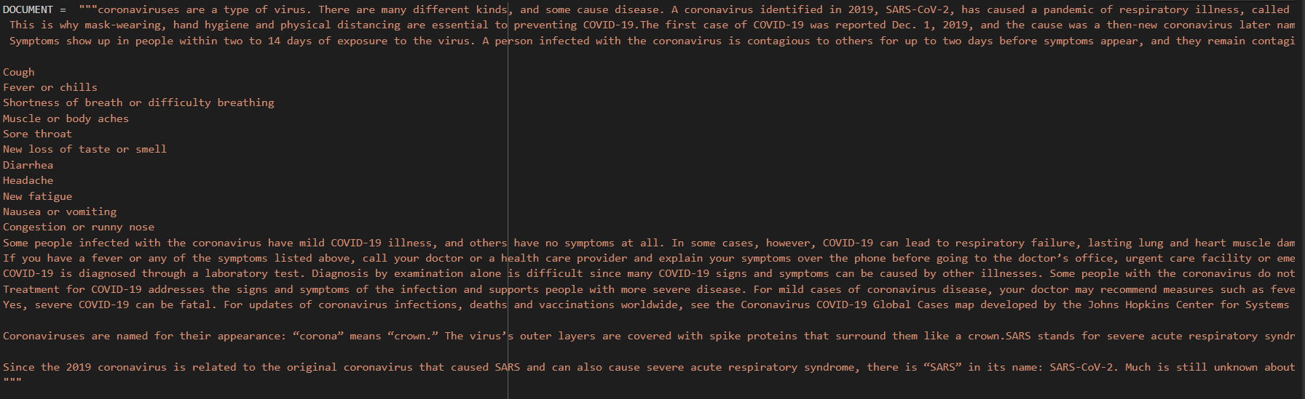
RESULT ANALYSIS
Results

Slide 11
CONCLUSION
Automatic text summarization is an old challenge but the current research direction diverts towards emerging trends in biomedicine, product review, education domains, emails and blogs.
This is due to the fact that there is information overload in these areas, especially on the World Wide Web. Automated summarization is an important area in NLP (Natural Language Processing) research.
It consists of automatically creating a summary of one or more texts. The purpose of extractive document summarization is to automatically select a number of indicative sentences, passages, or paragraphs from the original document .
Text summarization approaches based on Neural Network, Graph Theoretic, Fuzzy and Cluster have, to an extent, succeeded in making an effective summary of a document.

Slide 12
FUTURE ENHANCEMENTS
Through this project, we may create a bot which will help to analyse the given sentence in shorter format.
We can enhance this project which may take videos and images as the data-set.
We may also implement this model in different social media platform say Facebook and Instagram

Slide 13
REFERENCES
Fang Chen, Kesong Han and Guilin Chen, “An Approach to sentence selection based text summarization", Proceedings of IEEE TENCON02, 489-493, 2002.
A. Kiani –B and M. R. Akbarzadeh –T, “Automatic Text
Summarization Using: Hybrid Fuzzy GA-GP”, IEEE International Conference on Fuzzy Systems, 16-21 July, Vancouver, BC, Canada,977 -983, 2006.

Slide 14

PROJECT SETUP AND DEMONSTRATION

Slide 15
Suggestions….!

Slide 16
Thank You!!!

