Slide 1
SUMMARIZE
SUMMARIZE() function used to create summary table based on specific expression.
You can include your expressions to calculate values for each group in the resulting summary table.
It 4 different parameter. First is table expression you want to summarize.
Groupby_columnname – columns which you want to group the data.
Name- name of your calculated column in the summary table
Expression – the expression to calculate for grouping.
Karthimeena

Slide 2
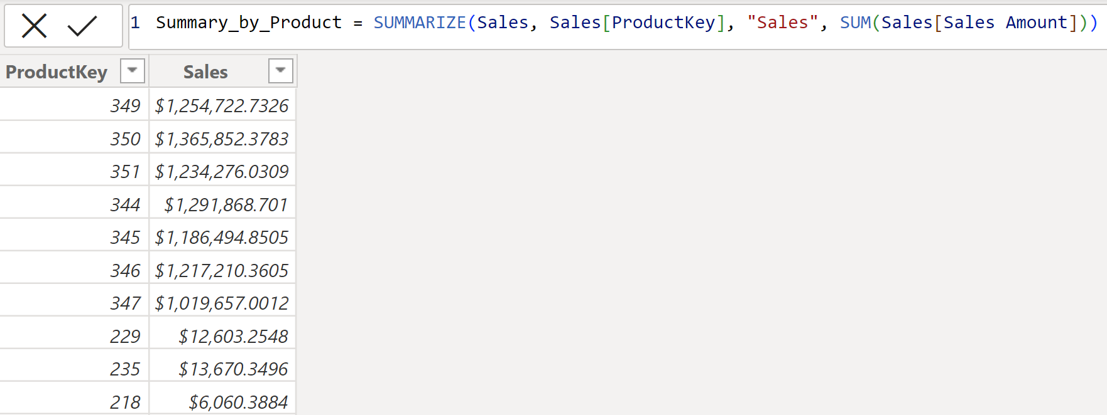
SUMMARIZE
In the below code, grouped the table by calculating sales amount for each products in a table .
Karthimeena

Slide 3
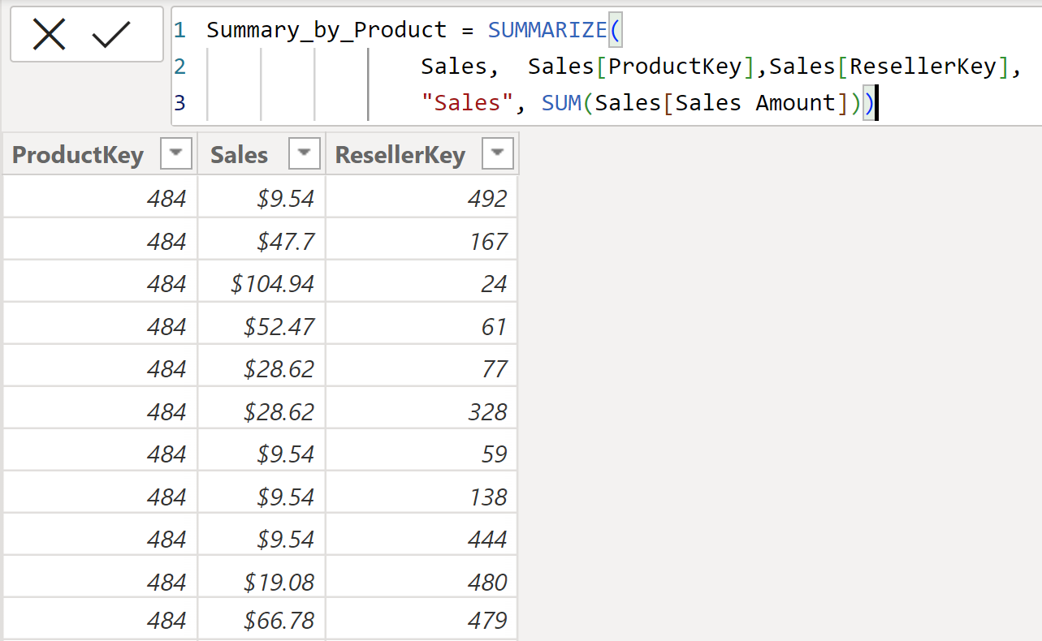
SUMMARIZE
In the below code, grouped the table by calculating sales amount for each products and reseller in a table .
Karthimeena

Slide 4
GROUPBY
GROUPBY() function used to create groups based on the values of one or more columns in a table and this allow you to perform calculations on the group.
It returns a table, that containing the groups along with aggregated values of each group.
It 4 different parameter. First is source table from which you want to create groups.
Group_by_column – The Column which you want to create group.
Name- name of your aggregated column
Expression – Aggregation or calculation to be performed on the group.
Karthimeena

Slide 5
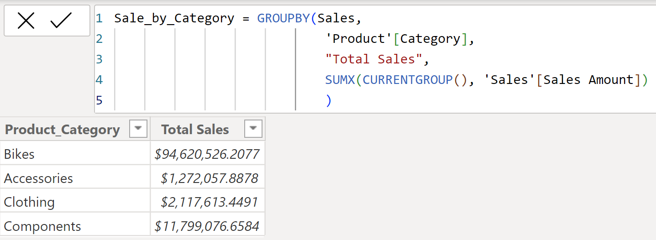
GROUPBY
In the example, GROUPBY() function creates groups based on the category column from Product table and calculates the total sales amount for each category in the product table.
Source table name
Group by column
Aggregated column name
Aggregation type
Karthimeena

Slide 6
GROUPBY
When using ‘Groupby’ in DAX, aggregation functions like SUM, MAX should operate within the context of the current group.
To define the current group, here CURRENTGROUP() function used inside the SUMX().
Karthimeena

Slide 7
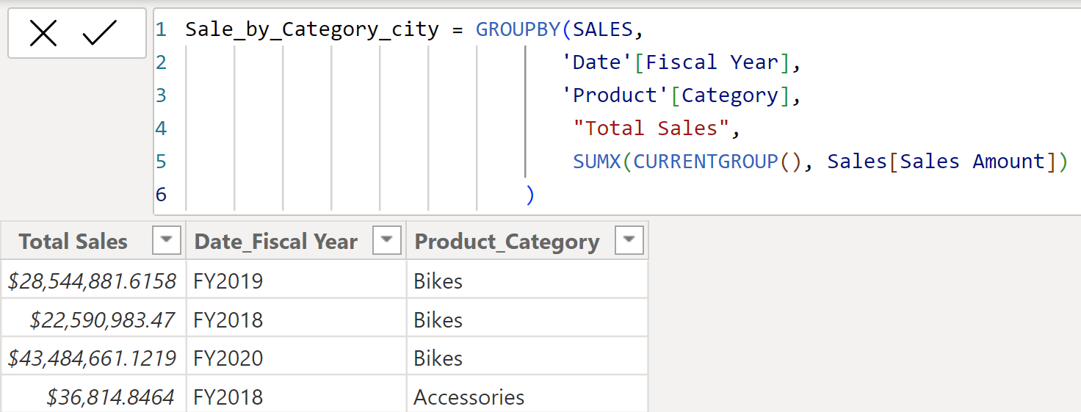
GROUPBY
In this example, groups are created based on two different columns from different tables.
Karthimeena

