Slide 1

Adult Income Prediction
Karthikeyan S

Slide 2
PROBLE STATEMENT:
This is the data of Income evaluation for different countries. Based on the available features, build a model to predict whether a person's income exceeds a certain threshold (e.g., <=50K or >50K), Which will help to identify the factors that contribute to higher incomes.
OBJECTIVE :
To build a model that predicts whether a person's income is above or below 50000 given some information like Age, Education Qualification, etc.

Slide 3
DATA DESCRIPTION
Age​: the age of an individual. (Integer greater than 0)
Workclass​: a general term to represent the employment status of an individual. (Private, Self­emp­not­inc, Self­emp­inc, Federal­gov, Local­gov, State­gov, Without­pay, Never­worked)
Final_census: final weight. In other words, this is the number of people the census believes the entry represents.
Education​: the highest level of education achieved by an individual. (Bachelors, Some­college, 11th, HS­grad, Prof­school, Assoc­acdm, Assoc­voc, 9th, 7th­8th, 12th, Masters, 1st­4th, 10th, Doctorate, 5th­6th, Preschool)
Education­-num​: The highest level of education achieved in numerical form. ○ Integer greater than 0
Marital-­status​: marital status of an individual. Married­civ­spouse corresponds to a civilian spouse while Married-­AF-­spouse is a spouse in the Armed Forces. (Married-­civ-­spouse, Divorced, Never-­married, Separated, Widowed, Married-­spouse­absent, Married-­AF­-spouse.)
Occupation​: the general type of occupation of an individual. (Tech­-support, Craft­repair, Other­-service, Sales, Exec­managerial, Prof-­specialty, Handlers­cleaners, Machine­-op-­inspct, Adm­-clerical, Farming­fishing, Transport­moving, Priv­house­serv, Protective-­serv, Armed­Forces)

Slide 4
Relationship​: represents what this individual is relative to others. For example an individual could be a Husband. (Wife, Own­child, Husband, Not­in­family, Other­relative, Unmarried)
Race​: Descriptions of an individual’s race. (White, Asian­Pac­Islander, Amer­Indian­Eskimo, Other, Black.
Sex​: the biological sex of the individual. (Male, Female)
Capital­-gain​: capital gains for an individual. (Integer greater than or equal to 0)
Capital­-loss​: capital loss for an individual.(Integer greater than or equal to 0 )
Hours­per­week​: the hours an individual has reported to work per week.
Native­country​: country of origin for an individual. (United­States, Cambodia, England, Puerto­Rico, Canada, Germany, Outlying­US(Guam­USVI­etc), India, Japan, Greece, South, China, Cuba, Iran, Honduras, Philippines, Italy, Poland, Jamaica, Vietnam, Mexico, Portugal, Ireland, France, Dominican­Republic, Laos, Ecuador, Taiwan, Haiti, Columbia, Hungary, Guatemala, Nicaragua, Scotland, Thailand, Yugoslavia, El­Salvador, Trinadad&Tobago, Peru, Hong, Holand­Netherlands)
● The target​: whether or not an individual makes more than $50,000 annually. ○ <=50k, >50k

Slide 5
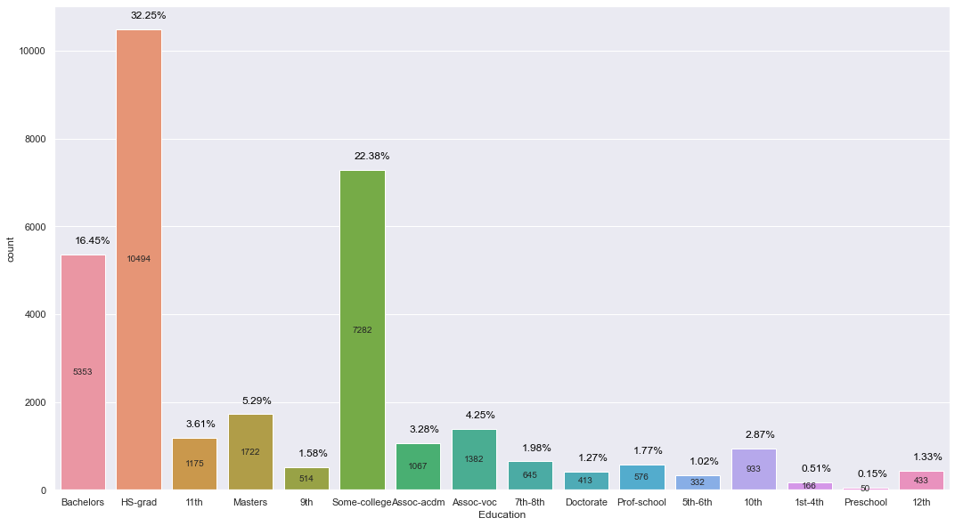
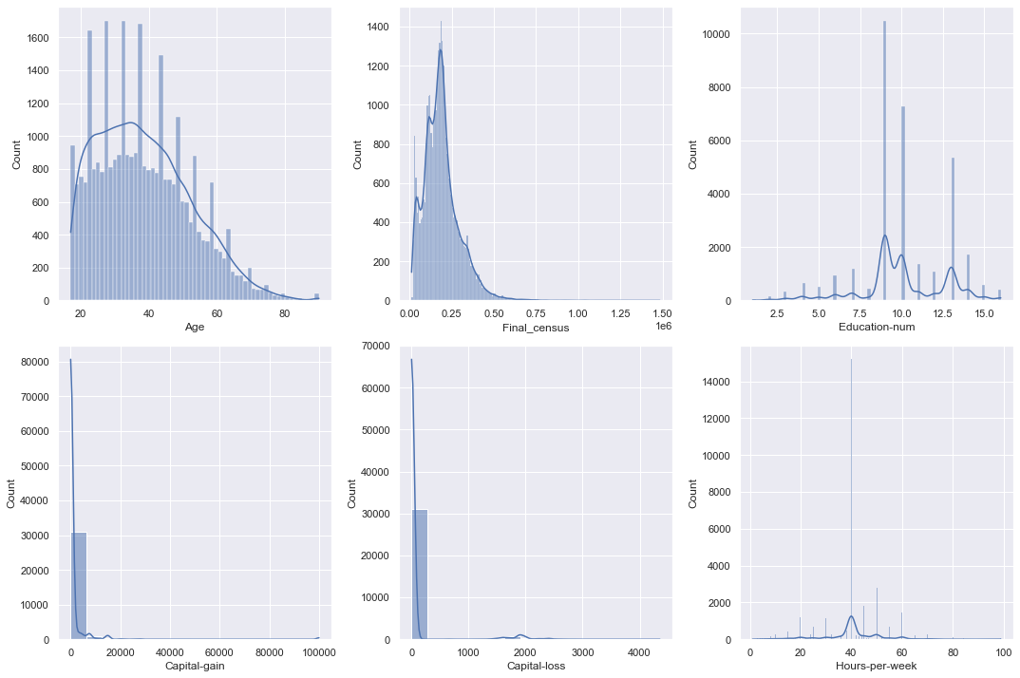
WHITE RACE | 85.43%
OTHERS | 14.57%
United-States | 92%
Other countries | 8%

Slide 6
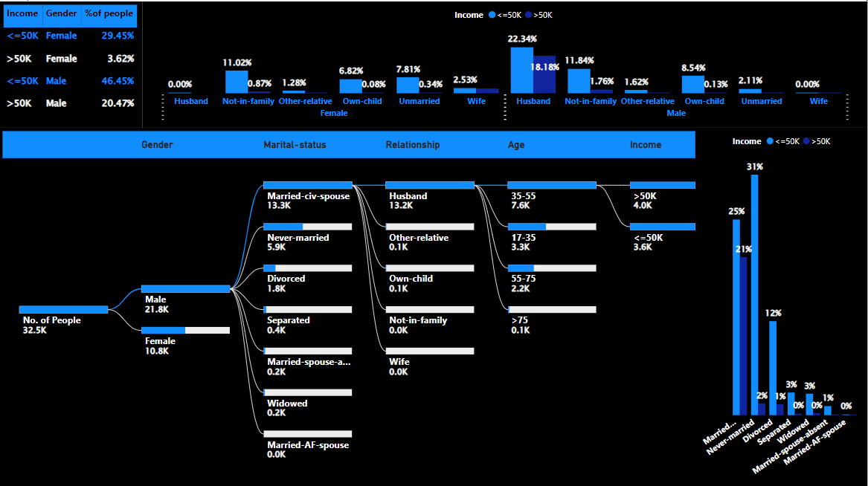

Slide 7
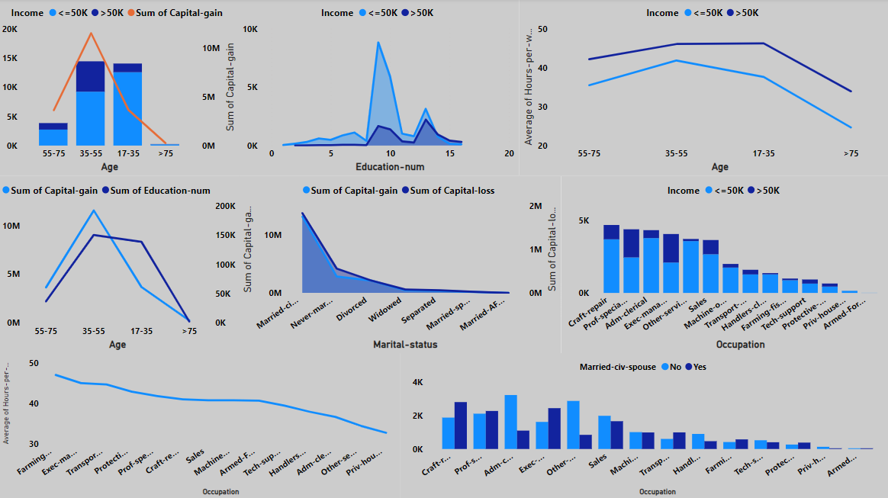

Slide 8
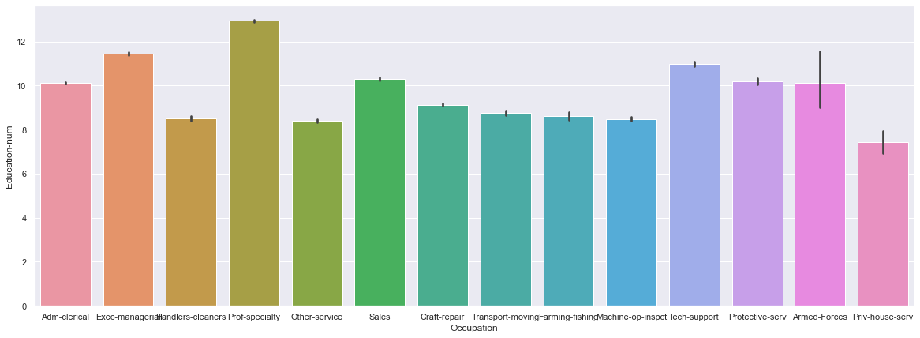
We could see Exec-managerial and Prof-specialty has high average Education-num. These are also the most common jobs for married people apart from Craft-Repair.
From this, we could say, Married Status, Education-num, Age, Occupation and Hours per week are the most important features.

Slide 9
INSIGHTS:
Private professional class simply dominates other profession classes.
Top 3 Education levels: HS-Grad, Some college, Bachelors(Around 70% of the people have atleast 1 of these education)
20% of male has income >50K and 18% of them are husbands and the remaining 2% would be from Not-in-family.
20% of the females are not-in-family or unmarried. 55% of Males are Husbands and Not-in-Family Male
White race people and USA have dominated other categories in Race and Country variable respectively.
We also have a class imbalance in our target variable
Out of 24% >50K income people, 20% are married civ-spouse. And people in the >50K class have higher average Education-num when compared to <50K class

Slide 10
INSIGHTS:
66% Male and 40% them are husbands and some 18% of them belong to >50K class. Out of those 18%, 13% have education-num greater than 12 and majority of this 13% belongs to >50K class. Therefore, Education num is an important feature.
3% of female has income >50K and 2% of them are wives.
Also keeping the above points in mind, people in the age of 40-55 tends to be in class >50K
Major contributors to the >50K class are Married-civ-spouse, Not-in-family, with more than 12 years of education and with average age around 40.
Similarly, Exec-manager, Prof-specialty, Tech support occupation have most people with average of 12 years education.
Husband's second highest common job 'Exec-manager’. Prof-specialty is one of the top most common job for wives and Not in family category.
People having the above mentioned features only tend to have capital-gain and capital-loss. Those also have an impact on our dependent variable.
People with age in 35-55 who are married-civ-spouse or not-in-family (male) with more than 12 years of education whose occupation is Exec-Manager or Prof-specialty or Tech Support and they work around 40-60 hours per week have a higher chance to be in >50K class

Slide 11
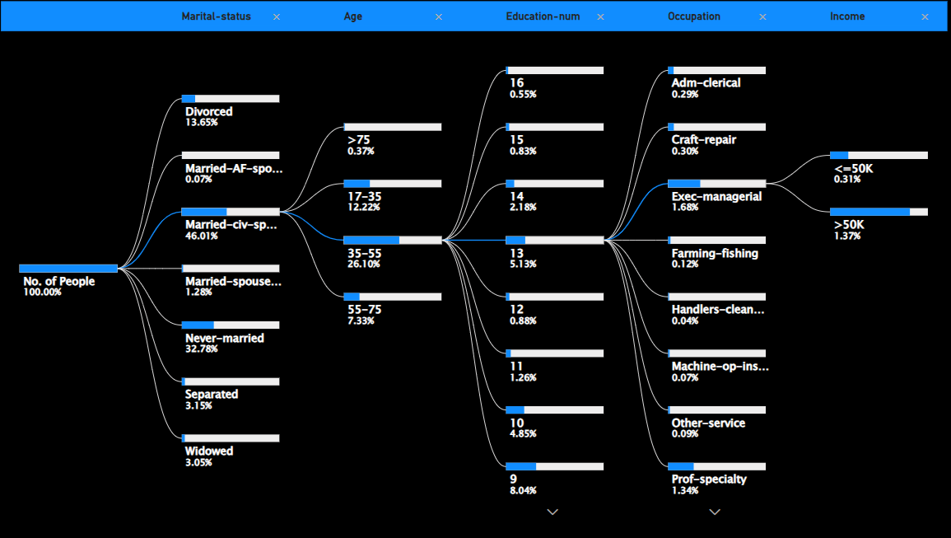

Slide 12
MODEL BUILDING
Algorithms Used: RandomForest Classifier, XGBoost Classifier, Bagging Classifier, K-Nearest Neighbour, Logistic Regression.
ALGORITHM | TRAINING ACCURACY | TESTING ACCURACY
RANDOMFOREST | 0.8959 | 0.8727
XGBOOST | 0.8875 | 0.8761
BAGGING CLASSIFIER | 0.8838 | 0.8701
LOGISTIC REGRESSION | 0.8478 | 0.8505
K-NEAREST NEIGHBOUR | 0.8724 | 0.8566

Slide 13
MODEL BUILDING
Since it is a slightly Imbalanced Dataset, we tried applying some of the Balancing Techniques. The result in the previous page is without any balancing technique. But after applying some of the Balancing techniques like SMOTE, UnderSampler, the models’ test accuracy didn’t improve much.
So, we choose the XGBoost model with 88% accuracy as our final model.
We used a XGBoost model with default parameters and specified learning rate=0.1 and n_estimators = 500. And while fitting the model we passed a validation set and early stopping parameters as 20 which will help the model to stop when there is no significant improvement for continuously 20 rounds. Though we have given 500 estimators, we would stop at some estimator in between if there is no improvement for some time. This will eventually avoid overfitting problem.

Slide 14
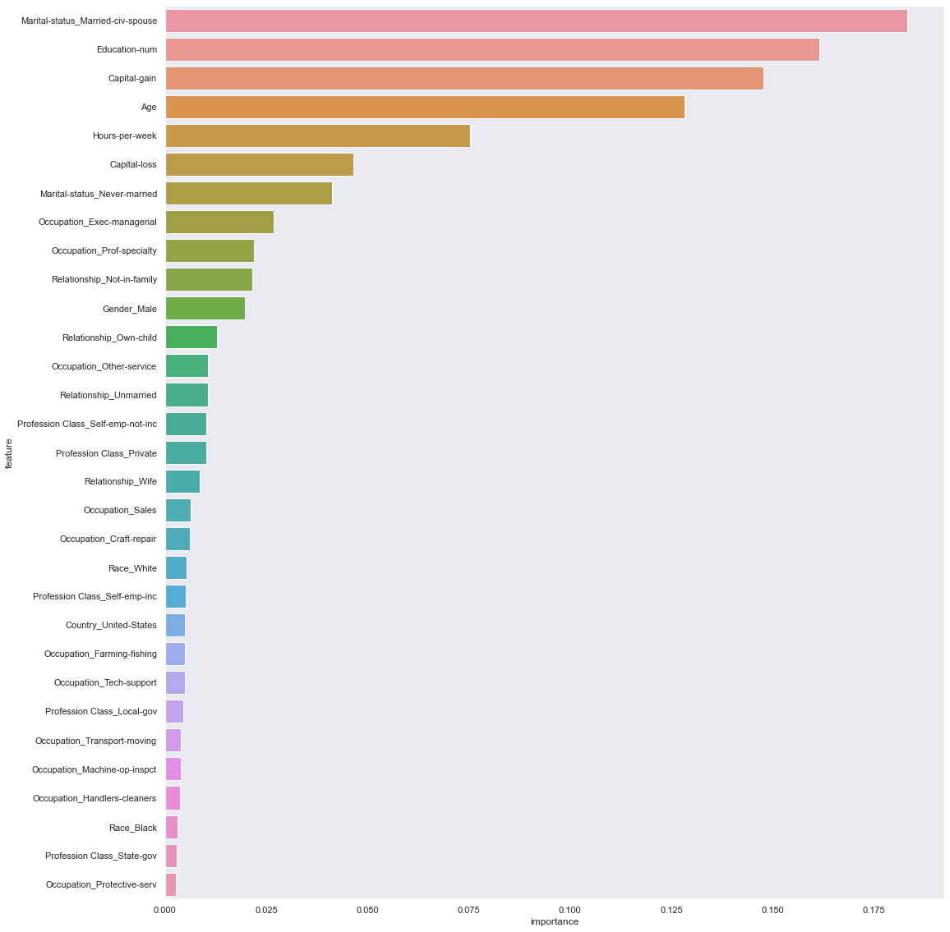
Model Interpretation

Slide 15
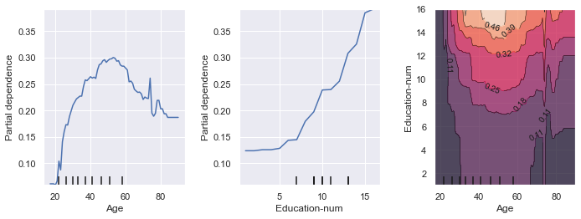
Partial Dependence plot allows us to get even more insights about our models and our Data Features. The above plot tells us how much how Age, Education-num has solely impacted our dependent variable. The graph on the right tells how both impact the dependent variable together.

Slide 16
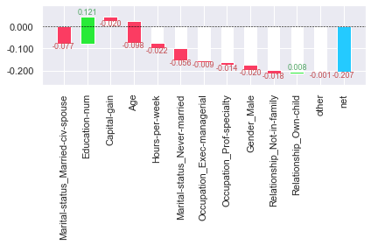
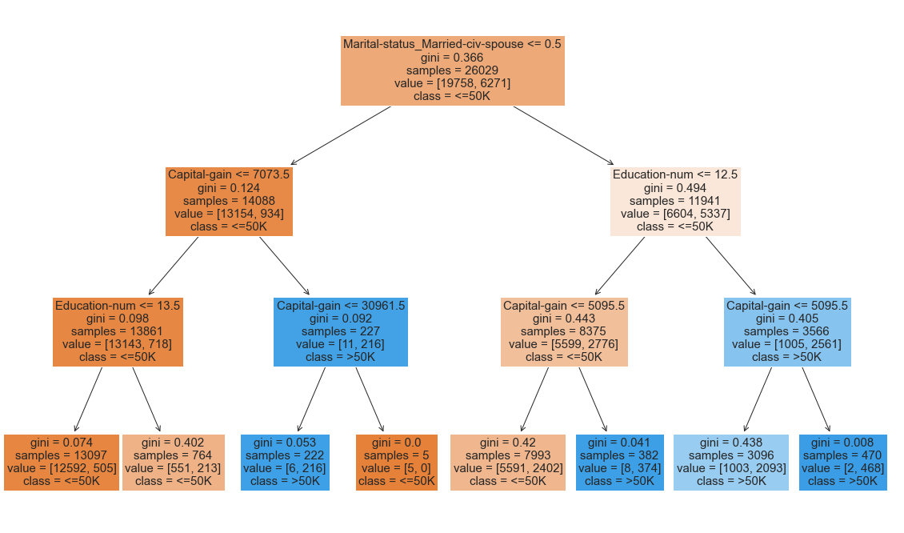
Prediction | 0.034038
Bias | 0.240908
From the above waterfall chart we can interpret how each feature has impacted a particular row’s prediction. Basically, which features contributed in what way for it to go from Bias to the model’s prediction.
This gives us more insights/clarity about how our model is making our predictions.

Slide 17
THANK YOU
KARTHIKEYAN s

