Slide 1


Heritage Haven
Preserving Culture, Enabling Discovery
Created by Namaste Techies
Culture Se Judne Ka Naya Tarika...

Slide 2

The Challenge We're Solving
Fragmented Information
Inefficient Planning
Limited Discovery
Heritage lovers struggle to find consolidated, reliable details on monuments, their history, and nearby services — everything is scattered across multiple apps and websites.
Planning an itinerary combining multiple sites is time-consuming and complex, with no intelligent tools to optimize routes or discover hidden gems.
Most travelers only visit famous landmarks, missing out on lesser-known heritage spots that offer equally rich cultural experiences and stories.
The gap is clear: there's no unified, intelligent platform designed specifically for cultural tourism in India.

Slide 3
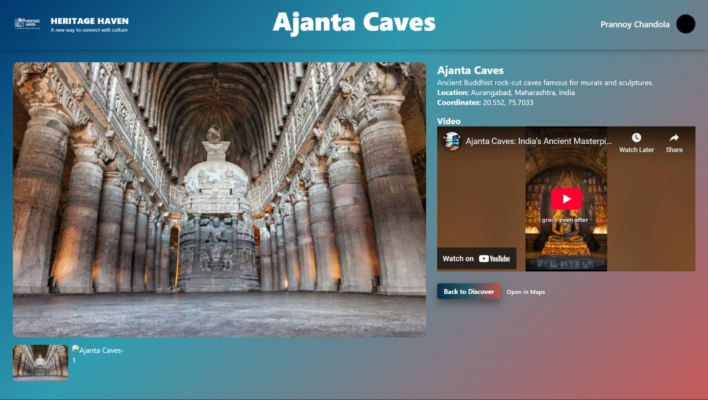

Introducing Heritage Haven
A Unified Heritage Discovery Platform
Heritage Haven is a comprehensive web-based solution that transforms how people explore India's cultural treasures. We bring together detailed heritage site profiles, interactive mapping, intelligent itinerary planning, and local recommendations — all in one seamless experience.
Whether you're a history enthusiast, a curious tourist, or a local explorer, Heritage Haven empowers you to discover, plan, and navigate India's rich cultural landscape with confidence and ease.

Slide 4
Core Features That Empower Exploration
Rich Heritage Profiles
Interactive Maps & Routes
Smart Recommendations
Each site features comprehensive historical facts, stunning imagery, architectural insights, and practical visitor tips to enhance your experience.
Visualize spatial relationships between sites with integrated geolocation, smart routing, and real-time navigation to plan your journey efficiently.
Discover nearby restaurants, hotels, and transport hubs through integrated map APIs, making your cultural tour seamless from start to finish.

Slide 5

More Ways to Discover & Plan
1
2
Intelligent Itinerary Planner
Advanced Search & Filtering
Select multiple sites and let our smart algorithm generate an optimized day-wise plan that maximizes your time and minimizes travel distance.
Find exactly what you're looking for by filtering sites by region, historical era, type (temple, fort, museum), or architectural style — making discovery intuitive.
3
Community Reviews & Ratings
Learn from fellow travelers through authentic user feedback, ratings, and tips that help you make informed decisions about which sites to visit.

Slide 6
Technical Architecture
Modern, Scalable Stack
Data Architecture
Frontend: React-based responsive UI for seamless cross-device experiences
Our structured data model ensures fast queries and rich relationships:
Backend: Node.js/Express API handling business logic and data processing
Heritage site profiles with metadata
User accounts and preferences
Database: MongoDB for flexible site data, user profiles, and itineraries
Reviews and ratings system
Third-party APIs: Maps/Places API for location services, directions, and nearby amenities
Itinerary planning and routing
Geospatial indexing for proximity searches
Deployment: Cloud-hosted with scalable infrastructure

Slide 7




User Journey: From Discovery to Experience
Search & Browse
Users explore heritage sites through intuitive search and filtering options
Learn & Explore
Detailed profiles reveal the history, architecture, and cultural significance of each site
Navigate & Visit
Interactive maps guide travelers with routes and nearby service recommendations
Review & Share
Travelers contribute reviews and ratings to help the community

Slide 8



Impact & Vision
Promoting Cultural Tourism
Empowering Discovery
Conservation Awareness
Heritage Haven shines a spotlight on lesser-known heritage sites across India, driving tourism to regions beyond the typical tourist circuit and supporting local economies.
Both locals and international travelers gain the tools to explore heritage in their vicinity, fostering deeper connections with India's diverse cultural landscape.
By educating visitors about the historical and architectural significance of sites, we cultivate a community committed to heritage preservation and protection.

Slide 9


Thank You
Let's Preserve Culture, Enable Discovery
Heritage Haven is more than a platform — it's a movement to make India's rich cultural heritage accessible, discoverable, and beloved by all.
Ready to explore the demo? Check out our GitHub repository and live prototype. We welcome your questions and feedback!

