Slide 1
Neuro-Symbolic-RAG
A Multi-Hop Agent Framework for Verifiable Scientific Reasoning
Codebase review, achieved results, and submission framing based on the current repository state.
Phase 4 is implemented and evaluated; Phase 5 verifier is implemented and pending final benchmark reporting.
Presenter: Student Name
Current headline
Phase 2 and 3 are strong. Phase 4 is near target with EM 8.8 and F1 19.53.
Prepared on April 7, 2026

Slide 2
Why This Project
problem -> system -> evidence
Research problem
NSRAG answer
What the repo already proves
Multi-hop and scientific questions need more than a single retrieval step. Systems must decompose, route, reason, and verify.
Use neural retrieval for evidence, symbolic structure for hop planning, and formal verification for trustworthiness.
This is not just an idea. The codebase already implements every major layer from decomposition to verification.
Submission stance: present this as a strong prototype with validated modules and a nearly-complete end-to-end story.
Phase 2 gives explicit and interpretable multi-hop plans.
Phase 3 provides the neuro-symbolic bridge: dense retrieval, optional graph traversal, and SymPy reasoning.
Phase 4 integrates the pipeline into an agent with hop traces, confidence, and final synthesis.
Phase 5 adds a verifier stack, which makes the project stronger than a pure generation baseline.
NSRAG | submission-ready snapshot

Slide 3
What The Codebase Is
repo structure at a glance
Primary modules
Supporting assets
Important nuance
phase1/: naive RAG baseline and FAISS index
phase2/: symbolic decomposer and DAG planner
phase3/: retrieval router over Qdrant, Neo4j, and SymPy
phase4/: multi-hop agent with hop traces and synthesis
phase5/: hallucination guard and formal verifier
eval/: shared EM/F1 harness
datasets/ and benchmarks/: HotpotQA, MuSiQue, 2Wiki, TheoremQA loaders
vector_db/ and baselines/: external resources and comparisons
The architecture is stronger than the current headline score.
The repo already contains early knowledge alignment, graph hooks, solver hooks, and verification gates, but some of those paths are scaffolded or optional in the present benchmark run.
That means the project is best framed as a complete prototype with one remaining integration bottleneck.
Core stack
Groq for LLM calls
BAAI bge-base-en-v1.5 for embeddings
Qdrant for local vector storage
Optional Neo4j graph retrieval
SymPy for symbolic solving and verification
NSRAG | submission-ready snapshot

Slide 4
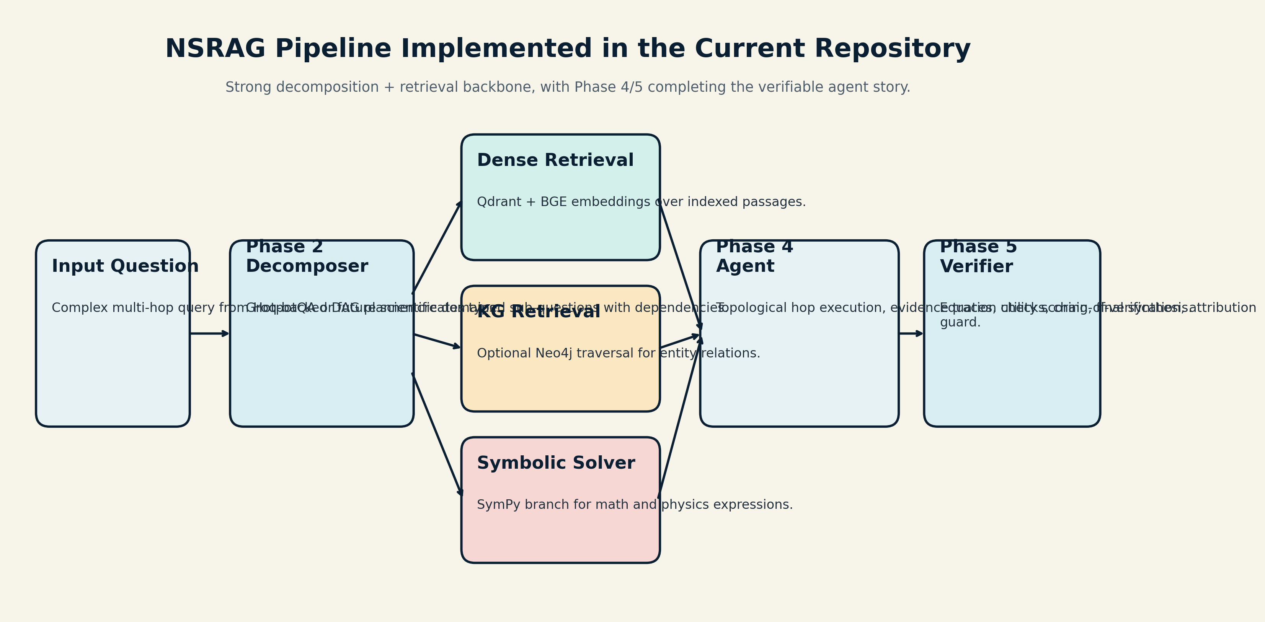
System Pipeline
implemented architecture
Interpretation: the decomposition and retrieval backbone is already convincing; the current gap is turning that structure into stronger exact final answers.
NSRAG | submission-ready snapshot

Slide 5
Phase-Wise Progress
achieved results as of now
Phase | Module | Achieved Result | Status
1 | Naive baseline | HotpotQA 1000-sample baseline: EM 16.6, F1 35.32 | Complete
2 | Decomposer | DAG validity 100.0 | hop accuracy 100.0 | domain 100.0 | Complete
3 | Hybrid retrieval | Recall@5 84.0 | Recall@10 84.0 | MRR 0.8027 | Complete
4 | NSRAG agent | EM 8.8 | F1 19.53 | avg hops 2.02 | In progress
5 | Formal verifier | Equation checks, CoVe, and attribution guard implemented; final benchmark report still pending | Pending eval
Best headline: phases 2 and 3 are solidly validated; phase 4 is implemented and close to the intended milestone.
NSRAG | submission-ready snapshot

Slide 6
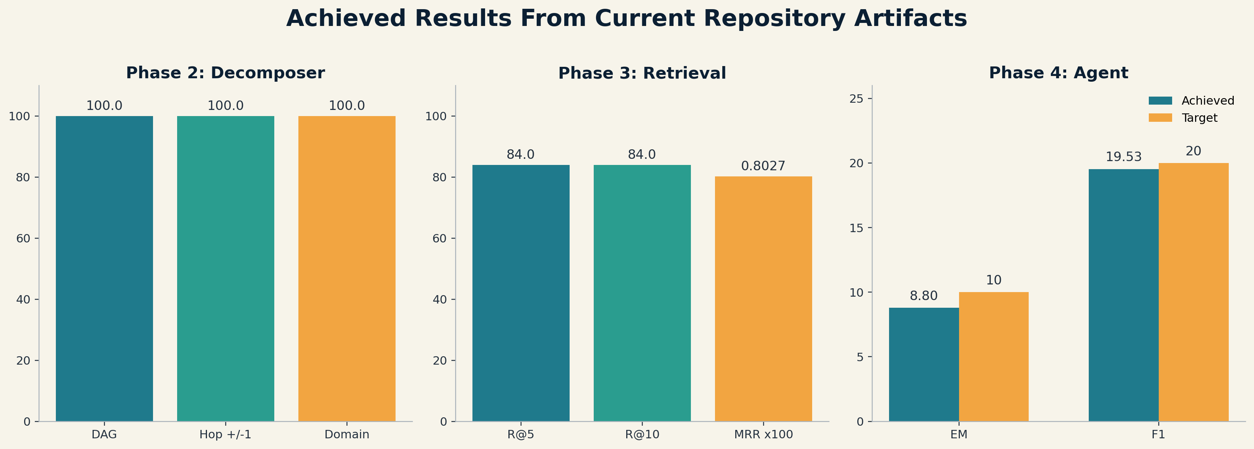
Current Results
where the project stands today
Strongest evidence
The decomposer and retrieval stack are already convincing and give the project real technical depth.
Current gap
Phase 4 is narrowly below target: EM 8.8 vs 10, F1 19.53 vs 20.
Honest comparison
The simple baseline still beats the current agent on HotpotQA answer quality: EM 16.6 / F1 35.32.
NSRAG | submission-ready snapshot

Slide 7
What I Think About The Project
balanced assessment
Why it is strong
What needs work
Best framing for submission
The project is structurally impressive: it has a phase plan, acceptance gates, reusable evaluation, interpretable traces, and a verifier design.
That already makes it more than a toy RAG demo.
The agent controller still loses too much quality between retrieval and final synthesis.
A lot of the gap looks like orchestration and exactness, not a lack of project vision.
Call it a serious neuro-symbolic reasoning prototype with validated decomposition and retrieval, plus a near-complete agent/verifier stack.
That claim is ambitious, accurate, and defensible.
Bottom line: the idea is good, the codebase is real, and the remaining gap is concentrated in Phase 4 quality tuning.
NSRAG | submission-ready snapshot

Slide 8
How To Present This Today
Closing message
Lead with the architecture and the phase-wise engineering story.
Report decomposition and retrieval as achieved results, not only planned goals.
Describe Phase 4 as implemented, evaluated, and close to target rather than fully complete.
Describe Phase 5 as the verifier pipeline already coded and ready for final reporting.
Say the project is moving from a strong prototype to a full verified reasoning system.
NSRAG already demonstrates a real neuro-symbolic multi-hop stack.
The most credible submission story is not finished SOTA performance, but a well-built and nearly-complete verifiable reasoning framework.
Practical reminder: remove or rotate any API keys before sharing the repo or slides.
Files generated from current repo artifacts

