Slide 1
IBM University Engagement Project Submission
“Exploring the Power of Agentic AI with IBM Granite and LangFlow”

Slide 2

Project Tile : Research Companion
Domain of Project : Education
Student Name | Recent Passport Photo | Email ID | Mobile number [WhatsApp]
Kartik Kamlesh Chinchole |  | kartikchinchole47@gmail.com | 9405443587

Slide 3
Problem Statement
Problem Statement : Research Agent
The Challenge
Researchers, students, and professionals often deal with scattered academic papers, technical articles, and experimental data spread across multiple platforms. Filtering relevant knowledge, summarizing insights, and keeping track of the latest developments is time-consuming and inefficient. The challenge is not just to collect references but to synthesize, analyze, and generate actionable research insights in real time.
The Objective
Build an agentic AI application that acts as an intelligent research companion. The solution should:
Fuse Academic Sources: Aggregate data from research papers, journals, preprints, and knowledge repositories, then synthesize them into clear, concise literature reviews.
Enable Multimodal Research Input: Accept user queries, notes, charts, or even PDFs, and convert them into structured insights, references, and summaries.
Create a Predictive & Agentic Layer: Highlight emerging trends, detect citation gaps, and predict promising directions for future research in a given domain.
Visualize Research Insights: Provide an interactive dashboard with topic clusters, citation maps, sentiment/trend analysis, and concise knowledge graphs.

Slide 4
Proposed Solution
AI Research Companion is an intelligent research assistant built using IBM watsonx Orchestrate that helps researchers, students, and professionals quickly understand research topics without manually reading numerous documents.
The solution uses a curated knowledge base of academic papers and technical documentation. When a user asks a research-related question, the agent searches the uploaded knowledge base, retrieves the most relevant information, and automatically generates structured research insights.
The system provides:
Retrieval of relevant research documents from the knowledge base.
Concise literature reviews based on retrieved information.
Extraction of key findings and common research themes.
Suggestions for future research directions.
A simple and interactive web interface built using IBM BOB with an embedded IBM watsonx Orchestrate agent.
This significantly reduces the time required to search, read, and summarize technical research while providing users with organized and actionable insights.

Slide 5
Technology Used
IBM watsonx Orchestrate: It enables intelligent task execution, knowledge retrieval from uploaded documents, and conversational interactions through an embeddable AI assistant.
IBM Cloud: Provides the cloud infrastructure for hosting and running the AI Research Companion. It offers a secure, reliable, and scalable environment for deploying the IBM watsonx Orchestrate agent.
GPT-OSS 120B: Serves as the Large Language Model (LLM) powering the agent. It is responsible for understanding user queries, retrieving relevant information from the knowledge base, generating literature reviews, extracting key findings, identifying common themes, and suggesting future research directions.
IBM BOB: Used to rapidly design and generate a responsive web interface for the AI Research Companion. The IBM watsonx Orchestrate agent is embedded into this interface, providing users with an interactive research experience.
Knowledge Base: A curated collection of academic papers, technical documentation, and industry reports uploaded to IBM watsonx Orchestrate. It acts as the primary source of information for answering research-related queries.
HTML, CSS & JavaScript: Used to build and customize the frontend interface and integrate the IBM watsonx Orchestrate chat widget into the web application.

Slide 6
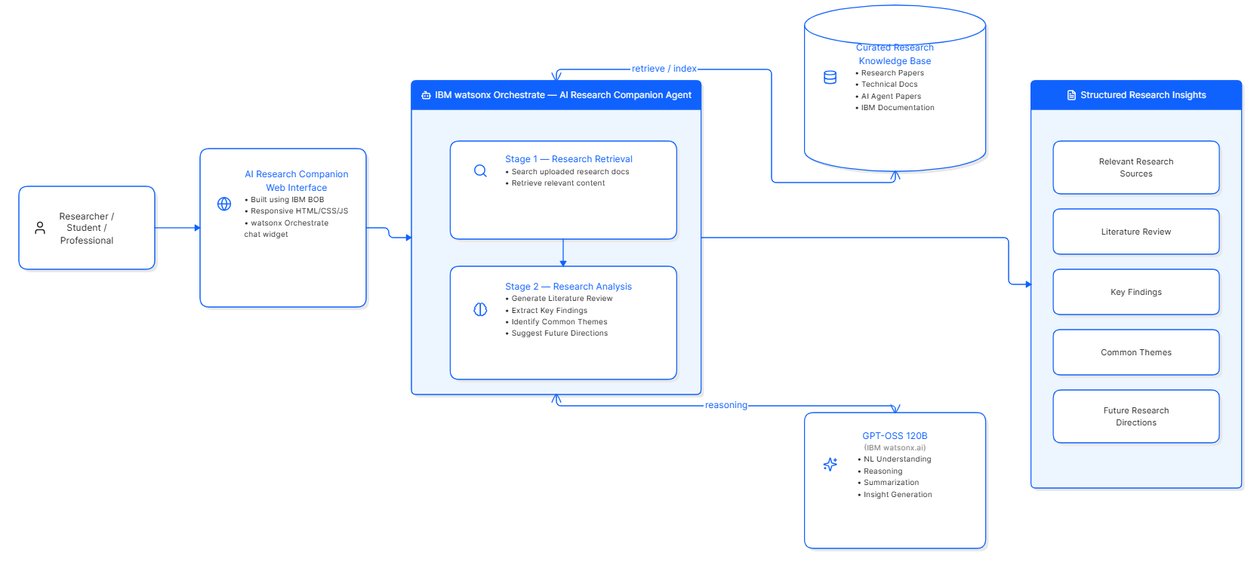
Architecture Blueprint

Slide 7

Role of Agentic AI in the solution
Agentic AI enables the system to go beyond simple question answering by performing multiple reasoning steps autonomously.
In this solution, the AI agent:
Understands the user's research intent.
Searches the curated knowledge base for relevant documents.
Identifies the most useful information.
Synthesizes information from multiple sources.
Generates structured outputs such as literature reviews, key findings, common themes, and future research directions.
Instead of merely retrieving information, the agent acts as an intelligent research companion that analyzes and organizes knowledge into meaningful insights, making the research process faster and more efficient.

Slide 8
Novelty and Uniqueness
AI-Powered Research Companion: Goes beyond a traditional search engine by not only retrieving information but also analyzing and synthesizing it into meaningful research insights.
Two-Stage Intelligent Workflow: Combines research retrieval and research analysis within a single AI agent, enabling users to obtain structured outputs instead of raw search results.
Structured Research Summarization: Automatically generates literature reviews, key findings, common themes, and future research directions, reducing the time spent reading multiple documents.
Curated Knowledge-Based Responses: Uses a curated repository of research papers and technical documentation, ensuring responses are grounded in trusted sources and minimizing hallucinations.
Interactive Research Experience: Provides a conversational interface where users can ask research questions naturally and receive organized, easy-to-understand insights.
Rapid and Accessible Research Assistance: Enables students, researchers, and professionals to understand complex research topics quickly without manually reviewing numerous papers.
Built on IBM Agentic AI Platform: Leverages IBM watsonx Orchestrate and IBM Cloud to demonstrate how agentic AI can automate knowledge retrieval and research synthesis in a scalable and user-friendly manner.

Slide 9
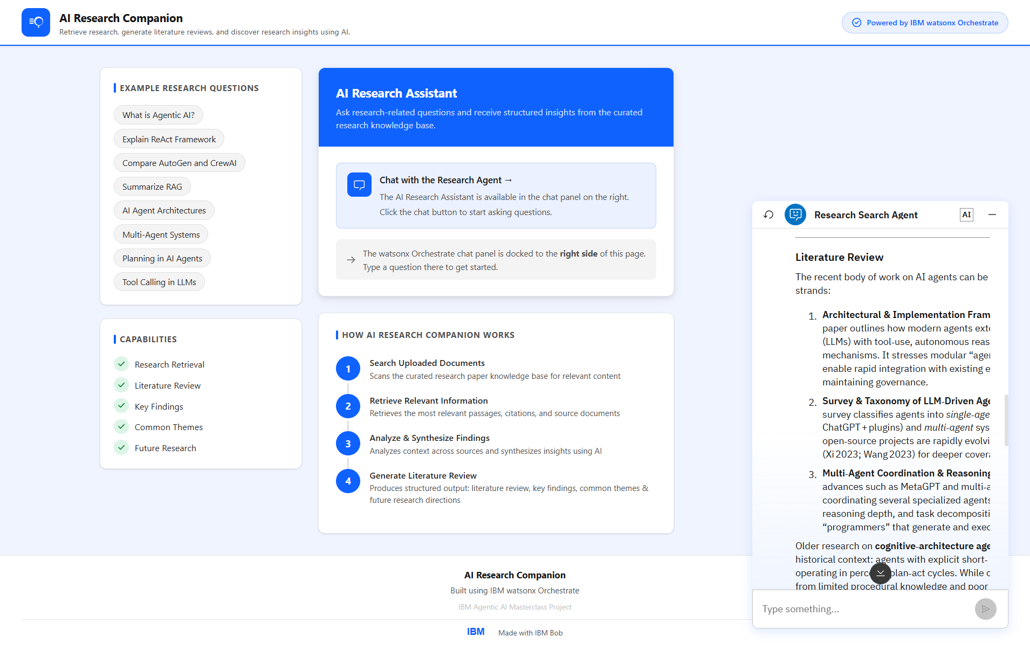
Output

Slide 10
Git Hub Link
https://github.com/Kartik-7813/research-agent
·
·
·

Slide 11
Future Scope
Integrate live academic sources such as arXiv, Semantic Scholar, CrossRef, and IEEE Xplore for real-time research retrieval.
Support multimodal inputs including PDFs, images, handwritten notes, charts, and presentations.
Implement multi-agent orchestration where separate agents handle retrieval, analysis, citation generation, and trend prediction.
Visualize research insights using topic clusters, citation networks, and interactive knowledge graphs.
Provide personalized research recommendations based on user interests and previous searches.
·
·
·

Slide 12
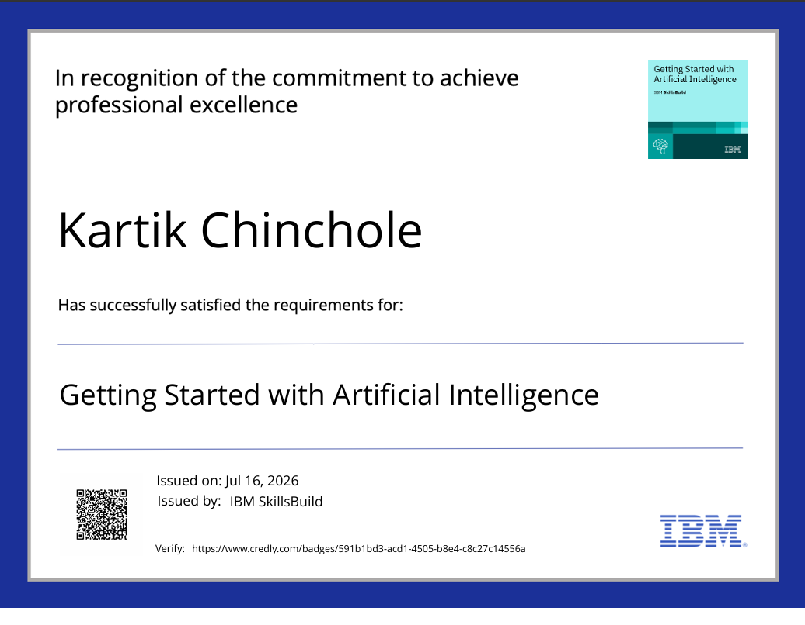
Certificates Earned:

Slide 13
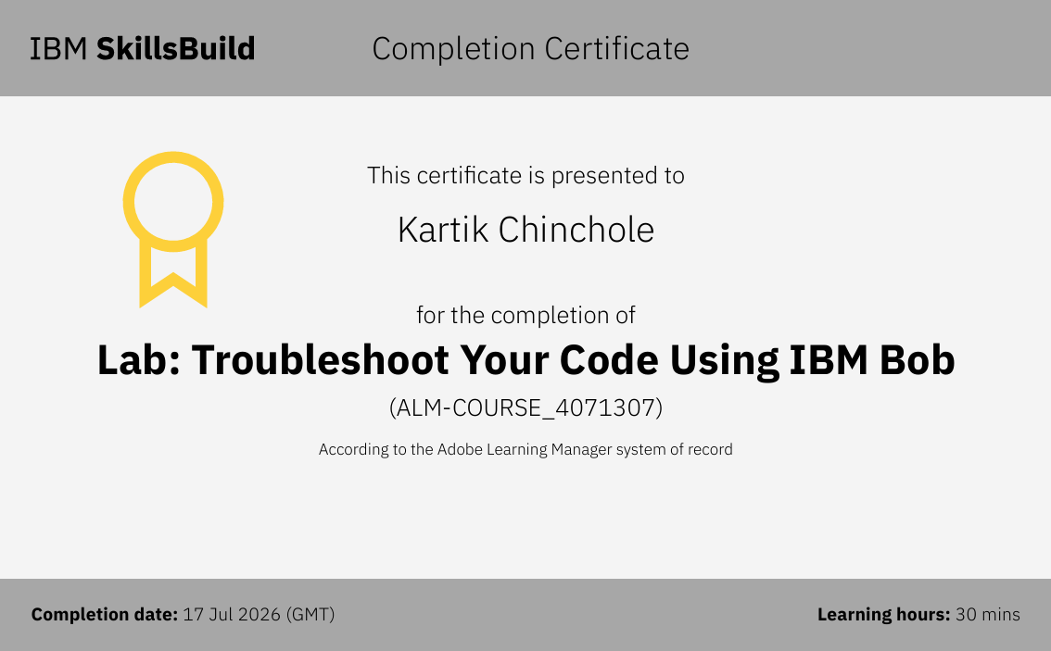
Certificates Earned:​

Slide 14


