Slide 1
PRAHARÍ
INDIA’S SOVEREIGN CYBER-RESILIENCE PLATFORM
The breach that never happened.
Behavioural cyber-resilience for critical national infrastructure.
प्रहरी — the sentinel who keeps the watch.
Kartik Bhardwaj · Harshita · Raghav Sharma | Hackathon Problem Statement #7
Notes:
Open calm and confident. PRAHARI is India's sovereign cyber-resilience platform. The promise: the breach that never happened - we prevent, not just detect.

Slide 2
PRAHARÍ
SOVEREIGN CYBER-RESILIENCE
02 / 12
THE PROBLEM
1.59M+
cyber incidents handled by CERT-In in a single year
Detection is the failure, not defence.
~2wks
AIIMS Delhi offline after ransomware — while CBSE exam records were breached
By the time a signature exists, the attack has already succeeded.
So we detect behaviour — not signatures.
≈200days
industry mean dwell time before an intrusion is detected
source: Mandiant M-Trends
Notes:
Reframe the problem: detection latency is the failure. CERT-In handled 1.59M+ incidents; AIIMS was down ~2 weeks; industry dwell time is ~200 days. By the time a signature exists, it is too late - so detect behaviour, not signatures.

Slide 3
THE PROOF — MEASURED, NOT CLAIMED
1.66
100
92.3
1
<
days
%
%
s
Mean time to detect
Recall @ 1% FPR
ATT&CK technique accuracy
Auto-containment
measured on the 21-day APT scenario · detection thresholds frozen
Notes:
The proof at a glance. Four numbers on the 21-day scenario with frozen thresholds: detect in 1.66 days, 100% recall at 1% FPR, 92.3% ATT&CK accuracy, sub-second auto-containment.

Slide 4
PRAHARÍ
SOVEREIGN CYBER-RESILIENCE
04 / 12
THE SYSTEM
One closed, auditable loop.
Six stages, ingest to audit — a full incident lifecycle that never leaves your perimeter.
1
2
3
4
5
6
Ingest
UEBA detection
Graph fusion
ATT&CK attribution
SOAR response
Tamper-evident audit
One OCSF contract — IT and OT together.
Scores behaviour against each entity's own baseline.
Weak signals reinforce into one ranked incident.
Names the adversary's play; predicts the next move.
Auto-runs the safe 75%; holds the crown jewels.
Append-only — edit one row and the chain breaks.
→
→
→
→
→
OCSF Redis Streams
IsolationForest + ECOD · no labels
Neo4j · PPR anomaly lift
mapper + cite-or- abstain agent
blast radius human gates
SHA-256 hash- chained ledger
↻
Closed & auditable — every action returns to the ledger
docker compose up
Notes:
One closed, auditable loop - six stages from ingest to tamper-evident audit. Unsupervised detection, graph fusion, ATT&CK attribution, human-gated SOAR, hash-chained ledger. Runs on Docker Compose.

Slide 5
PRAHARÍ
SOVEREIGN CYBER-RESILIENCE
05 / 12
WHAT’S DIFFERENT
What sets it apart.
01
02
FUSION
ATTRIBUTION
Graph anomaly-lift fusion
Agentic, with integrity rails
Weak signals — scores 0.68–0.75 — fuse to ≥0.90 in one ranked incident. The top incident scores ~4× the next.
A cite-or-abstain agent reasons over local RAG. It never sees ground truth — it can only cite evidence or decline.
03
04
AUTONOMY
INTEGRITY
The AI cannot open a gate
Tamper-evident by design
Agents only propose {action, target, rationale} . The platform decides the gate; high-impact actions need one human click.
Rewrite one row and verify_chain() breaks at that exact entry. Plus zero-egress air-gap mode PRAHARI_OFFLINE=1.
Notes:
Four choices that set it apart: graph anomaly-lift fusion, agentic attribution with integrity rails, the AI cannot open a gate, and a tamper-evident ledger with air-gap mode.

Slide 6
PRAHARÍ
SOVEREIGN CYBER-RESILIENCE
06 / 12
THE SCENARIO
A 21-day intrusion, step by step.
A nation-state actor targets a State Examinations authority.
21 DAYS · LOW-AND-SLOW
DAY 01
02:00
—
WS03
DC01
DB-EXAMS
—
DAY 21
Foothold
Valid login
Memory dump
Lateral move
Escalation
Crown jewels
Staging
Exfiltration
phishing on a clerk’s PC
2 a.m. credential use
credentials harvested
→ workstation WS03
→ domain controller
→ exam database
exam records collected
planned data theft
Confirmed on day 1.66 — seventeen days before the planned theft.
C2 severed at confirmation; the day-21 exfiltration never runs — breach prevented.
Each step is individually ignorable — the graph fuses them into one incident.
Notes:
The story: a 21-day nation-state intrusion against a State Examinations authority. Phishing foothold, a 2am valid credential, memory dump, lateral movement to the domain controller and the exam database, staging, then planned exfiltration. Each step is individually ignorable - the graph fuses them.

Slide 7
PRAHARÍ
SOVEREIGN CYBER-RESILIENCE
07 / 12
DETECTION & RESPONSE
Confirmed on day 1.66 — and contained.
1.66days
AUTOMATED RESPONSE
<1 s
command-and-control severed
to confirmed detection
Playbook actions
6 of 8 · 75% auto
17 days before the planned theft — not 200.
Held for a human:
isolate DB-EXAMS
disable domain admin
✓
Counterfactual — the May-21 exfiltration never happens.
Breach prevented
Notes:
Detection and response. Confirmed on day 1.66 - seventeen days before the scheduled theft, not 200 days. C2 severed in under a second. Six of eight playbook actions auto-execute; the two crown-jewel actions wait for a human. Counterfactual: the exfiltration never happens - the breach is prevented.

Slide 8
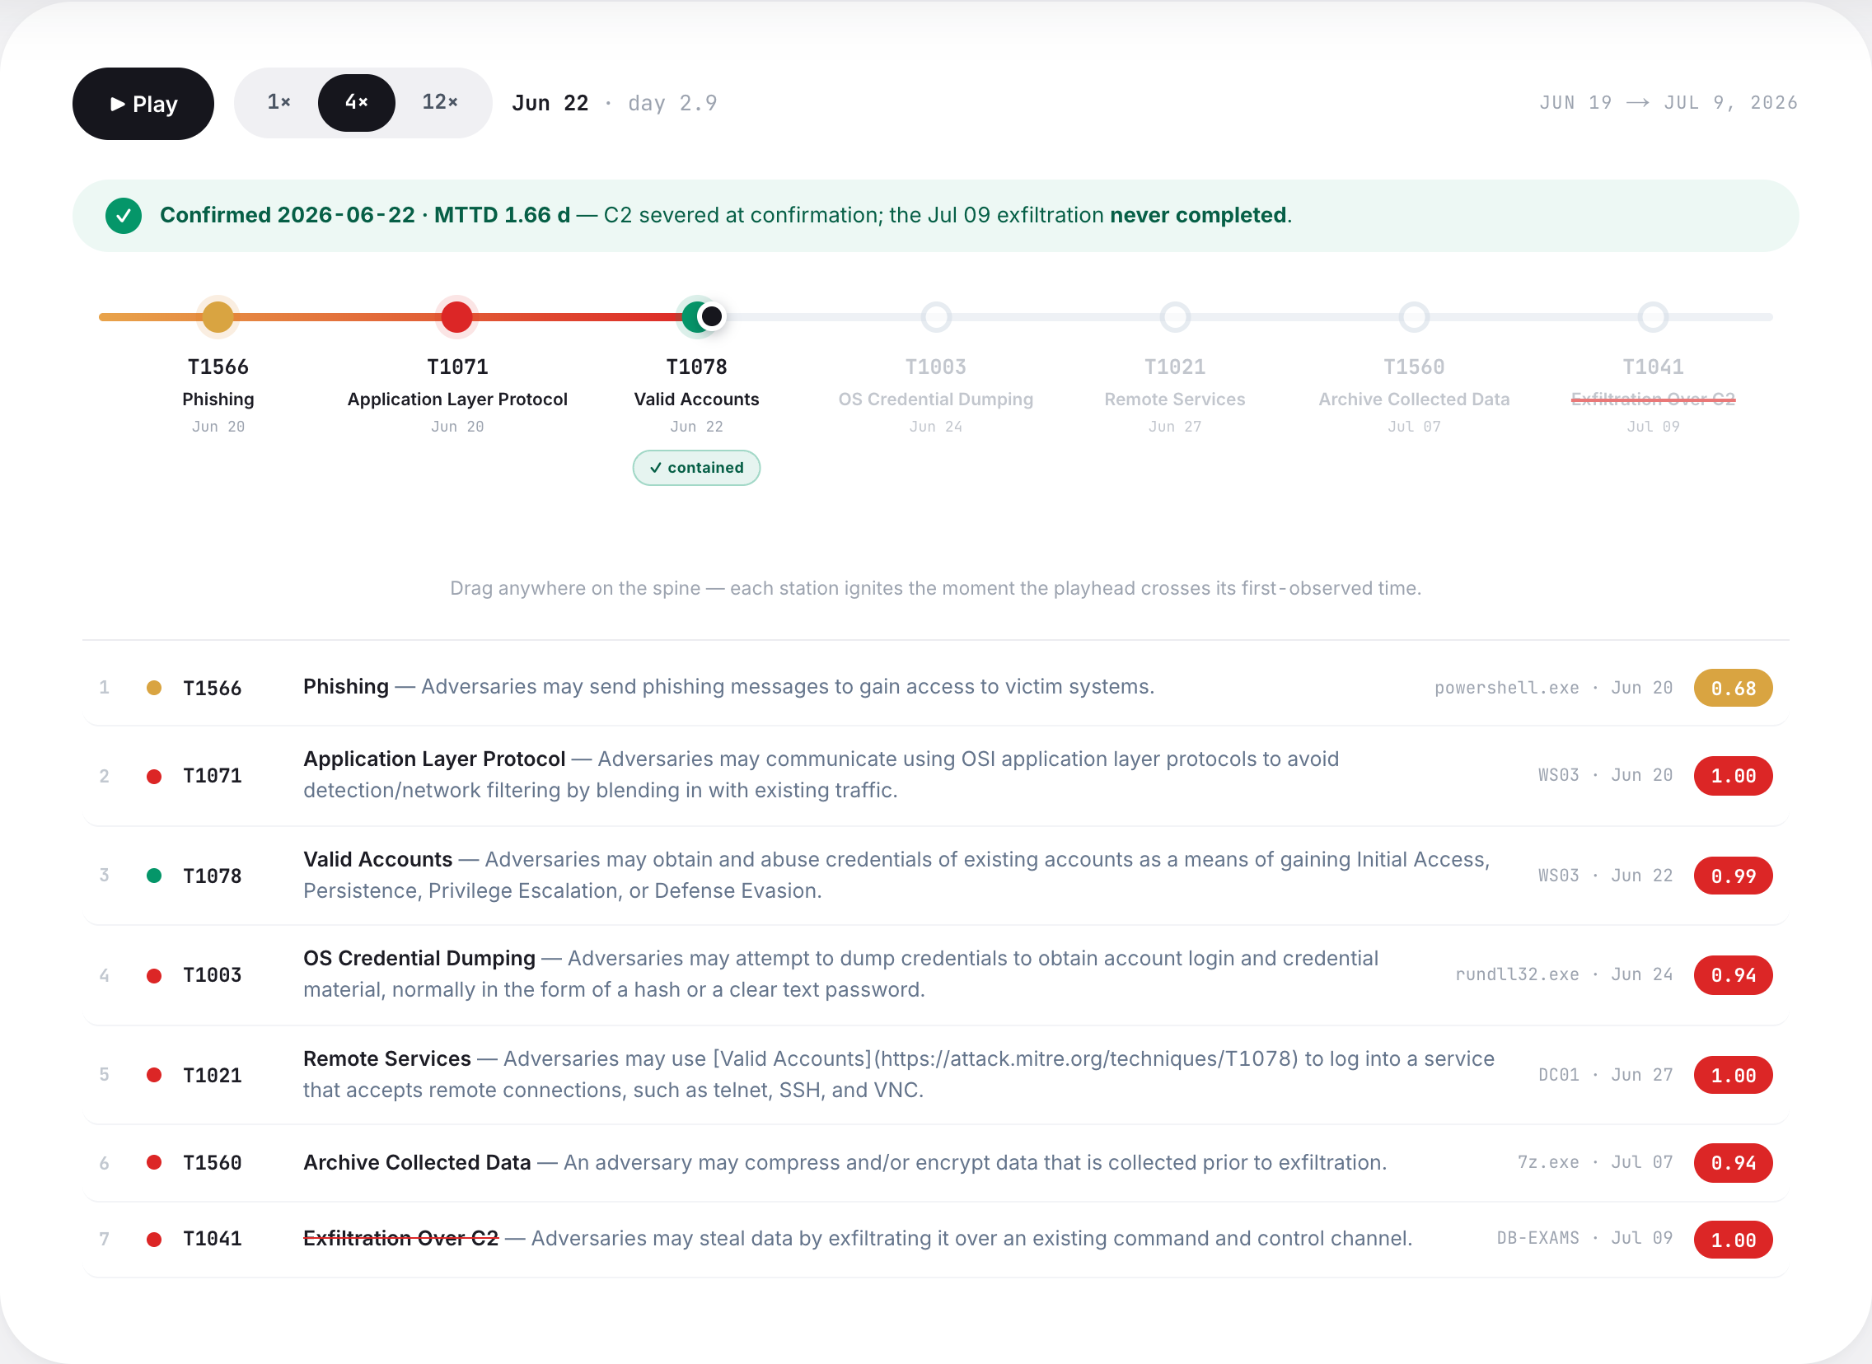
PRAHARÍ
SOVEREIGN CYBER-RESILIENCE
08 / 12
THE CONSOLE
One console, from verdict to ledger.
praharí · soc-console
live
VERDICT
REPLAY CLOCK
day 1.66
INC-001 · CRITICAL
VERDICT
INC-001 · CRITICAL
ATT&CK MATRIX
observed + predicted next moves
PROVENANCE GRAPH
ATT&CK MATRIX
REPLAY CLOCK
day 1.66 · contained
SOAR QUEUE
6 auto · 2 human-gated
PROVENANCE GRAPH
coloured by the system's own scores
TAMPER-EVIDENT LEDGER
SHA-256 chain · verify ✓
SOAR QUEUE
6 auto · 2 gated
TAMPER-EVIDENT LEDGER
chain
✓
Notes:
The console. One SOC surface takes you from verdict to replay clock to provenance graph to the ATT&CK matrix to the SOAR queue to the tamper-evident ledger. Insert the live console screenshots here.

Slide 9
PRAHARÍ
SOVEREIGN CYBER-RESILIENCE
09 / 12
RESULTS
Results, in the honest order.
EVALUATION
WHAT IT TESTS
HEADLINE METRIC
01
External benchmark
Public CIC-IDS-2017, never seen in training
0.845
HELD-OUT
macro ROC-AUC
02
Cross-attack transfer
Unseen insider attack, no re-tuning
0.9987
THRESHOLDS FROZEN
ROC · 100% recall @1% FPR
03
In-domain APT
Full controlled intrusion, end to end
0.9988
THE 21-DAY SCENARIO
ROC · 13/13 in one incident
Near-perfect in-domain reflects a clean, controlled scenario — which is exactly why the external and frozen-threshold numbers are reported first.
Notes:
Results, in the honest order. External held-out benchmark first at 0.845 macro ROC-AUC. Then frozen-threshold transfer to an unseen insider at 0.9987 and 100% recall. Then the in-domain 21-day APT at 0.9988 with 13 of 13 caught. Near-perfect in-domain reflects a clean scenario - that is exactly why external and frozen numbers lead.

Slide 10
PRAHARÍ
SOVEREIGN CYBER-RESILIENCE
10 / 12
TRUST & SCALE
Trustworthy at scale.
THROUGHPUT
GUARANTEES
✓
Tamper-evident hash chain
~54k
10-entry chain · verify_chain() passes
✓
Zero-egress air-gap mode
PRAHARI_OFFLINE=1 · proven
events / second
end-to-end throughput · on a single core
✓
Ground truth is never a model input
assert_no_leakage · API strips gt_* · 0/8 endpoints leak
O(1) per event — scales with cores, not luck.
detector core 158k/s · Neo4j ingest 53.5k nodes/s · 2.5 GB peak RSS
✓
Human holds the gate
agents only propose · the platform decides blast radius
Notes:
Trust and scale. A verified 10-entry tamper-evident hash chain, a proven zero-egress air-gap mode, and throughput around 54,000 events per second end-to-end on a single core. Ground truth is never a model input: the API strips gt fields and 0 of 8 endpoints leak.

Slide 11
PRAHARÍ
SOVEREIGN CYBER-RESILIENCE
11 / 12
HONEST LIMITATIONS
We report what didn’t move, too.
KNOWN GAP
KNOWN GAP
IN PROGRESS
Attribution generalises less than detection
Off-hours evasion lowers recall
OT coverage is still improving
Under the evasion profile, detection ROC still holds ~0.92.
Operational-technology telemetry is on the roadmap, not yet complete.
Mapping technique IDs across unseen tactics is the harder half of the problem.
2 / 45
13%
0.84 → 0.895
techniques the deterministic mapper recovers on the unseen insider case — vs 12/13 in-domain. The stable, reproducible number is 92.3%.
recall @1% FPR once the attacker evades off-hours signals. But detection ROC still holds 0.92, and recall @5% FPR is 80%.
Modbus OT ROC after adding OT-native features — malicious writes alarmed 8/16 → 13/16. Some ICS techniques stay outside the enterprise mapper.
Notes:
Honest limitations. Attribution generalises less well than detection. Off-hours evasion lowers recall, though detection ROC still holds around 0.92. OT coverage is improving. We report what didn't move, too.

Slide 12
PRAHARÍ
Detection in hours, not months.
Behavioural detection
Graph fusion
Auditable autonomy
github.com/Kartik-99999/prahari
प्रहरी — the watch never ends.
Notes:
Close. Detection in hours, not months - behavioural detection, graph fusion, auditable autonomy. The repo is public. Praharí: the watch never ends.

