Slide 1
CV hackathon
Problem statement
To classify the given fabric image as defected or not defected
and create a bounding box around the defect
Solved as an Object Detection problem

Slide 2
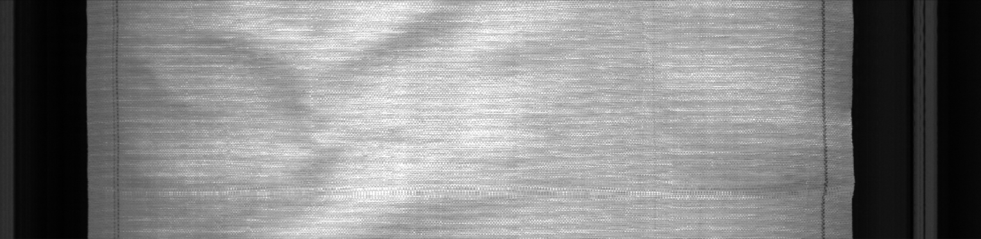
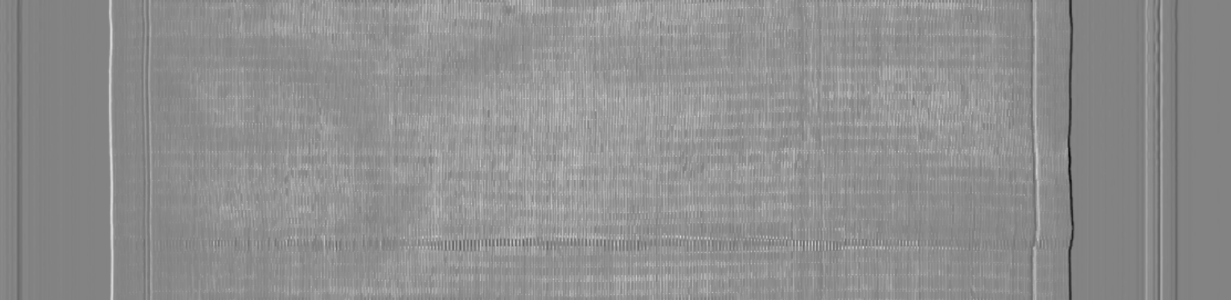
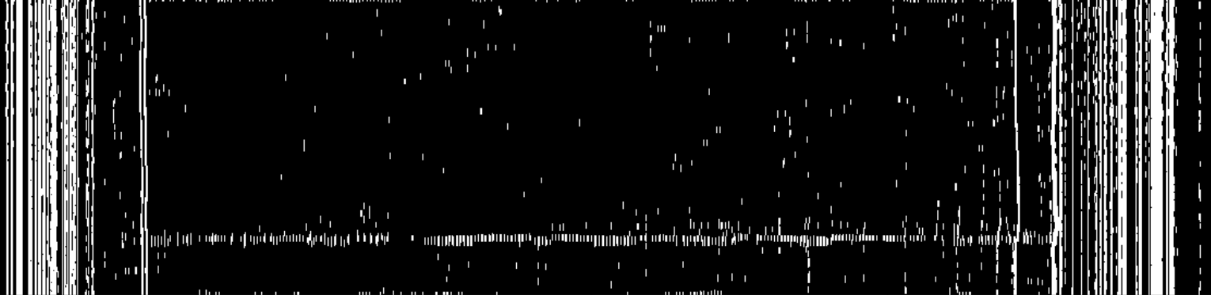
Approach 1 - using Morphological Operators
This approach takes advantage of the fact that the fabric is textured as "small dots" where as the defect is textured as "horizontal lines“
First figure is the original image
Second image is obtained by applying closing morphological operation over a blended image of sobelx and sobely filter.
Last image is obtained the applying binary thresholding.
A very clear line can be seen across the image.
This is the defect

Slide 3
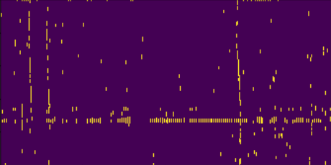
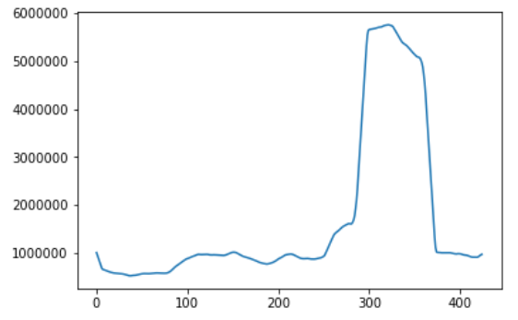
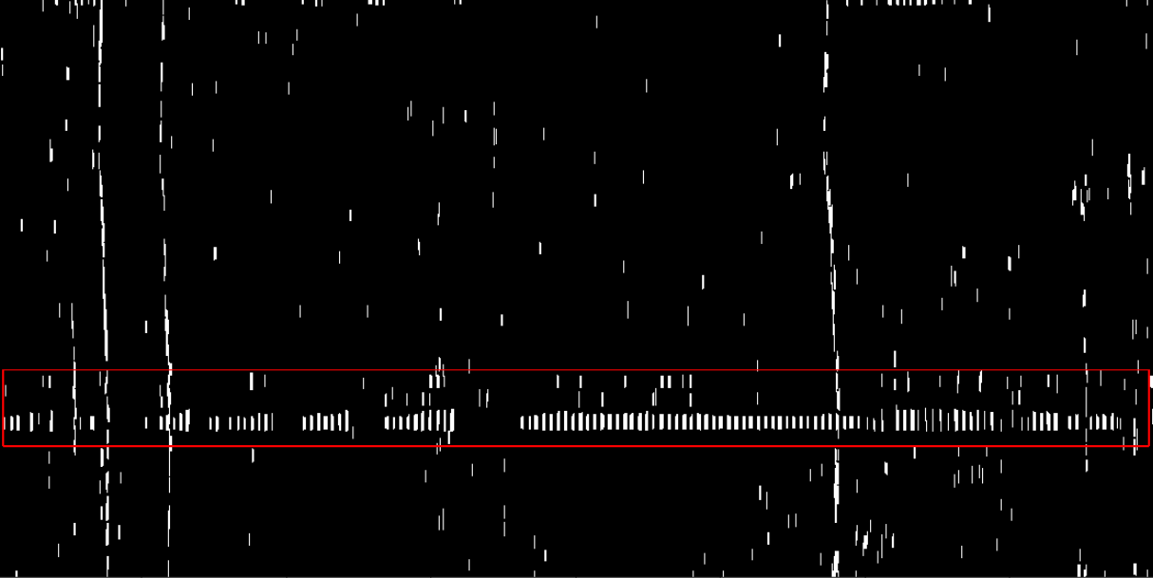
Since we have noise on the border of the image, a center portion is taken out as ROI
Now the image is divided into several rectangles and intensity of pixels is noted
The intensity is maximum at the defect
Thus we find the bounding box of the defect

Slide 4
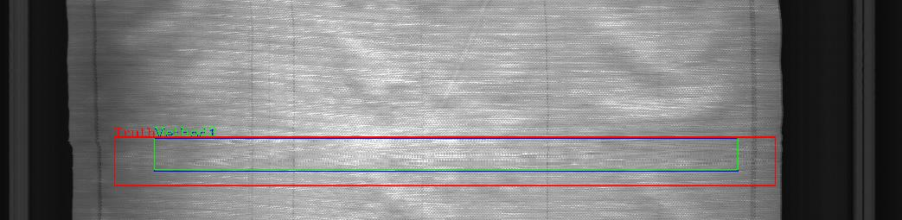
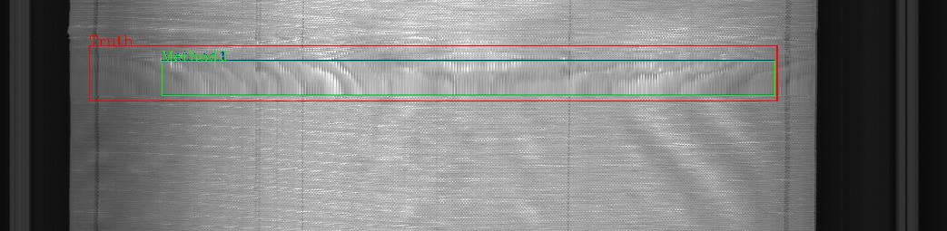
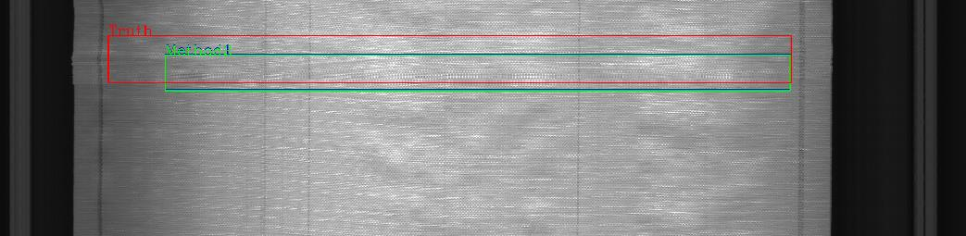
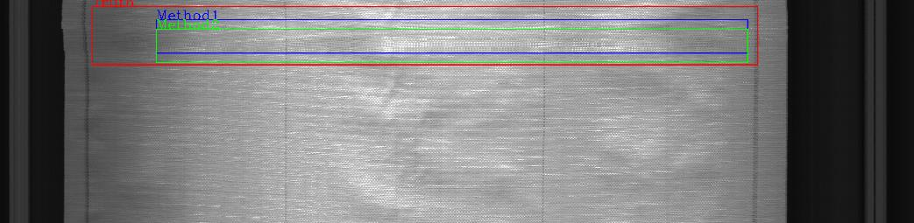
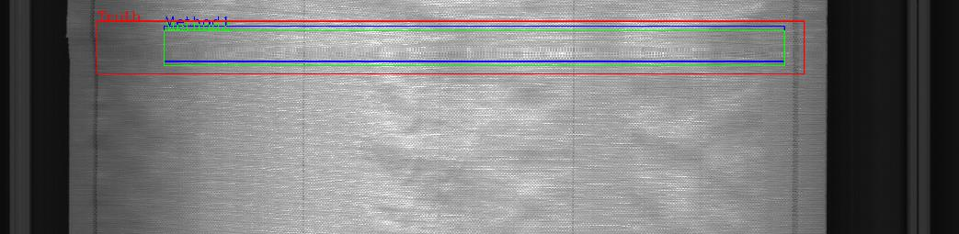
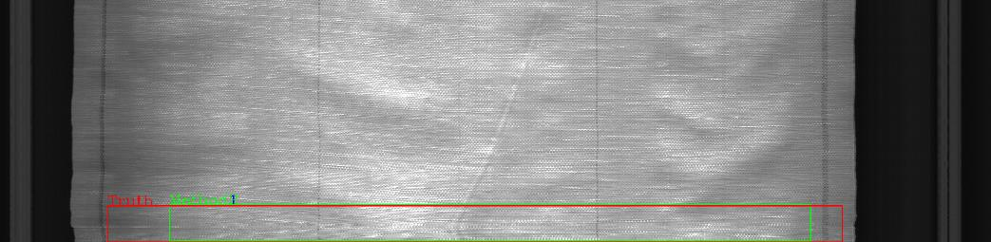
Following are some of the instances which shows the method works with high accuracy in most of the cases

Slide 5
Disadvantages
The method fails in case of multiple defects as it targets ROI with maximum intensity.
This method is prone to noise
Advantages
Very high accuracy
The method is very computationally effective.
No pre-training is required
The detection is done on the spot without the need of training dataset
The method is memory efficient

Slide 6
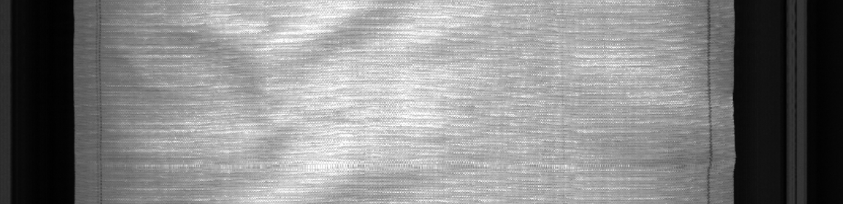
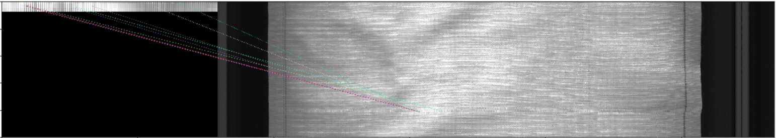
Approach 2 - Feature Matching
This approach matches the feature of defect in an image
A defect image is taken and using SIFT descriptors, similar features are searched within the image
Figure3 shows the match found

Slide 7
Advantages
The method is very computationally effective.
No pre-training is required
A few images of defects are required
Able to detect multiple defects
Disadvantages
This method specifies only the single point the location of the defect.
Parameters like x, y, w, h are not obtained.
It is assumed that all defects will have uniform pattern

Slide 8
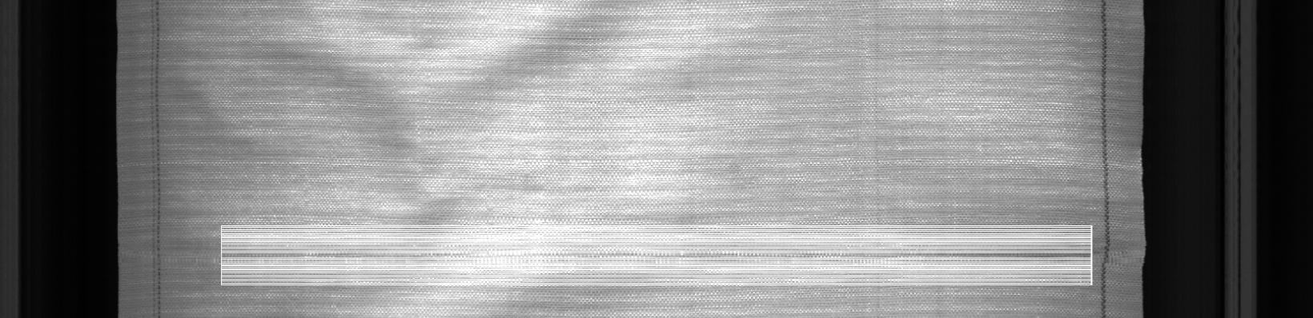
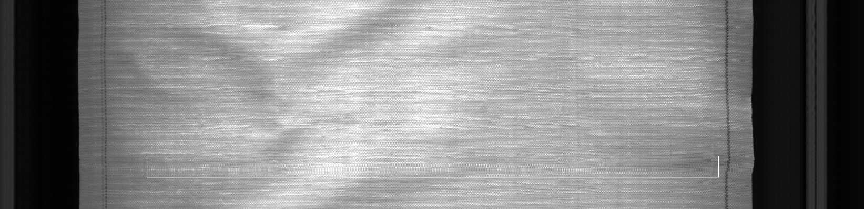
Approach 3 - Classification using Linear Binary Patterns (lbp)
This feature exploits the fact the non-defected fabric has a unique uniform pattern and the defect has its own unique pattern
That pattern is computed as local binary pattern and a histogram of patterns is formed. Then these histograms are fed to SVM Classifier for classification
Then while testing, the input image is divided into several rectangular sections and each of which is fed into SVM clalssifier.
The final ROI is taken as the intersection of all ROIs
Defect label
No defect label

Slide 9
Advantages
Very high accuracy obtained
This method is memory effective
Disadvantages
You need to create the dataset for LBP before training.
Training of Linear SVM on images takes long time as images are high featured data
*Note
Creating dataset can be very tedious task.
So a program is made to ease and speed up the process.
Code file of which is in the main repository

Slide 10
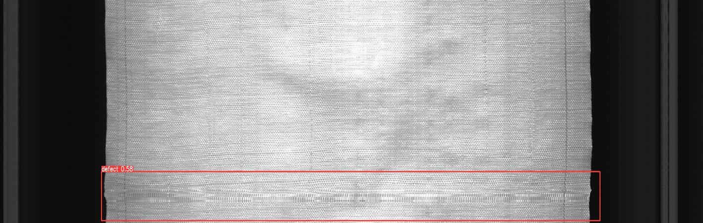
Final Approach used – YOLOv5
Yolo is an object detection algorithm, open sourced by ultralytics.
This method gives high accuracy and is computationally effective than most of the other object detection algorithms (r cnn, F-r cnn)

Slide 11
Advantages
Outputs high accuracy
Efficient than other object detection method available like rcnn, F-rcnn
Self-Adversarial training
Single shot detector
Disadvantages
Required hardware accelerated machines for training
Requires bounding box coordinates for training dataset
Requires high training time

Slide 12
Scope of Improvement
In our solution, yolo alone is used finally to detect and classify the images.
But the 3 approaches discussed can be applied to images in the preprocessing stage before feeding them to yolo. This would increase the accuracy by highlighting the defects.
All the methods can be applied simultaneously and the region common among output of all the methods can the considered as the final defect region.

Slide 13
Thank You
Team – AlphaQ
Kartik Aggarwal
Aryan Garg
Notes:
Download more minimal templates here: https://crmrkt.com/GK9Dwa

