Slide 1
CAPSTONE PROJECT
Secure Data Hiding in Image Using Steganography
Presented By
Student Name : Kartik Bhor
College Name & Department :Rnc arts Jdb commerce Nsc science college Bytco Nashik (Computer Science)

Slide 2
OUTLINE
Problem Statement
Technology used
Wow factor
End users
Result
Conclusion
Git-hub Link
Future scope

Slide 3
Problem Statement
The task involves securely concealing sensitive information within an image using steganography to ensure privacy and guard against unauthorized access. Standard encryption techniques often make the hidden data more detectable, whereas steganography embeds the information within the image pixels, preserving its visual integrity. The objective is to create a robust algorithm that can both embed and retrieve data efficiently while maintaining the quality of the image and ensuring security.

Slide 4
Technology used
Libraries Used:
Standard Libraries:
OpenCV: For image processing and manipulation.
NumPy: For handling and manipulating image arrays.
PIL (Pillow): For image handling and operations.
Cryptography: For encrypting and securing the hidden messages.
Platforms:
Operating System:Windows

Slide 5
Wow factors
Dual-Layer Security: Merges encryption with concealed messages for enhanced protection.
Historical Use: Steganography has roots in ancient history, including applications in wartime intelligence.
Modern Applications: Employed in digital forensics, copyright safeguarding, and various other fields.
Invisibility: Information can be embedded in images without noticeable alterations.
Open Source Power: Tools like OpenCV enable accessible and powerful image processing capabilities.

Slide 6
End users
Cybersecurity Professionals – Use steganography for secure data transmission and covert communication.
Forensic Experts – Extract hidden information from images for digital investigations.
Government & Defense Agencies – Securely embed sensitive data in images for intelligence and confidential operations.
Researchers & Academics – Study and improve steganographic techniques for data security and cryptography.
Privacy-Conscious Users – Individuals who want to protect personal or confidential information from unauthorized access.

Slide 7
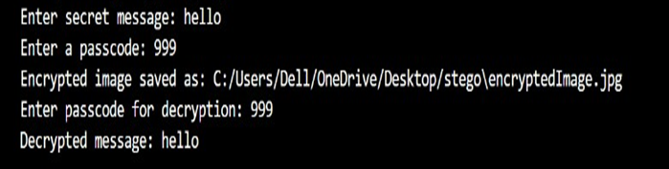
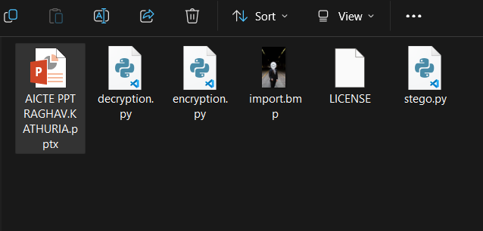
Results

Slide 8
Conclusion
The objective is to safely hide confidential information within an image through steganography to protect privacy and prevent unauthorized access. Traditional encryption methods frequently render the concealed data more visible, while steganography integrates the information into the image pixels, maintaining its visual quality. The goal is to develop a reliable algorithm that can efficiently embed and extract data without compromising the integrity of the image or its security.

Slide 9
GitHub Link
https://github.com/Kartik-Bhor/Kartik-Steganography-Project

Slide 10
Future scope(optional)
Graphical User Interface (GUI) – Develop a user-friendly GUI to make embedding and extracting messages easier.
Drag and Drop Support – Allow users to select images and messages through a simple drag-and-drop interface.
Customization Options – Provide settings for users to adjust the encoding method and choose different bit depths.
Real-time Preview – Show a preview of the image before and after steganography is applied.

Slide 11
THANK YOU

