Slide 1

Visvesvaraya National Institute of Technology, Nagpur
Electronics and Communication Engineering Department
Executive M.Tech. in Applied AI
Cohort 3A sem. 3, Summer 2026
Eval. 1 (14/03/2026)
Edge AI based Predictive Maintenance of Industrial Motors
Presented by
Kartik Burele (MT24AAC011)
Embedded Software Engineer @ L & T Technology Services
Under the supervision of
Dr. Mansi A. Radke Asst. Professor
VNIT Nagpur

Slide 2
Table of Contents:
Introduction
Objective of the Project
Proposed Model
Methodology
Timeline of the Project
Literature Survey
Results and Discussion
Conclusion
References

Slide 3
Introduction
Overview
Industrial motors are critical components in manufacturing systems. Unexpected failures can lead to:
Production downtime
Maintenance cost
Safety hazards
Traditional maintenance strategies include:
Reactive maintenance (repair after failure)
Preventive maintenance (scheduled replacement)
These methods are inefficient and often lead to unnecessary downtime.
Motivation
Predictive maintenance uses sensor data and machine learning to detect faults before failure occurs.
Key benefits:
Reduced downtime
Lower maintenance cost
Increased equipment lifespan
Edge AI enables real-time monitoring directly on embedded devices, eliminating the need for cloud processing.
Research Gap
Many existing systems rely on:
Cloud processing
High-cost industrial monitoring systems
There is a need for:
Low-cost embedded AI solutions
Real-time fault detection at the edge

Slide 4
Objective of the Project
The primary objective of this project is to develop an Edge AI based predictive maintenance system for industrial motors.
Specific Objectives:
Collect vibration and temperature data from industrial motors using sensors
Develop a machine learning model to classify motor operating conditions
Deploy the trained model on an embedded device for real-time monitoring
Detect faults such as imbalance, misalignment, and bearing faults
Reduce equipment downtime through early fault detection

Slide 5
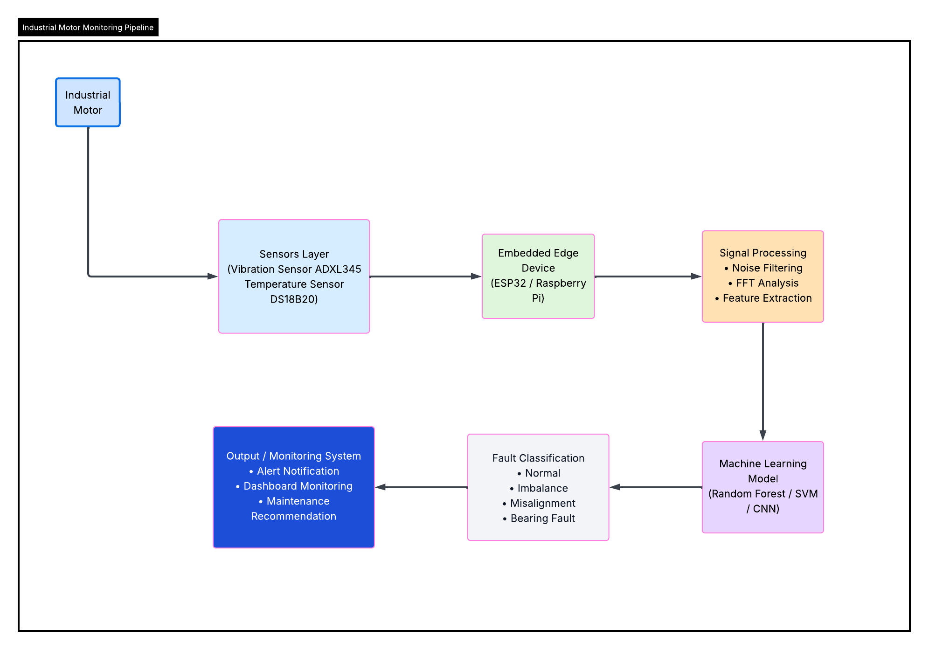
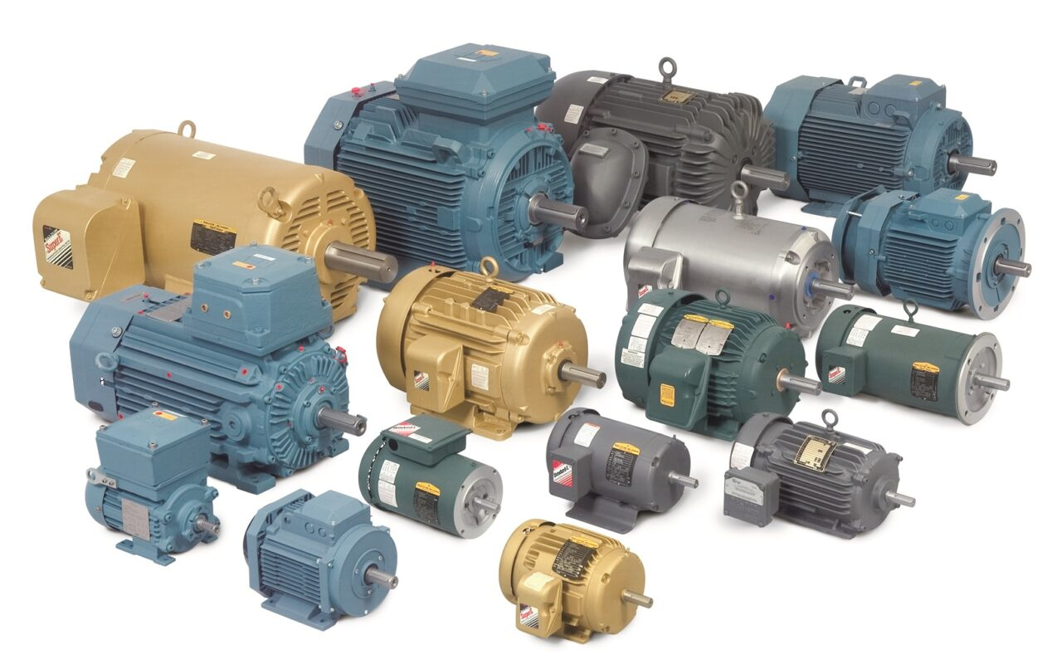
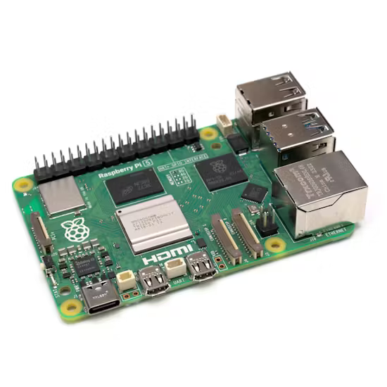
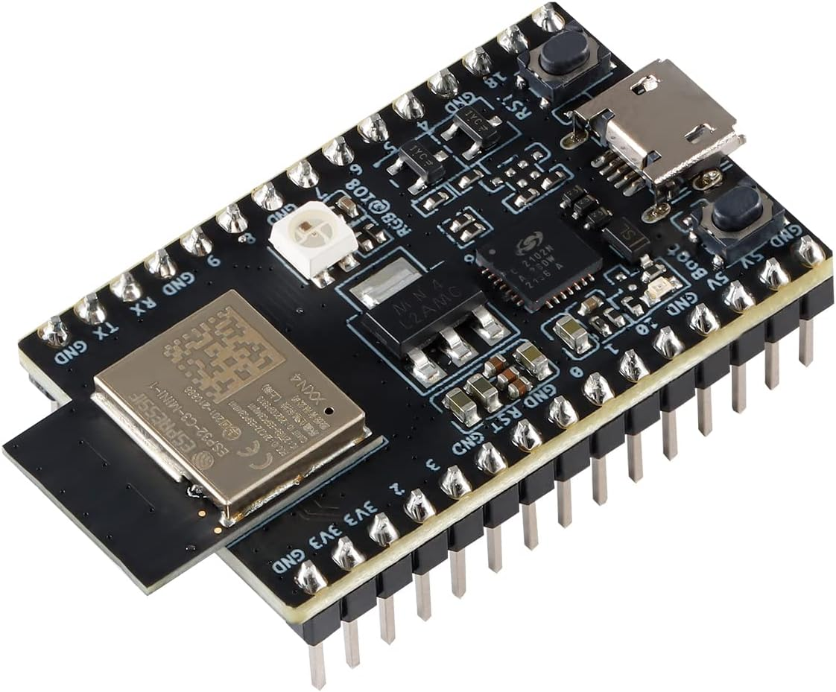
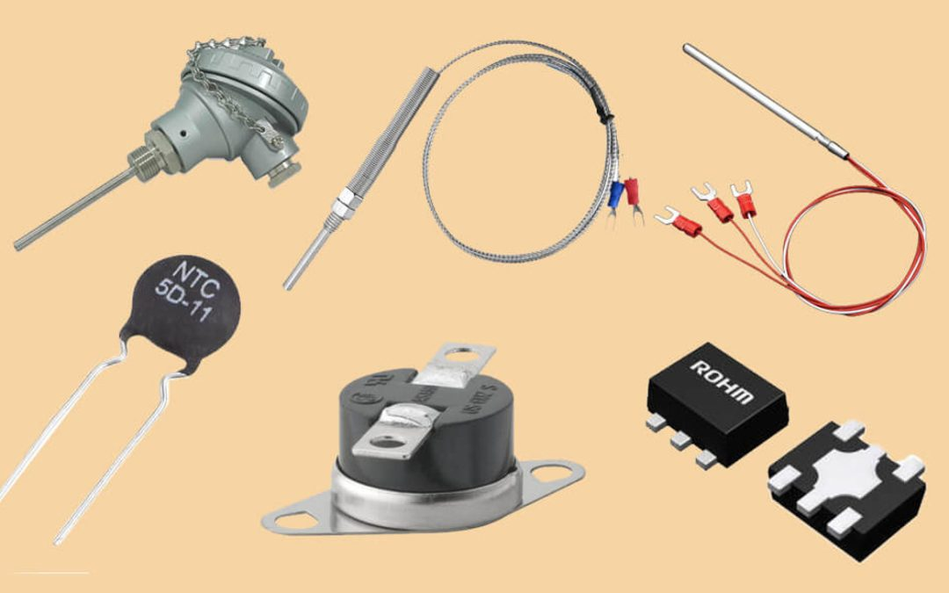
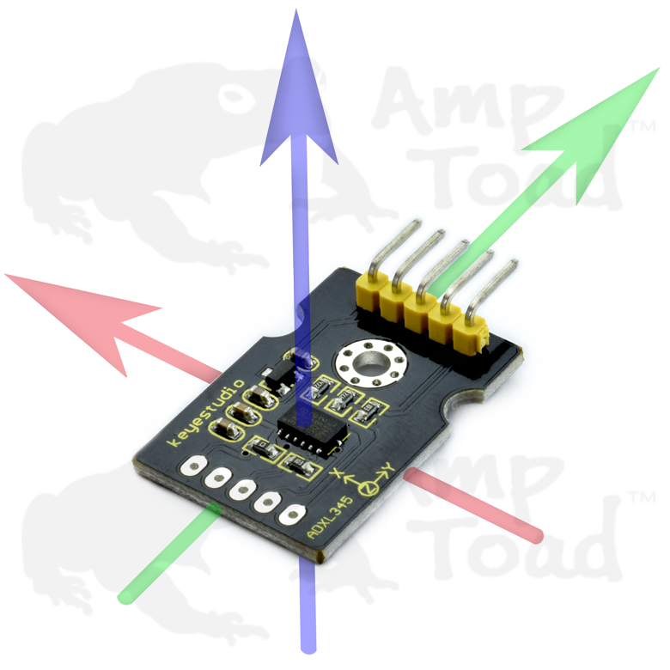
Proposed Model

Slide 6
Methodology
The project methodology consists of five major stages.
Data Acquisition
Sensor data will be collected from industrial motors using:
Vibration sensors
Temperature sensors
The signals represent motor operating conditions.
Data Preprocessing
Raw signals will undergo:
Noise filtering
Fast Fourier Transform (FFT)
Feature extraction
Features include:
RMS vibration
Kurtosis
Spectral entropy
Model Training
Machine learning models will be trained using Python libraries such as:
Scikit-learn
TensorFlow
Models evaluated:
Random Forest
Support Vector Machine
CNN
Model Deployment
The trained model will be converted to:
TensorFlow Lite
and deployed on an embedded device for real-time inference.
Fault Detection
The system will classify motor conditions into:
Normal operation
Imbalance
Misalignment
Bearing fault

Slide 7
Timeline of the project

Slide 8
Literature Survey
Predictive Maintenance (PdM) has become an important strategy in Industry 4.0 to reduce equipment downtime and improve production efficiency using sensor data and machine learning models.
AI techniques such as machine learning, deep learning, and time-series forecasting enable early detection of faults by analysing historical operational data from industrial machines.
Studies show that predictive maintenance systems can reduce maintenance costs by 15–70% while improving system reliability and safety in manufacturing environments.
Traditional predictive maintenance architectures rely heavily on cloud-based processing, which may introduce latency and large data transmission overhead in industrial environments.
Edge AI enables local processing of sensor data near industrial equipment, significantly reducing latency and bandwidth consumption compared to centralized cloud solutions.
Research on Edge AI for motor condition monitoring demonstrates that edge-based systems can reduce diagnostic latency by more than 70% while achieving fault detection accuracy above 94%.
Embedded AI models deployed on microcontrollers and IIoT edge devices allow real-time monitoring of vibration, temperature, and electrical signals of industrial motors.
Several machine learning models including SVM, Random Forest, Neural Networks, and k-NN have been tested for predictive maintenance tasks in industrial manufacturing systems.

Slide 9
Results and discussion
Current Progress
The following tasks have been completed:
• Literature survey on predictive maintenance techniques
• Identification of suitable sensors and embedded hardware
• Initial system architecture design
• Study of publicly available vibration datasets
Expected Results
The proposed system is expected to:
Accurately classify motor faults
Provide early warning of equipment failure
Enable real-time edge monitoring
Performance will be evaluated using:
Accuracy, Precision,
Recall, Confusion matrix

Slide 10
Conclusion
This project proposes a low-cost Edge AI solution for predictive maintenance of industrial motors.
Key contributions:
Sensor-based motor monitoring system
Machine learning model for fault detection
Embedded edge deployment for real-time inference
The system can help industries reduce downtime and improve operational efficiency.
Future work includes:
Multi-sensor fusion
Cloud dashboard integration
Testing with real industrial equipment

Slide 11
References
Achouch, M., Dimitrova, M., Ziane, K., Sattarpanah Karganroudi, S., Dhouib, R., Ibrahim, H., & Adda, M. (2022). On Predictive Maintenance in Industry 4.0: Overview, Models, and Challenges. In Applied Sciences (Switzerland) (Vol. 12, Issue 16). MDPI. https://doi.org/10.3390/app12168081
Aires, F. L., Galeno, G. D., Belchior, F. N., Oliveira, A. M., & Hunt, J. D. (2025). Enhancing three-phase induction motor reliability with health index and artificial intelligence-driven predictive maintenance. Royal Society Open Science, 12(5). https://doi.org/10.1098/rsos.241946
Artiushenko, V., Lang, S., Lerez, C., Reggelin, T., & Hackert-Oschätzchen, M. (2024). Resource-efficient Edge AI solution for predictive maintenance. Procedia Computer Science, 232, 348–357. https://doi.org/10.1016/j.procs.2024.01.034
Bharathi, Y. H. (n.d.). International Journal of INTELLIGENT SYSTEMS AND APPLICATIONS IN ENGINEERING Edge AI for Real-Time Motor Condition Monitoring in Smart Grids. In Original Research Paper International Journal of Intelligent Systems and Applications in Engineering IJISAE (Vol. 2024, Issue 23s). Retrieved www.ijisae.org
Dey, S., & Nagavalli, S. P. (2022). AI-Based Predictive Maintenance in Edge IoT Devices: A Proactive Approach to Latency Reduction. International Journal of Emerging Trends in Computer Science and Information Technology, 3(1), 55–64. https://doi.org/10.63282/3050-9246.ijetcsit-v3i1p107
Drakaki, M., Karnavas, Y. L., Tzionas, P., & Chasiotis, I. D. (2021). Recent Developments towards Industry 4.0 Oriented Predictive Maintenance in Induction Motors. Procedia Computer Science, 180, 943–949. https://doi.org/10.1016/j.procs.2021.01.345
Hafeez, T., Xu, L., & McArdle, G. (2021). Edge intelligence for data handling and predictive maintenance in IIoT. IEEE Access, 9, 49355–49371. https://doi.org/10.1109/ACCESS.2021.3069137
Lamdjad, B., & Chaiter, A. (2026). AI-Powered Predictive Maintenance and Prognostic Health Management Using Edge-Based Predictive Algorithms for Industrial Operations. https://doi.org/10.20944/preprints202603.0010.v1
Lazzaro, A., D’Addona, D. M., & Merenda, M. (2024). A Detailed Study on Algorithms for Predictive Maintenance in Smart Manufacturing: Chip Form Classification Using Edge Machine Learning. IEEE Open Journal of the Industrial Electronics Society, 5, 1190–1205. https://doi.org/10.1109/OJIES.2024.3484006
Nunes, P., Santos, J., & Rocha, E. (2023). Challenges in predictive maintenance – A review. In CIRP Journal of Manufacturing Science and Technology (Vol. 40, pp. 53–67). Elsevier Ltd. https://doi.org/10.1016/j.cirpj.2022.11.004
Soni, K., & Agrawal, M. (2025). AI Driven Predictive Maintenance at the Edge.
Vermesan, O., & Coppola, M. (2023). Embedded Edge Intelligent Processing for End-To-End Predictive Maintenance in Industrial Applications. In Industrial Artificial Intelligence Technologies and Applications (pp. 157–175). River Publishers. https://doi.org/10.1201/9781003377382-12
Zhou, Z., Qiao, Y., Lin, X., Li, P., Wu, N., & Yu, D. (2025). A Deployment Method for Motor Fault Diagnosis Application Based on Edge Intelligence. Sensors, 25(1). https://doi.org/10.3390/s25010009

Slide 12
Thank you

