Slide 1

Visvesvaraya National Institute of Technology, Nagpur
Electronics and Communication Engineering Department
Executive M.Tech. in Applied AI and Communications
Cohort 3B sem. 3, Summer 2026
Eval. 2 (18/04/2026)
Edge AI based Predictive Maintenance of Industrial Motors
Presented by
Kartik Burele (MT24AAC011)
Embedded Software Engineer @ L & T Technology Services
Under the supervision of
Dr. Mansi A. Radke Asst. Professor
VNIT Nagpur

Slide 2
Table of Contents:
Introduction
Objective of the Project
Proposed Model
Methodology
Timeline of the Project
Literature Survey
Work Done
Results and Discussion
Conclusion
References

Slide 3
Introduction
Overview
Industrial motors are critical components in manufacturing systems. Unexpected failures can lead to:
Production downtime
Maintenance cost
Safety hazards
Traditional maintenance strategies include:
Reactive maintenance (repair after failure)
Preventive maintenance (scheduled replacement)
These methods are inefficient and often lead to unnecessary downtime.
Motivation
Predictive maintenance uses sensor data and machine learning to detect faults before failure occurs.
Key benefits:
Reduced downtime
Lower maintenance cost
Increased equipment lifespan
Edge AI enables real-time monitoring directly on embedded devices, eliminating the need for cloud processing.
Research Gap
Many existing systems rely on:
Cloud processing
High-cost industrial monitoring systems
There is a need for:
Low-cost embedded AI solutions
Real-time fault detection at the edge

Slide 4
Objective of the Project
The primary objective of this project is to develop an Edge AI based predictive maintenance system for industrial motors.
Specific Objectives:
Collect vibration and temperature data from industrial motors using sensors
Develop a machine learning model to classify motor operating conditions
Deploy the trained model on an embedded device for real-time monitoring
Detect faults such as imbalance, misalignment, and bearing faults
Reduce equipment downtime through early fault detection

Slide 5
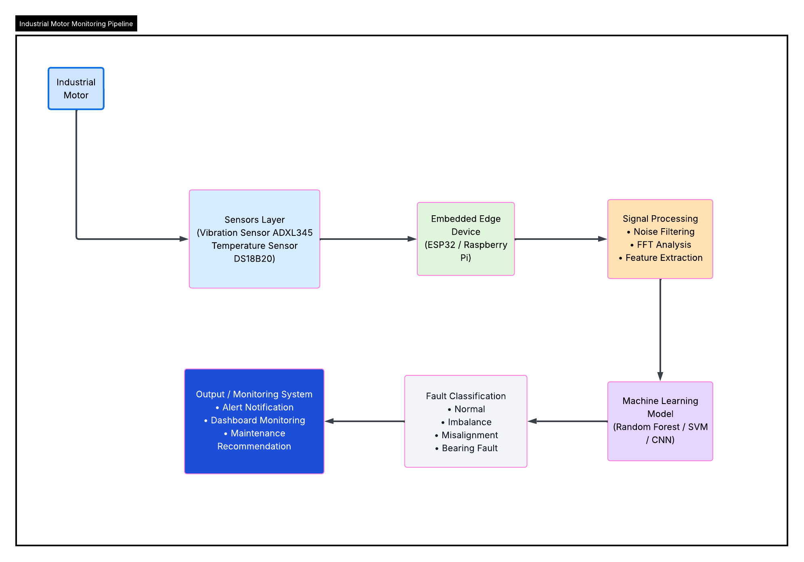
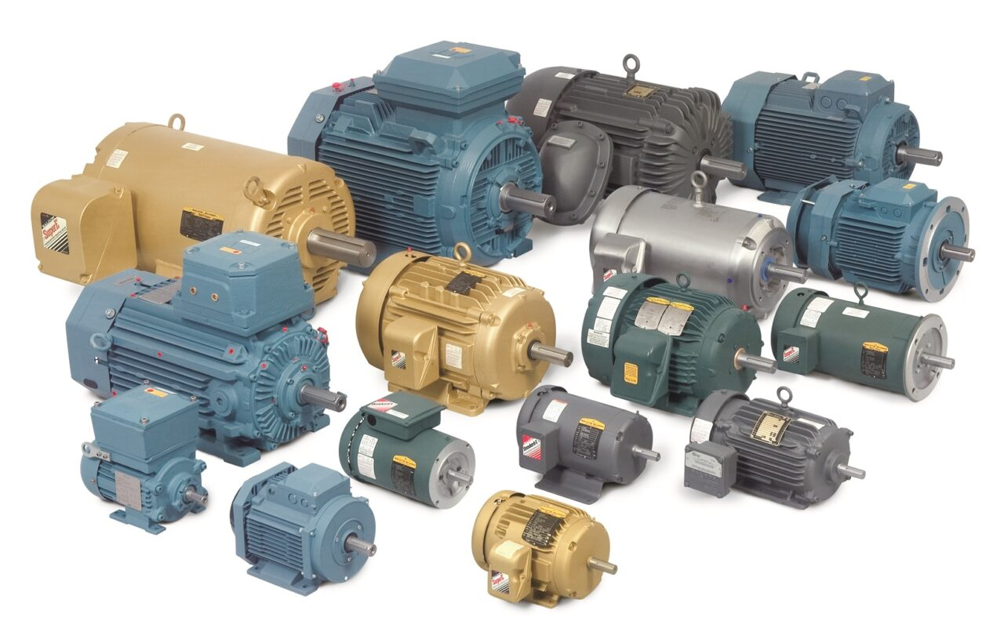
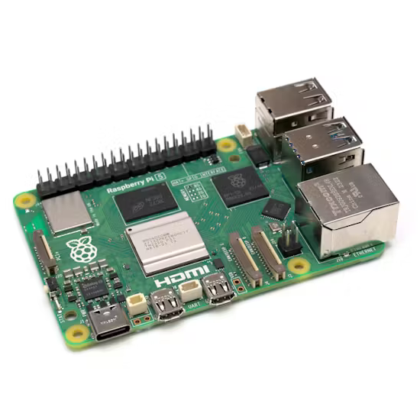
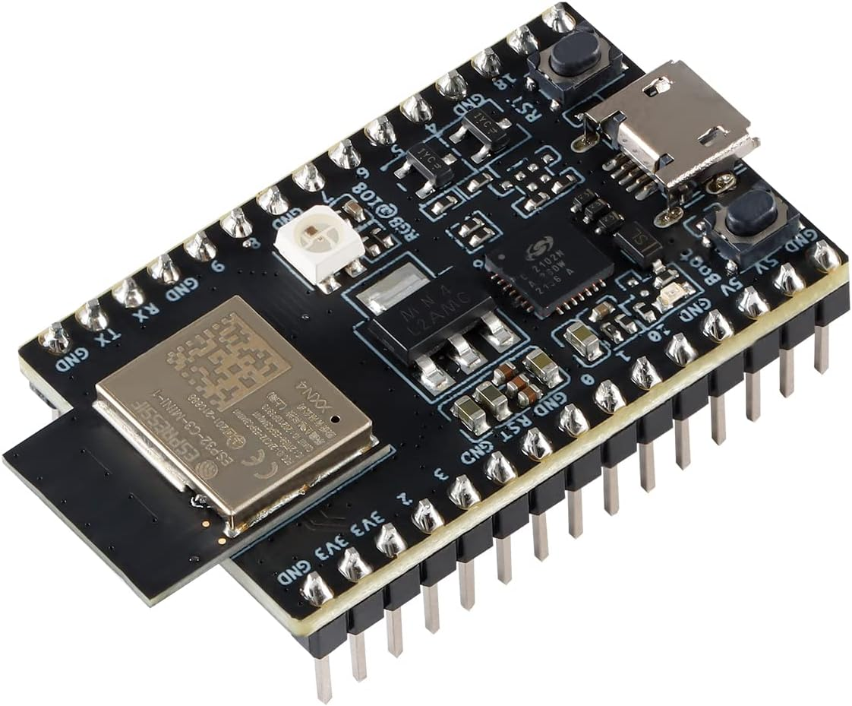
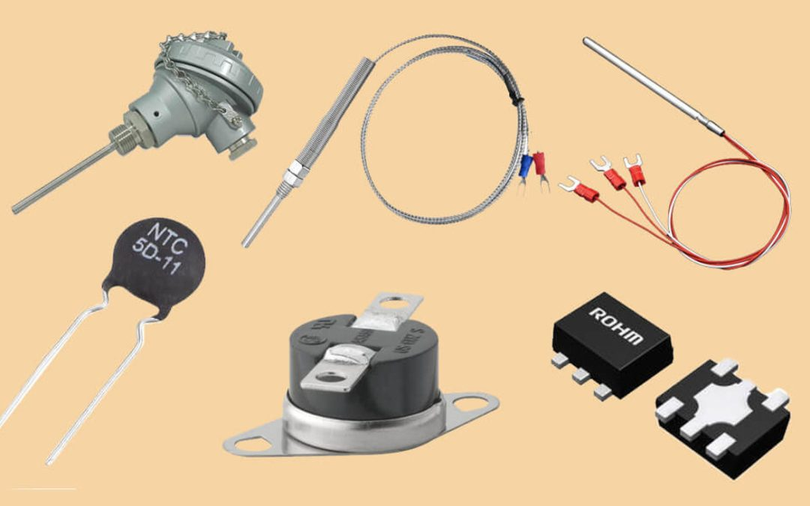
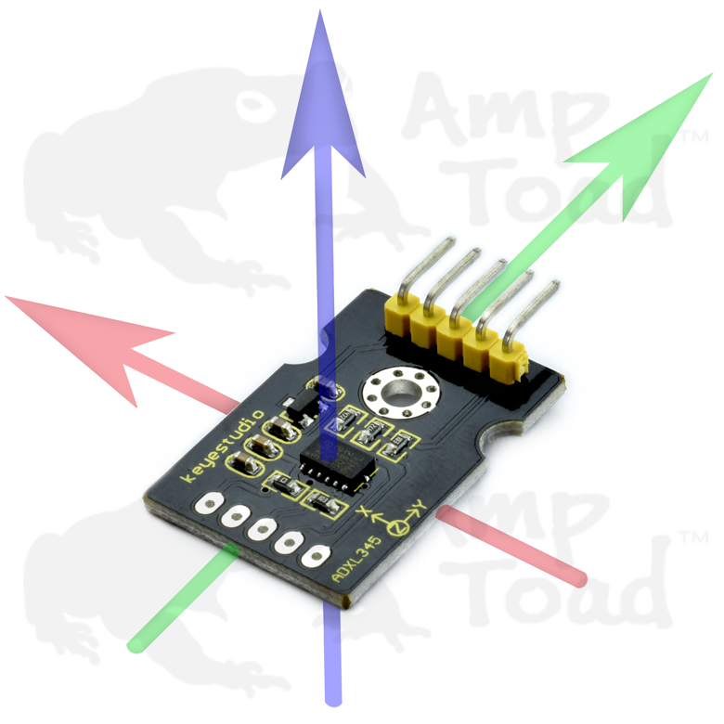
Proposed Model

Slide 6
Methodology
The project methodology consists of five major stages.
Data Acquisition
Sensor data will be collected from industrial motors using:
Vibration sensors
Temperature sensors
The signals represent motor operating conditions.
Data Preprocessing
Raw signals will undergo:
Noise filtering
Fast Fourier Transform (FFT)
Feature extraction
Features include:
RMS vibration
Kurtosis
Spectral entropy
Model Training
Machine learning models will be trained using Python libraries such as:
Scikit-learn
TensorFlow
Models evaluated:
Random Forest
Support Vector Machine
CNN
Model Deployment
The trained model will be converted to:
TensorFlow Lite
and deployed on an embedded device for real-time inference.
Fault Detection
The system will classify motor conditions into:
Normal operation
Imbalance
Misalignment
Bearing fault

Slide 7
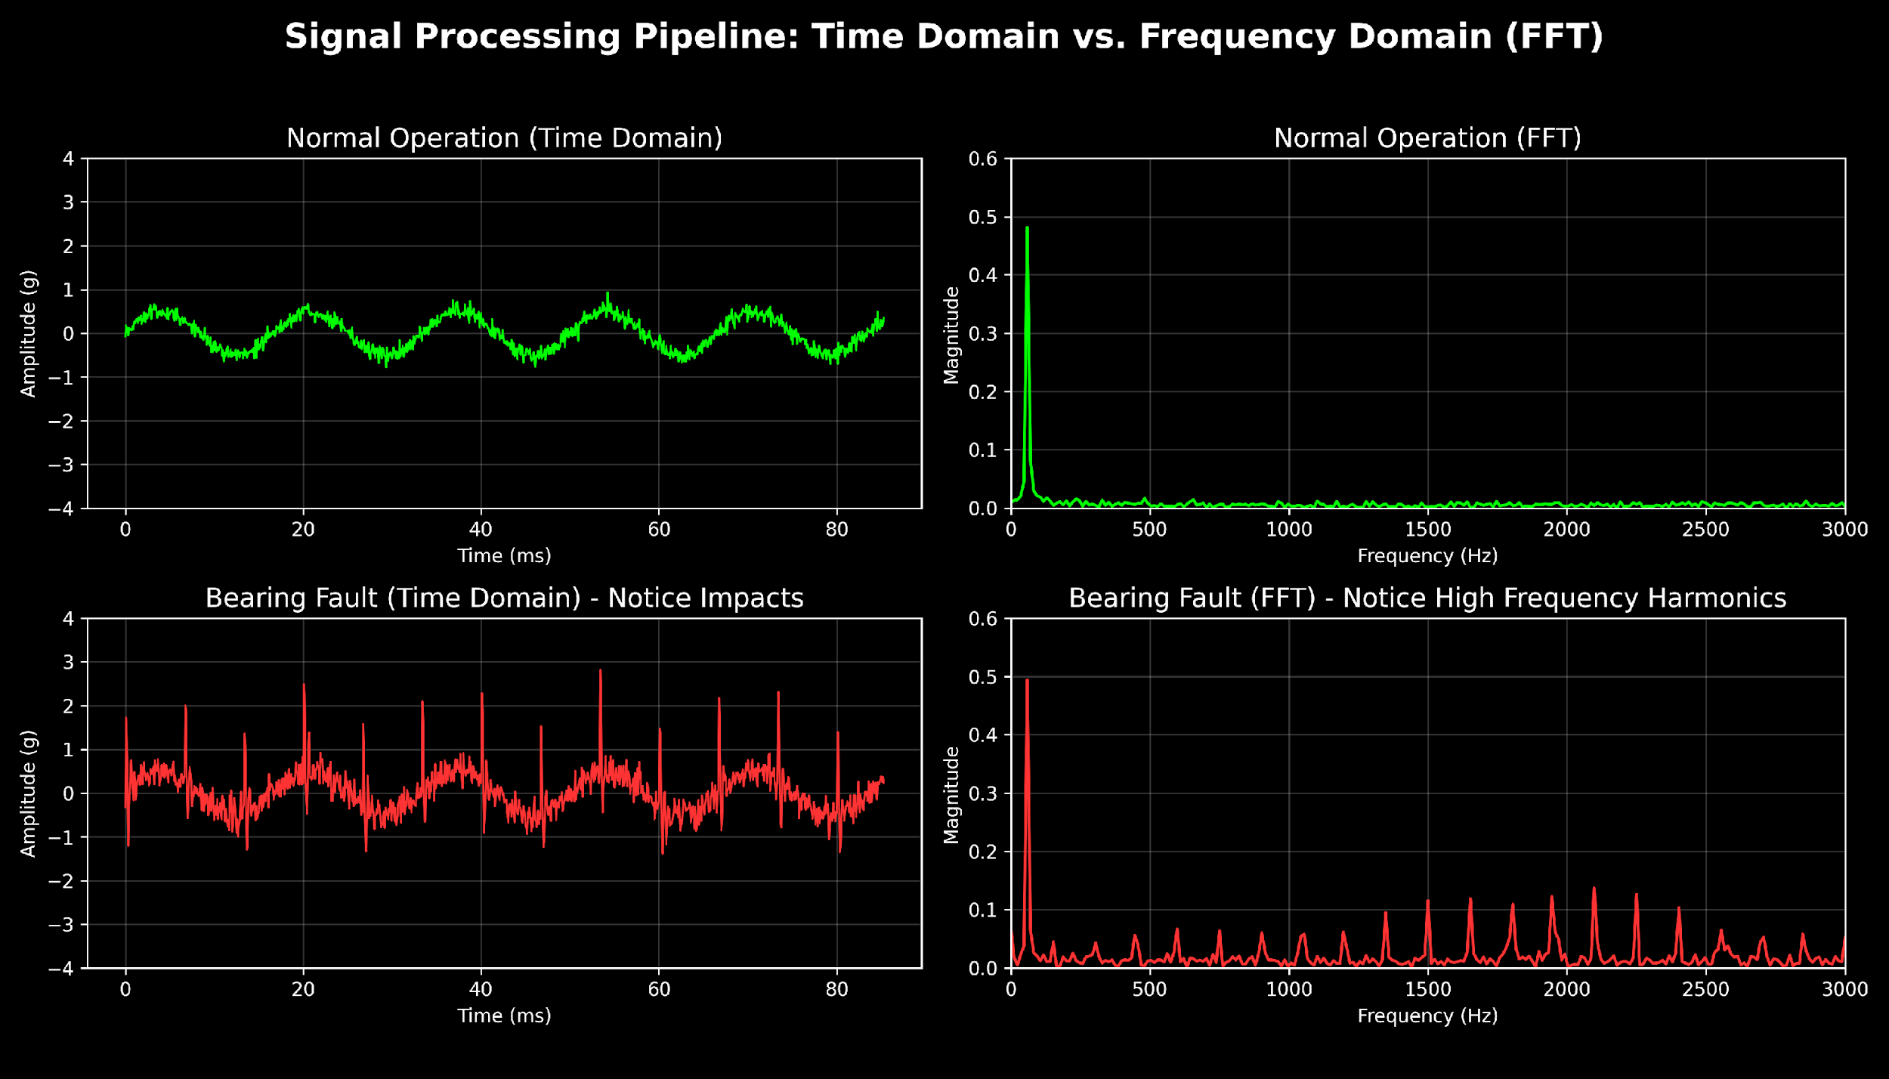
Methodology Continued…

Slide 8
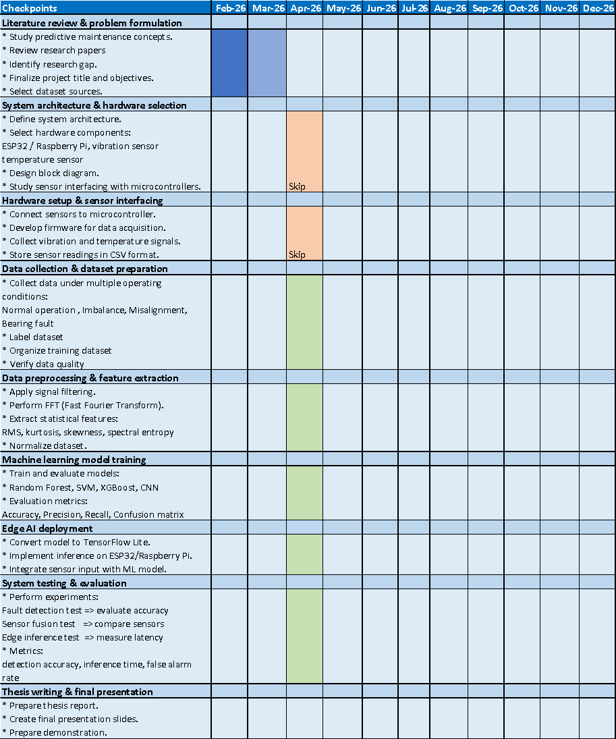
Timeline of the project

Slide 9
Literature Survey
Predictive Maintenance (PdM) has become an important strategy in Industry 4.0 to reduce equipment downtime and improve production efficiency using sensor data and machine learning models.
AI techniques such as machine learning, deep learning, and time-series forecasting enable early detection of faults by analysing historical operational data from industrial machines.
Studies show that predictive maintenance systems can reduce maintenance costs by 15–70% while improving system reliability and safety in manufacturing environments.
Traditional predictive maintenance architectures rely heavily on cloud-based processing, which may introduce latency and large data transmission overhead in industrial environments.
Edge AI enables local processing of sensor data near industrial equipment, significantly reducing latency and bandwidth consumption compared to centralized cloud solutions.
Research on Edge AI for motor condition monitoring demonstrates that edge-based systems can reduce diagnostic latency by more than 70% while achieving fault detection accuracy above 94%.
Embedded AI models deployed on microcontrollers and IIoT edge devices allow real-time monitoring of vibration, temperature, and electrical signals of industrial motors.
Several machine learning models including SVM, Random Forest, Neural Networks, and k-NN have been tested for predictive maintenance tasks in industrial manufacturing systems.

Slide 10
Work Done
Data Acquisition:
Due to hardware time constraints for Phase 1, physical sensor acquisition was substituted with the industry-standard Case Western Reserve University (CWRU) Bearing Dataset.
This provided high-fidelity, validated vibration telemetry across 4 states: Normal, Ball Defect, Inner Race Fault, and Outer Race Fault.
Data Preprocessing:
Adopted a strict 1024-sample windowing approach.
Extracted 4 core statistical features: RMS Vibration, Kurtosis, Spectral Entropy, and Peak Frequency.
Key Edge Constraint: This extraction reduced the data payload to under 1KB, essential for low-latency edge networks.
Model Training & Quantization:
We trained two distinct models optimized for microcontrollers:
A Random Forest model transpiled entirely into pure C code (.c header) for bare-metal execution.
A TensorFlow Lite Neural Network aggressively quantized to INT8 to drastically reduce memory footprint.

Slide 11
Results and discussion
Current Progress
The following tasks have been completed:
• Literature survey on predictive maintenance techniques
• Identification of suitable sensors and embedded hardware
• Initial system architecture design
• Study of publicly available vibration datasets
Expected Results
The proposed system is expected to:
Accurately classify motor faults
Provide early warning of equipment failure
Enable real-time edge monitoring
Performance will be evaluated using:
Accuracy, Precision,
Recall, Confusion matrix

Slide 12
Results and discussions
1. ESP32 Hardware Deployment (Wokwi Simulation):
Successfully deployed the compiled C-based ML model onto a simulated ESP32 microcontroller.
Achieved real-time inference (in microseconds) directly on the edge hardware without relying on any cloud API.
2. Streamlit “Digital Twin” Dashboard:
Developed a fully functional web dashboard that loads the quantized edge_model.tflite model.
Evaluates simulated real-time telemetry, plotting continuous Telemetry Trends (Vibration & Entropy) and visualizing Model Confidence Distributions.
3. Implementation of Smart Alerting Rules:
Built dynamic thresholding: If the model's prediction confidence drops below 75%, the system safely flags the state as "Uncertain" rather than triggering a false-positive factory alarm.

Slide 13
Results and Discussions Continued…
Model Comparison and Trade-off
Rigorous 80/20 Train/Test Split on 2,200+ telemetry windows.
MODEL 1: INT8 Quantized TensorFlow Lite Neural Network
Overall Accuracy: 100.00%
Average Latency: 0.010 ms per sample
Memory Footprint: 2.7 KB
MODEL 2: Embedded Random Forest (Pure C-Transpiled)
Overall Accuracy: 100.00%
Average Latency: 0.005 ms per sample
Memory Footprint: ~43 KB (Raw C Array footprint)
Verdict: Extremely compact in memory, making it perfect for the tightest microcontroller storage limitations, but slightly slower than pure C logic (though still unbelievably fast at 10 microseconds).
Verdict: Unbeatable execution speed because it is compiled as raw machine instructions (twice as fast as TFLite), but it takes up significantly more flash memory (43KB vs 2.7KB) because every branch of the 15 decision trees is hardcoded.

Slide 14
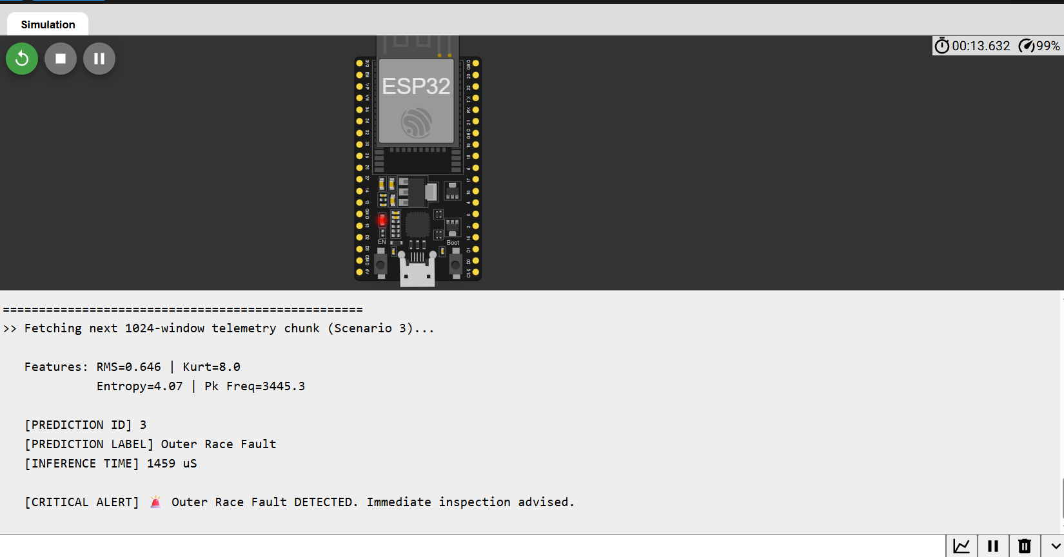
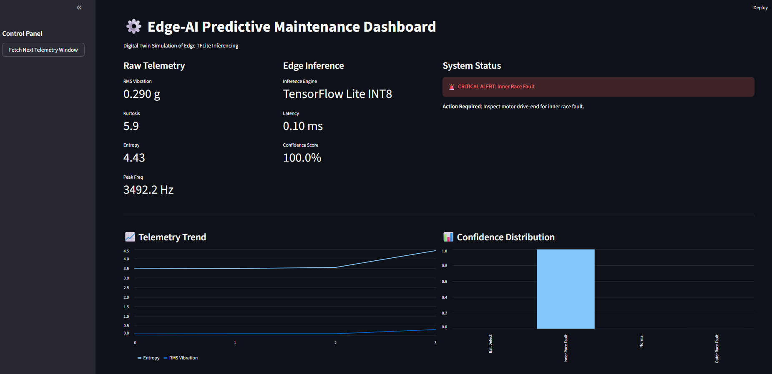
Results and Discussions Continued…
Simulation: Random Forrest model deployed over ESP32
Simulation: INT8 Quantized Tflite neural Network

Slide 15
Conclusion
This project proposes a low-cost Edge AI solution for predictive maintenance of industrial motors.
Key contributions:
Sensor-based motor monitoring system
Machine learning model for fault detection
Embedded edge deployment for real-time inference
The system can help industries reduce downtime and improve operational efficiency.
Future work includes:
Multi-sensor fusion
Cloud dashboard integration
Testing with real industrial equipment

Slide 16
Conclusion
Conclusion: Successfully validated that complex frequency-domain features and predictive models can operate entirely on resource-constrained Edge IoT devices, maintaining high accuracy while eliminating cloud-latency.
Future Work:
Test with different open-source datasets related to motors.
Migrating from the CWRU simulation to physical hardware deployment by interfacing ADXL345 vibration sensors directly to the ESP32 on a live industrial motor rig.

Slide 17
References
Achouch, M., Dimitrova, M., Ziane, K., Sattarpanah Karganroudi, S., Dhouib, R., Ibrahim, H., & Adda, M. (2022). On Predictive Maintenance in Industry 4.0: Overview, Models, and Challenges. In Applied Sciences (Switzerland) (Vol. 12, Issue 16). MDPI. https://doi.org/10.3390/app12168081
Aires, F. L., Galeno, G. D., Belchior, F. N., Oliveira, A. M., & Hunt, J. D. (2025). Enhancing three-phase induction motor reliability with health index and artificial intelligence-driven predictive maintenance. Royal Society Open Science, 12(5). https://doi.org/10.1098/rsos.241946
Artiushenko, V., Lang, S., Lerez, C., Reggelin, T., & Hackert-Oschätzchen, M. (2024). Resource-efficient Edge AI solution for predictive maintenance. Procedia Computer Science, 232, 348–357. https://doi.org/10.1016/j.procs.2024.01.034
Bharathi, Y. H. (n.d.). International Journal of INTELLIGENT SYSTEMS AND APPLICATIONS IN ENGINEERING Edge AI for Real-Time Motor Condition Monitoring in Smart Grids. In Original Research Paper International Journal of Intelligent Systems and Applications in Engineering IJISAE (Vol. 2024, Issue 23s). Retrieved www.ijisae.org
Dey, S., & Nagavalli, S. P. (2022). AI-Based Predictive Maintenance in Edge IoT Devices: A Proactive Approach to Latency Reduction. International Journal of Emerging Trends in Computer Science and Information Technology, 3(1), 55–64. https://doi.org/10.63282/3050-9246.ijetcsit-v3i1p107
Drakaki, M., Karnavas, Y. L., Tzionas, P., & Chasiotis, I. D. (2021). Recent Developments towards Industry 4.0 Oriented Predictive Maintenance in Induction Motors. Procedia Computer Science, 180, 943–949. https://doi.org/10.1016/j.procs.2021.01.345
Hafeez, T., Xu, L., & McArdle, G. (2021). Edge intelligence for data handling and predictive maintenance in IIoT. IEEE Access, 9, 49355–49371. https://doi.org/10.1109/ACCESS.2021.3069137
Lamdjad, B., & Chaiter, A. (2026). AI-Powered Predictive Maintenance and Prognostic Health Management Using Edge-Based Predictive Algorithms for Industrial Operations. https://doi.org/10.20944/preprints202603.0010.v1
Lazzaro, A., D’Addona, D. M., & Merenda, M. (2024). A Detailed Study on Algorithms for Predictive Maintenance in Smart Manufacturing: Chip Form Classification Using Edge Machine Learning. IEEE Open Journal of the Industrial Electronics Society, 5, 1190–1205. https://doi.org/10.1109/OJIES.2024.3484006
Nunes, P., Santos, J., & Rocha, E. (2023). Challenges in predictive maintenance – A review. In CIRP Journal of Manufacturing Science and Technology (Vol. 40, pp. 53–67). Elsevier Ltd. https://doi.org/10.1016/j.cirpj.2022.11.004
Soni, K., & Agrawal, M. (2025). AI Driven Predictive Maintenance at the Edge.
Vermesan, O., & Coppola, M. (2023). Embedded Edge Intelligent Processing for End-To-End Predictive Maintenance in Industrial Applications. In Industrial Artificial Intelligence Technologies and Applications (pp. 157–175). River Publishers. https://doi.org/10.1201/9781003377382-12
Zhou, Z., Qiao, Y., Lin, X., Li, P., Wu, N., & Yu, D. (2025). A Deployment Method for Motor Fault Diagnosis Application Based on Edge Intelligence. Sensors, 25(1). https://doi.org/10.3390/s25010009
Dataset: CWRU Download a Data File | Case School of Engineering

Slide 18
Thank you

